Slide 1
PREDICTION OF COVID-19 USING SUPERVISED MACHINE LEARNING ALGORITHMS.
DOMAIN: MACHINE LEARNING
BATCH : A19
PROJECT GUIDE:
K.KIRUITHIKA(M.TECH,AP)
TEAM MEMBERS:
HARSHITHA P 211417104083
MADDINA SIREESHA 211417104134

Slide 2
INTRODUCTION
Machine learning (ML) based forecasting mechanisms have proved their significance to anticipate in preoperative outcomes to improve the decision making on the future course of actions.
The ML models have long been used in many application domains which needed the identification and prioritization of adverse factors for a threat. Several prediction methods are being popularly used to handle forecasting problems.
The ML models to forecast the number of upcoming patients affected by COVID-19 which is presently considered as a potential threat to mankind.
The COVID -19 predicts the cases in particular area using machine learning algorithms.

Slide 3
LITERATURE SURVEY
S.No | Title | Author Name | Algorithm | Benefit | Descripition
1 | Application of deep learning technique to manage COVID-19 in routine clinical practice using CT images: Results of 10 convolutional neural networks-2020 | Ali Abbasian Ardakani, Alireza Rajabzadeh Kanafi, U. Rajendra Acharya IEEE,VOL-62,ISSUE:1 Nazanin Khadem , Afshin Mohammad | Variants of CNN | Cheaper and faster compared to the traditional laboratory analysis of COVID-19. Reduces medical worker’s workload. | We proposed to distinguish infection of COVID-19 from other atypical and viral pneumonia diseases. This study showed that the ResNet-101 can be considered as a promising model to characterize and diagnose COVID-19 infections

Slide 4
2 | Deep learning system to screen coronavirus disease 2019 pneumonia-2020 | Xiaowei Xu , Xiangao Jiang , Chunlian Ma , Peng Du , Xukun Li Shuangzhi Lv , Liang Yu , Yanfei Chen , Junwei Su , Guanjing Lang , Yongtao Li , Hong Zhao , Kaijin Xu , Lingxiang Ruan , Wei Wu , | CNN | fast and reliable in detecting COVID-19 pandemic. | In this multi-center case study, we had presented a novel method that could screen COVID-19 fully automatically by deep learning technologies

Slide 5
3 | Deep Neural Network-Based Screening Model for COVID-19-Infected Patients Using Chest X-Ray Images-2021 | Dilbag Singh , Vijay Kumar , Vaishali Yadav and Manjit Kaur | MODE based CNN | The proposal is beneficial to COVID-19 real-time classification | In this paper, a COVID-19 disease classi¯cation model is designed and implemented to classify the infected persons. Initially, the benchmark COVID-19 data is obtained. Thereafter, the obtained data is divided into training and testing sets. The training set is used for building the COVID-19 disease classi¯cation model.

Slide 6
4 | COVIDiagnosis-Net: deep Bayes-SqueezeNet based diagnostic of the coronavirus disease 2019 (COVID-19) from x-ray images-2020 | Ferhat Ucara, Deniz Korkmazb | Bayesian-based SqueezeNe | It will be of benefit to healthcare professionals in diagnosing COVID-19 efficiently | A rapid diagnosis method has a key role in the control of infectious diseases and pandemic situations like the up to date COVID-19. Some limitations of the RT-PCR nucleic acid-based test modules reveal a need for fast alternative methods to be able to serve the front-line experts to make them reach a quick and accurate diagnosis. In this study, we propose an AI-based decision-making system including the recognition of input X-ray images under the roof of a very practical deep learning model.

Slide 7
5 | Deep learning-based multi-view fusion model for screening 2019 novel coronavirus pneumonia-2020 | Xiangjun Wua, Hui Huib, Meng Niud, Liang Lie, Li Wangf , Bingxi Heb,c , Xin Yangb , Li Lig , Hongjun Lig , Jie Tianb, Yunfei Zhae, | ResNet50 | Reduce the workload of a radiologist by offering fast and accurate COVID-19 diagnosis | we developed a multi-view fusion model to initial screening of COVID-19 pneumonia. This model achieved a better performance with single-view model and subgroup analysis. It showed great potential to improve the efficiency of diagnosis and mitigate the workload of radiologists. We envision that the multi-view deep learning-based tools can be used to assistant radiologist to fast and accurately identify COVID19 pneumonia.

Slide 8
6 | Analysis, Prediction and Evaluation of COVID-19 Datasets using Machine Learning Algorithms-2022 | Kolla Bhanu Prakas , S. Sagar Imambi , Mohammed Ismail , VOL-39,NO.11 T Pavan Kumar , YVR Naga Pawan | Random Forest Regressor and Random Forest Classifier | The results show that the Random Forest Regressor and Random Forest Classifier has outperformed other models in terms of CoD and Accuracy | A virus with no vaccine creating unpredictable havocs in the human lives and financial and economic systems in every country throughout the world. It is precariously halted everything in the society mercilessly. An analysis on COVID-19 datasets to understand which age group is mostly effected due to COVID-19.

Slide 9
7 | The Number of Confrmed Cases of Covid‑19 by using Machine Learning: Methods and Challenges-2021 | Amir Ahmad, Sunita Garhwal, Santosh Kumar Ray, Gagan Kumar, Sharaf Jameel Malebary, Omar Mohammed Barukab | Regression | This paper will help to generate novel ideas of using machine learning methods for accurate prediction of the number of confrmed cases of Covid-19. | Machine learning methods learn from the historical data and make predictions about the events. Machine learning methods have been used to predict the number of confrmed cases of Covid-19. In this paper, we present a detailed review of these research papers. We present a taxonomy that groups them in four categories. We further present the challenges in this feld. We provide suggestions to the machine learning practitioners to improve the performance of machine learning methods for the prediction of confrmed cases of Covid-19

Slide 10
8 | Prediction of COVID-19 using Genetic Deep Learning Convolutional Neural Network (GDCNN)-2020 | R.G. Babukarthik, V. Ananth Krishna Adiga, G. Sambasivam, D. VOL-19, ISSUE-3,Chandramohan, J. Amudhavel | Convolutional Neural Network | Early diagnosis of diseases is in urgent need in the treatment of COVID-19, which should be faster and cheaper. In the above context, a deep learning method is used for the prediction of COVID-19 from CXR image samples | Rapid spread of Coronavirus disease COVID-19 leads to severe pneumonia and it is estimated to create a high impact on the healthcare system. An urgent need for early diagnosis is required for precise treatment, which in turn reduces the pressure in the health care system. Some of the standard image diagnosis available is Computed Tomography (CT) scan and Chest X-Ray (CXR). Even though a CT scan is considered a gold standard in diagnosis, CXR is most widely used due to widespread, faster, and cheaper. This study aims to provide a solution for identifying pneumonia due to COVID19 and healthy lungs (normal person) using CXR images. One of the remarkable methods used for extracting a high dimensional feature from medical images is the Deep learning method

Slide 11
9 | COVID-19 Prediction and Detection Using Deep Learning-2020 | Moutaz Alazab , Albara Awajan , Abdelwadood Mesleh , Ajith Abraham , Vansh Jatana , Salah Alhyari VOL-2,ISSUE-3 | CNN Model | prediction of potential infections will enable authorities to tackle the consequences effectively. Furthermore, it is necessary to keep up with the number of infected people by performing regular check-ups, and it is often vital to quarantine infected people and adopt medical measures. | We present an artificial-intelligence technique based on a deep convolutional neural network (CNN) to detect COVID19 patients using real-world datasets. Our system examines chest X-ray images to identify such patients. Our findings indicate that such an analysis is valuable in COVID-19 diagnosis as X-rays are conveniently available quickly and at low costs. Empirical findings obtained from 1000 X-ray images of real patients confirmed that our proposed system is useful in detecting COVID-19 and achieves an F-measure

Slide 12
10 | Prediction for global African swine fever outbreaks based on a combination of random forest algorithms and meteorological data-2020 | Ruirui Liang, Yi Lu, Xiaosheng Qu, Qiang Su, Chunxia Li, Sijing Xia, Yongxin Liu, Qiang Zhang, Xin Cao, Qin Chen, Bing Niu | Random Forest Algorithm | Diagnosing Fever efficiently | qualitative prediction model to build a global online prediction system for ASF outbreaks, in the hope that this study will help to decision-makers who can then take the relevant prevention and control measures in order to prevent the further spread of future epidemics of the disease

Slide 13
TECHNOLOGY STACK
HARDWARE SYSTEM CONFIGURATION
Processor - Intel Core i7
RAM - 4 GB
Hard Disk - 500 GB
SOFTWARE SYSTEM CONFIGURATION
Operating System - Windows 7/8/10
Programming Language : Python 3.7

Slide 14
PROBLEM STATEMENT
Coronaviruses are a large family of viruses which may cause disease in animals or humans.[1] Seven coronaviruses can produce infection in people around the world but commonly people get infected with these four human
coronaviruses: 229E, NL63, OC43, and HKU1. They usually cause a respiratory
infection ranging from the common cold to more severe diseases such as Middle East Respiratory Syndrome (MERS) and Severe Acute Respiratory Syndrome (SARS) and the most recently discovered coronavirus (COVID-19) causes infectious disease. This zoonotic disease caused by severe acute respiratory syndrome coronavirus 2 (SARS-CoV-2).
The WHO originally called this infectious disease Novel Coronavirus-Infected Pneumonia (NCIP).

Slide 15
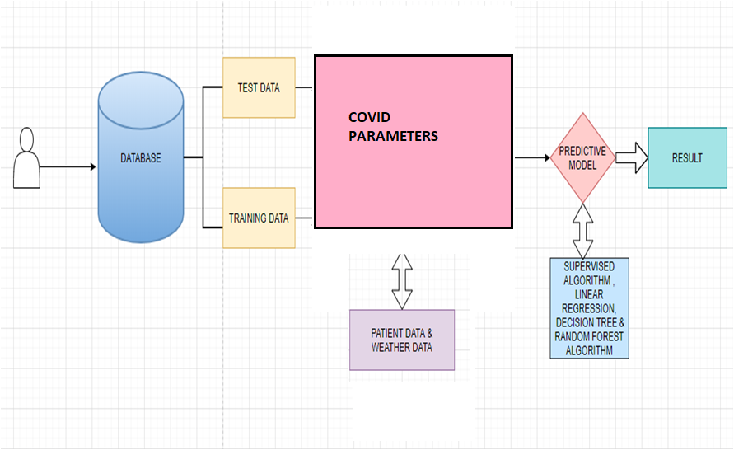
ARCHITECTURE DIAGRAM

Slide 16
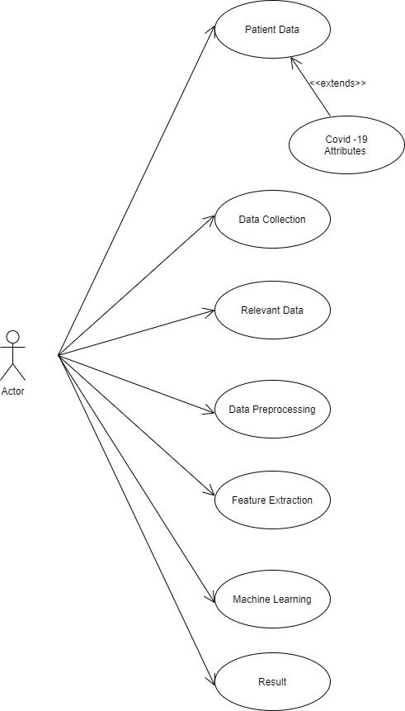
SYSTEM DESIGN

Slide 17
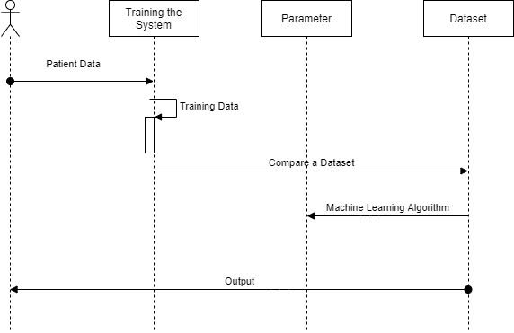
SEQUENCE DIAGRAM

Slide 18
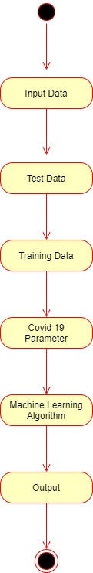
USE CASE DIAGRAM

Slide 19
MODULE DESCRIPTION:
1. Data Collection
2.Data Preprocessing
3.Training the system
4.Testing
5.Prediction Model

Slide 20
DATA COLLECTION
The dataset contains last 6 months values
The dataset contains null values. The null values cannot process by the
programming hence these values need to convert into numerical values
Monitoring the health situation, trends, progress and performance of health systems requires data from multiple sources on a wide variety of health topics.
A core component of WHO’s support to Member States is to strengthen their capacity to collect, compile, manage, analyze and use health data mainly derived from population-based sources (household surveys, civil registration systems of vital events) and institution-based sources (administrative and operational activities of institutions, such as health facilities).

Slide 21
DATA PREPROCESSING
At this point, India had already crossed 10M cases. It still is very important to contain the situation in the coming days.
The main reason behind data processing is that data almost never comes in a form that is ready for us. And in my personal experience, a large amount of time spent on a data science project is on manipulating data.
The numbers of corona virus patients had started doubling after many countries hit the large cases, and almost starting increasing exponentially.
The dataset contains all the information which the learning model is
supposed to learn for making right predictions.
The raw data might have a variations in the values of each feature which might lead to incorrect results. Hence the learning process will re-process the dataset.
The pre-processing techniques include the following;
Mean removal.
Scaling.

Slide 22
TRAINING THE SYSTEM
Real time data is collected from kaggle.
Training data is used to make sure the machine recognizes patterns in the data .
The cross-validation data is used to ensure better accuracy and efficiency of the algorithm used to train the machine. Supervised learning is used to train the system
Training data is used to make sure the machine recognizes patterns in the data
Unsupervised learning is used to train the system.

Slide 23
TESTING
Predictive analytics is the practice of extracting information from existing datasets in order to determine patterns and predict future outcomes .
The test data is used to see how well the machine can predict new answers based on its training.
It is important that no observations from the training set are included in the test set.

Slide 24
PREDICTION
The patient medical details are compared with the data sets
Apply the Supervised Machine Learning algorithm for the datasets to predict the Covid-19 Cases.
The current data is fed into the predictive model.
The predictive model predicts the dengue using the training provided to the system .
The prediction is done regionwise .
Timely Prediction of Covid is the only way to outbreak the disease.
Existing methodology of prediction is not efficient .
The prediction result is finally given to the Ministry of Health and Family Welfare.

Slide 25
.
At this point, India had already crossed 10M cases. It still is very important to contain the situation in the coming days.
The numbers of corona virus patients had started doubling after many countries hit the large cases, and almost starting increasing exponentially
Compare the patient medical details with the data sets
Apply the Supervised machine Learning algorithm for the datasets to predict the Covid-19 Cases.
Predicts the dengue using the training provided to the system .The prediction is done region wise . Timely Prediction of Dengue is the only way to outbreak the disease.
Existing The current data is fed into the predictive model .The predictive model methodology of dengue prediction is not efficient . The prediction result is finally given to the Ministry of Health and Family Welfare.

Slide 26
SYSTEM TESTING
Testing is a process of executing a program with the intent of finding an error. A good test case is one that has a high probability of finding an as-yet –undiscovered error.
A successful test is one that uncovers an as-yet- undiscovered error. System testing is the stage of implementation, which is aimed at ensuring that the system works accurately and efficiently as expected before live operation commences.
It verifies that the whole set of programs hang together. System testing requires a test consists of several key activities and steps for run program, string, system and is important in adopting a successful new system.
This is the last chance to detect and correct errors before the system is installed for user acceptance testing.
The software testing process commences once the program is created and the documentation and related data structures are designed. Software testing is essential for correcting errors. Otherwise the program or the project is not said to be complete. Software testing is the critical element of software quality assurance and represents the ultimate the review of specification design and coding.

Slide 27
SCREENSHOTS

Slide 28
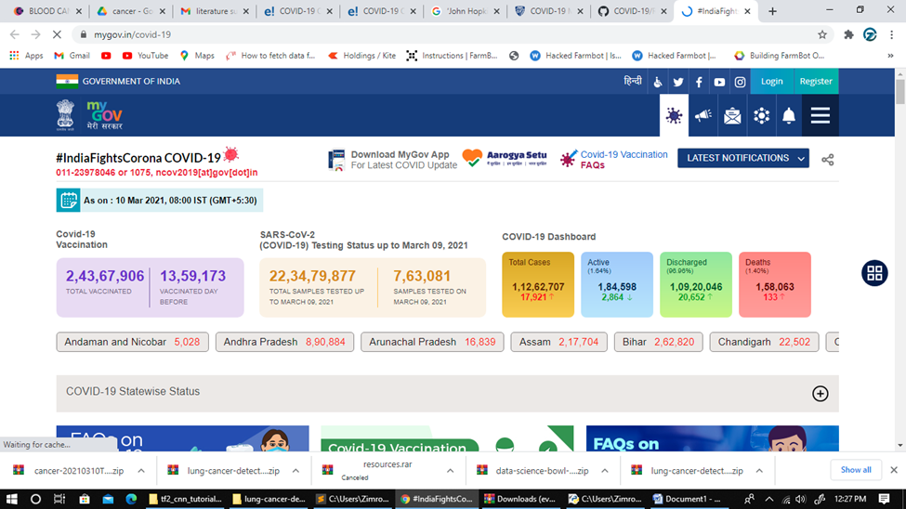

Slide 29
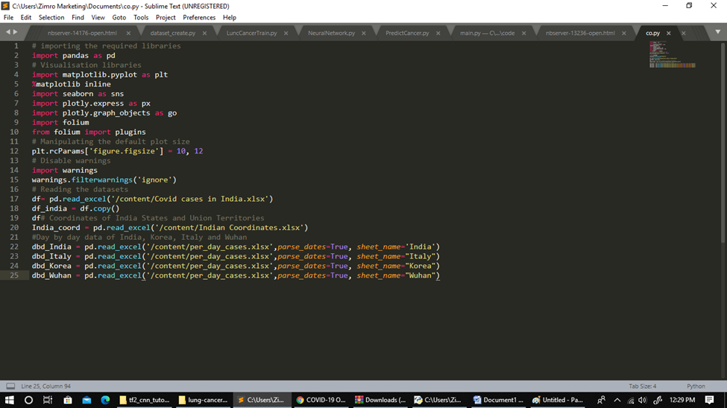

Slide 30
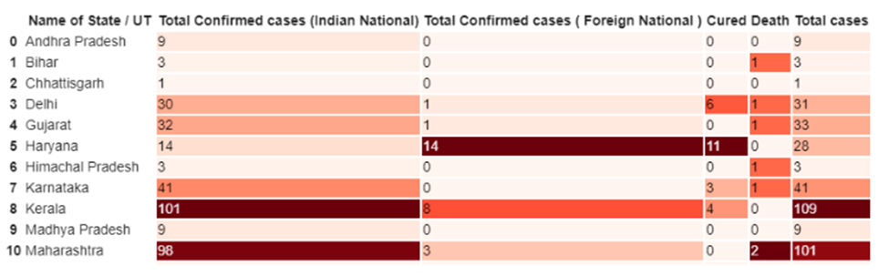

Slide 31
CONCLUSION
Modeling will show us which features, and which combination of features, will be good predictors of the number of cases. However, it is important to remember that it is not the current weather that determines the number of covid-19 cases. The next post will look into determining the monthly trend .After that, I will describe methods to use historical weather to predict the current amount of Covid-19 fever cases.

Slide 32
REFERENCES
[1] S. Makridakis, E. Spiliotis, and V. Assimakopoulos, ‘‘Statistical and machine learning forecasting methods: Concerns and ways forward,’’ PLoS ONE, vol. 13, no. 3, Mar. 2018, Art. no. e0194889.
[2] G. Bontempi, S. B. Taieb, and Y.-A. Le Borgne, ‘‘Machine learning strategies for time series forecasting,’’ in Proc. Eur. Bus. Intell. Summer School. Berlin, Germany: Springer, 2012, pp. 62–77.
[3] F. E. Harrell Jr, K. L. Lee, D. B. Matchar, and T. A. Reichert, ‘‘Regression models for prognostic prediction: Advantages, problems, and suggested solutions,’’ Cancer Treat. Rep., vol. 69, no. 10, pp. 1071–1077, 1985.
[4] P. Lapuerta, S. P. Azen, and L. Labree, ‘‘Use of neural networks in predicting the risk of coronary artery disease,’’ Comput. Biomed. Res., vol. 28, no. 1, pp. 38–52, Feb. 1995.
[5] K. M. Anderson, P. M. Odell, P. W. Wilson, and W. B. Kannel, ‘‘Cardiovascular disease risk profiles,’’ Amer. heart J., vol. 121, no. 1, pp. 293–298, 1991.

Slide 33
[6] H. Asri, H. Mousannif, H. A. Moatassime, and T. Noel, ‘‘Using machine learning algorithms for breast cancer risk prediction and diagnosis,’’ Procedia Comput. Sci., vol. 83, pp. 1064–1069, Jan. 2016.
[7] F. Petropoulos and S. Makridakis, ‘‘Forecasting the novel coronavirus COVID-19,’’ PLoS ONE, vol. 15, no. 3, Mar. 2020, Art. no. e0231236.
[8] G. Grasselli, A. Pesenti, and M. Cecconi, ‘‘Critical care utilization for the COVID-19 outbreak in lombardy, italy: Early experience and forecast during an emergency response,’’ JAMA, vol. 323, no. 16, p. 1545, Apr. 2020.
[9] WHO. Naming the Coronavirus Disease (Covid-19) and the Virus That Causes it. Accessed: Apr. 1, 2020. [Online]. Available: https:// www.who.int/emergencies/diseases/novel-coronavirus-2019/technic% alguidance/naming-the-coronavirus-disease-(covid-2019)-and-the-virusthat-cau%ses-it
[10] C. P. E. R. E. Novel, ‘‘The epidemiological characteristics of an outbreak of 2019 novel coronavirus diseases (Covid-19) in China,’’ Zhonghua Liu Xing Bing Xue Za Zhi= Zhonghua Liuxingbingxue Zazhi, vol. 41, no. 2, p. 145, 2020

