Slide 1
Introduction to Deep Learning
Dr. Sireesha Rodda
Professor, Dept of CSE,
Institute of Technology,
GITAM Deemed to be University

Slide 2
Agenda
Understanding the fundamentals of Deep Learning
Decoding the working of Artificial Neural Networks
Convolutional Neural Networks
Recurrent Neural Networks
Case Studies

Slide 3
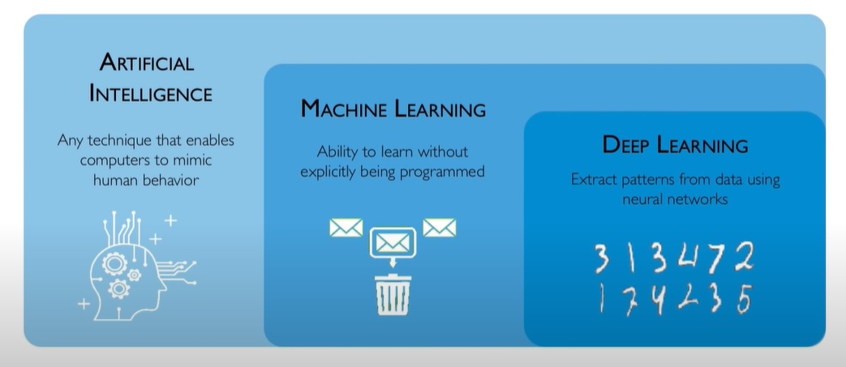
What is Deep Learning?

Slide 4
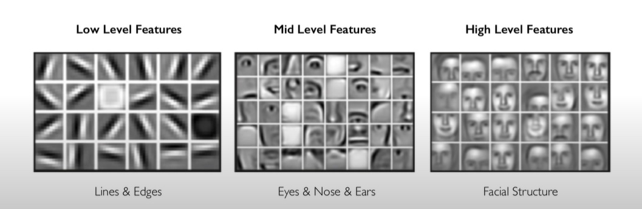
Why Deep Learning?
Hand engineered features can be time consuming, brittle, and not scalable in practice.
Is there a way to learn underlying features directly from the data?

Slide 5
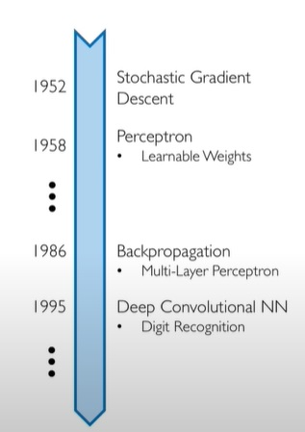
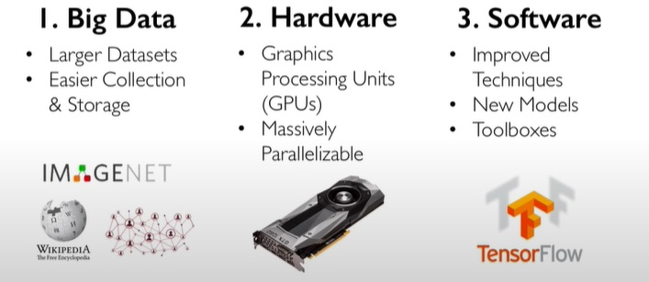
Revival of Neural Networks

Slide 6
AI vs ML vs DL
Machine Learning is the application of Artificial Intelligence(AI) that provides the system the ability to automatically learn and improve from experience without being explicitly taught.
Machine Learning (ML) focuses on the development of computer programs that can access data and use it to learn for themselves.
Deep Learning (DL) is a subset of Machine Learning, based on Artificial Neural Networks. The learning mode of humans is emulated to gain knowledge.
Been in the research community but garnered lot of attention of late.
While ML is linear in nature, DL is hierarchical.

Slide 7
Contd.,
Deep Learning is incremental learning. The learning happens step by step through HIDDEN layer approach. (Neural networks)
Learning to recognize alphabets first, followed by words and then sentences.
Identifying lower level categories first, and incrementally learning higher-order categories next.

Slide 8
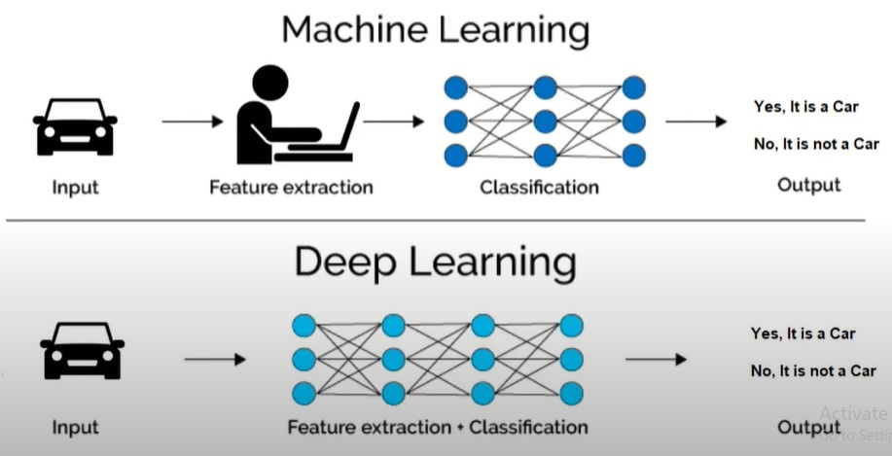
Contd.,

Slide 9
When to choose Deep Learning over Machine Learning?
Deep Learning could outperform other ML techniques if data size were large. But with small data size, machine learning algorithms may be preferred.
Deep Learning techniques require high-end infrastructure and processing abilities.
The lack of domain understanding for feature introspection make Deep Learning algorithms suitable for applications across different disciplines.
Extensive applications in image classification, natural language processing, and speech recognition.

Slide 10
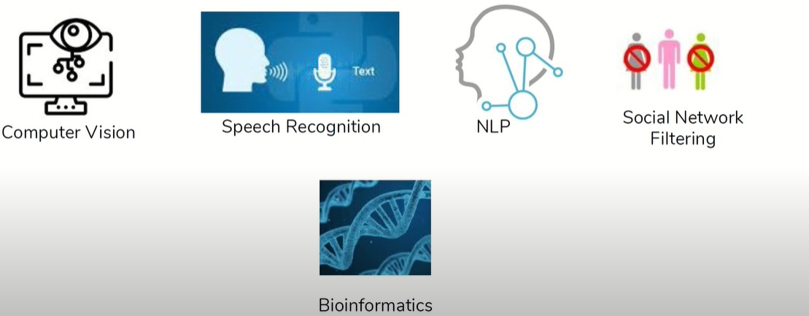
Applications of Deep Learning

Slide 11
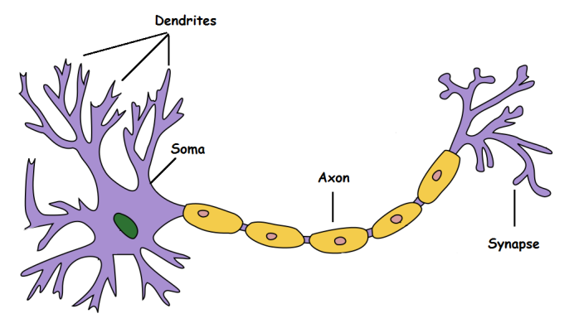
Artificial Neural Networks
Deep Learning is based on Artificial Neural Networks, which emulate the behavior of a human brain.
A typical biological neural network comprises of biological nerve cells connected to each other. Neurons are connected to each other to help with transfer of information.

Slide 12
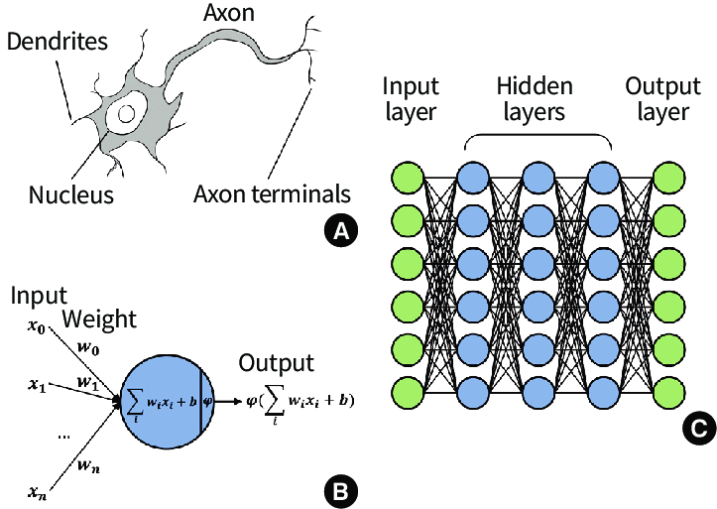
Artificial Neuron

Slide 13
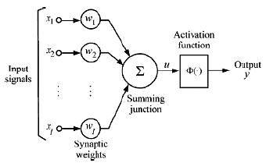
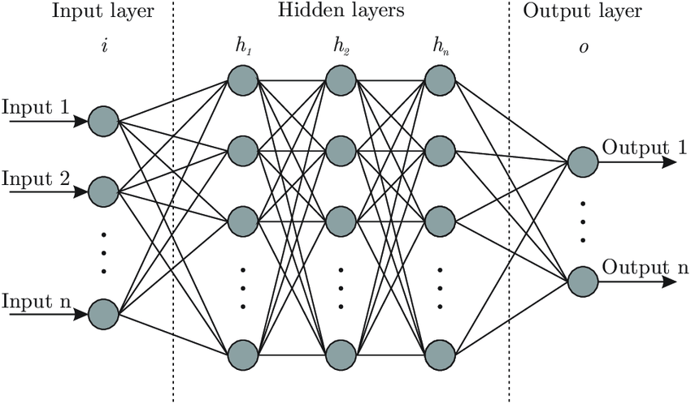
Artificial Neural Networks
Each node is associated with a weight.
Weighted sum of the inputs and bias is obtained.
Based on the weighted sum of inputs, activation function fires off appropriately.
Using error functions, the discrepancies between actual and observed outputs is evaluated, and weights are adjusted based on back propagation algorithm,
Shallow ANN
Deep ANN

Slide 14
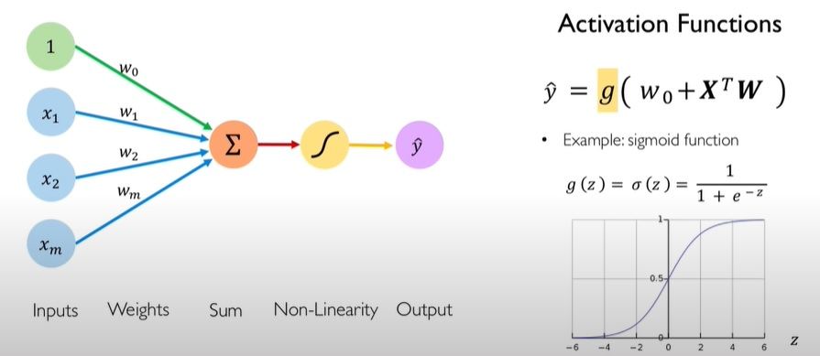
Perceptron: Forward Propagation

Slide 15
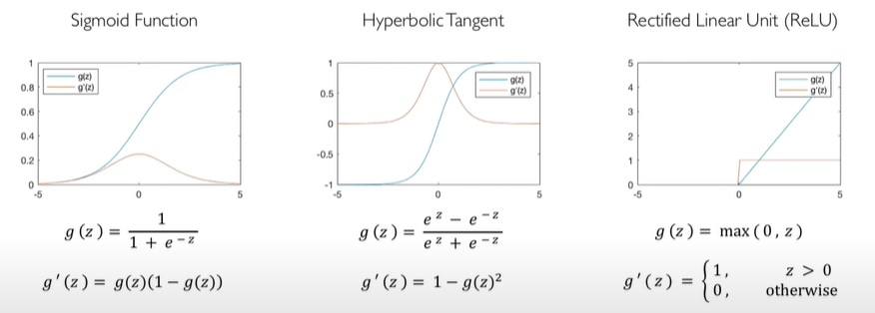
Common Activation Functions

Slide 16
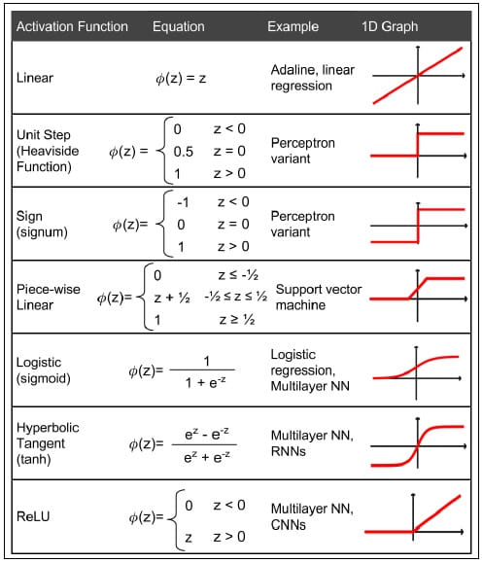
Activation Functions

Slide 17
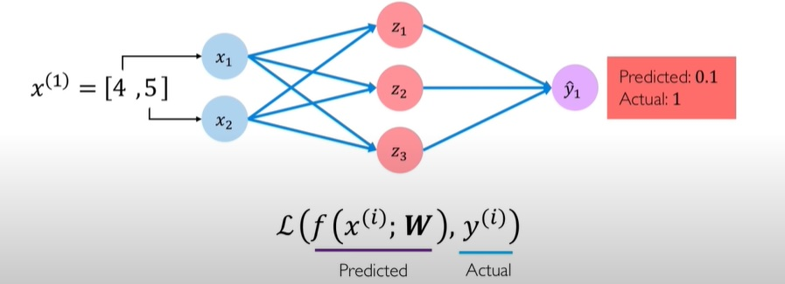
Quantifying Loss in ANNs
Cost incurred from incorrect predictions

Slide 18
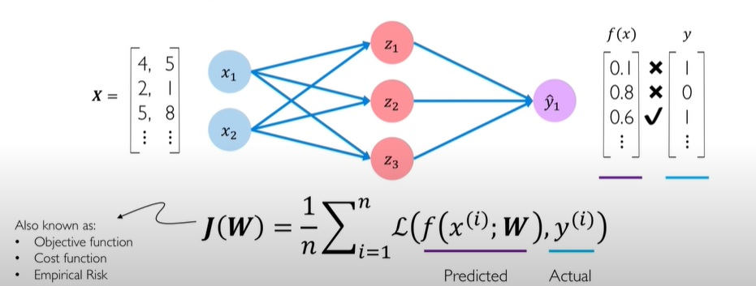
Empirical Loss in ANNs
Total loss over entire dataset

Slide 19
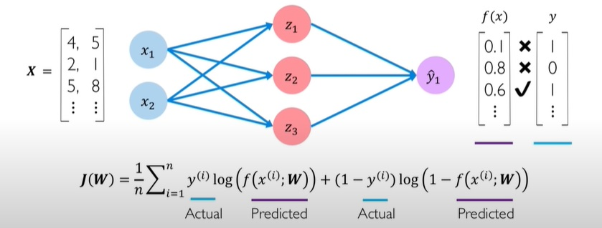
Binary Cross Entropy Loss in ANNs
Models that output probability between 0 and 1

Slide 20
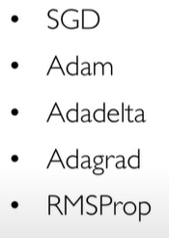
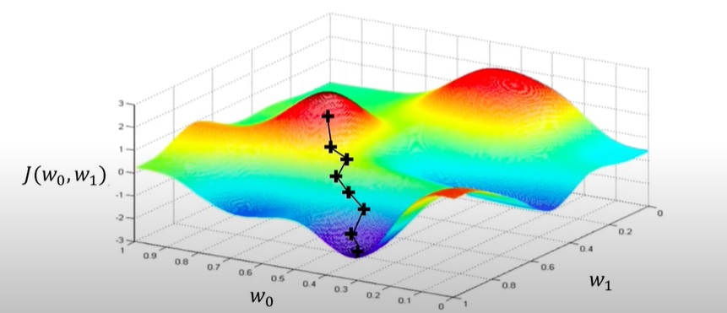
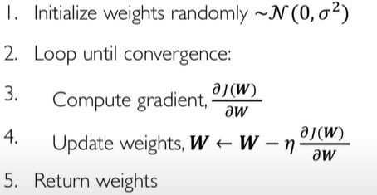
Gradient Descent
Repeat till convergence

