Slide 1
Convolutional Neural Networks
Dr. Sireesha Rodda
Professor, Dept of CSE,
Institute of Technology,
GITAM Deemed to be University

Slide 2
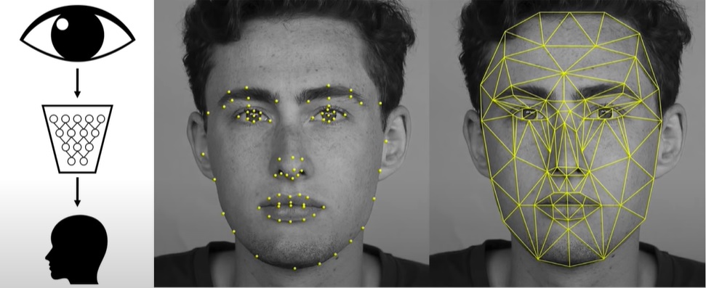
Computer Vision

Slide 3
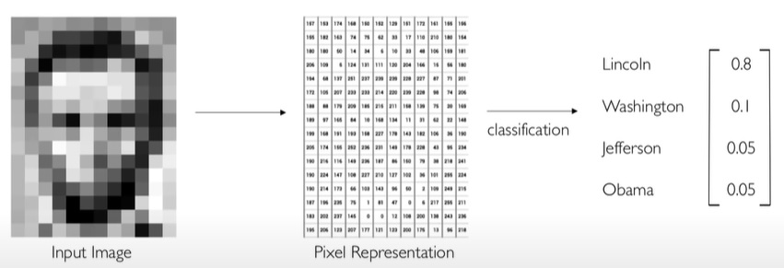
Image Representation

Slide 4
Computer Vision

Slide 5
Issues faced
Viewpoint variation
Scale variation
Illuminating Conditions
Image Occlusion
Deformation
Background Clutter

Slide 6
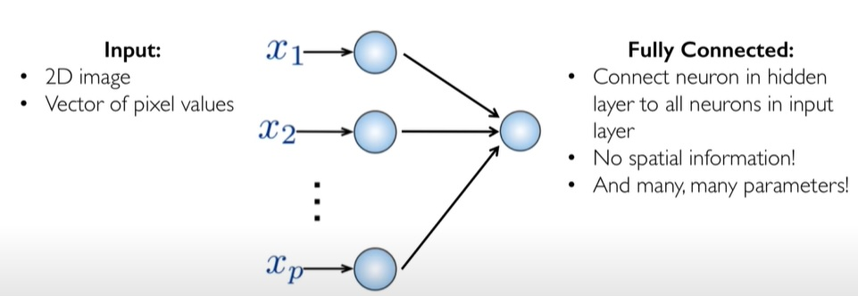
Fully Connected Neural Networks

Slide 7
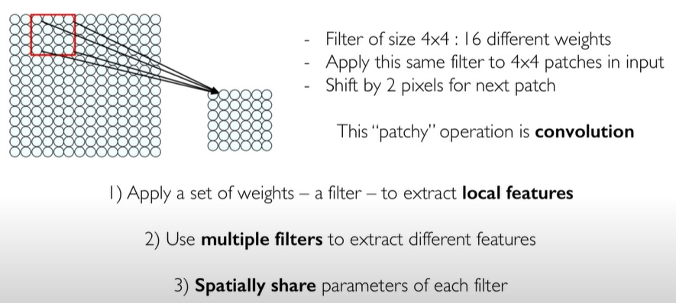
Feature extraction with Convolution

Slide 8
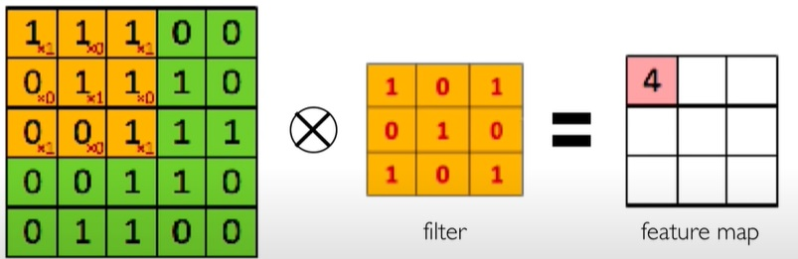
Convolution Operation
Sliding/hovering a 3X3 filter over the input image

Slide 9
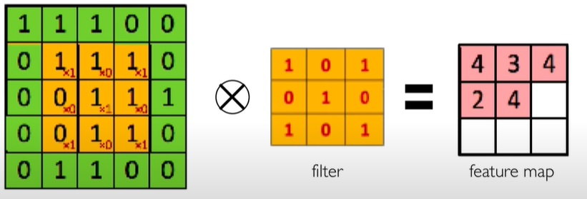
Convolution Operation
Slide filter over the input image, element-wise multiply and add the results

Slide 10
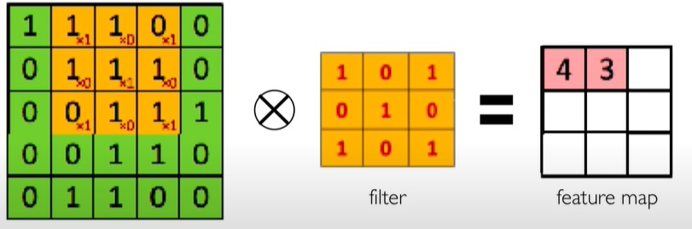
Convolution Operation
Slide filter over the input image, element-wise multiply and add the results

Slide 11
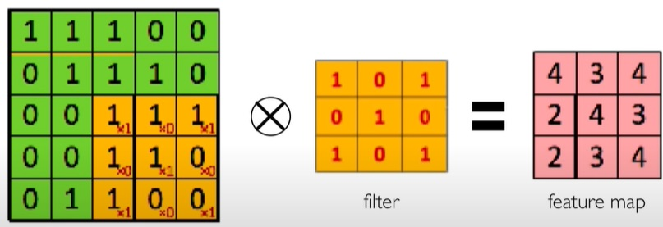
Convolution Operation
Slide filter over the input image, element-wise multiply and add the results

Slide 12
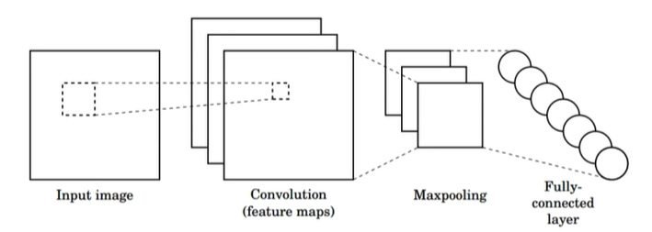
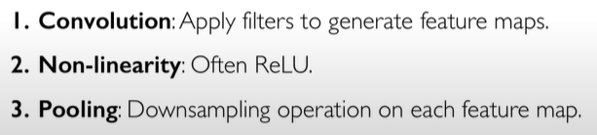

CNNs for Classification

Slide 13
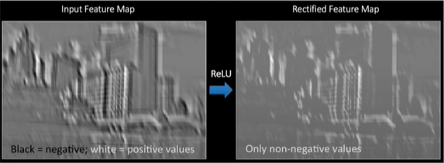
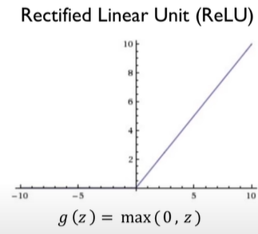
Non-Linearity
Apply after every convolution operation
ReLU: pixel-by-pixel operation that replaces the negative values with zero

Slide 14
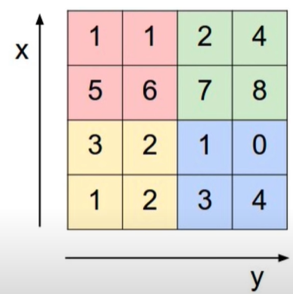
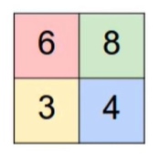
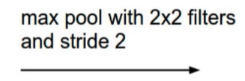
Pooling
Reduced Dimensionality
Spatial Invariance

Slide 15
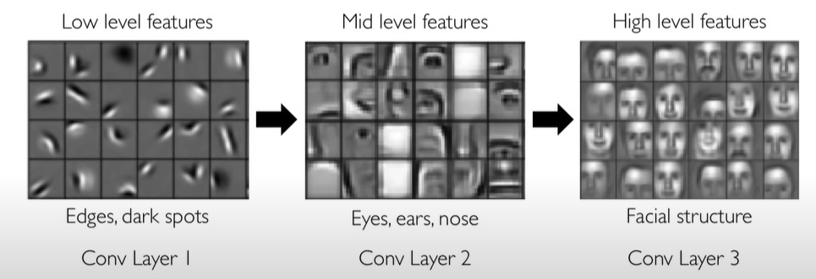
Representation Learning in Deep CNNs

Slide 16
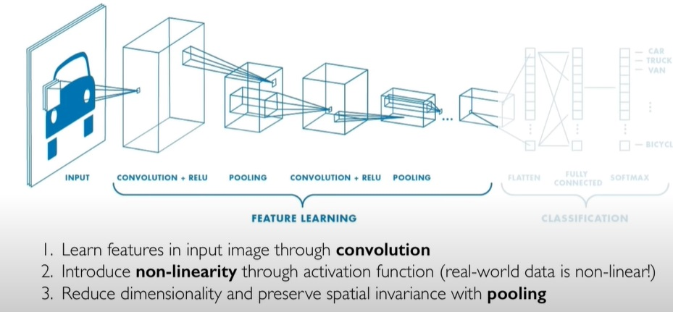
CNNS : Feature Learning

Slide 17
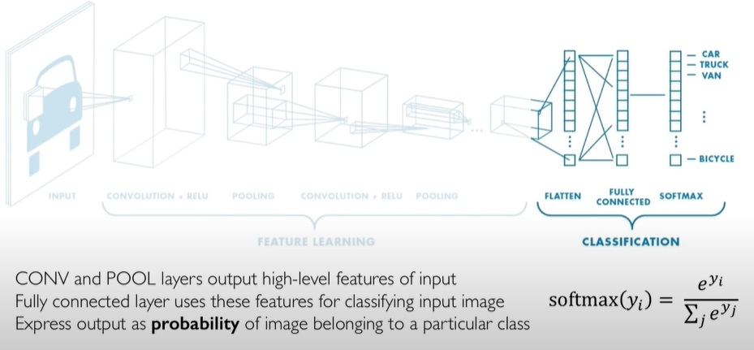
CNNS : Class Probabilities

Slide 18
Applications of CNNs
Biomedical Image Analysis
Identifications of Diseases from X-Ray/MRI Images
Self-driving cars
Navigation from Visual Perception
Face Recognition
Automatic tagging of Images
Scene Labeling
Semantic Segmentation and Classification
Human Pose Recognition
Yoga Pose Estimation
Human Activity Detection
Document Analysis
Optical Character Recognition

Slide 19
Various CNN Architectures
LeNet
AlexNet
ZFNet
GoogleLeNet
VGGNet
ResNet
DenseNet

Slide 20
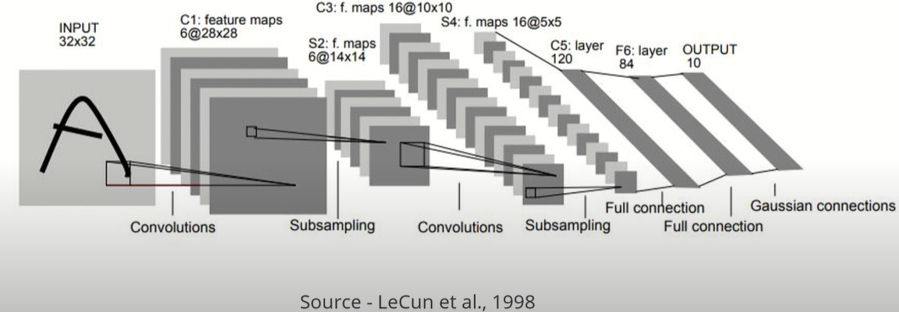
LeNet Architecture

Slide 21
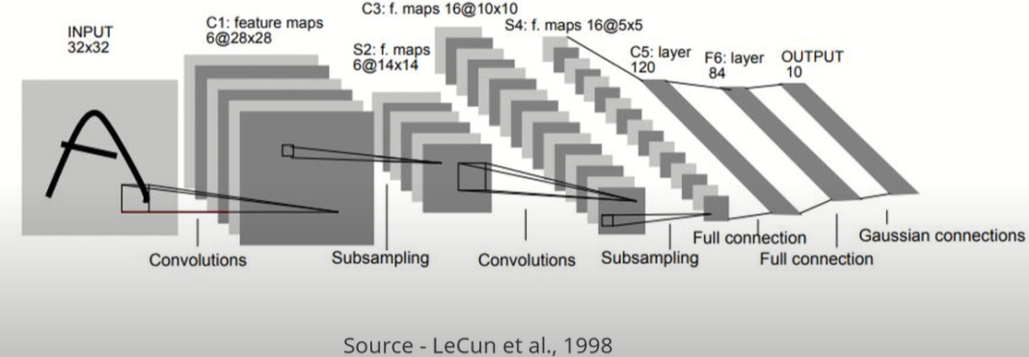
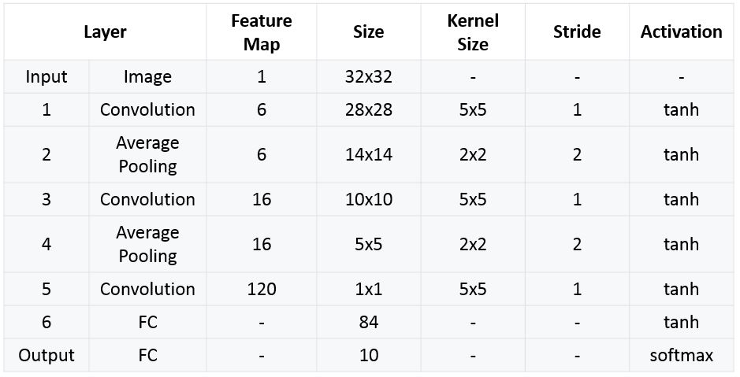
LeNet

Slide 22
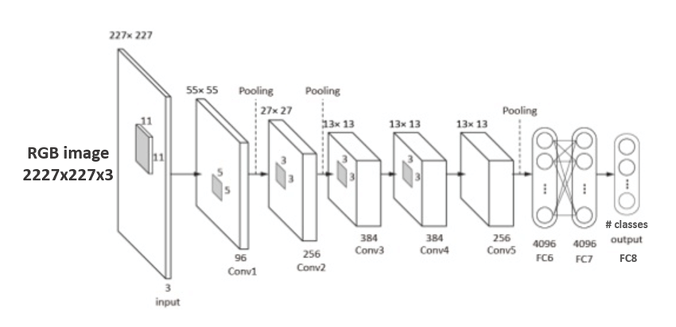
AlexNet Architecture
5 convolution layers
3 fully connected layers

Slide 23
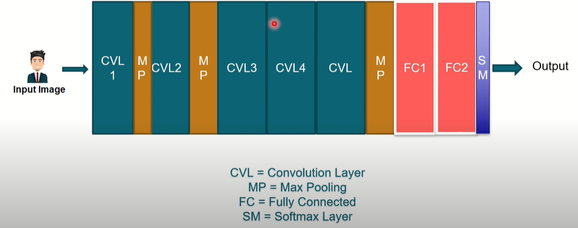
AlexNet

Slide 24
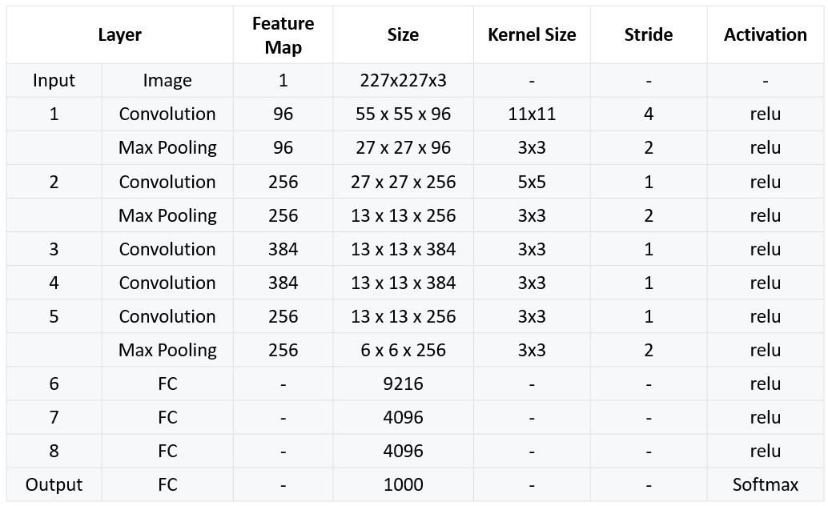
AlexNet

