Slide 1
Instagram User Analytics
Trainity task-2

Slide 2
INSTAGRAM USER ANALYTICS
Description:
User analysis is the process by which we track how users engage and interact with our digital product (software or mobile application) in an attempt to derive business insights for marketing, product & development teams. These insights are then used by teams across the business to launch a new marketing campaign, decide on features to build for an app, track the success of the app by measuring user engagement and improve the experience altogether while helping the business grow. You are working with the product team of Instagram and the product manager has asked you to provide insights on the questions asked by the management team.

Slide 3
A) Marketing
1.Rewarding Most Loyal Users
People who have been using the platform for the longest time. Task: Find the 5 oldest users of the Instagram from the database provided
Here I need to find the top 5 oldest users of Instagram in the provided database.
For this I need to select the users data , ordering it based on the created_at column, which is the Instagram account created date of users.
Query:
Select * from ig_clone.users order by created_at limit 5;

Slide 4
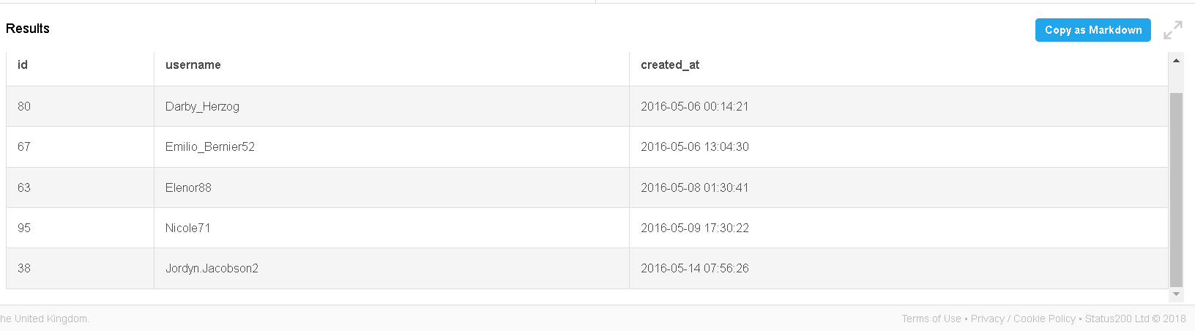
Output:

Slide 5
2.Remind Inactive Users to Start Posting
By sending them promotional emails to post their 1st photo. Task: Find the users who have never posted a single photo on Instagram
For this, I need to use a left join users and photos and find the users who have image url value as null.
Query:
Select users.id, users.username
from ig_clone.users
left join ig_clone.photos
on users.id=photos.user_id
where photos.image_url is null

Slide 6
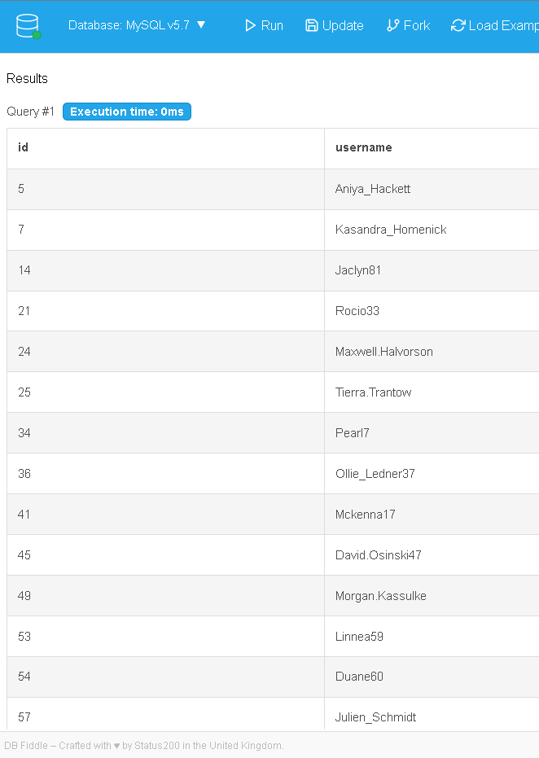
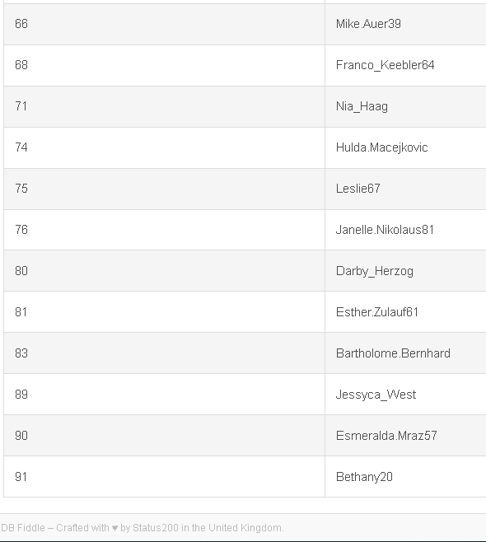

Slide 7
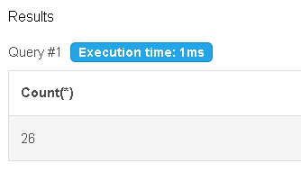
Above is the list of users , who didn’t post a single post on Instagram. Here we got 26 users.
To know the number of users with out counting the above output data manually, we can use below query.
Query:
Select Count(*)
from ig_clone.users
left join ig_clone.photos
on users.id=photos.user_id
where photos.image_url is null
Output:

Slide 8
3. Declaring Contest Winner
The team started a contest and the user who gets the most likes on a single photo will win the contest now they wish to declare the winner. Task: Identify the winner of the contest and provide their details to the team
For this task, we should do an inner join of photos, likes and users to find out who are the users with more likes for their posts.
Among them we should get the user with hightest number of likes , so that we can declare him/her as winner of contest
Below is the query used to identify the contest winner:

Slide 9
Query:
Select users.id user_id,users.username,
photos.image_url,
photos.id photo_id,
count(*) as TotalLikes
from ig_clone.photos
join ig_clone.likes
on photos.id=likes.photo_id
join ig_clone.users
on photos.user_id=users.id
group by photos.id
order by TotalLikes desc limit 1

Slide 10
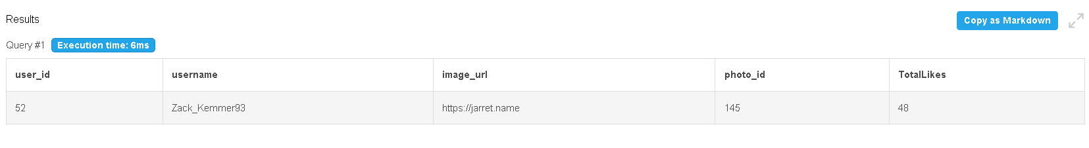
Output:
From the above output we can see that Zack_Kemmer93 , whose ID is 52 is the content winner with most likes for his post i.e., with 48 likes .

Slide 11
4. Hashtag Researching
A partner brand wants to know, which hashtags to use in the post to reach the most people on the platform. Task: Identify and suggest the top 5 most commonly used hashtags on the platform
For this task, we need to do an inner join between photo_tags and tags tables, to find out the tag names, with its count of tag ids used in the photos . To do this we have to group it by tag id and order by the count in descending order.
As we need top 5 mostly used hash tags , we should do a limit 5
Below is the query used to find out the output.

Slide 12
Query:
Select tags.id, tags.tag_name,
count(*) as total
from ig_clone.photo_tags
join ig_clone.tags
on photo_tags.tag_id = tags.id
group by tags.id
order by total desc limit 5

Slide 13
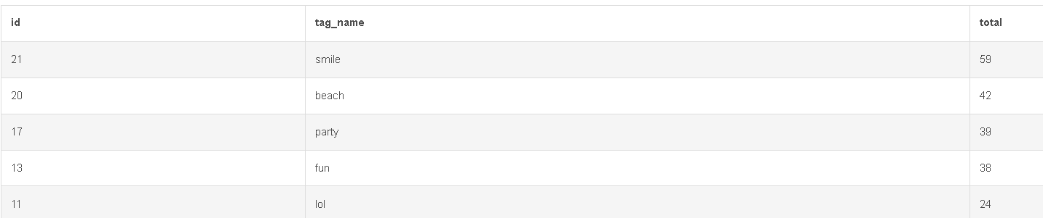
Here if we observer the whole output, we have “#smile”as highest used hashtag with 59 total uses, followed by “#beach” with 42 total uses, third is “#party” with 39 total uses, fourth is “#fun” with total uses 38.
If we observe the output closely, we got 3 hashtags with same 24 number of total uses. They are “#lol”, “#concert”,”#food”.
As all the three hashtags are used same number of times i.e., 24, lol is showed when we limited the output to 5 entries.

Slide 14
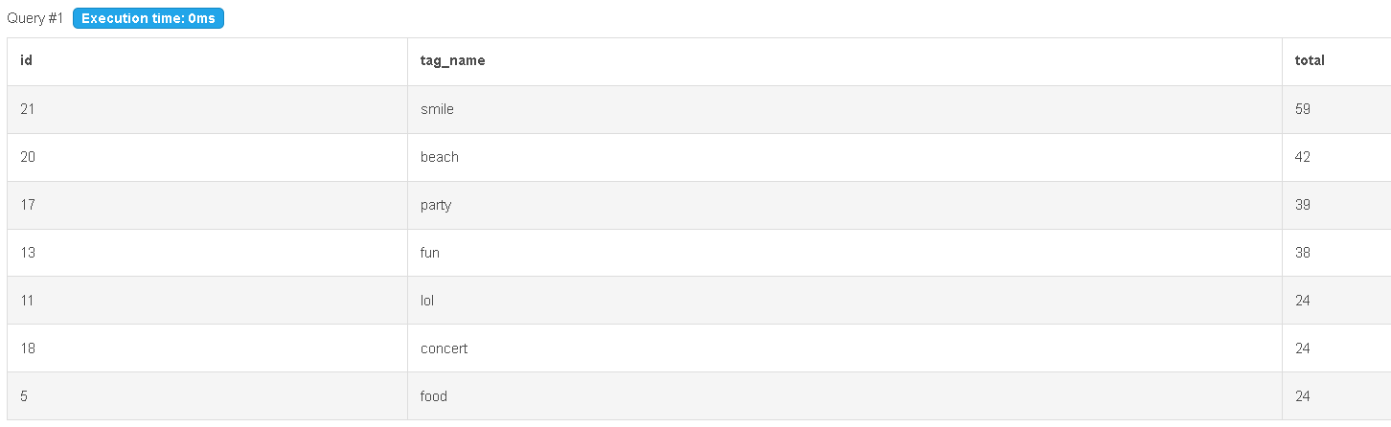
Fifth most used hash tags according to our data set is “#lol”, ”#concert”, ”#food”

Slide 15
5. Launch AD Campaign
The team wants to know, which day would be the best day to launch ADs. Task: What day of the week do most users register on? Provide insights on when to schedule an ad campaign
Here we can use a method called dayname() to know the name if the day from the datetime format.
And with that , we can use the count function to count the number of registerations happened in each day of the week using the group by function with day.
By using below query, we got the output as mentioned below.
As per the output, we have more users registered on Sundays and Thurdays. So those days would be best to schedule an Ad Campaign.

Slide 16
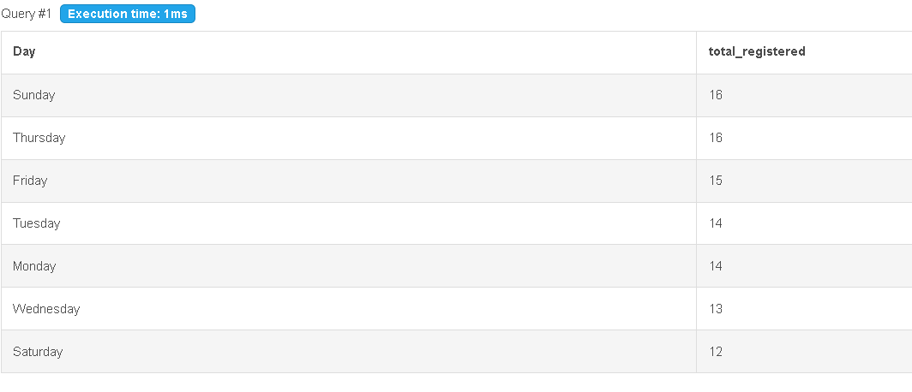
Query:
Select dayname(created_at) as Day,
count(*)as total_registered
from ig_clone.users
group by Day
order by total_registered Desc
Output:

Slide 17
B. Investor Metrics
1. User Engagement
Are users still as active and post on Instagram or they are making fewer posts Task: Provide how many times does average user posts on Instagram. Also, provide the total number of photos on Instagram/total number of users.
To get the total number of photos on Instagram / Total number of users, we need to write below query.
Query:
Select (Select count(*) from ig_clone.photos)/(Select Count(*) from ig_clone.users ) as Average_userPost

Slide 18
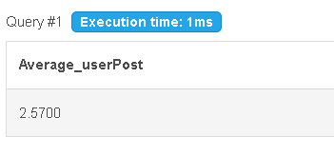
Output:
From the output, the total number of users/total number of posts= 2.57. So we can say that on an average, users posted 2.57 posts in our dataset.
To know the overall data of each user vs number of posts posted by them , we can use below query:
Query : Select photos.user_id, users.username, Count(*) as Num_of_posts
from ig_clone.photos
join ig_clone.users
on photos.user_id=users.id
group by user_id
order by Num_of_posts desc

Slide 19
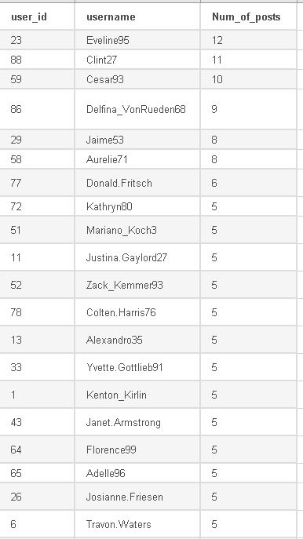
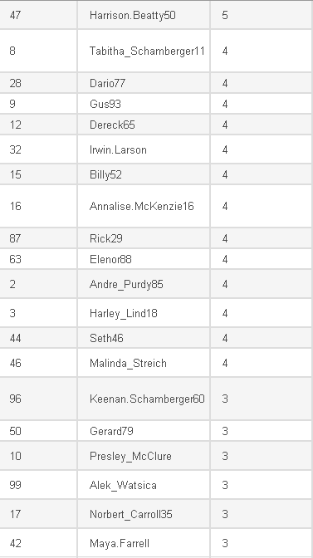
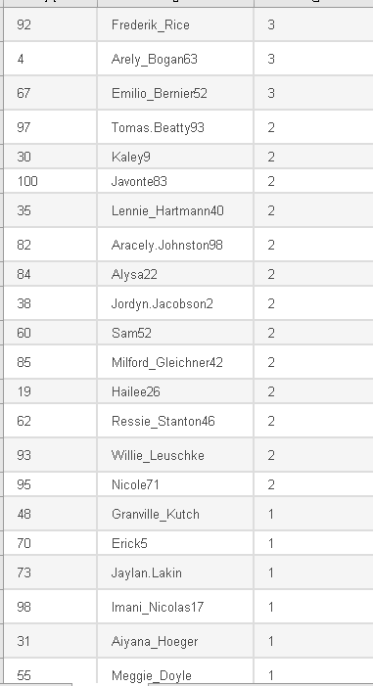
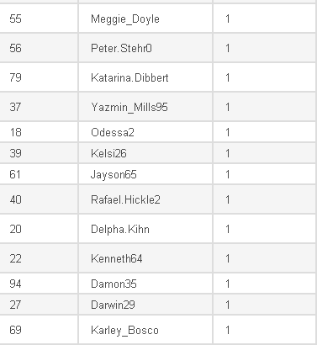
Output:

Slide 20
2. Bots & Fake Accounts
The investors want to know if the platform is crowded with fake and dummy accounts Task: Provide data on users (bots) who have liked every single photo on the site (since any normal user would not be able to do this).
To know the fake/dummy accounts, we are considering that the users who likes each and every photos on Instagram as Fake accounts/Dummy accounts , as no normal user can like all the posts on instagaram
For this we can do an inner join between likes and users to find the username and can count the number of likes, by grouping by userid , and check if number of likes of users are equal to the total number of posts in the dataset.
We no need to use a join if we don’t require the username, as userid and likes id are present in likes table itself. Here I am using it to get the username along with the userID.

Slide 21
Query:
Select users.Id, users.username,
count(*) as num_likes
from ig_clone.users
join ig_clone.likes
on users.id=likes.user_id
group by users.Id
having num_likes = (select count(*) from ig_clone.photos)

Slide 22
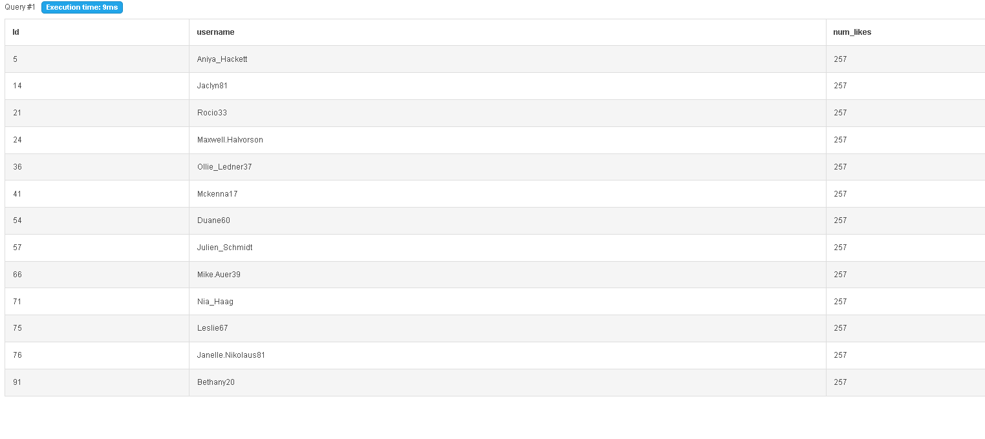
Output:

Slide 23
Tech stack used : MYSQL V5.7 from dbfiddle.com
Please find my work space , where I have practiced and found the insights for the above tasks here for reference:
https://www.db-fiddle.com/f/6bazsmJqSiioxigQ1SpE6t/1
Thank you
G A R Sireesha

