Slide 1
CSCI_6364_81
Understanding Attention and Transformers in Machine Learning
Presented by:
Sireesha Kurapalli

Slide 2

From Words to Images: The Journey of Transformers
Challenges in ML: Long sequences, dependencies
Game-Changers: Attention mechanisms, Transformers, Vision Transformers
Impact: Unified architecture across text and vision
Notes:
Machine learning models initially struggled to handle long sequences—whether text or images. Context often got lost, and relationships between distant parts were hard to capture. Attention mechanisms emerged as a solution, and the Transformer model took this innovation further, revolutionizing NLP. Today, we’ll explore this journey and how it extended into vision tasks with Vision Transformers. This diagram represents the Transformer architecture, consisting of an Encoder (left) and a Decoder (right). The Encoder processes input sequences using Multi-Head Attention and Feed-Forward Networks, while the Decoder generates output sequences by combining Masked Multi-Head Attention and Encoder-Decoder Attention. Positional encoding ensures the model understands word order, and the final output is produced using a Softmax layer. This parallel structure enables faster and more efficient processing compared to older models like RNNs.

Slide 3

Attention: The Key to Focus
Challenge: Seq2Seq models lose context in long inputs
Solution: Attention mechanisms focus on relevant parts
Types of Attention:
Self-Attention: Understand relationships within input
Global vs. Local: Wide vs. narrow focus
Notes:
Seq2Seq models often struggled with long sequences because they compressed all the input into a single fixed-length vector. Attention mechanisms introduced a dynamic way to focus on the most relevant parts of the input at every step."
"For example, self-attention allows models to look at relationships between words within a sequence. Types of attention include global, which considers the entire input, and local, which zooms in on specific areas. This breakthrough allowed models to better handle context and dependencies, paving the way for Transformers.
This image illustrates how attention mechanisms work by focusing on specific parts of an input (like key areas in an image) to understand relationships and prioritize information. In this case, attention highlights the dog's features (ears, nose, scarf) to process the image contextually.

Slide 4
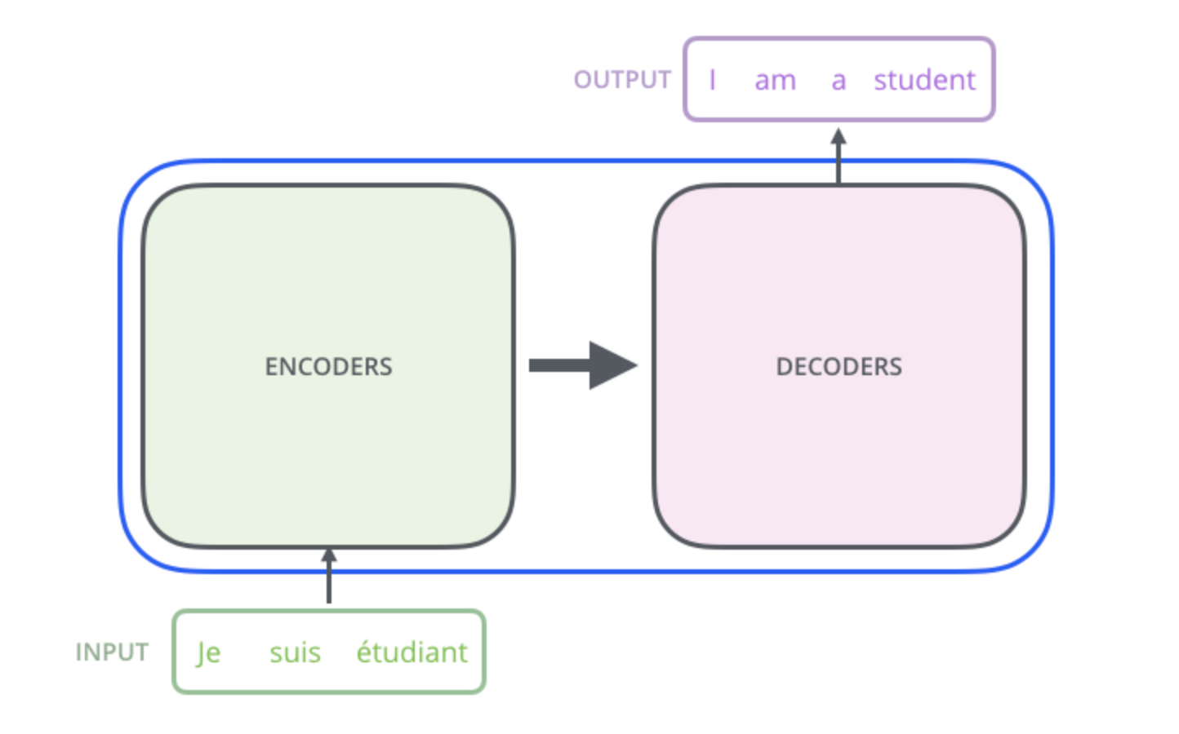
Transformers: NLP Redefined
Self-Attention Everywhere: Captures dependencies at scale
Encoder-Decoder Architecture: Processes input and generates output
Parallelization: Faster training without recurrence
Positional Encoding: Adds word order information
Notes:
The Transformer, introduced in the 'Attention Is All You Need' paper, is built entirely on self-attention mechanisms. Unlike earlier models that processed inputs sequentially, Transformers handle all parts of the input in parallel, making them faster and more efficient."
"The encoder processes the input to capture its meaning, while the decoder generates the output step by step. Positional encoding ensures the model understands the order of words, critical for tasks like machine translation. Transformers didn’t just change how we approach NLP—they set new benchmarks for accuracy and speed. "This image shows the Transformer’s Encoder-Decoder structure. The **Encoder** processes the input (‘Je suis étudiant’), and the **Decoder** generates the output (‘I am a student’), enabling tasks like translation through attention mechanisms."

Slide 5
Transformers See the World
Images as Patches: Divided into tokens like words in text
Long-Range Dependencies: Captures relationships across the image
ViT Advantage: Outperforms CNNs in classification tasks
Requires large datasets for training
Notes:
Transformers didn’t stop at text—they revolutionized image recognition with Vision Transformers, or ViT. Instead of treating images as a collection of pixels, ViT divides them into patches, treating each patch as a token, much like words in a sentence."
"ViT excels at capturing long-range dependencies, identifying relationships between distant parts of an image. With sufficient training data, it even outperforms traditional CNNs on classification benchmarks, proving the adaptability and power of the Transformer architecture.

Slide 6
THANK YOU

