Slide 1
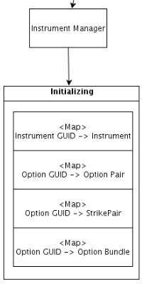
Map<Instrument GUID, Instrument> example:
<774112, 6BU3>
<432813, LOZ4>
<152703, 6BU3 C1500>
<164807, LOZ4 P1600>
Map<Option GUID, Option Pair> example:
< 152703, 6BU3 P1500>
< 164807, LOZ4 C1600>
Map<Instrument GUID, StrikePair> example:
< 152703, [6BU3 C1500, 6BU3 P1500]>
< 164807, [LOZ4 C1600, LOZ4 P1600]>
Map<Instrument GUID, OptionChainSettleBundle> example:
< 152703, {[6BU3 C1200, 6BU3 P1200], [6BU3 C1300, 6BU3 P1300], …… , [6BU3 C2500, 6BU3 P2500]} >
< 164807, {[LOZ4 C1000, LOZ4 P1000], [LOZ4 C1100, LOZ4 P1100], …… , [LOZ4 C2200, LOZ4 P2200]} >

Slide 2
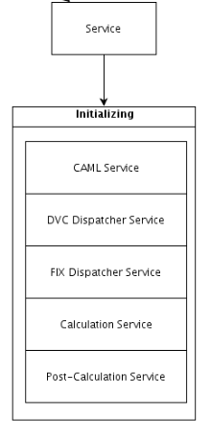
<CAML Service>
Starting CAML Tibco Receiver and Sender.
<DVC Dispatcher Service>
Parse the incoming DVC binary message.
Dispatch to Instrument Updater then goes into Event Queue.
<FIX Dispatcher Service>
Parse the incoming FIX message.
Dispatch to Instrument Updater then goes into Event Queue.
<Calculation Service>
Runs every X mins.
Take all events from Event Queue.
Find the specific option bundle for each event.
Dispatch all the option bundles to Algorithm.
<Post-Calculation Service>
Runs after Calculation Service finishes.
Export calculated volatility to XML file.

Slide 3
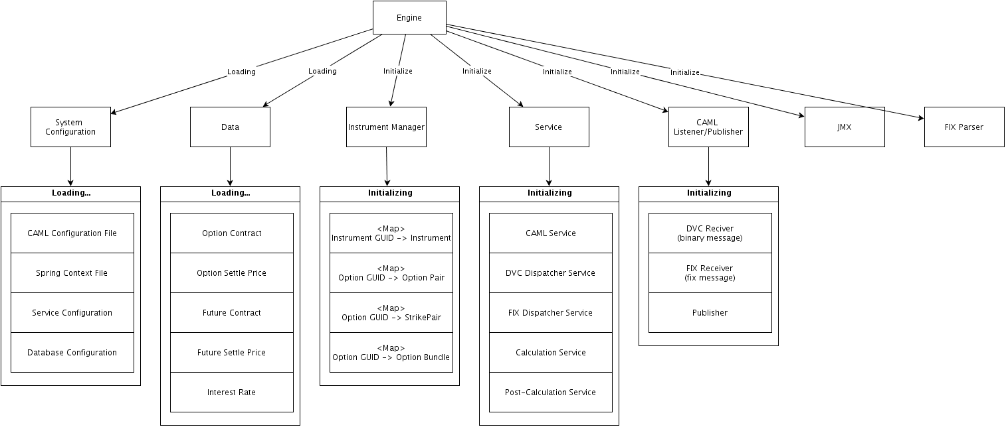

Slide 4
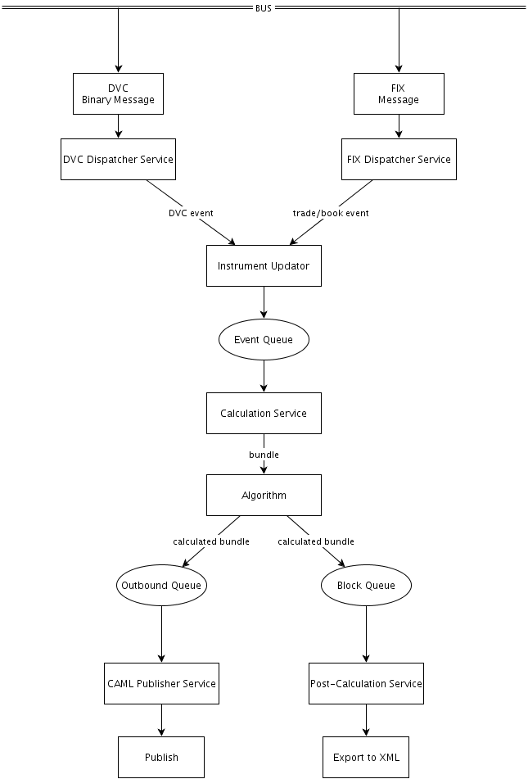
Waiting…

Slide 5
About model…
Black Model
(European Option)
Whaley Model
(American Option)
Vol = calculateVol(futurePrice, optionPrice, strikePrice, interestRate, dayToExpiration)

Slide 6
About calculation…
Calculate put volatility
50
60
70
80
90
100
110
120
130
140
150
Current Future Price
Calculate call volatility

Slide 7
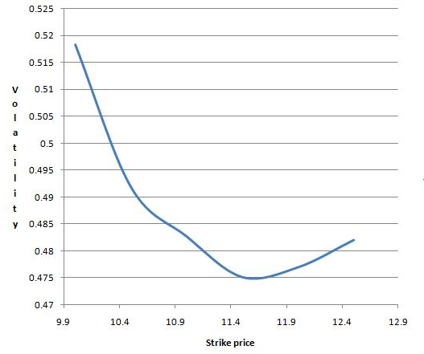
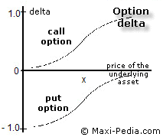
About delta…
0.5
seed
0.3
0.2
interpolated
-0.2
-0.3
-0.5

Slide 8
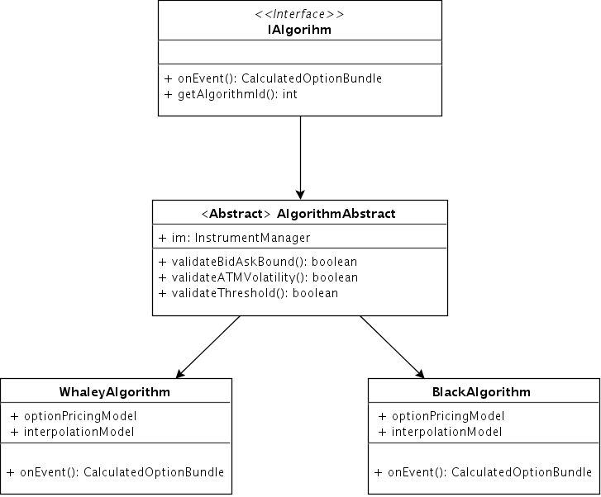
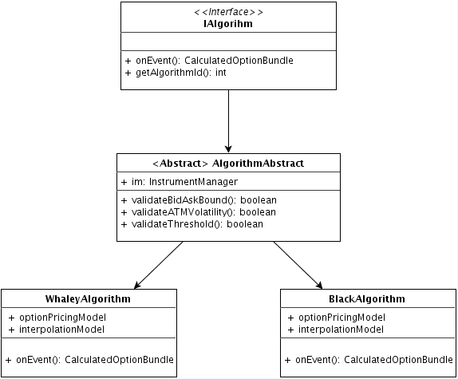

Slide 9
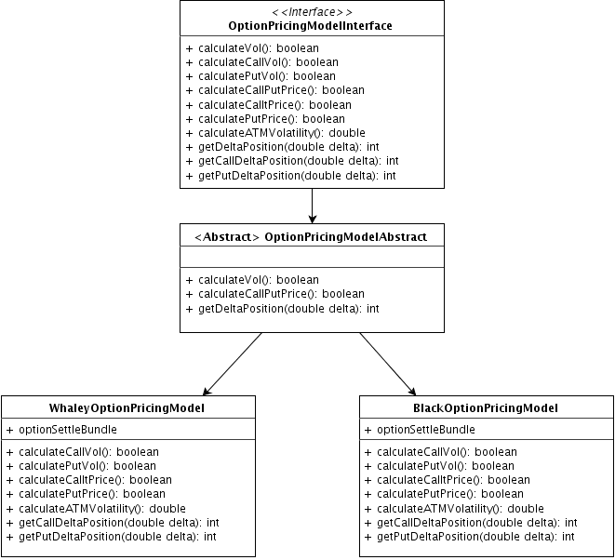

Slide 10

