Slide 1
Funding by Keywords and Program Types for IMLS Discretionary Funds (1996-2014)
Amanda Lee
17 November 2015
Data Science Course, General Assembly Atlanta

Slide 2
Problem Statement
Matching funding amounts granted by the Institute of Museum and Library Services with program types and key words.
Independent US federal agency
Sets own agenda
Are funding amounts a truer reflection of the importance of issues to the organization?

Slide 3

Established in 1996 by Museum and Library Services Act.
Main source of federal support for 123,000 libraries and 35,000 museums in the US.
Libraries: public, academic, research, tribal, etc.
Museums: art, history, science and technology, children’s museums, historical societies, tribal museums, planetariums, botanic gardens, and zoos.
2015:
Budget: $227,860,000
$28.7 million through Museum Services Act
$180.9 million through Library Services Technology Act
Includes $154.8 million for grants to states.

Slide 4
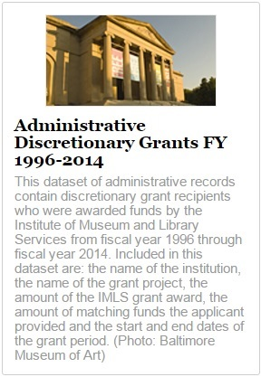
Administrative Discretionary Grants Data Set
Reproduced each year.
Data set has 13,594 records and 43 features:
LogNumber
Institution
Program
ProgramType
ProjectTitle
ProjectType
AwardDate
InstAddr1
InstAddr2
InstAddr3
InstCity
InstState
InstZip
AwardOrig
AwardTotal
AppMatchAmount
ReqAwardAmount
ReqMatchAmount
Prefix
FirstName
LastName
OrgType
FiscalYear
AwardPeriodFr
AwrdPeriodTo
OrgUnit
OUAddr1
OUAddr2
OUAddr3
OUCity
OUState
OUZip
Latitude
Longitude
FIPSState*
FIPSCounty
CensusTract
CensusBlock
FIPSMCDCode**
FIPSPlaceCode
CBSACode***
MetroDivisionCode
Description
* Federal Information Processing Standards (FIPS)
** Minor Civil Division (MCD)
*** Core Based Statistical Area code (CBSA)

Slide 5
Analysis
Funding Amounts for Program Types
Funding Amounts for Keywords
Classifier models for Keywords

Slide 6
Analysis
Funding Amounts for Program Types
Funding Amounts for Keywords
Classifier models for Keywords

Slide 7
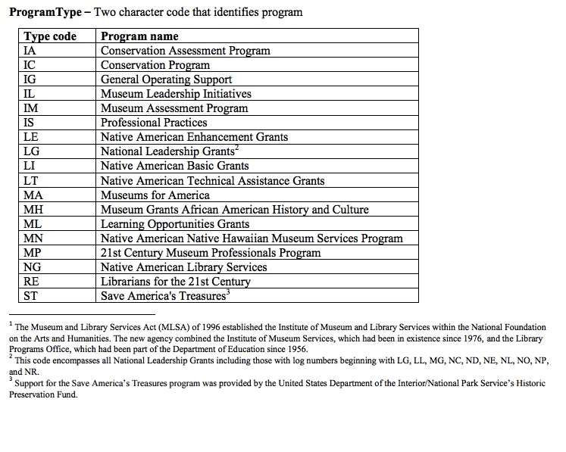

Slide 8
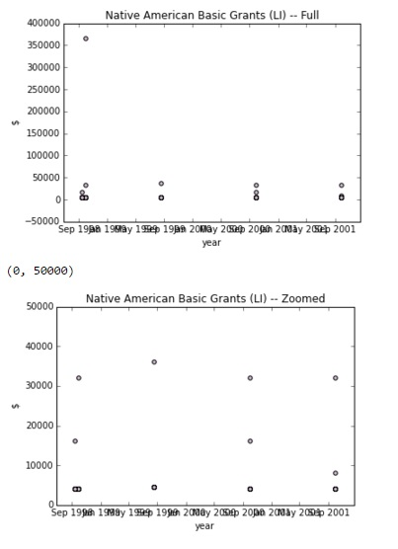
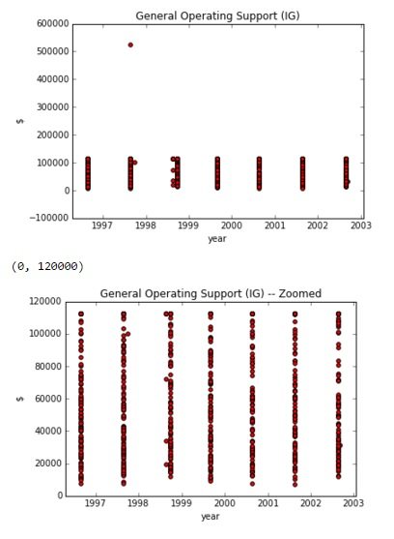
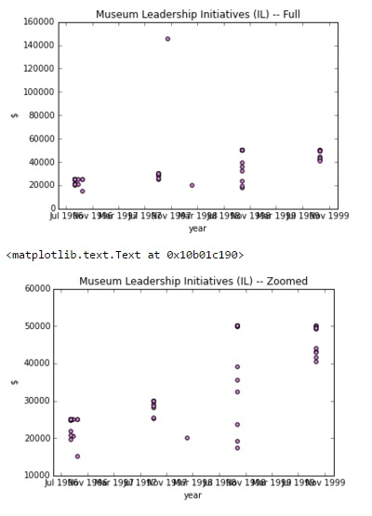
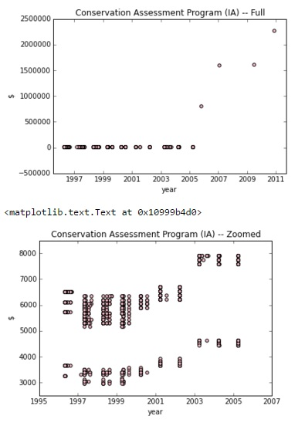
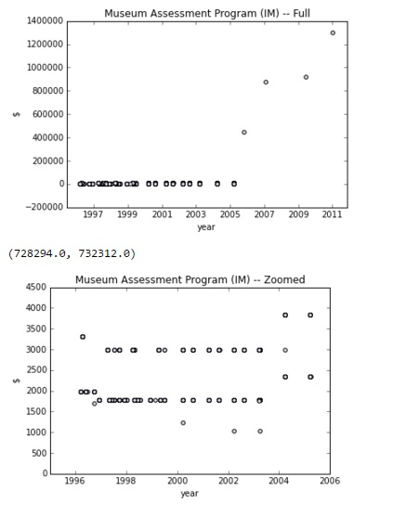

Slide 9
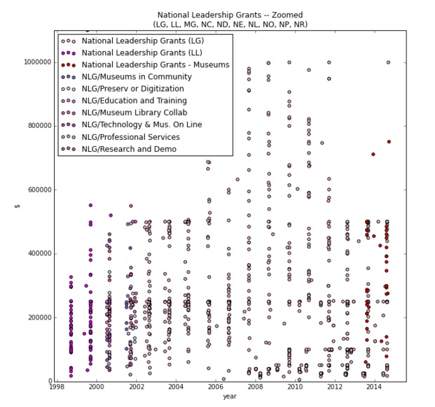
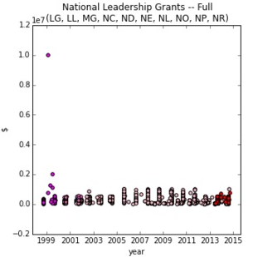

Slide 10
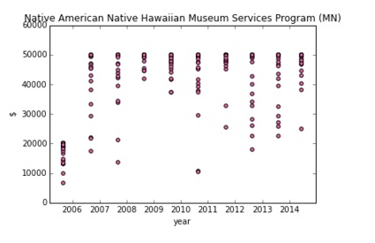
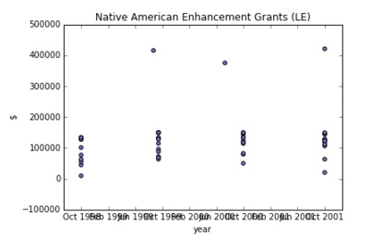
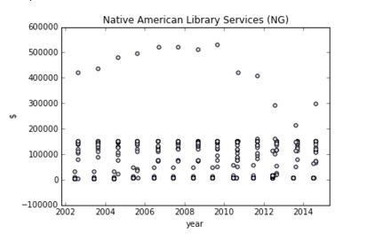
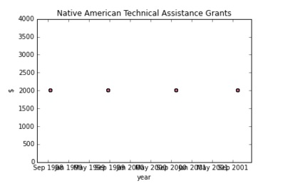
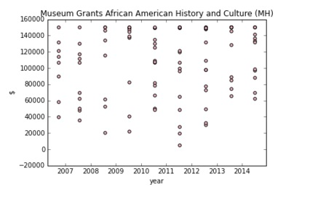
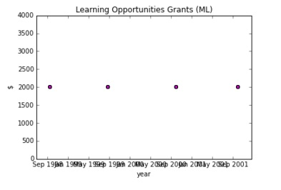

Slide 11
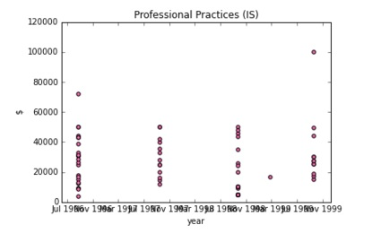
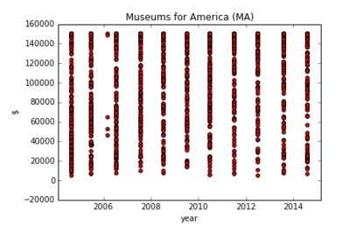
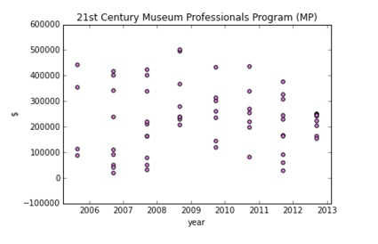
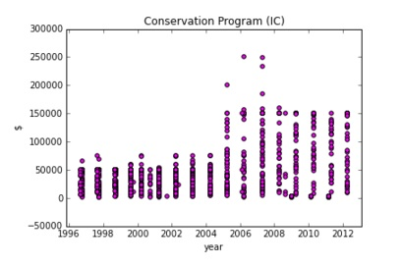
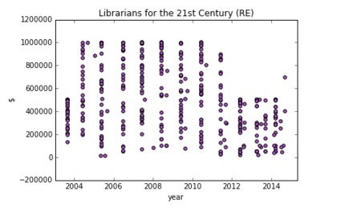
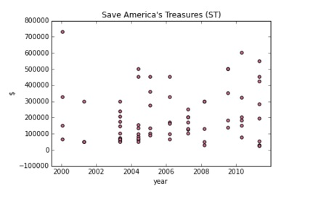

Slide 12
Analysis
Funding Amounts for Program Types
Funding Amounts for Keywords
Classifier models for Keywords

Slide 13
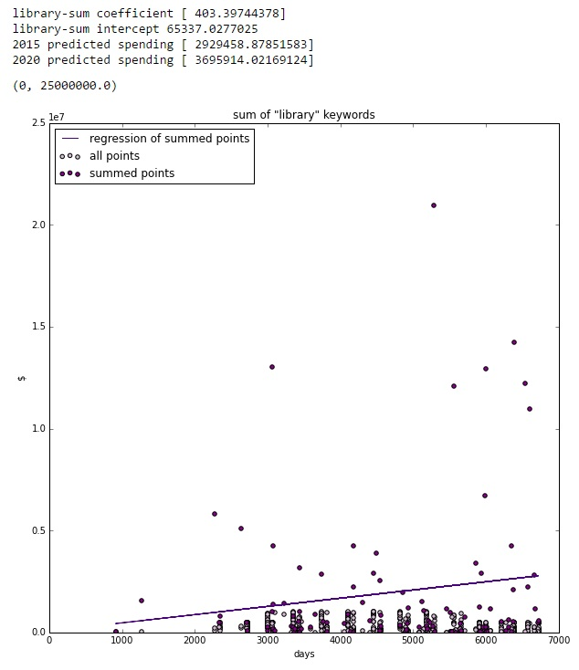
“Library” Keywords
Time (x) is expressed in days.
Linear model is run over summed award amounts per day.
Also predicted spending amounts for some date in 2015 and some date in 2020.

Slide 14
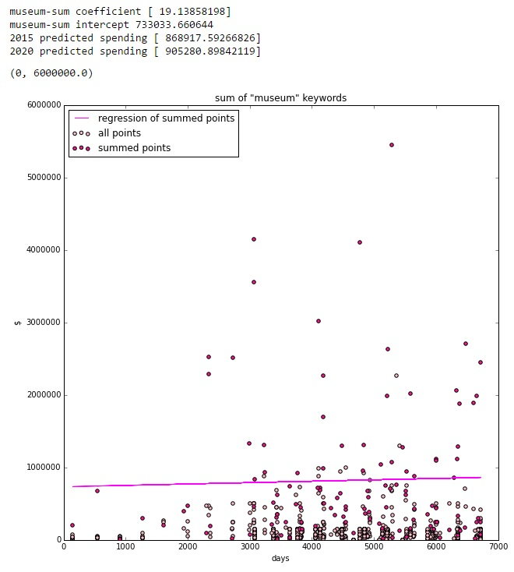
“Museum” Keywords
Time (x) is expressed in days.
Linear model is run over summed award amounts per day.
Also predicted spending amounts for some date in 2015 and some date in 2020.

Slide 15
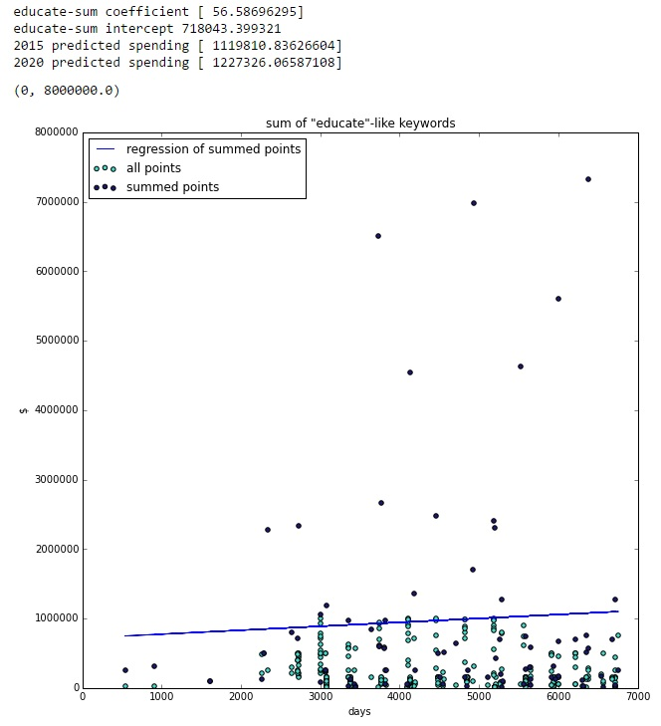
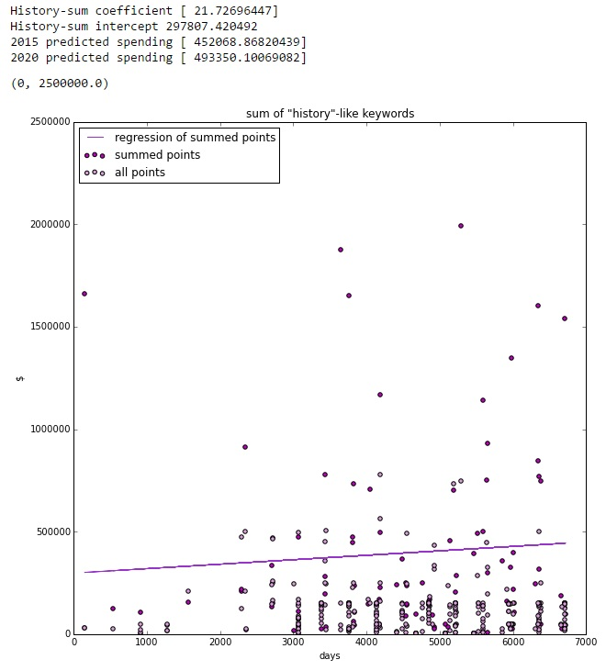
“History” and “Educate”

Slide 16
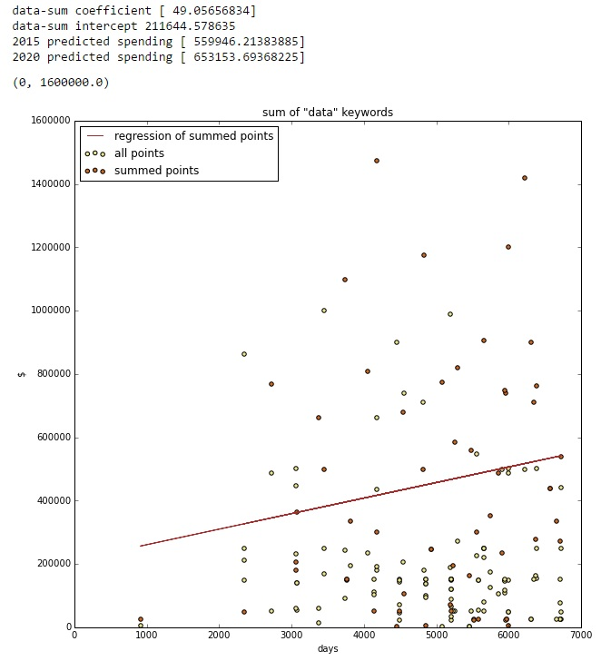
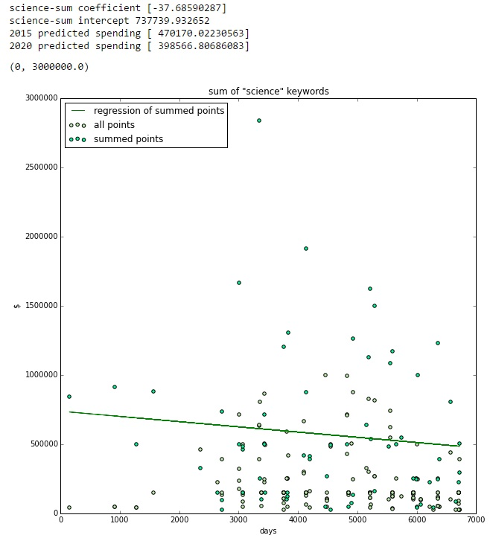
“Data” and “Science”

Slide 17
Analysis
Funding Amounts for Program Types
Funding Amounts for Keywords
Classifier models for Keywords

Slide 18
Classifier Models for Keywords
Project Title and Award Amount
General Failure with accuracy score never exceeding .13
 | MultinomailNB | SGDClassifier | KNeighborsClassifier | RandomForestClassifier
CountVectorizer | 0.123
CountVectorizer (stop_words = 'english') | 0.102 | 0.047
CountVectorizer (ngram_range = (1,2) | 0.119 |  |  | 0.075
TfidfVectorizer | 0.117
TfidfVectorizer (stop_words = 'english') | 0.108 |  | 0.018

Slide 19
Conclusions
Nothing conclusive to be inferred from keywords or program types.
Periodical award dates for continuous funding creates column-like pattern of points.
Different levels of awards on an award date in same program.
Linear regression model, even over sum of all awards/day, is severely underfitted and just reflects a predictable average.
Other Features or Missed Opportunities
ZIP Code
Organization Type

