Slide 1
Encoding Spark Proof Types and Functions for Kiasan

Slide 2
Context and Problem
Context
Kiasan sym-exec of Spark.
Problem
In the Spark approach, the semantics of proof types and proof functions (PT&Fs) can only be defined in the Spark Functional Description Language (FDL).
For the purposes of Kiasan sym-exec, we need another means of encoding the semantics of PT&Fs.

Slide 3
Requirements
Our encoding of PT&Fs should be
Verifiable using the standard Spark tools.
“Easy” for our tools to support.

Slide 4
Create Real Types and Functions in Child Package named P.PTF

Slide 5
Problem: Package Body Elements are Inaccessible

Slide 6
Solution: Create a Shadow for P
A shadow is a Spark spec created solely for the purpose of verification (Barnes §13.1).
Check the PTF child package against the shadow

Slide 7
Overall Picture (Artifacts and Tools)
Orig. Source
P.ada (or could be .ads + .adb)
Shadow
P_ads4ptf.ads
Kiasan
reads
writes
uses
PT&PF Definitions in P.PTF
P_ptf.ads
Spark
reads
check

Slide 8
Shadow for P
Single .ads file.
Content:
All specification elements of P.
The “private” keyword, followed by …
The necessary body elements of P.
Proof functions
Concrete fields used in representations.

Slide 9
Example of Shadow (P_ads4ptf.ads)

Slide 10
Spark Examiner
Run on
P_ads4ptf.ads
P_ptf.ada

Slide 11
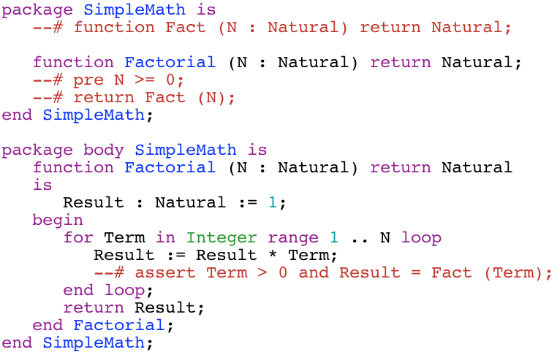
Factorial Example: Original Source

Slide 12
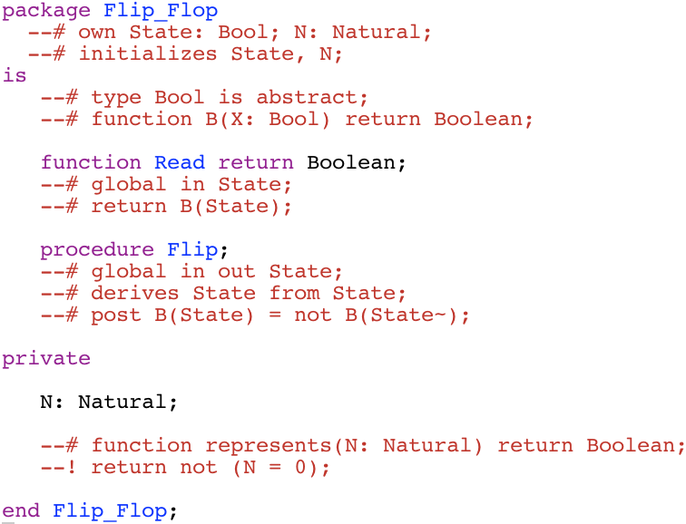
Factorial Example: PTF file

Slide 13
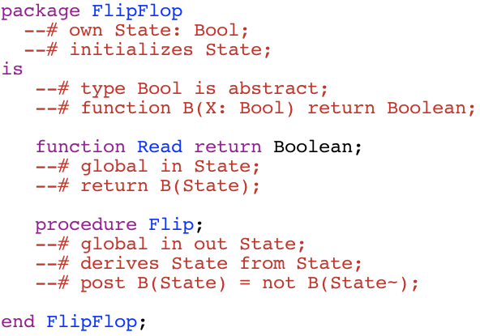
Flip-Flop Example: Spec
Notes:
A spec variable cannot have a concrete type.
Here we illustrate an abstract type that can be used in place for Boolean.

Slide 14
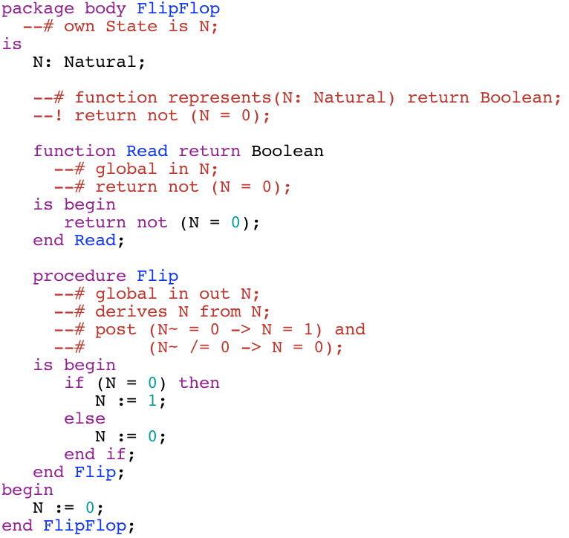
Flip-Flop Example: Body

Slide 15
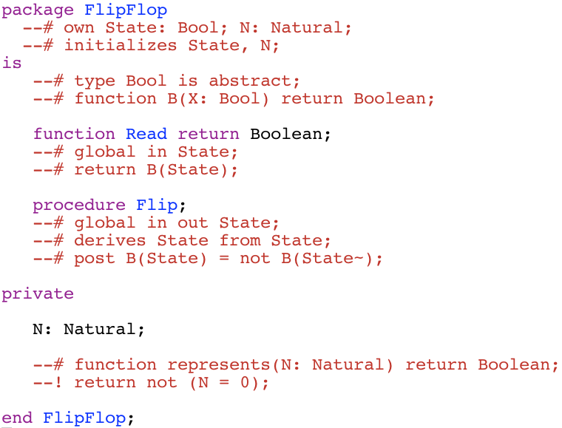
Flip-Flop Shadow: Flip_Flop_ads4ptf.ads

Slide 16
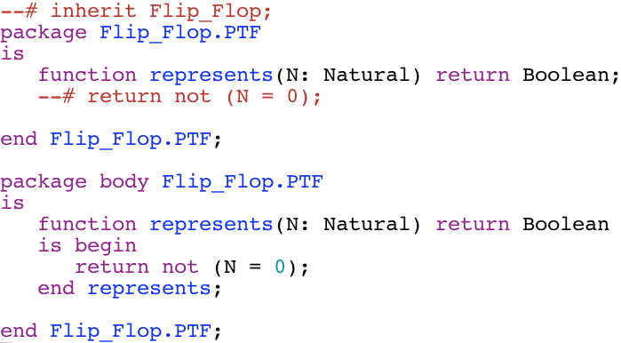
Flip-Flop Example: Flip_Flop_ptf.ada

Slide 17
Possible Issues
Might not work in complex cases where there are nested packages and/or nested subroutine definitions within other subroutines.

