Slide 1
Claim Transformer -- While-Loop
While-loop can be viewed as repeated conditionals …
Execute statement C as long as loop-condition e is true, i.e., if (e) { C if (e) { C if (e) { … } } }
Do not know when (or even if) it will terminate
… need to summarize behavior
inside loop body
before and after loop
while (e)
C

Slide 2
Loop Invariants
Since we don’t know how many times the loop will execute, we need to establish a property that summarizes its behavior and gives us knowledge about the loop ”no matter what happens”
The loop invariant is, in essence, a short summary of the loop code, and for this reason it is valuable documentation, whether it is stated in English words or in algebra symbols.
The invariant comes into play at four different points of the loop.
Guarantee (prove) that invariant holds here (just like a client must guarantee pre-condition of called function)
1: Guarantee: I
while (e)
Assume that that invariant holds here (just like a caller gets to assume that function’s post-condition holds)
Assume that invariant holds here (just like a function gets to assume that its pre-condition is true)
2: Assume: I
4: Assume: I
C
Guarantee (prove) that invariant holds here (just like a function has to prove that its post-condition holds)
3: Guarantee: I

Slide 3
Loop Invariants – Why They Work
Since we don’t know how many times the loop will execute, we need to establish a property that summarizes its behavior and gives us knowledge about the loop ”no matter what happens”
Why do we get to assume I at Point 4? There are two ways to exit loop: (a) skip completely because test condition is true at beginning, (b) do the loop some number of times (can’t tell exactly), then exit)
By appropriately applying the loop invariant concept, no matter which way we exit the loop, the invariant will hold
1: Guarantee: I
If we exit due to (a), then invariant will hold at Point 4 because we proved it at Point 1
a
If we exit due to (b), then invariant will hold at Point 4 because we proved it at Point 3
b
while (e)
2: Assume: I
4: Assume: I
C
3: Guarantee: I

Slide 4
Loop Invariants – Why They Work
Since we don’t know how many times the loop will execute, we need to establish a property that summarizes its behavior and gives us knowledge about the loop ”no matter what happens”
Why do we get to assume I at Point 2? There are two ways to arrive at loop body: (a) enter the first time when starting from Point 1 above, (b) start after repeating the loop some number of times (can’t tell exactly) arriving from Point 3
By appropriately applying the loop invariant concept, no matter which way we arrive at the top of the loop body, the invariant will hold
1: Guarantee: I
If we arrive due to (a), then invariant will hold at Point 2 because we proved it at Point 1
a
If we repeat the loop due to (b), then invariant will hold at Point 2 because we proved it at Point 3
b
while (e)
2: Assume: I
4: Assume: I
C
3: Guarantee: I

Slide 5
Loop Invariants – Knowledge from Test
Similar to the conditional, we pick up information depending on if the test is true or false
1: Guarantee: I
If we reach Point 4, we know the test expression must be false.
If we reach Point 2, we know the test expression must be true.
while (e)
2: Assume: I ^ e
4: Assume: I ^ !e
C
3: Guarantee: I

Slide 6
Loop Invariants – Putting it in Context
We some times need to consider the overall interaction between the loop invariant and the method pre/post-condition – This gives us three different assume/guarantee pairs.
Assume method pre-condtion: Pre
Show that knowledge from Pre, other code (…), and loop variable initialization is strong enough to establish I at Point 1
…
(loop variable initialization)
1: Guarantee: I
while (e)
2: Assume: I ^ e
4: Assume: I ^ !e
Show that knowledge from I ^ !e at Point 4 and other code (…) is strong enough to establish Post at method exit
C
…
3: Guarantee: I
Guarantee method pre-condtion: Post
Show knowledge from I ^ e at Point 2 and knowledge from body of the loop is strong enough to establish I at Point 3.

Slide 7
Demo
Demo of the Program Logic Checker
applied to the development of proofs
for the mult and factorial examples

Slide 8
mult Example
Computing the multiplication of two non-negative integers …
import org.sireum.logika._ // Given non-negative integer arguments m and n, // mult computes multiplication of m and n by using repeated addition. def mult(m: Z, n: Z): Z = { // Goal: return m + m + ... (n times)
while (…) {
}
return … }

Slide 9
mult Example
Add method pre/post-conditions…
import org.sireum.logika._ // Given non-negative integer arguments m and n, // mult computes multiplication of m and n by using repeated addition. def mult(m: Z, n: Z): Z = { // Goal: return m + m + ... (n times)
l"""{ requires m ≥ 0 ∧ n ≥ 0 // call this Pre below ensures result == m * n // call this Post below }"""
while (…) {
}
return … }
Add method pre/post-conditions

Slide 10
mult Example
Add implementation…
def mult(m: Z, n: Z): Z = {
l"""{ requires m ≥ 0 ∧ n ≥ 0 // call this Pre below ensures result == m * n // call this Post below }""" // loop variable initialization var r: Z = 0 var i: Z = 0 while (i != n) { r = r + m i = i + 1 } return r }

Slide 11
mult Example – Documenting Loops
Document loop modifications and invariants …
def mult(m: Z, n: Z): Z = {
l"""{ requires m ≥ 0 ∧ n ≥ 0 // call this Pre below ensures result == m * n // call this Post below }""" // loop variable initialization
var r: Z = 0 var i: Z = 0 while (i != n) { // call this B l"""{ invariant r == m * i // call this I modifies r, i }""" r = r + m i = i + 1 } return r }
Document loop invariant and loop modifies clause
Note: typically one should try to think about the loop invariant before you design the body of the loop, but sometimes you interleaving the coding and the loop invariant design.
Note: we will have a subsequent lecture that gives advice on how to come up with a loop invariant.

Slide 12
mult Example
The loop modifies clause is necessary to indicate what facts may be invalidated by a loop, i.e., facts about variables modified in the loop cannot be automatically carried over within the loop or without it.…
E.g., the fact r == 0 does not apply here: it could hold if we are entering for the first time, but otherwise doesn’t hold. The modifies clause tells us that all knowledge about r coming from outside the loop or flowing up from the bottom of the loop must be cancelled. We are only allowed to have knowledge about r that comes from the invariant.
def mult(m: Z, n: Z): Z = {
l"""{ requires m ≥ 0 ∧ n ≥ 0 // call this Pre below ensures result == m * n // call this Post below }""" // loop variable initialization
var r: Z = 0 // we know r == 0 here var i: Z = 0 while (i != n) { // call this B l"""{ invariant r == m * i // call this I modifies r, i }""" // what’s the value of r?
r = r + m i = i + 1 }
// what’s the value of r? return r }
E.g., the fact r == 0 does not apply here: it could hold if we skipped over the loop altogether, but otherwise it won’t hold. The modifies clause tells us that all knowledge about r coming from outside the loop or flowing up from the bottom of the loop must be cancelled. We are only allowed to have knowledge about r that comes from the invariant.

Slide 13
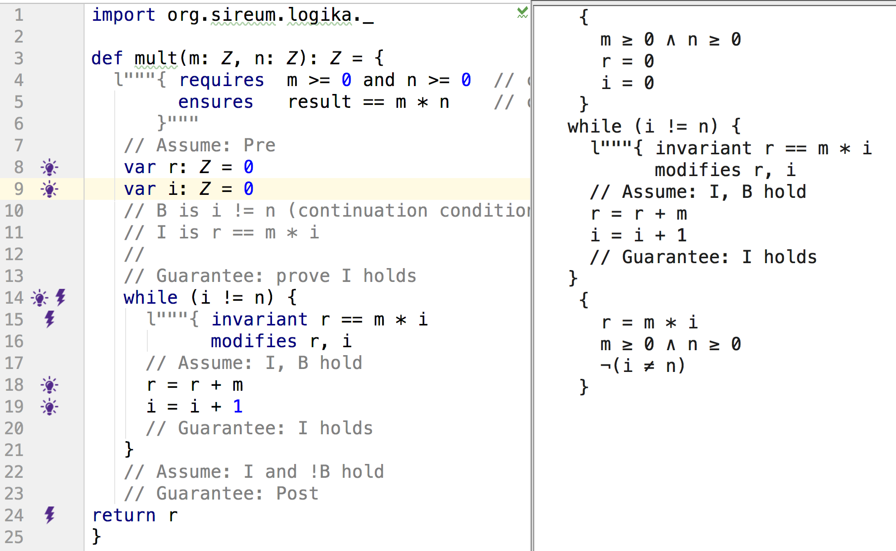
Loop Modifies Clause – Modified Variables
The loop modifies clause is necessary to indicate what facts may be invalidated by a loop, i.e., facts about variables modified in the loop cannot be automatically carried over within the loop or without it.…
Knowledge before loop
Facts about variables modified by the loop cannot be carried over to the end of the loop. The only knowledge about such variables comes from the loop invariant.
Knowledge after loop
(Click here)

Slide 14
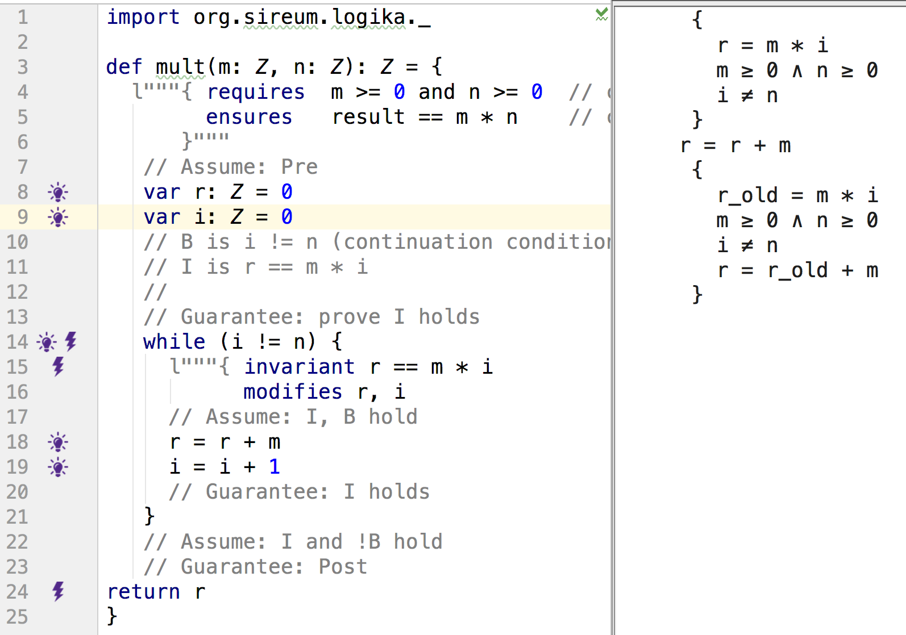
Loop Modifies Clause – Modified Variables
The loop modifies clause is necessary to indicate what facts may be invalidated by a loop, i.e., facts about variables modified in the loop cannot be automatically carried over within the loop or without it.…
Knowledge inside loop before assigning to r
Knowledge inside loop after assigning to r
Facts about variables modified by the loop cannot inherited from before the loop. The only knowledge about such variables comes from the loop invariant.
(Click here)

Slide 15
mult Example
The loop modifies clause is necessary to indicate what facts may be invalidated by a loop, i.e., facts about variables not modified in the loop can be automatically carried over within the loop or without it.…
def mult(m: Z, n: Z): Z = {
l"""{ requires m ≥ 0 ∧ n ≥ 0 // call this Pre below ensures result == m * n // call this Post below }""" // loop variable initialization
var r: Z = 0 var i: Z = 0
var dummy: Z = 5 while (i != n) { // call this B l"""{ invariant r == m * i // call this I modifies r, i }""" l”””{ 1. dummy == 5 premise }”””
r = r + m i = i + 1 }
l”””{ 1. dummy == 5 premise }””” return r }
Knowledge about variables not modified by the loop can carry over into the loop. Such knowledge does not need to be captured in the loop invariant.
Knowledge about variables not modified by the loop can carry over past the loop. Such knowledge does not need to be captured in the loop invariant.

Slide 16
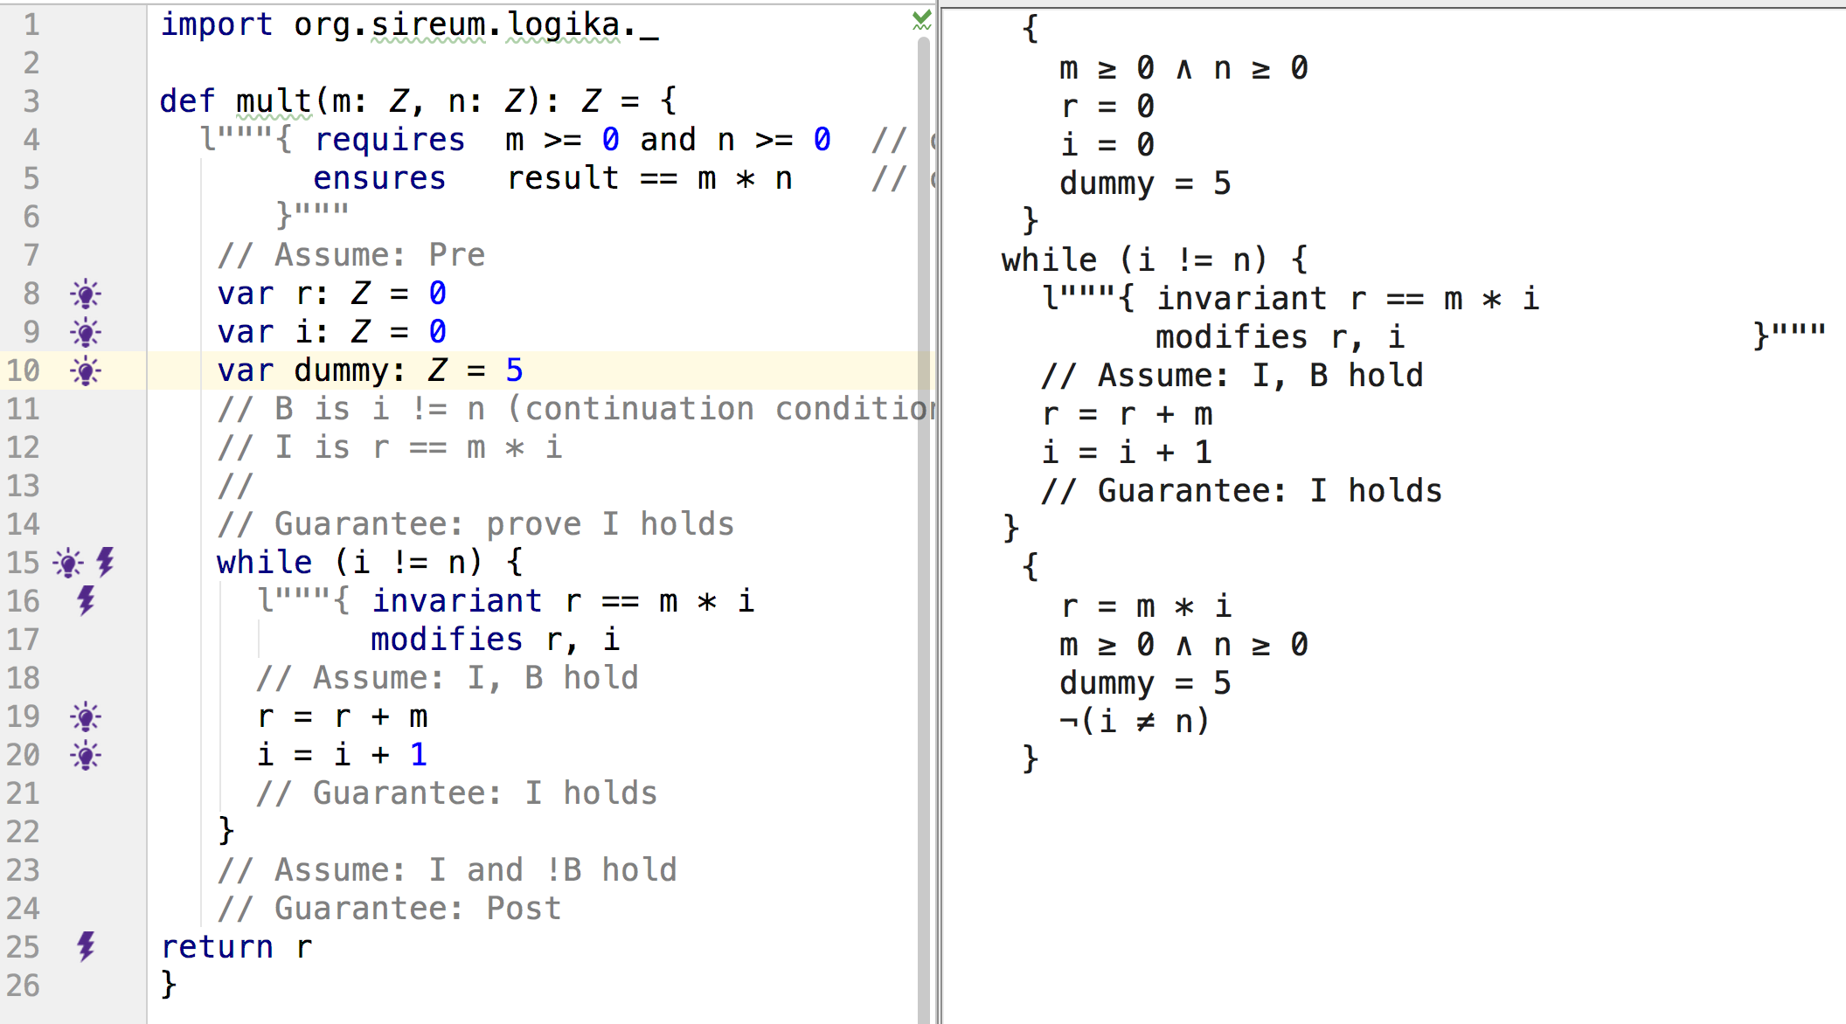
Loop Modifies Clause – Non-modified Variables
The loop modifies clause is necessary to indicate what facts may be invalidated by a loop, i.e., facts about variables not modified in the loop can be automatically carried over within the loop or without it.…
Knowledge before loop
Facts about variables not modified by the loop can be carried over and applied after the loop.
Knowledge after loop
(Click here)

Slide 17
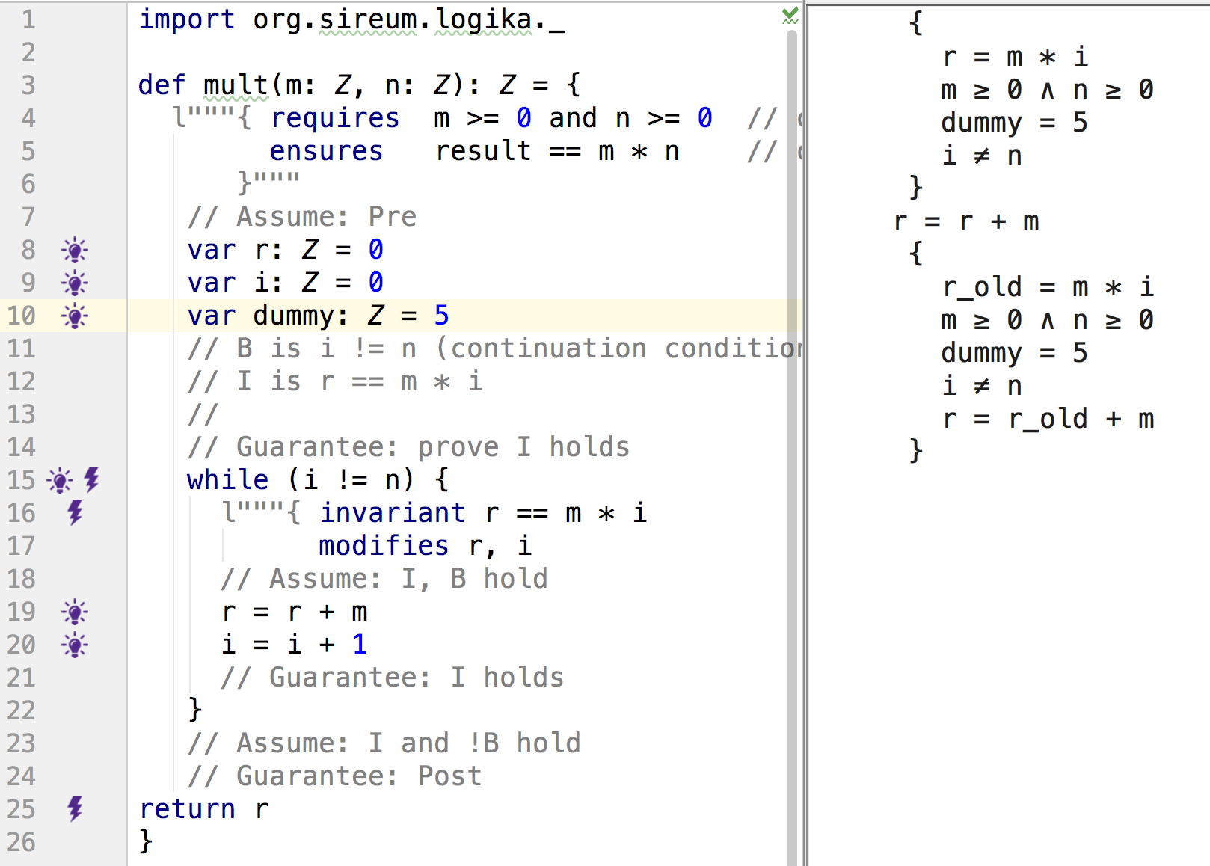
Loop Modifies Clause – Non-modified Variables
The loop modifies clause is necessary to indicate what facts may be invalidated by a loop, i.e., facts about variables not modified in the loop can be automatically carried over within the loop or without it.…
Knowledge inside loop before assigning to r
Knowledge inside loop after assigning to r
Facts about variables not modified by the loop can be applied within the loop.
(Click here)

Slide 18
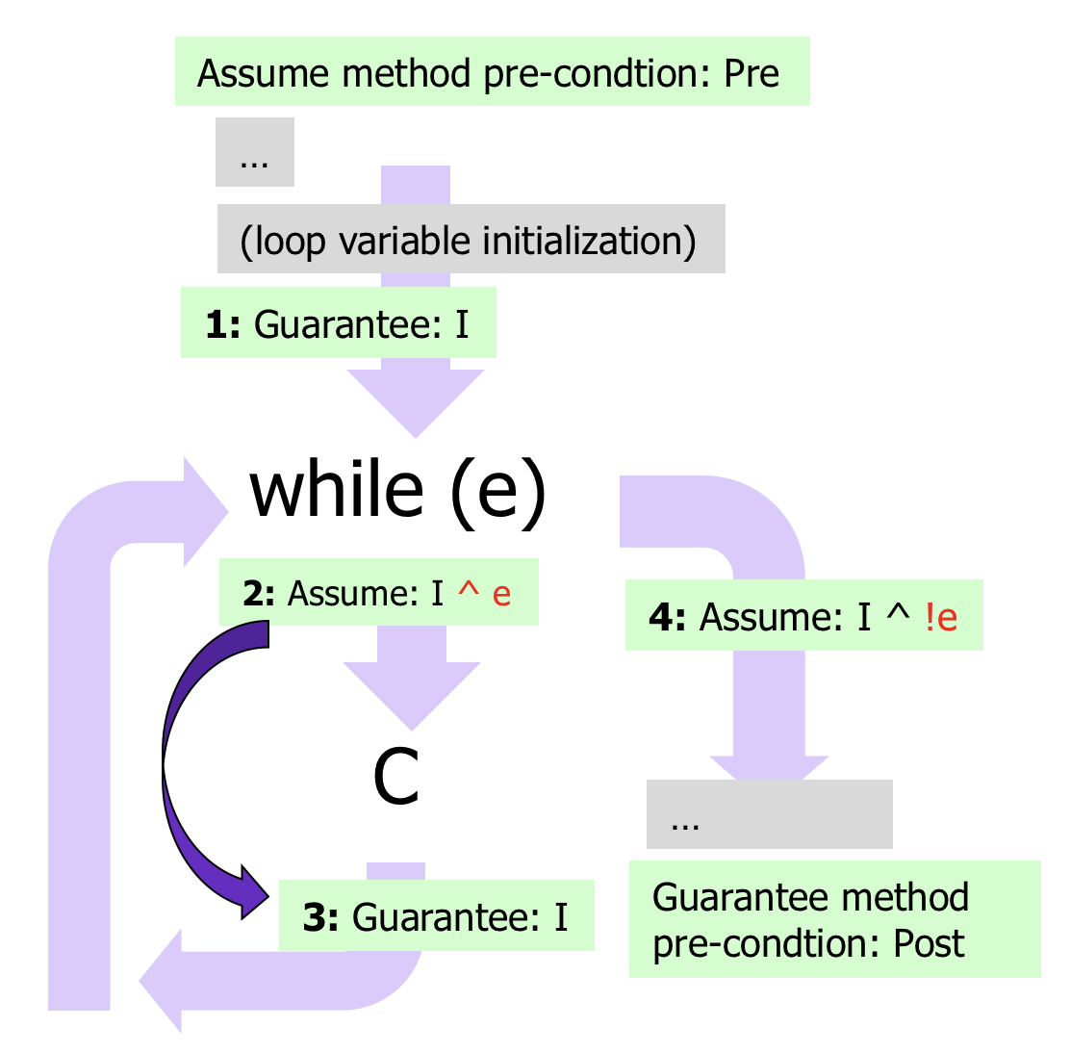
mult Example
Overall loop reasoning pattern…
def mult(m: Z, n: Z): Z = {
l"""{ requires m ≥ 0 ∧ n ≥ 0 // call this Pre below ensures result == m * n // call this Post below }""”
// Assume Pre // loop variable initialization
var r: Z = 0 var i: Z = 0
// Guarantee I while (i != n) { // call this B l"""{ invariant r == m * i // call this I modifies r, i }""“
// Assume I ^ B r = r + m i = i + 1
// Guarantee I }
// Assume I ^ !B
// Guarantee Post return r }
Apply the overall loop reasoning pattern to determine what we can assume and what we can guarantee

Slide 19
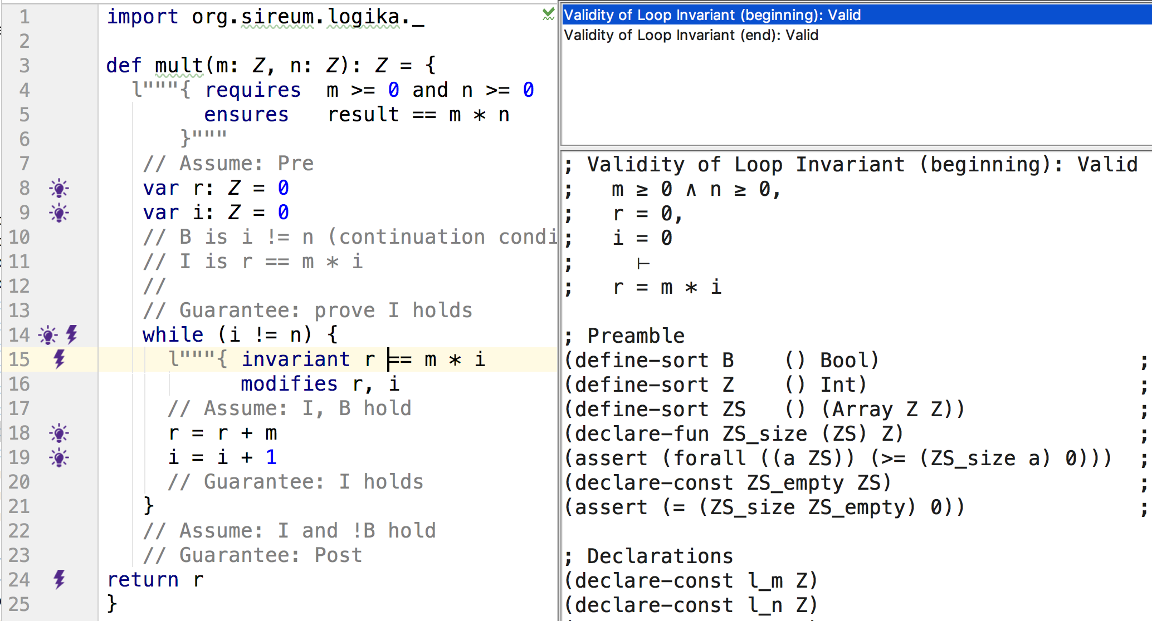
Logika Annotations Reflect Overall Loop Reasoning Pattern
Verification obligations at Point 1 (line where starts with “Validity of Loop Invariant (beginning)” selected): Pre along with loop variable initializations should imply I.
(Click here)

Slide 20
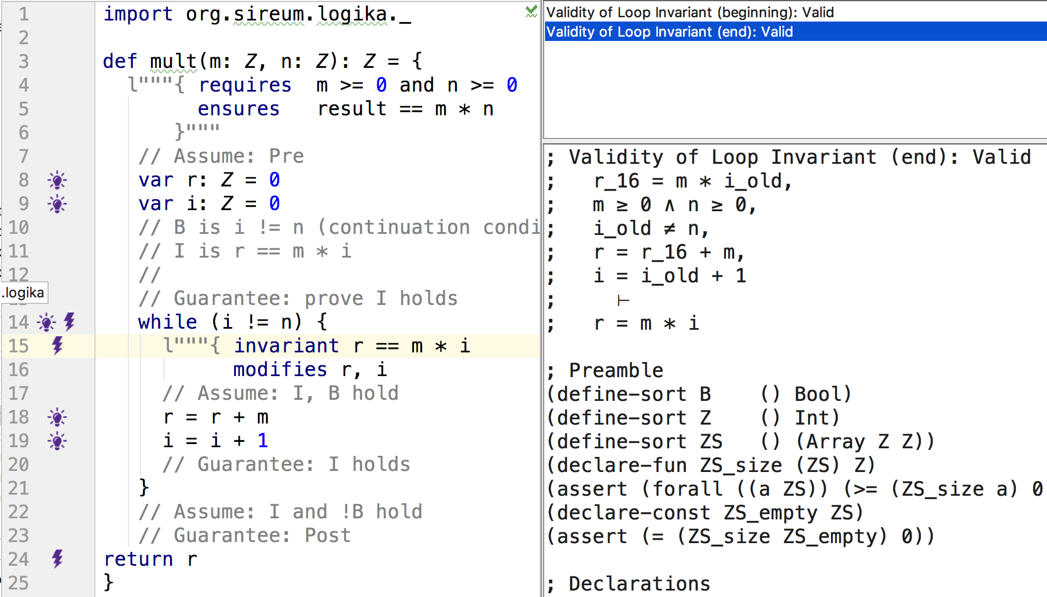
Logika Annotations Reflect Overall Loop Reasoning Pattern
Assumption of the loop invariant at Point 2 (line 16) and loop test.
Verification obligations at Point 3 (line where starts with “Validity of Loop Invariant (end)” selected): Assumption of loop invariant and test expression at Point 2, along with knowledge from body of loop should imply invariant at Point 3.
Invariant
(Click here)

Slide 21
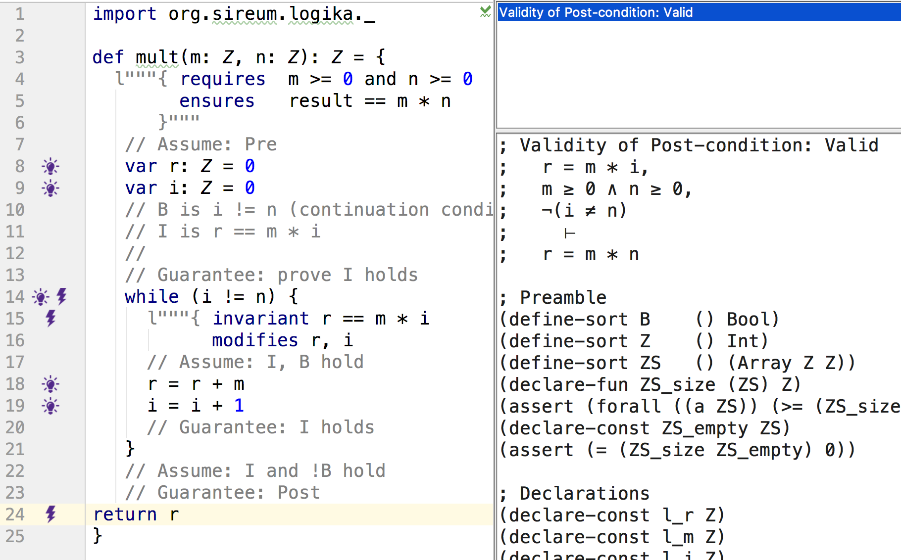
Logika Annotations Reflect Overall Loop Reasoning Pattern
Assumption of the loop invariant at Point 4 and negation of loop test.
Post-condition
Verification obligations at end of method (post-condition): loop invariant and negation of loop test at Point 4 should imply post-condition
(Click here)

Slide 22
Claim Transformer -- While Loops
Forward Rule for While-Loop
Must prove invariant holds before entering loop
l"""{ ... I }"""
while (B) {
l"""{ invariant I
modifies <variable list>
}"""
l"""{ 1. B premise
2. I premise
...
}"""
C
l"""{ ...I }"""
}
l"""{ 1. ¬(B) premise
2. I premise
...
}"""
Specification/Declaration of invariant.
Frame-condition for loop (so we know what premises to cancel)
Assume invariant holds (and test – just like in the conditional statement)
Prove that I holds (just like proving a post-condition)
Get to assume that invariant holds (just like caller assuming post-condition of function) and get to assume that test is false (just like else branch of a conditional).

Slide 23
Summary -- Loops
The loop invariant property documents the loop's structure --- how the loop achieves its goal.
The loop invariant is, in essence, a short summary of the code, and for this reason it is valuable documentation, whether it is stated in English words or in algebra symbols.
Guarantee (prove) that invariant holds here (just like a client must guarantee pre-condition of called function)
I
while (e)
Assume that that invariant holds here (just like a caller gets to assume that function’s post-condition holds)
Assume that invariant holds here (just like a function gets to assume that its pre-condition is true)
I
I
C
Guarantee (prove) that invariant holds here (just like a function has to prove that its post-condition holds)
I

Slide 24
Summary -- Loops
The invariant property documents the loop's structure --- how the loop achieves its goal.
Another summarizing aspect: the while statement has two ways in and two ways out.
The invariant should hold regardless of the path that we enter the loop
The invariant should hold regardless of the path that we exit the loop
Invariant hold along both paths entering the loop – when we reason about the body, we don’t care about how we got here, or the number of iterations before. We don’t have to worry about a bunch of different cases!
I
Invariant hold along both paths exiting the while (either we skipped it entirely, or we iterated). We don’t care about how we got here, or the number of iterations before. We don’t have to worry about a bunch of different cases!
while (B)
I
I
C
I

Slide 25
factorial Example
Computing the factorial of a non-negative integer …
import org.sireum.logika._ // Given a non-negative integer argument n, // factorial computes n!, where n! is defined as follows:
// 0! == 1
// 1! == 1 * 0!
// 2! == 2 * 1!
// …
// n! == n * (n – 1)! (if n > 0) def factorial(n: Z): Z = {
// Goal: return 1 * 2 * 3 * … * n
var r: Z = 1 var i: Z = 0 while (i < n) { i = i + 1 r = r * i } return r }

Slide 26
factorial Example
Formalizing n! as f(n) with axioms …
import org.sireum.logika._ // Given a non-negative integer argument n, // factorial computes n!, where n! is defined as follows:
// 0! == 1
// 1! == 1 * 0!
// 2! == 2 * 1!
// …
// n! == n * (n – 1)! (if n > 0)
l"""{ fact // axioms def f(n: Z): Z fZero. f(0) == 1 fPos. ∀x: Z x > 0 → f(x) == f(x - 1) * x }""" def factorial(n: Z): Z = { … }

Slide 27
factorial Example
Formalizing pre/post-conditions …
import org.sireum.logika._ // Given a non-negative integer argument n, // factorial computes n!, where n! is defined as follows:
// 0! == 1
// 1! == 1 * 0!
// 2! == 2 * 1!
// …
// n! == n * (n – 1)! (if n > 0)
l"""{ fact // axioms def f(n: Z): Z fZero. f(0) == 1 fPos. ∀x: Z x > 0 → f(x) == f(x - 1) * x }""" def factorial(n: Z): Z = {
l"""{ requires n ≥ 0 ensures result == f(n) }""" …
}

Slide 28
factorial Example
Formalizing loop modifications and invariants …
l"""{ fact // axioms def f(n: Z): Z fZero. f(0) == 1 fPos. ∀x: Z x > 0 → f(x) == f(x - 1) * x }""" def factorial(n: Z): Z = {
l"""{ requires n ≥ 0 ensures result == f(n) }""" var r: Z = 1 var i: Z = 0 while (i < n) { l"""{ invariant r == f(i) i ≥ 0 i ≤ n modifies r, i }""" i = i + 1 r = r * i } return r }

Slide 29
factorial Example
Proving the loop invariants hold at entry point …
… fZero. f(0) == 1 …
def factorial(n: Z): Z = {
l"""{ requires n ≥ 0 ensures result == f(n) }""" var r: Z = 1 var i: Z = 0
while (i < n) { l"""{ invariant r == f(i) i ≥ 0 i ≤ n …
l"""{ 1. r == 1 premise
2. i == 0 premise
3. n ≥ 0 premise
4. f(0) == 1 fact fZero
5. r == f(i) algebra 1 2 4
6. i ≥ 0 algebra 2
7. i ≤ n algebra 3 2 }"""

Slide 30
factorial Example
Proving the loop invariants hold at loop end point …
… fPos. ∀x: Z x > 0 → f(x) == f(x - 1) * x …
while (i < n) { l"""{ invariant r == f(i) i ≥ 0 i ≤ n modifies r, i }""" i = i + 1
r = r * i
l"""{ 1. i == i_old + 1 premise
2. r == f(i_old) premise
3. i_old ≥ 0 premise
5. i_old < n premise
6. r == f(i - 1) algebra 1 2
7. i > 0 algebra 1 3
8. i ≤ n algebra 5 1 }"""
l"""{ 1. r == r_old * i premise
2. r_old == f(i - 1) premise
3. i > 0 premise …

Slide 31
factorial Example
Proving the loop invariants hold at loop end point … (cont’d)
… fPos. ∀x: Z x > 0 → f(x) == f(x - 1) * x …
while (i < n) { l"""{ invariant r == f(i) i ≥ 0 i ≤ n modifies r, i }""" …
r = r * i
}
l"""{ 1. r == r_old * i premise
2. r_old == f(i - 1) premise
3. i > 0 premise
4. i ≥ 0 algebra 3
5. r == f(i - 1) * i algebra 1 2
6. ∀x: Z x > 0 → f(x) == f(x - 1) * x fact fPos
7. i > 0 → f(i) == f(i - 1) * i ∀e 6 i
8. f(i) == f(i - 1) * i →e 7 3
9. r == f(i) subst2 8 5 }"""

Slide 32
factorial Example
Proving the post-condition holds …
def factorial(n: Z): Z = {
l"""{ requires n ≥ 0 ensures result == f(n) }"""
… while (i < n) { l"""{ invariant r == f(i) i ≥ 0 i ≤ n modifies r, i }""" … }
return r }
l"""{ 1. r == f(i) premise
2. ¬(i < n) premise
3. i ≤ n premise
4. r == f(n) algebra 1 2 3 }"""

Slide 33

That was… Painful!

Slide 34
factorial Example
That was long!! But now, the good news… auto mode…
def factorial(n: Z): Z = { l"""{ requires n ≥ 0 ensures result == f(n) }""" var r: Z = 1 var i: Z = 0
while (i < n) { l"""{ invariant r == f(i) i ≥ 0 i ≤ n modifies r, i }""” i = i + 1 l"""{ 1. r == f(i - 1) auto 2. i > 0 auto 3. i ≤ n auto }"""
r = r * i l"""{ 1. r == f(i) auto }""" }
return r }
In this example, auto mode can prove everything automatically.
There is a special preference setting (command line setting) that must be enabled for auto mode to be used.

Slide 35
factorial Example
Even better… SymExe (summarizing) mode…
def factorial(n: Z): Z = { l"""{ requires n ≥ 0 ensures result == f(n) }""" var r: Z = 1 var i: Z = 0
while (i < n) { l"""{ invariant r == f(i) i ≥ 0 i ≤ n modifies r, i }""” i = i + 1 r = r * i }
return r }
There is a special preference setting (command line setting) that must be enabled for SymExe mode to be used.
In this example, SymExe mode can prove everything automatically without any proof steps.
SymExe rewrites x_old into a fresh variable x_N instead of throwing away the information (where N is a natural number).

Slide 36
Claim Transformer -- While Loops
Forward Rule for While-Loop
Must prove invariant holds before entering loop
l"""{ ... I }"""
while (B) {
l"""{ invariant I
modifies <variable list>
}"""
l"""{ 1. B premise
2. I premise
...
}"""
C
l"""{ ...I }"""
}
l"""{ 1. ¬(B) premise
2. I premise
...
}"""
Specification/Declaration of invariant.
Frame-condition for loop (so we know what premises to cancel)
Assume invariant holds (and test – just like in the conditional statement)
Prove that I holds (just like proving a post-condition)
Get to assume that invariant holds (just like caller assuming post-condition of function) and get to assume that test is false (just like else branch of a conditional).

Slide 37
Claim Transformer -- While Loops (Auto & SymExe)
Forward Rule for While-Loop in Auto and SymExe modes
l"""{ ... P
... I }"""
while (B) {
l"""{ invariant I
modifies <variable list> }"""
l"""{ 1. B premise
2. I premise
3. P premise // if all vars in
// P are unmodified
...
}"""
C
l"""{ ...I }"""
}
l"""{ 1. ¬(B) premise
2. I premise
3. P premise // if all vars in
// P are unmodified
...
}"""
Any claim whose variables are not modified by the loop can be considered as a loop invariant

Slide 38
Manual vs. Auto vs. SymExe
Manual
Pro: readable proofs (human auditable)
Con: tedious, too much effort (but good for learning!)
... note that Logika automates algebra reasoning
some programs cannot be proven, still need a way to manually prove algebra
Auto
Pro: shorter proofs
Cons: depending on tools, non-obvious (hard to follow)
SymExe (Summarizing)
Pro: shortest proofs
Cons: depending on tools, non-obvious, need to keep track many more claims and variables

Slide 39
For You To Do
Prove the following program manually, using auto, and using SymExe …
import org.sireum.logika._ l"""{ fact def f(n: Z): Z f0. f(0) == 0 fPos. ∀x: Z x > 0 → f(x) == f(x - 1) + x }""" // Given a non-negative integer N, returns 1 + 2 + ... + (N - 1) def sumTillN(n: Z): Z = {
l"""{ requires ??? // TODO ensures ??? // TODO (use f above)
}""" var r: Z = 0 var i: Z = 0 while (i < n) { i = i + 1 r = r + i } return r }

Slide 40
Unsatisfiable Specification
Suppose that we made a mistake in specifying a precondition …
def f(n: Z, m: Z): Z = { l"""{ requires n > m ∧ m ≥ 0 ∧ n < 0 ensures result == 42 }""" val r: Z = n + m
return n }
l"""{ 1. n > m ∧ m ≥ 0 ∧ n < 0 premise 2. n > m ∧ m ≥ 0 ∧e1 1 3. n > m ∧e1 2 4. m ≥ 0 ∧e2 2 5. n < 0 ∧e2 1 6. ⊥ algebra 3 4 5 7. r == 42 ⊥e 6 }"""
This program can be verified by Logika!
... because the precondition is inconsistent
Logika can detect this can of situation using a special preference setting (command line setting) that must be enabled for checking satisfiability of pre/post-conditions or fact.

Slide 41
Unsatisfiable Specification
Suppose that we made a mistake in specifying n! …
l"""{ fact // axioms def f(n: Z): Z fZero. f(0) == 1 fPos. ∀x: Z f(x) == f(x - 1) * x }"""
This is unsatisfiable because
… from fPos, we can substitute x with 0: f(0) == f(-1) * 0
Thus, f(0) == 0 … but from fZero, f(0) == 1
It is inconsistent, thus, there is no suitable implementation!
Logika can detect this can of situation using a special preference setting (command line setting) that must be enabled for checking satisfiability of fact (axioms) or pre/post-conditions.

Slide 42
Unsatisfiable Specification
Suppose that we made a mistake in specifying n! …
l"""{ fact // axioms def f(n: Z): Z fZero. f(0) == 1 fPos. ∀x: Z f(x) == f(x - 1) * x // missing condition x > 0 }"""
This is unsatisfiable because
… from fPos, we can substitute x with 0: f(0) == f(-1) * 0
Thus, f(0) == 0 … but from fZero, f(0) == 1
It is inconsistent, thus, there is no suitable implementation!
Logika can detect this can of situation using a special preference setting (command line setting) that must be enabled for checking satisfiability of fact (axioms) or pre/post-conditions.

Slide 43
Better Specification for factorial
We can specify the behavior of factorial more concisely …
l"""{ fact def f(x: Z): Z = 1, if x == 0 (fZero) = f(x - 1) * x, if x > 0 (fPos) }"""
Given the above (partial) recursive function, Logika extracts the axioms below
l"""{ fact // axioms def f(n: Z): Z fZero. ∀x: Z x == 0 → f(x) == 1 fPos. ∀x: Z x > 0 → f(x) == f(x - 1) * x }"""

Slide 44
Acknowledgements
The material in this lecture is based on
The chapter on Programming Logic for Assignments and Conditionals, by Dr. David A. Schmidt
The chapter on Loops, Invariants, and Induction, by Dr. David A. Schmidt

