Slide 1

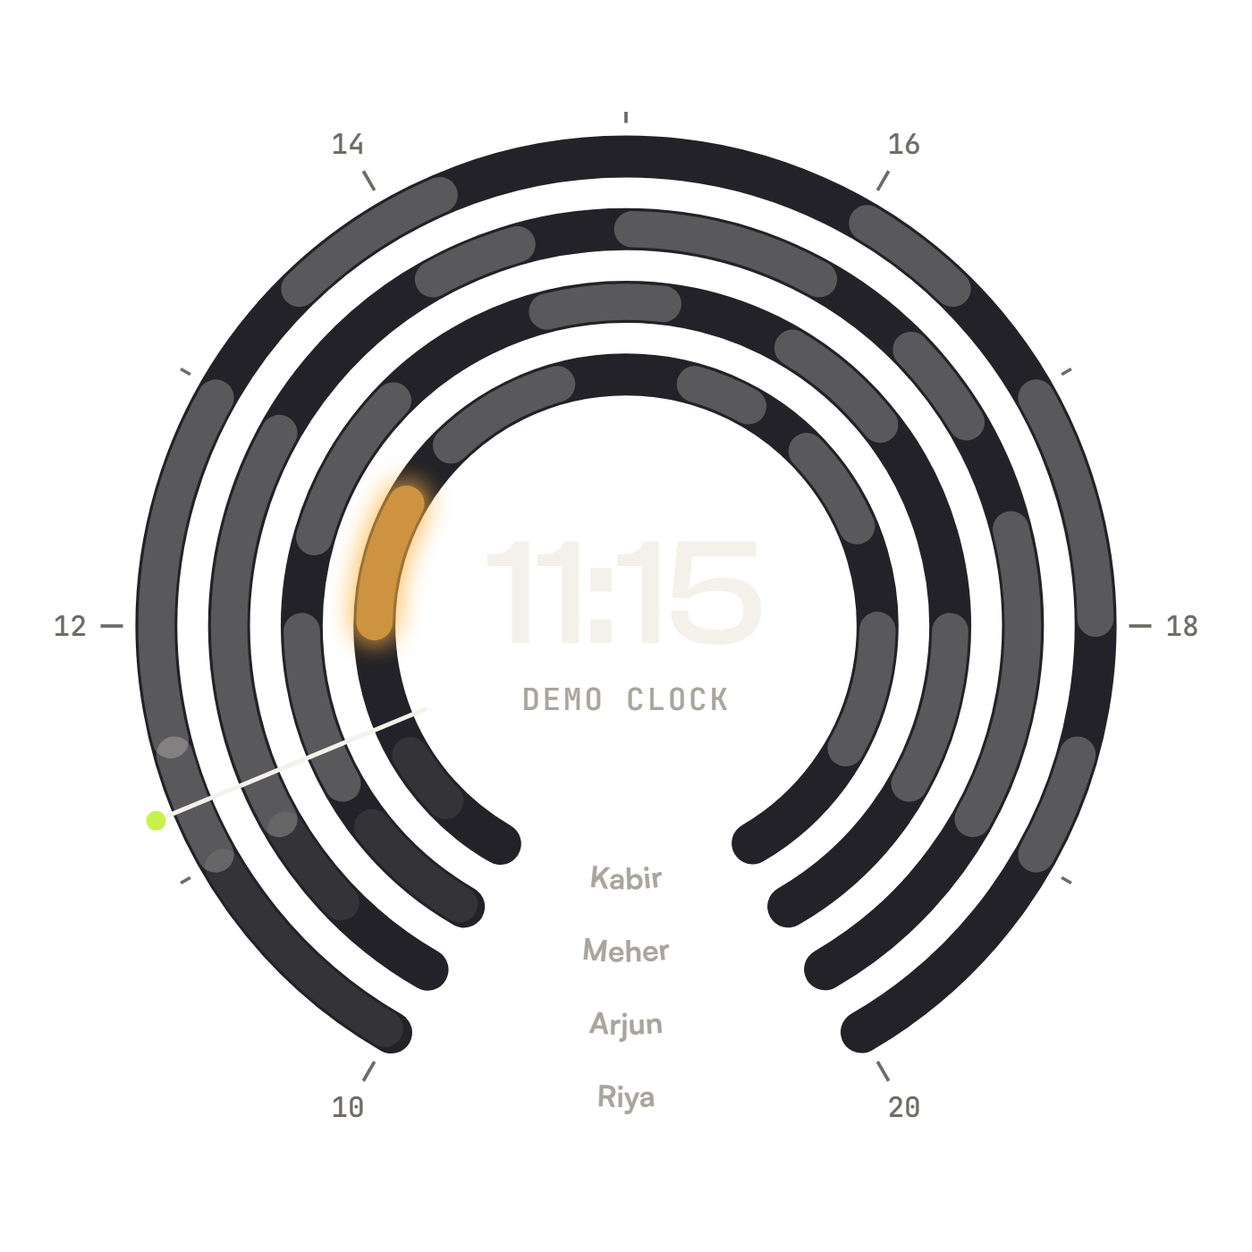
Refill
fillthechair.vercel.app
REFILL · APPOINTMENT RECOVERY DESK
Every cancelled
appointment,
filled again.
When a client cancels, Refill offers the time to the next person on the waitlist who fits it and said yes to messages. The first to accept gets it.
TEAM C29
B.TECH
Vedanth Raj TEAM LEAD
Dhruv Sonar · Parth Kachhara · Chirag Seervi
MBA
Parth Srivastava · Tushar Walia
Fynd × NMIMS Hyderabad · Product & Business Simulation · Case C29 · 18 October 2026
Notes:
Open on the promise: every cancelled appointment, filled again. The dial is the product's own view of a day: one ring per staff member, one arc per appointment; the amber arc is a cancelled slot waiting to be refilled. Introduce Team C29: B.Tech, led by Vedanth (team lead), with Dhruv, Parth K. and Chirag; MBA: Parth S. and Tushar.

Slide 2
01 · PRODUCT OVERVIEW
Refill Appointment Recovery Desk
Recover eligible cancellation slots without overbooking or contacting anyone who hasn't opted in.
PRODUCT
PRICE
Five-feature recovery desk:
cancellation visibility → waitlist match → consent gate → rebook → audit trail
₹499–₹699 / location / month
(hypothesis; willingness-to-pay to be validated with owners)
WHO
Salon / tutoring-centre owner + reception staff
WHAT
Convert eligible cancellations into confirmed bookings
WHERE
One-calendar pilot · Hyderabad beachhead
PLACE
PROMOTION
Founder-led local demo
One Hyderabad calendar pilot
Software/consultant referral later
Cancellation scenario demo
Recovered-contribution calculator
Consent + collision test proof
WHEN
Triggered at cancellation; outreach before slot expires
WHY
Unused capacity = lost contribution · Manual recovery wastes staff time
Fynd × NMIMS Hyderabad | Product & Business Simulation | Case C29 | 18 October 2026
Notes:
Refill does one narrow job: when a booking is cancelled, it fills the freed slot with someone who fits and has opted in, and it never overbooks. Walk the five Ws on the left, then the four Ps on the right.

Slide 3


02 · STP & BEACHHEAD
Solopreneurs Who Sell Their Time to High-Income Clients
SEGMENT
Independent salons, recurring appointments, service-duration constraints. Tutoring centres: adjacent, later.
PSYCHOGRAPHIC INSIGHT
BEACHHEAD: INDEPENDENT SALONS
"Rich people value time."
Sector
Independent salon · Recurring appts
TARGET
Owner-operated 1-location salon (3–15 staff). Recurring cancellations. Some waitlist demand. Hyderabad-first.
Footprint
One location · 3–15 bookable staff
End customers who book premium salons place high value on convenience — making a relevant, opt-in waitlist offer credible.
Cancellations
Recurring eligible · Measurable capacity
Waitlist
Customers willing to opt in
POSITION
Recovery-first, consent-first. Not a full salon ERP. Narrow job: fill eligible slots without overbooking or unauthorised outreach.
Constraints
Duration + staff skills capturable
Geography
One Hyderabad cluster first
P1 — Business side
P2 — Client side
OWNER + FRONT DESK · ECONOMIC BUYER & DAILY OPERATOR
OPTED-IN END CUSTOMER
Any appointment business: salons, clinics, tutoring centres, spas, studios.
Anyone who books time: a haircut, a physio session, a tuition class.
Low time
Fragmented records
Afraid of overbooking
Wants a relevant offer
Hates intrusive outreach
Front-desk multitasking
Stale waitlist
Competing requests
Controls consent
Fill a freed slot fast, never double-book, and see what was recovered.
Hear about an earlier slot only after saying yes; book it in one tap.
[HYPOTHESIS] Segmentation assumptions to validate through owner interviews and pilot.
Notes:
Two personas, not three, because Refill works for any appointment business, not only salons. P1 is the business side: the owner who pays and the front desk who uses it every day. P2 is the client side: the opted-in customer who receives offers. Keep the psychographic insight, STP and beachhead as the core of the slide.

Slide 4
03 · 5 FEATURES + GAP ANALYSIS
5 Main Features & Competitive Gap
01
02
03
04
05
Who-fits
matching
Consent
gate
One slot,
one booking
Offer
rules
Staff out &
rescheduling
Each waiting client is checked against the open slot: consent, staff skill, duration, availability. Fits listed in queue order; every skip shows its reason.
Yes / no / never asked: only yes is messaged. Checked when offers go out and again at booking. STOP withdraws every open offer at once.
The booking is decided inside the database under a lock. Two taps at the same instant: one booking, the other client keeps their place.
Offers held 15 min, then passed on. Max 3 offers per client a day. Under-2-hour cancellations flagged late. Mistakes undone. Owner sets every limit.
"I can't come in" withdraws that person's offers, holds their gaps and flags their clients. The desk moves them or sends a pick-a-time link.
6 FIT · 11 SKIPPED
TESTS C05 · C06 · C12
RACE: 8 TAPS → 1 BOOKING
OWNER → RULES
LIVE · FLOW-TESTED
MANDATORY CASE SCORING CHECKS (C29)
10 pts
60-min request cannot occupy a 30-min slot — duration hard-constraint before any outreach
PASS · LIVE
10 pts
Two competing requests for one slot → one confirmed booking + one waitlist entry (no duplicate)
PASS · LIVE
5 pts
Customer without contact consent is excluded from outreach — logged with reason
PASS · LIVE
GAP vs competitors (Fresha, Zenoti, Square): Existing platforms offer waitlists but do not expose auditable consent-state, duration-mismatch rejection, or slot-contention proof to the operator. Validate by demo before claiming.
Notes:
Five features that are built and live today, each with its proof. 1) Who-fits matching: the desk sees who fits and who is skipped, with a reason for every skip (in the demo, 6 fit and 11 are skipped). 2) Consent gate: only clients who said yes are ever messaged, checked twice; STOP withdraws everything. 3) One slot, one booking: decided in the database; 8 simultaneous taps give exactly 1 booking. 4) Offer rules: 15-minute hold, max 3 offers a day, late flag, undo; the owner controls the limits. 5) Staff out and rescheduling. The three case checks all pass live on the Proof page.

Slide 5
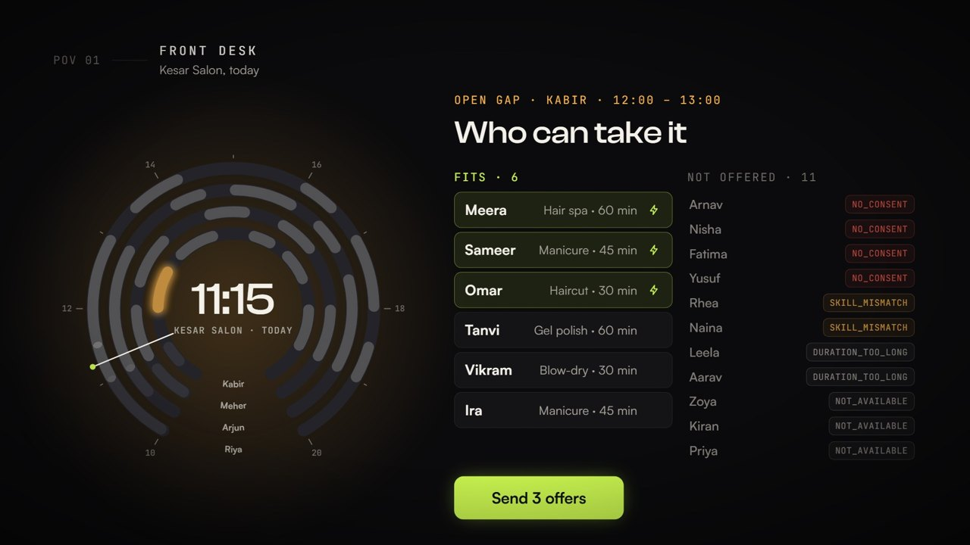
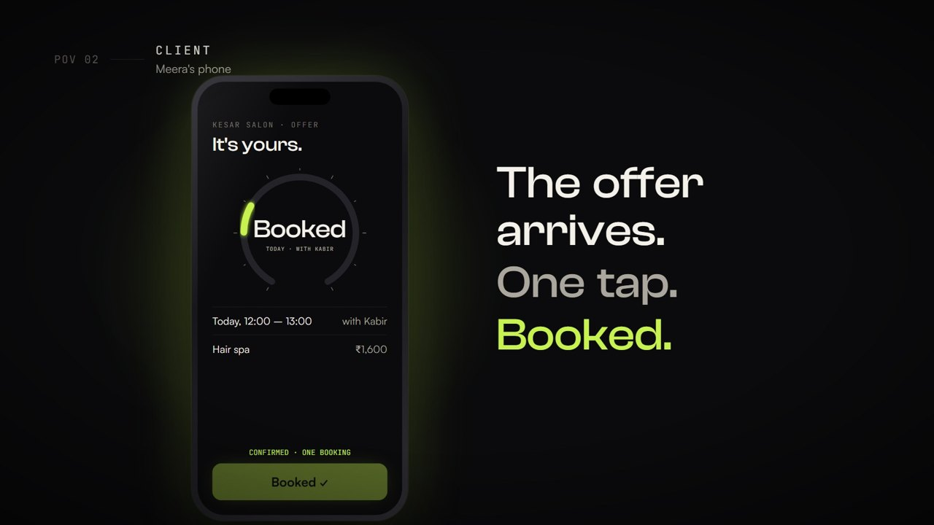
04 · ONBOARDING & DAY-TO-DAY
Onboarding + What Does a Day on Refill Look Like?
ONBOARDING · IN THE APP
1
Create account
2
Set up the business
3
Share the links
4
Set the rules
Email + password, then "I run a business".
Name and type, services (minutes, price), team and working hours. Any appointment business.
Front-desk login link, a private link per staff member, the client booking page + QR (yes / no to messages, never pre-ticked).
Offer hold 15 min · 3 messages per client a day · late if under 2 h · no offers inside 10 min. Owner can change all.
A DAY ON REFILL · FRONT DESK
Open Today
Client cancels
Who fits
Send offers
Client books
Slot refilled
Staff out?
The Day Dial: every staff ring, every booking; "needs you now".
Desk records it. The gap turns amber with ₹ at stake; late if under 2 h.
Fits in queue order; every skip with its reason.
One tap. Held 15 min; max 3 a day per client.
One tap on their phone. Two taps at once: one booking.
Lime on the dial; the owner sees ₹ recovered.
Their clients flagged; desk moves them or sends a link.
EVIDENCE TRAIL SAVED AT EVERY STEP
Every cancellation, offer (sent or skipped, with its reason), booking, expiry, move and undo is logged automatically. Export as CSV or JSON for the owner; live businesses archive each day into History.
FRONT DESK · WHO FITS
CLIENT · ONE-TAP BOOKING
Notes:
Onboarding is done inside the app: create an account, set up the business (services, staff, hours), share three links (front desk, staff, client booking page with QR), and set the rules. A day: the desk opens Today on the Day Dial; a client cancels and the gap turns amber; Refill shows who fits and who is skipped and why; one tap sends offers; the first client to tap Book gets it; the slot turns lime and the owner sees the money recovered. If a staff member is out, their clients are flagged and moved by the desk. Every step is logged and exportable.

Slide 6
05 · PRICING + EXPERIMENT
Pricing Hypothesis & 30-Day Experiment
WHY
₹699
UNIT ECONOMICS (ILLUSTRATIVE)
₹699 is an ANCHOR for owner discovery interviews — not a final list price.
Test at ₹499, ₹699 and ₹999. Concrete paid-pilot decision is the only real validation. Stated interest ≠ willingness to pay.
Price per location
₹699 / month (test ₹499–₹999)
/location/month
Cost to serve
Low: hosting + messages
CORE
Contribution margin
High, software-like
Core workflow + consent log
Service/staff constraints
Duplicate protection
Acquisition cost
Low early: founder-led demos
Payback
Within the first months
₹499
₹699 · ANCHOR
₹999
[HYPOTHESIS] Base price
Lifetime value
Rises with retention
Break-even
A few hundred active locations
VALUE FORMULA: Monthly recovered contribution = Completed recovered appts × Contribution/appt − Incremental messaging / platform / recovery costs
VOICE OF CONSUMER
- 5 consenting role-players · pseudonymous IDs
Example: At ₹500 contribution/service → need ~2 recovered bookings/month to justify ₹699 subscription after costs.
RP-01
RP-02
RP-03
RP-04
RP-05
[HYPOTHESIS] Price to be tested with owners; 5 role-players ≠ market validation of WTP.
Notes:
₹699 is an anchor for owner interviews, not a list price; we test ₹499, ₹699 and ₹999, and only a paid-pilot decision counts as validation. Unit economics in plain terms: the cost to serve one location is small (hosting and messages), so contribution per location is high, like most software; acquisition is cheap early because the founders demo in person; and the business breaks even at a few hundred active locations. The value formula shows why an owner pays: about two recovered bookings a month cover the subscription.

Slide 7
06 · GTM + FINANCIAL PROJECTIONS
Go-to-Market Strategy & Financial Projections
WEEK 1
Rule Verification
WEEK 2
Role-Player Test
WEEK 3
Owner Baseline
WEEK 4
Pilot + Proof
Pass all 3 case checks. Fix duration/consent/concurrency issues. Save evidence.
5 consented participants. Record approach, response, usefulness. No market-size conclusions.
Secure one salon permission. Capture cancellation volume and manual effort baseline.
Supervised one-calendar run. Measure fill rate, no-show, correction effort, contribution.
FINANCIAL PROJECTIONS
RISK MITIGATION · THE THREE STAR FEATURES
₹ Lakh | Year 1 | Year 2 | Year 3
Avg Locations | 50 | 250 | 800
Revenue | 4.19 | 20.97 | 67.10
Variable COGS | 0.60 | 3.00 | 9.60
Gross Profit | 3.59 | 17.97 | 57.50
Total OpEx (revised) | 15.00 | 27.00 | 49.00
EBITDA | -11.41 | -9.03 | +8.50
Duration & staff fit
Risk Wrong durations or skills entered at setup lead to wrong offers.
Fix Owner sets minutes per service; database re-checks fit at send and at booking; every skip shows its reason.
One slot, one booking
Risk A phone or walk-in booking outside Refill collides.
Fix Desk adds every booking in Refill; slot lock + unique index; daily log export to reconcile.
Consent
Risk A client withdraws consent through another channel.
Fix Client sets yes / no themselves (never pre-ticked); STOP withdraws all offers at once; consent time and source logged; 3-a-day cap.
Revenue = avg locations × ₹699 × 12 · COGS ₹100 / location / month
NORTH-STAR KPIS
Fill rate
Recovered ÷ eligible cancellations
Duplicates
Zero, tested + pilot
Consent
100%, zero post-withdrawal
Time-to-fill
Cancel → confirmed
Staff effort
Correction mins ↓ vs baseline
WTP signal
Paid-pilot commitment
SCALE ONLY WHEN: Zero critical safety failures · Measured fill rate + contribution · Concrete WTP decision · Repeatable at ≥ 2 locations
Notes:
GTM: four weeks, one gate each: prove the three rules, test with five consenting role-players, capture one owner's baseline, then a supervised one-calendar pilot.
FINANCIAL PROJECTIONS (illustrative; full reasoning in the presenter brief):
• Revenue = average active locations × ₹699 × 12. Y1 50 × 699 × 12 = ₹4.19 L; Y2 250 → ₹20.97 L; Y3 800 → ₹67.10 L.
• Average locations are an average across the year, net of churn. Y1 ≈ 8 net new locations a month (founder-led demos in one Hyderabad cluster, ending near 100); Y2 adds a second cluster and referral partners (≈ 25 a month); Y3 is channel-led (salon software consultants, associations).
• Market room: published estimates put India's beauty-salon market around USD 12.6 bn (2025) with roughly 3 lakh players and 13,000+ organised outlets. 800 locations is under 0.3% of all players, or about 6% of organised outlets.
• Variable COGS ₹100 per location per month covers its share of hosting, client messages (about 90 a month at roughly ₹0.12–0.25 each) and payment collection (about 2%). Gross margin ≈ 86%, in line with software.
• OpEx: Y1 ₹15 L for a lean team (founders on stipends, part-time engineering, demos, local marketing, compliance like DLT/GST); Y2 ₹27 L adds onboarding/support and sales; Y3 ₹49 L adds a second city team.
• Break-even: each location contributes ₹599 a month (₹7,188 a year); ₹49 L of Y3 OpEx needs about 682 average locations, so Y3 at 800 turns EBITDA positive (+₹8.50 L).
• Why an owner pays: an owner-reported industry survey (Fresha) found hair and beauty businesses lose about 7% of monthly revenue to cancellations; recovering two bookings a month covers ₹699.
• Biggest sensitivities: price (₹499 keeps Y3 negative at about -₹10.7 L; ₹999 makes it about +₹37 L) and churn (SMB software commonly loses 3–7% of customers a month; onboarding is the lever).
RISK MITIGATION: the three star features and how we keep them safe: wrong setup data (database re-checks fit twice, reasons shown); bookings made outside Refill (desk records all, lock + unique index, daily export); consent withdrawn elsewhere (client controls it, STOP clears all offers, logged with time and source).

