Slide 1
Using Terraform and Ansible to provision a HPC Cluster
Rik Kisnah rikesh@gmail.com
09-09-2021

Slide 2
Agenda
Introduction
Terraform and Ansible in the DevOps World
HPC in the Cloud
The love triangle – Terraform, Ansible and HPC
Demo

Slide 3
Introduction
Principal Engineer with more than ten years in Cloud Industry (Systems engineering/QA/Automation)
Disclaimer: I am here in a personal capacity. I don’t represent or speak behalf of current or previous employers
Based in Seattle
Avid reader of books and listener to audio ( I read about 2-4 books per month)
Favorite programming language is Python

Slide 4
Terraform
Terraform is a infrastructure as code
A hashicorp product which supports multiple cloud vendors – Oracle, AWS, Azure etc
  https://www.terraform.io/intro/index.html
Example of a simple snippet to launch a host
resource "oci_core_instance" "ubuntu_instance" {
# Required
availability_domain = data.oci_identity_availability_domains.ads.availability_domains[0].name
compartment_id = "<compartment-ocid>"
shape = "VM.Standard.E2.1"
source_details {
source_id = "<source-ocid>"
source_type = "image"
}
# Optional
display_name = "<your-ubuntu-instance-name>"
create_vnic_details {
assign_public_ip = true
subnet_id = "<subnet-ocid>"
}
metadata = {
ssh_authorized_keys = file("<ssh-public-key-path>")
}
preserve_boot_volume = false
}

Slide 5
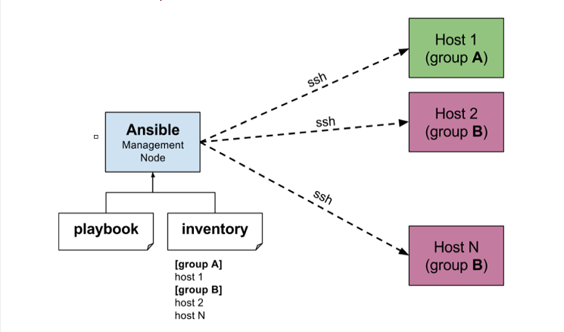
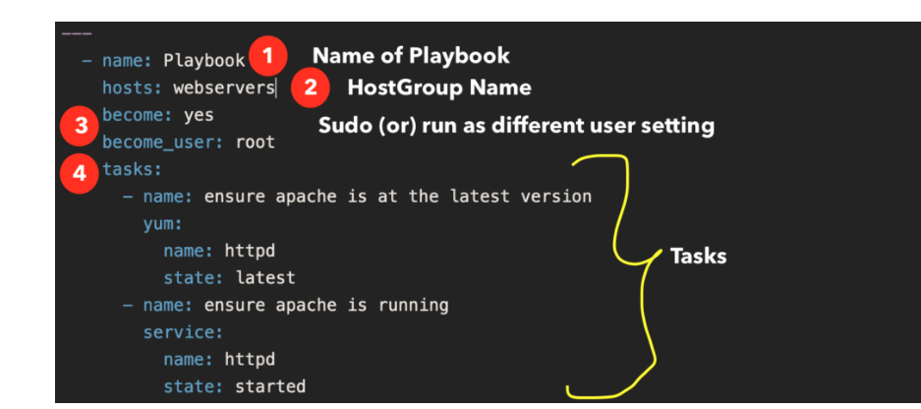
Ansible
Open Source redhat project that automates provisioning without the use of external agents (it uses SSH)

Slide 6
HPC in the cloud
High Power Computing is ability to process huge amount of data in a short span of time (uses in AI/ML/Big Data industries)
Vendors or on premise solutions configures hosts with special NICs (RDMA) or network (infiniband) to optimize latency
HPC Cloud providers provides multiple implementations – Infiniband(Azure), ROCEv1, ROCEv2 (OCI) .Uses RDMA NICs for networking (Mellanox)
Great whitepaper on HPC and RDMA
https://www.open-mpi.org/papers/euro-pvmmpi-2006-hpc-protocols/euro-pvmmpi-2006-hpc-protocols.pdf

Slide 7
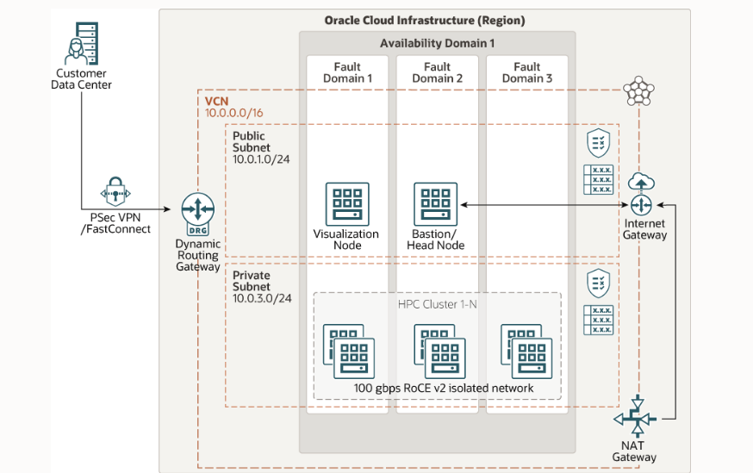
Example of HPC cloud provider
https://www.oracle.com/cloud/hpc/
https://docs.oracle.com/en/solutions/deploy-hpc-on-oci/index.html#GUID-FB8F3DC8-CA7B-47CE-85F6-426CE92B74A7
Provides a clusters of HPC host with and without GPUs on fast RDMA network

Slide 8
Terraform+Ansible=Cluster
Use Terraform to launch the cluster and a bastion
Use Terraform to set up ansible roles on the bastion
Use roles to set up the cluster in the the network
Set up packages / NFS / Slurm / NICs etc
Open source solution:
https://github.com/oracle-quickstart/oci-hpc

Slide 9
Demo
Show how to launch a cluster with the TF and Ansible
Ping a host on the RDMA network

Slide 10
Q&A

