Slide 1
Disease Prediction Toolkit using Machine Learning
Harshitha Somavarapu | Bootcamp Project

Slide 2
Dataset
- UCI Heart Disease Dataset (Kaggle)
- Features: age, sex, chest pain, BP, cholesterol, etc.
- Target: Heart Disease (Yes / No)
- ~300 samples

Slide 3
Models Used
- Logistic Regression
- Random Forest
⚙️ Preprocessing:
• Missing value handling
• Encoding categorical features
• Feature scaling
Pipeline: Data → Preprocessing → Model → Evaluation

Slide 4
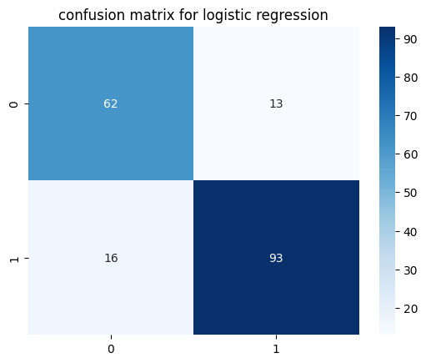

Results
- Logistic Regression Accuracy: ~84%
- Random Forest Accuracy: ~88%
📈 Random Forest performed best

Slide 5
Conclusion & Future Work
✅ Random Forest gave best accuracy & F1-score
✅ Useful workflow for healthcare ML projects
🔜 Future Work:
- Try Decision Tree, XGBoost, Neural Networks
- Hyperparameter tuning
- Larger, diverse datasets
Thank You

