Slide 1
DEVOPS
DEV OPS
Requirements
Deploy
Coding
Operate
Build
Monitor
Configure
Testing

Slide 2
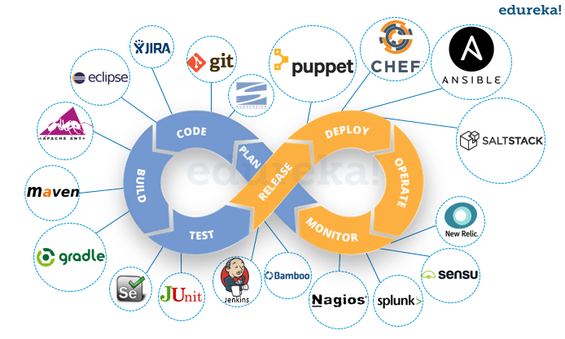
Devops

Slide 3
SDLC MODELS
1 . AGILE MODEL 2. WATERFALL MODEL

Slide 4
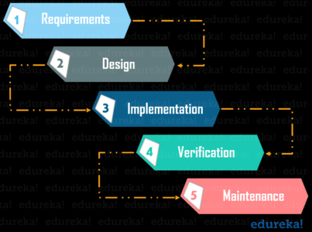
waterfall model

Slide 5
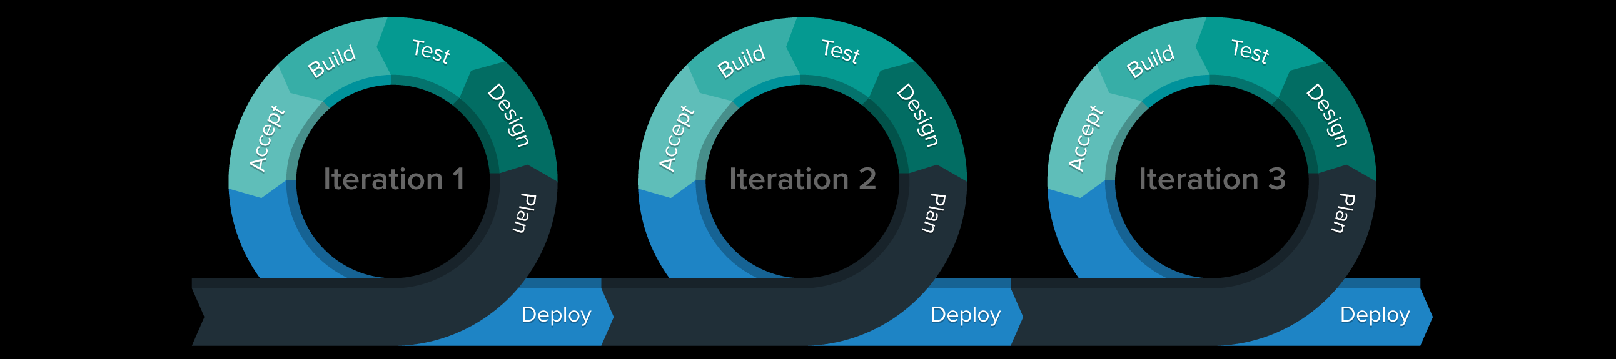
Agile model

Slide 6
Goals and advantages
1. Improve deployment frequency
2. Achieve faster time to market
3. Lower failure rates of new releases
4. Shorten lead time b/w fixes
5. Improve mean time to recovery.

Slide 7
DEVOPS ARCHITECTURE
CM
SERVERS
1
2
.
.
.
. 100
ANSIBLE
CHEF
PUPPET
PLANNING
DEPLOY
GIT
CODEBASE
OPERATE
SVN
INTEGRATION
MAVEN
BUILDING
MONITOR
ANT
NAGIOS
CI/CD
JENKINS
TESTING
JUNIT
SENSU
SEL

Slide 8
Svn
GIT
Centralized
Distributed
Central server
Remote server
D1
D2
D3
D1
D2
D3

Slide 9
Git Data flow
Remote repository
fetch
push
Local repository
Commit
clone
Index area
Checkout HEAD
Add
Working directory

Slide 10
GIT WORKFLOW
Commit- a
ADD
COMMIT
Staging area
push
WORKSPACE
INDEX
LOCAL REPO.
Remote repo.
Clone or pull or rebase
Checkout HEAD
Revert
fetch
Reset (un stage)
Diff HEAD
Compare
Diff

Slide 11
GIT Terminology
Branch -1
HEAD
Merge
master
Checkout
Branch-2
Commit id”s

