Slide 1
Global Sales Dashboard using Power BI
Insights from Global Superstore Data

Slide 2
Objective
• Provide actionable sales insights for stakeholders
• Identify trends, best-performing regions, and improvement areas
• Enable interactive filtering for decision-making

Slide 3
Dataset Details
• Source: Global Superstore Dataset
• 178K records, multiple regions & categories
• Key fields: Sales, Profit, Quantity, Category, Region, Market, Segment

Slide 4
Tools Used
• Power BI Desktop
• Power Query for data transformation
• DAX for measures and calculated columns
• Microsoft Bing Maps for geospatial visualization

Slide 5
ETL Process
• Data cleaning and transformation using Power Query
• Creation of calculated columns & measures using DAX
• Data model optimized for performance and interactivity

Slide 6
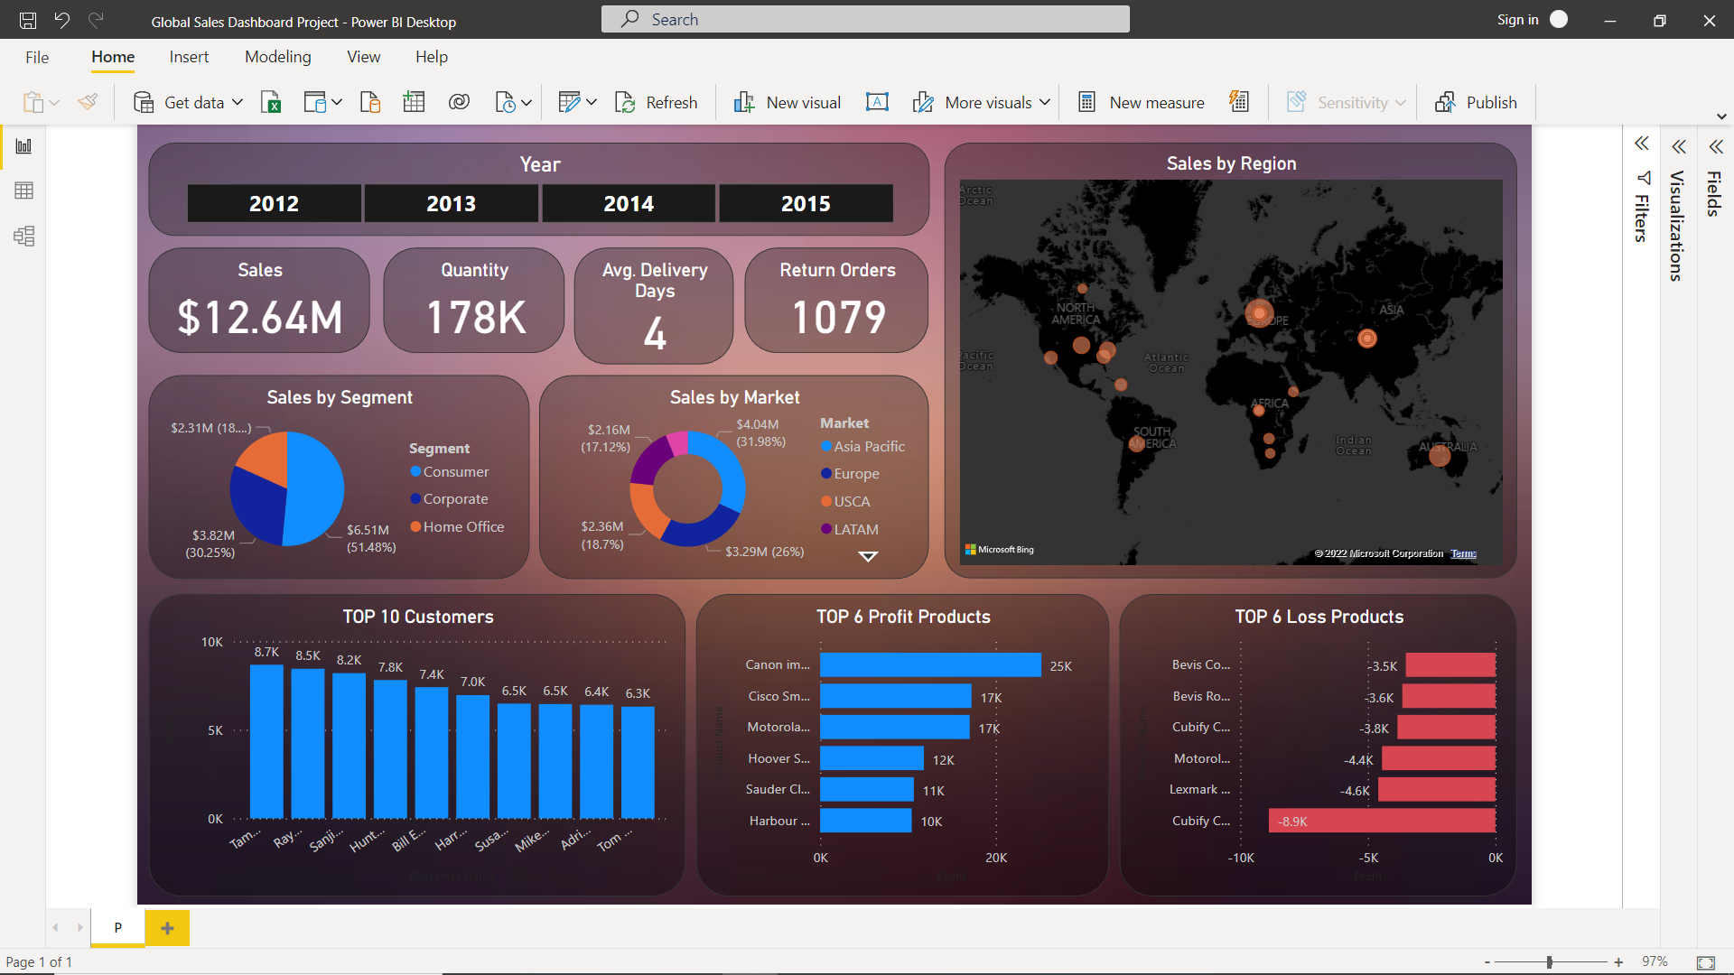
Dashboard Overview

Slide 7
Insights
• Total Sales: $12.64M | Quantity: 178K | Avg. Delivery Days: 4
• Highest Sales Segment: Consumer ($6.51M)
• Top Market: APAC ($4.04M)
• Most Profitable Product: Canon imageCLASS ($25K)
• Highest Loss Product: Cubify Cube ($-8.9K)

Slide 8
Business Recommendations
• Focus on high-profit products and top regions to scale revenue
• Investigate reasons for losses in identified products
• Optimize delivery operations to maintain or reduce average delivery time

Slide 9
Conclusion
• Dashboard provides a comprehensive view of sales performance
• Insights support data-driven decision making for sales growth
• Power BI enables interactive and real-time business intelligence

