Slide 1

A Literature Survey on Machine Learning Models for COVID-19 Prediction and Detection

Slide 2
Group Member Information
Gautham Reddy Tota – 700742570
Sireesha Poloju - 700740297
Sudheer Gajulapalli - 700741485

Slide 3
Role/Responsibilities and Contribution in project
Name | RESPONSIBILITIES AND CONTRIBUTION
Gautham Tota | Analyzing methodologies and outcomes of the research papers, Drafting a comprehensive literature review based on the analysis.
Sireesha Poloju | Organizing and summarizing the research papers, Analysis of common findings and conclusions and writing recommendations.
Sudheer Gajulapalli | Searching and collecting relevant literature, Identifying gaps in the current literature and potential future research areas.

Slide 4
Motivation
The COVID-19 pandemic has caused significant health and socio-economic challenges worldwide.
Researchers are relying on machine learning (ML) algorithms to address these challenges.
ML models are being used to predict and detect the presence of the virus, forecast the number of cases, and analyze potential outcomes.
This literature review aims to provide a comprehensive overview of the various ML models used for COVID-19 prediction and detection.
The review will examine the features and performance of these models to enhance our understanding of their potential applications in managing the pandemic.

Slide 5
OBJECTIVES
This literature review aims to:
Provide an overview of the ML models used in recent studies for COVID19 prediction and detection.
Compare the performance of different ML models.
Identify the most effective models for various applications, such as forecasting cases, predicting the severity of the disease, and detecting the presence of the virus.

Slide 6
RELATED WORK
Studies published between January 2020 and April 2023
IEEE Papers and ACM databases
Diverse ML models covered
Technique | Times Used
Random Forest | 9
Decision Tree | 8
Logistic Regression | 6
LSTM | 5
K-Nearest Neighbors | 5
Support Vector Machine (SVM) | 5
XGBoost | 2
CNN | 2
ARIMA | 3
Prophet | 2
AutoML | 2
Naive Bayes | 1
Autoencoder | 1
SVR | 1
Gradient Boosting Decision Tree (GBDT) | 1

Slide 7
PROBLEM STATEMENT
Understanding the performance and applicability of different ML models for COVID-19 prediction and detection is crucial for developing effective strategies to control the spread of the virus and mitigate its impact.
This review will provide valuable insights for researchers, policymakers, and healthcare professionals working on COVID-19 related projects.

Slide 8
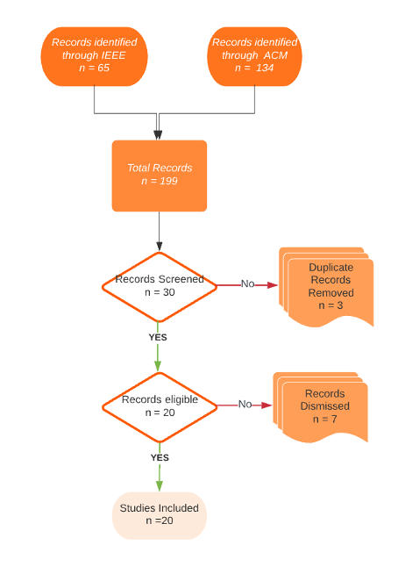
PROPOSED SOLUTION
Comprehensive literature review
Data Collection
Data Screening and Refinement
Performance comparison of various ML models
Evaluation of challenges and limitations

Slide 9
Results
XGBoost, LSTM, Random Forest, SVM, CNN, and AutoML as effective models
XGBoost Performance:
Effective in predicting COVID-19 existence. Highest accuracy of 99.3% in one study
LSTM Models:
Excellent performance in forecasting cases and detecting infections. Autoencoder and LSTM combination achieved 97.45% accuracy in detecting COVID-19 infection
Random Forest Models:
Successful in various COVID-19 applications like predicting the outcome. Best performance in some studies with accuracies ranging from 93.07% to 98.15%
Support Vector Machine (SVM) Models:
High accuracy in predicting and detecting COVID-19. SVM achieved the highest accuracy of 92.54% in one study

Slide 10
Conclusion
This literature review on machine learning techniques for COVID-19 prediction and detection has provided a comprehensive overview of the various models employed in recent studies.
The review covered models such as XGBoost, LSTM, Random Forest, SVM, and CNN, all of which demonstrated promising results for various applications related to the pandemic.

Slide 11
REFERENCES
[1] Bhandari S, Tak A, Gupta J, et al. Evolving trajectories of COVID-19 curves in India: prediction using autoregressive integrated moving average modeling [Preprint] Posted 2020 Jul 7. Research Square. c.
[2] E. Casiraghi et al., "Explainable Machine Learning for Early Assessment of COVID-19 Risk Prediction in Emergency Departments," in IEEE Access, vol. 8, pp. 196299-196325, 2020, doi: 10.1109/ACCESS.2020.3034032
[3] Ferdib-Al-Islam, Rayhan Robbani, and Md. Wali Ullah. 2022. COV-HM: Prediction of COVID-19 Patient's Hospitalization Period for Hospital Management Using SMOTE and Machine Learning Techniques. In Proceedings of the 2nd International Conference on Computing Advancements (ICCA '22). Association for Computing Machinery, New York, NY, USA, 25–33. https://doi-org.cyrano.ucmo.edu/10.1145/3542954.3542959
[4] F. Rustam et al., "COVID-19 Future Forecasting Using Supervised Machine Learning Models," in IEEE Access, vol. 8, pp. 101489-101499, 2020, doi: 10.1109/ACCESS.2020.2997311
[5] H. Turabieh and W. Ben Abdessalem Karaa, "Predicting the Existence of COVID-19 using Machine Learning Based on Laboratory Findings," 2021 International Conference of Women in Data Science at Taif University (WiDSTaif ), Taif, Saudi Arabia, 2021, pp. 1-7, doi: 10.1109/WiDSTaif52235.2021.9430233

Slide 12

Thank You

