Slide 1
CICP Online Course Content
Notes:
The below and following notes on the template slides are to guide you only. In your final presentation, you may delete these notes and add relevant notes if any.
Title slide:
Title – should not exceed beyond 3 lines, font size 30-34, Arial Headings
(Font size for the title of the PPT can vary between 30-34, Arial Headings, Bold depending on the amount of text, however should not be smaller than 30 font size)
Name should not exceed beyond 1 line, Designation; font size to remain at 18, Arial Headings
Please keep the title slide simple, just the logo, title and name and designation to appear. No other graphic elements or any design, photograph, image can be added to this slide, alignment to remain the same

Slide 2
HR &Tech Panel Guidelines
Notes:
Title slide with customer logo
Customer logo to be placed on the right
Use this slide if you need to create a presentation in conjunction/partnership with a
client/customer. Logo placement cannot be changed
Title should not exceed beyond 3 lines, font size 30-34, Arial Headings (Font size for the title of
the PPT can vary between 30-34, Arial Headings, Bold depending on the amount of text, however should not be
smaller than 30 font size)
Name should not exceed beyond 1 line, Designation should not exceed beyond 1 line , font size to
remain at 18,Arial Headings
Keep this slide simple just the logo, title, name and designation to appear.
No other graphic elements or any design, photograph, image can be added to this slide , alignment to remain the same

Slide 3
Course Content
1
Do’s & Don’t s
2
Attitude and Behaviors
3
Levels of Learning
4
STAR & Profile Score Card
5
Interview Opening & Closing
6
Sample Questions
Notes:
Agenda slide
Heading – Agenda - Font size 30, Arial Headings
Agenda points to be in Arial Body (font size 28)
Please restrict this slide with just 5 agenda points.
If you have more than 5 points on the agenda slide please add another slide.
If you have only 3 then you can use just one slide and delete the other 2 points.

Slide 4
Dos
DO greet the candidate and give a brief description about yourself and your role in WIPRO
DO explain the interview flow to the candidate and follow the same.
Don'ts
DON’T go into the interview without clarity on what to hire for?
DON'T ask questions candidates are going to lie to you about or share ideal responses to. Asking broad situational questions will give you better scope for assessment
DO ask Open Ended questions for the candidate to describe past behavior in similar situations
DO be consistent in asking the same questions to the candidate for the yardstick to measure the right hire for you.
DO acknowledge and set aside your own biases
DO coach your candidate to give you specifics on how they got those results. For example, ask something like, “I’m looking for a time when you demonstrated really good customer service.”
DO follow the STAR model to get concrete response from candidates( S-Situation, T-Tasks, A-Action, R-Result)
DON’T ask questions around futuristic situations or behavior, focus on the past.
DON’T be afraid to probe. Keep asking follow-up questions until you get a satisfactory understanding
Notes:
Title Heading – font size 30, Arial Heading

Slide 5
Candidate Measure
The only way to measure a candidate is to measure every single candidate with the same yardstick.
DO ask Open Ended questions. Behavioral interviewing is the key to hiring because it helps predict future success on the job by looking into past behavior. Thus, questions should be shaped to look at previous behavior – not potential behavior. A question that begins with “Tell me about a time when…” for example, is much more predictive than “What would you do if…” which tends to lead candidates to say what they think you want to hear, rather than give a real-life example that provides insight into their skills, personality and work ethic.
DO coach your candidate. Coach them to give you specifics on how they got those results. For example, ask something like, “I’m looking for a time when you demonstrated really good customer service.”
DO be consistent. Ask the same questions to every candidate. The minute you stop using the same yardstick, the yardstick doesn’t measure anything. You can’t find your right hire that way. (Follow up questions can be different.) Your candidates are smarter, they’re savvier, and they’re going to challenge your skills as a recruiter.

Slide 6
Candidate Measure
DO acknowledge and set aside your own biases. The time for evaluation comes later. The interview process is the time for gathering data. “Get out of your own way. “Get over your own biases, your own assumptions. Do not write someone off who doesn’t show up to an interview dressed in the way you might think is “proper.” “You never know where people are coming from. Maybe they’re coming from another job where the dress code is casual. These minor details don’t necessarily reflect the type of employee this candidate will be.
DON’T go into the interview without clarity. It’s crucial that you have a clear idea of what you want your end result to look like. Before interviewing any candidate, consider the following questions:
Why am I filling the job?
What do our customers need, require and expect?
What sort of person will fit best within this organizational culture?
What skills am I willing to train on, and what skills do I need to hire for?

Slide 7
Candidate Measure
DON’T tip your hand. Ask the questions first, and then talk about the job and the company. Don’t lead them. What you say and when you say it matters. Explain what the interview process is going to look like
DON’T be afraid to probe. Keep asking follow-up questions until you get a satisfactory understanding. Rephrase questions when required. For example, instead of asking, “Tell me about a time when you accomplished something,” ask, “When did something not go well?” You’ll see not only how people handle adversity but also what, to them, constitutes a problem.
DON’T waste your time. Don’t ask questions candidates are going to lie to you about. Questions like, “Are you planning on staying in the area?” or “Can you do (X thing)?” tell candidates what you want to hear. Asking big, broad questions will generate more telling, honest answers. For example, a question like, “Tell me about a time you had to deal with a difficult peer/classmate,” enables the candidate to tell you what they think a difficult peer/classmate looks like and how they handle adversity.

Slide 8
Desirable Attitudes
Making the student comfortable
Treating them with respect
Response Vs. Reaction
Check on what Candidate Knows and not what he does not know(Don’t Compete with Him)
Find Reason to Recruit and not Reason to Reject.
Notes:
Content Slide: This is usually the most frequently used slide in every presentation.
Use this slide for Text heavy slides. Text can only be used in bullet points
Title Heading – font size 30, Arial Heading
Slide Content – Should not reduce beyond Arial body font 16
If you need to use sub bullets please use the indent buttons located next to the bullets buttons in the tool bar and this will automatically provide you with the second, third, fourth & fifth level bullet styles and font sizes
Please note you can also press the tab key to create the different levels of bulleted content

Slide 9
Behavioral / Competency Based Interview
Standardized method of interviewing designed to measure how one will perform on the job.
The principle behind the technique is the belief that the best indicator of future behavior is past behavior.

Slide 10
Verify 6 Levels of Learning
Creating : Designing, constructing, planning, producing, inventing
Evaluating : Checking, hypothesising, critiquing, experimenting, judging Analysing : Comparing, organising, deconstructing, interrogating, finding Applying : Implementing, carrying out, using, executing Understanding : Interpreting, summarising, paraphrasing, classifying, explaining Remembering : Recognising, listing, describing, retrieving, naming, finding
Notes:
Image slide
The image slides help you represent the topic visually. There are 4
options you can choose from for an image slide.
Title font size 30, Arial Heading
Click on the icon to add image, the size of the image will be automatically determined once inserted
In the text box below the image the content should not exceed beyond 2 lines, font size – 24, Arial normal
* Do not alter the size of the image

Slide 11
STAR Method of Questioning
Follow the STAR method to get a concrete response from candidates:
A specific situation (S)
The tasks that needed to be done (T)
The action you took (A)
The results i.e. what happened (R)

Slide 12
Fresher Success Profile Scorecard
Knowledge
Competencies
Initiatives
Motivation & Values
Notes:
Column content slide
This is a slide with 2 columns and you can have text in bullet points under each column. You can have separate header for each of the columns in the blue box provided on top of each of the columns.
Heading font size of the column should remain at 30 and the column content font size should not reduce beyond 16.

Slide 13
Components of Fresher Success Profile
Area | Component | Definition
Knowledge | Knowledge of fundamental concepts | In-depth understanding of fundamental concepts of the subjects in curriculum
 | Application of knowledge/ Analytical & Problem Solving Ability | Good understanding of practical, everyday and industry applications of theory learnt in class and a logical, analytical approach towards obtaining solution to a problem through multiple means without being deterred.
 | Flair for Computer Programming | Has a good aptitude towards programming
Notes:
Full Size Image slide
The image slides help you represent the topic visually.
Click on the icon to add image, the size of the image will be automatically determined once inserted
Except an image do not add any content in this slide

Slide 14
Components of Fresher Success Profile
Area | Component | Definition
Competencies | Ability to communicate effectively | Communicates and relays information effectively with the team and others and ensures mutual understanding of the subject
 | Achievement Orientation | Follows through with plan of action manages obstacles to successfully achieve work objectives
 | Self Confidence/Energy | Establishes credibility in own role
 | Ability to work in teams | Understanding team dynamics and displaying the interest and ability to work in a team/Effective Team Player
Notes:
Full Size Image slide
The image slides help you represent the topic visually.
Click on the icon to add image, the size of the image will be automatically determined once inserted
Except an image do not add any content in this slide

Slide 15
Components of Fresher Success Profile
Area | Component | Definition
Motivation & Values | Adaptability & Flexibility | Ability to adjust to changing environments whilst maintaining effectiveness
 | Passion for learning/Willingness to Learn | Sustained energy and drive towards learning new concepts and enhancing knowledge
Initiatives | Co Curricular excellence | Achievements related to course curriculum
 | Extracurricular excellence | Achievements outside the course curriculum/Personal achievements
Notes:
Full Size Image slide
The image slides help you represent the topic visually.
Click on the icon to add image, the size of the image will be automatically determined once inserted
Except an image do not add any content in this slide

Slide 16
Components of Fresher Success Profile
Success Factors | Components | Maximum Score per Factor | Score Obtained | Comments
Knowledge | Knowledge of fundamental concepts | 10
 | Application of Knowledge/Analytical & Problem Solving Ability
 | Flair for Computer Programming
Competencies | Ability to communicate effectively | 10
 | Achievement Orientation
 | Self Confidence / Energy
 | Ability to work in teams
Motivation & Values | Adaptability & Flexibility | 10
 | Passion for learning / Willingness to Learn
Initiatives | Co Curricular excellence | 5
 | Extra curricular excellence
TOTAL |  | 35

Slide 17
Interview Opening and the Way Forward..
Read
The candidate CV and mark relevant items you want to question them.
Greet
Candidates warmly and offer a seat
Intro
Introduce yourself and allow initial few minutes to relax and build rapport
Queries
Proceed with the behavior based interview. Select a range of questions from the list provided. Ask similar questions to each candidate.
If you require further information from the candidate ask further questions until you are satisfied with the answer . Ensure that all questions are non-discriminatory
Proceed with the other standard questions as mentioned in the assessment form .
(for e.g. gaps in education, arrears/backlogs)
Notes:
Vertical Image slide - bullet text
Use this slide for a vertical image with bulleted text Text– font size 20, Arial Body
Click on the icon to add image, the size of the image will be automatically determined once inserted, do not alter the size of the image
In the text box on the right the font size should not be beyond 20, Arial normal, and ensure the maximum content used is aligned to the size of the image, content should not exceed beyond the size of the image

Slide 18
Interview Closing
End
Explain to the applicant that you are reaching the end of the interview
Invite
Invite relevant questions
On identifying a prospective hire, spend some more time with the applicant to leave a lasting impression about Wipro
Thank the applicant for attending the Wipro Hiring Process
Thank
Notes:
Vertical Image slide - bullet text
Use this slide for a vertical image with bulleted text Text– font size 20, Arial Body
Click on the icon to add image, the size of the image will be automatically determined once inserted, do not alter the size of the image
In the text box on the right the font size should not be beyond 20, Arial normal, and ensure the maximum content used is aligned to the size of the image, content should not exceed beyond the size of the image

Slide 19
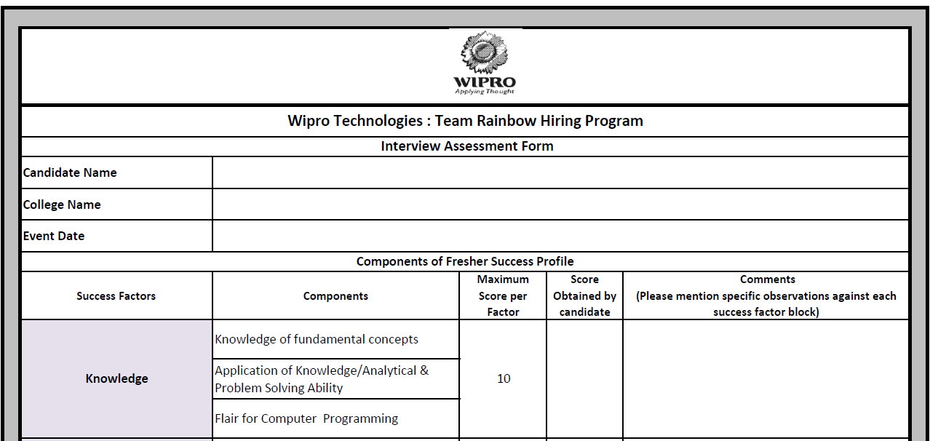
Interviewer Assessment Form

Slide 20
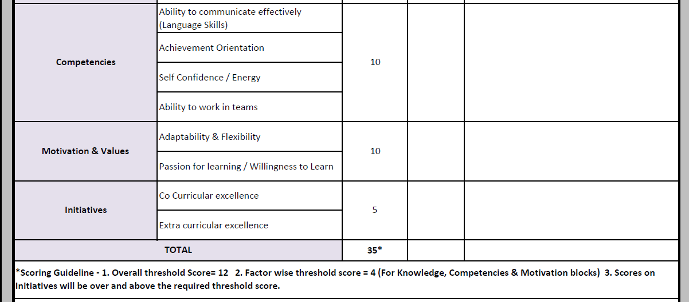
Interviewer Assessment Form

Slide 21
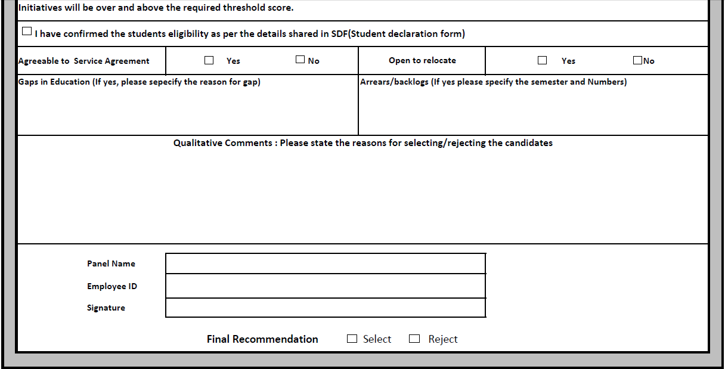
Interviewer Assessment Form

Slide 22
Sample Questions
Sample Questions
SI. No. | Questions | Primary Components covered
1 | How is the day going for you? How was the aptitude test? What is your reaction to the selection process so far? Have you also attended the processes conducted by other companies? What have you learnt about yourself from this experience? | Ability to communicate effectively
2 | Can you sum up the various courses you studied in the last 3-4 years? What did you enjoy studying the most and why? | Ability to Communicate effectively
3 | Questions from core subjects can be asked to test knowledge and willingness to learn | Passion for learning / Willingness to learn
4 | What do you know about "XYZ Concept"? (Panels to probe on this and ask few fundamental questions) | Knowledge of Fundamental Concepts
5 | Tell me some practical applications of this concept. Have you worked on any projects related to this particular concept? What books/journals have you referred on this concept? (In case they have done their project on some other concept they can be asked what kind of project would they like to pick on this topic. If the interest level on the topic seems to be superficial, they can be asked about other topics). | Application of Knowledge / Analytical & Problem Solving Ability / Co Curricular excellence / Passion for Learning
Initiatives *The four Competency Definitions have been taken from Our Competency Dictionary and the definitions are aligned to Project Stream>TRB/WASE competency expectations. For a more detailed list of indicators for each of the competencies, please refer to the notes shared in the reference section of this document. | Co Curricular excellence | Achievements related to course curriculum
 | Extracurricular excellence | Achievements outside the course curriculum/Personal achievements
Notes:
Horizontal image with bulleted text
Title – font size 30, Arial Headings
Click on the icon to add image, the size of the image will be automatically determined once inserted, do not alter the size of the image
In the text box below the bulleted text should not be beyond one line
Font size should be 20, Arial body normal and should not exceed beyond 4 bullet points

Slide 23
Sample Questions
6 7 | Which was the toughest assignment you worked on? What made it tough? (probe on what was expected from the assignment) What did you do to complete the task? What was the final outcome? Was there anything you would do differently if you had to do it again? | Application of Knowledge/Problem solving ability / Achievement Orientation
8 | Have you studied Programming languages? If yes, can you please write this brief program for me? | Flair for Computer Programming
9 | What are the standards followed while writing a basic program? | Flair for Computer Programming/Knowledge of fundamental Concepts
10 | Which subject is your least favourite? (as far as possible, pick a subject from college, not school). Why do you dislike it? What did you do to overcome it? | Adaptability & Flexibility
11 | Describe a difficult situation/circumstance you faced in the last couple of years. How did you handle it and what was the outcome? | Adaptability & Flexibility
12 | What kind of group assignments have you worked on? What are the types of activities you like to do with others and kind of activities you like to do on your own? Can you give an example of a group assignment you really enjoyed - what did you like about it? How did you distribute the work; what was your contribution? Why did you choose this part of the assignment for yourself? How much did the group and you score? | Ability to work in teams
13 | Tell me about an assignment/game/extra curricular activity where you had a disagreement with someone. What was it about and what action did you take to resolve it? | Ability to work in teams
14 | Which was your toughest semester in terms of workload and why? What did you do in this situation and how did you prioritize your tasks? | Achievement Orientation / Energy
Notes:
Title Heading – font size 30, Arial Heading

Slide 24
Sample Questions
15 | What is your favourite hobby/interest? Why do you like pursuing this hobby/interest? How much time do you invest in cultivating your hobby/interest? What satisfaction do you derive out of it? | Passion for Learning / Extracurricular excellence
16 | Tell me why you chose this particular college and stream for your graduation amongst others? One of the things you should know about is that during the course of your career with Wipro, you might be posted in a different location away from your hometown. This is beneficial both for the organization and for you. We believe that it gives you exposure to different kinds of projects and roles. Have you thought about this and do you have any questions to ask about it? | Adaptability & Flexibility
Notes:
Title Heading – font size 30, Arial Heading

Slide 25
Sample Technical Questions
Computer Science
What is the difference between white box, black box, and gray box testing?
How do you define a testing policy?
What is the difference between a defect and a failure?
Which test cases are written first: white boxes or black boxes?
What is the difference between latent and masked defects?
What's the difference between alpha and beta testing?
A defect which could have been removed during the initial stage is removed in a later stage. How does this affect cost?
What are the major data structures used in the following areas: RDBMS, Network data model and Hierarchical data model?
List few of the applications that make use of Multilinked Structures?
Does the minimum spanning tree of a graph give the shortest distance between any 2 specified nodes?
Distinguish between HTML and XML?
What is the latest version of DOTNET (.NET)?
What is the latest version of Oracle DBA?
What is the difference between intranet and extranet?
What is cloud?

Slide 26
Sample Technical Questions
Electrical Engineering
What is the difference between AC and DC?
Difference between Single Phase and 3 Phase power
What is inrush current?
In a tap changing transformer where is the tap connected?
Why transformer ratings are in KVA?
What is the difference between fuse and breaker?
Why electricity in India is in multiples of 11 like 11KV, 22KV, 33KV?
Why a ‘computer humming sound’ occurs in HT transmission lines?
Electronics Engineering
Distinguish between a tungsten bulb and a CFL bulb?
Distinguish - NAND gate and a NOR gate
Distinguish - analog signal and digital signal
Which is the latest Intel processor?
Name any 5 companies that design embedded systems?
What is the difference between RFID and Bluetooth ?
What is the difference between the image processing and pattern recognition?
UTMS v/s CDMA

Slide 27
Sample Technical Questions
Mechanical & Civil Engineering
What is the difference between diesel and petrol?
What is the difference between the dynamics and kinetics?
What is the difference between hatchback car and sedan car?
What is the difference between the centripetal force and the centrifugal force?
What is the difference between 2-stroke engine and 4-stroke engine?
What is the difference between atom bomb and hydrogen bomb?
What is thermodynamics?
What is a propeller?
What is the difference between RCC and Pre-stressed concrete
What are the different types of building foundations seen in practice

Slide 28
We believe, that you hire the “Best” Thank you
Notes:
Thank you slide with customer logo
Thank you slide with the customer logo:
Should have only the details shown here. Logo placement cannot be changed. Wipro logo to appear on the left as per our corporate guidelines.
Thank you– font size 30, Arial Headings
Name & Designation – font size 18, Arial Headings, not to exceed beyond 2 lines
Your/contact email id – font size 18, Arial Headings

