Slide 1
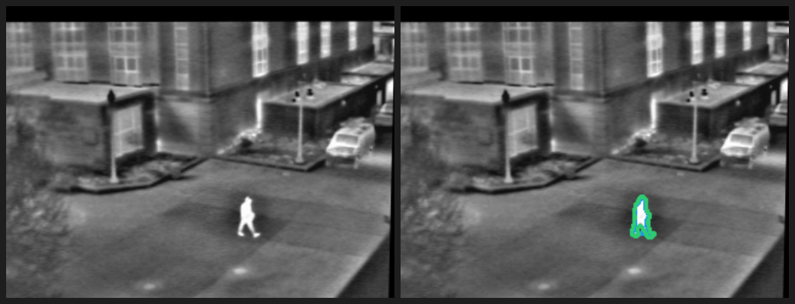
Finding a person across a video
Week 5 Challenge 1 | Inspired by Keynote 6
The problem
Finding the right moment often means scrubbing through the clip more than once.
Small, partially hidden people and low contrast make a person harder to follow across time.
Problem statement
Can a Video-LLM find when a person is visible and give a reviewer evidence to check?
Thermal person segmentation example from the previous computer vision assignment
Sirichandana Bikkasani | CSc 8830 Computer Vision
1 / 3
Notes:
NARRATION: “Reviewing a clip for one person can take several passes. First, someone has to find the person. Then they have to locate the moment they need. Small or partly hidden people make that search harder. The problem statement is: can a video language model identify an approximate time range when a person is visible and give a reviewer enough evidence to check the moment?”
The comparison image is a thermal person-segmentation example from the previous course assignment; it provides context for the problem. Keynote 6 is Fahad Khan’s “Towards Detailed Video Understanding in Generative AI Era.” Add one specific takeaway from watching the keynote in class before presenting. Sources: https://www.crcv.ucf.edu/cvpr2025-vidllms-workshop/program.html and https://www.crcv.ucf.edu/cvpr2025-vidllms-workshop/speakers.html

Slide 2
A natural-language query finds the moment
Video input | Time-grounded response | Human review
01
02
03
Video + query
Gemini 3.8 Flash
Timestamp + evidence
“When is the person clearly visible?”
The app accepts a short video.
The model reads the video and returns a time range with a brief description.
Replay the suggested moment and check the answer against the video.
Keynote 6 connection
Fahad Khan’s “Towards Detailed Video Understanding in Generative AI Era” explores text-conditioned spatiotemporal grounding. This prototype applies that idea to finding a person’s time span in a clip.
Sirichandana Bikkasani | CSc 8830 Computer Vision
2 / 3
Notes:
NARRATION: “Keynote 6 by Fahad Khan is titled ‘Towards Detailed Video Understanding in Generative AI Era.’ The workshop description focuses on detailed visual understanding and grounding video content from text queries. This prototype tests a narrower question: when is a person visible? The selected model is Gemini 3.8 Flash, which accepts video through its API. Gemini is the model choice for this prototype; the talk provides the inspiration. The app returns a time range and a short explanation for a person to review.”
Sources: https://www.crcv.ucf.edu/cvpr2025-vidllms-workshop/speakers.html and https://ai.google.dev/gemini-api/docs/video-understanding

Slide 3
Prototype and feasibility assessment
A deployed Streamlit app connects video input to Gemini
Prototype
Live demonstration
The web app accepts a video and a natural-language question. Gemini returns an approximate time range and a short description of the visible evidence.
Upload a short clip, enter the query, and review Gemini’s timestamped response in the browser.
Evaluation measure
Feasibility check
Timing difference = model start or end time minus the manually marked time. A reviewer also checks whether the person and described action match the clip.
Compare Gemini’s start and end times with a reference interval marked by watching the same clip. Record the timing difference and whether the response identifies the correct person and event.
The live run supplies the observed result for the presentation.
Sirichandana Bikkasani | CSc 8830 Computer Vision
3 / 3
Notes:
NARRATION: “The prototype is deployed as a Streamlit app. A user uploads a short clip, enters a question, and receives Gemini’s proposed time range and description. To check feasibility, compare the start and end times with an interval marked by watching the same clip. Record the difference in seconds and check whether the person and action match. I’ll show one example in the app now.”
DEMO: Select a clip under 20 MB, confirm permission to send it to Google, and choose Analyze video. After the answer appears, replace the bracketed values in the accompanying script with the actual timestamps and a brief comparison to the manual review. Do not infer general accuracy from one clip. Sources: https://ai.google.dev/gemini-api/docs/video-understanding and https://ai.google.dev/gemini-api/docs/pricing.

