Slide 1
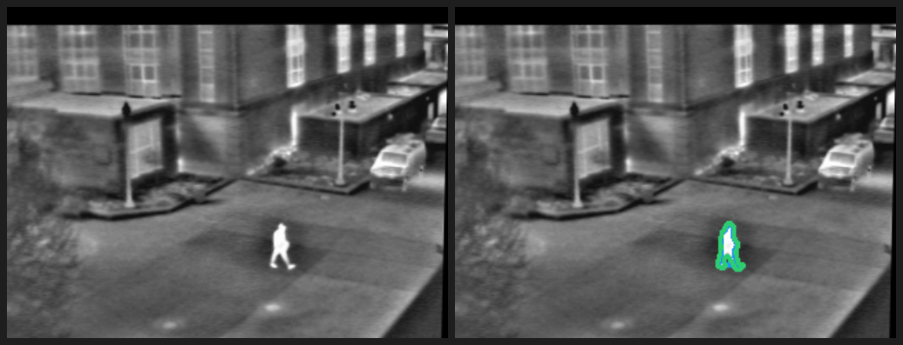
Finding a person across a video
Week 5 Challenge 1 | Inspired by Keynote 6
The problem
Finding the right moment often means scrubbing through the clip more than once.
Small, partially hidden people and low contrast make a person harder to follow across time.
Problem statement
Can a Video-LLM find when a person is visible and give a reviewer evidence to check?
Thermal person segmentation example from the previous computer vision assignment
Sirichandana Bikkasani | CSc 8830 Computer Vision
1 / 3
Notes:
NARRATION: “Reviewing a clip for one person can take several passes. First, someone has to find the person. Then they have to locate the moment they need. Small or partly hidden people make that search harder. The problem statement is: can a video language model identify an approximate time range when a person is visible and give a reviewer enough evidence to check the moment?”
The comparison image is a thermal person-segmentation example from the previous course assignment; it provides context for the problem. Keynote 6 is Fahad Khan’s “Towards Detailed Video Understanding in Generative AI Era.” Add one specific takeaway from watching the keynote in class before presenting. Sources: https://www.crcv.ucf.edu/cvpr2025-vidllms-workshop/program.html and https://www.crcv.ucf.edu/cvpr2025-vidllms-workshop/speakers.html

Slide 2
A natural-language query finds the moment
Video input | Time-grounded response | Human review
01
02
03
Video + query
Gemini 3.8 Flash
Timestamp + evidence
“When is the person clearly visible?”
The app accepts a short video.
The model reads the video and returns a time range with a brief description.
Replay the suggested moment and check the answer against the video.
Keynote 6 connection
Fahad Khan’s “Towards Detailed Video Understanding in Generative AI Era” explores text-conditioned spatiotemporal grounding. This prototype applies that idea to finding a person’s time span in a clip.
Sirichandana Bikkasani | CSc 8830 Computer Vision
2 / 3
Notes:
NARRATION: “Keynote 6 by Fahad Khan is titled ‘Towards Detailed Video Understanding in Generative AI Era.’ The workshop description focuses on detailed visual understanding and grounding video content from text queries. This prototype tests a narrower question: when is a person visible? The selected model is Gemini 3.8 Flash, which accepts video through its API. Gemini is the model choice for this prototype; the talk provides the inspiration. The app returns a time range and a short explanation for a person to review.”
Sources: https://www.crcv.ucf.edu/cvpr2025-vidllms-workshop/speakers.html and https://ai.google.dev/gemini-api/docs/video-understanding

Slide 3
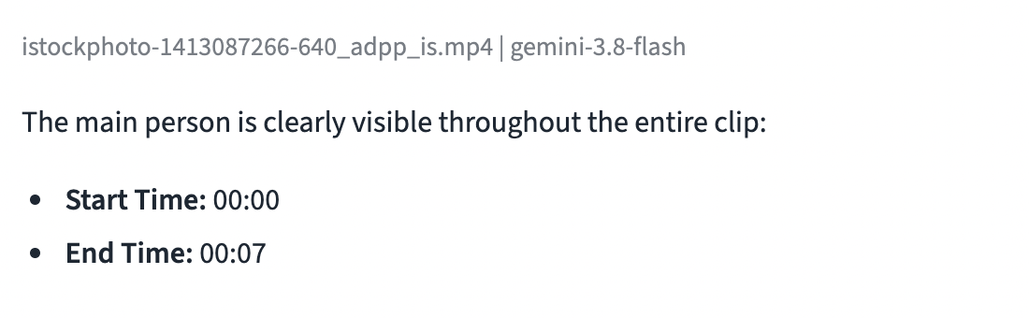
Prototype and feasibility assessment
A deployed Streamlit app connects video input to Gemini
Prototype
The web app accepts a video and a natural-language question. Gemini returns an approximate time range and a short description of the visible evidence.
Feasibility check
MODEL DESCRIPTION
Replay the clip and mark when the person first and last appears. Compare those times with Gemini’s answer, then check whether its description matches the video.
A worker checks the warehouse shelves and interacts with a tablet.
Timestamp error has not yet been measured.
The model returned a result; timing accuracy is not yet measured.
csc8830-week5-clipcheck.streamlit.app
Sirichandana Bikkasani | CSc 8830 Computer Vision
3 / 3
Notes:
NARRATION: “The prototype is deployed as a Streamlit app. A user uploads a short clip, enters a question, and receives Gemini’s proposed time range and description. On the seven-second warehouse clip, Gemini returned 00:00 to 00:07 and described a worker checking the shelves and interacting with a tablet. The response came back successfully. I still need to compare those boundaries with a manual review of the full clip before reporting a timestamp error. This one example demonstrates that the workflow is feasible; it does not establish general accuracy.”
DEMO: Show the successful result in the app. If time permits, replay the full clip and note the first and last frames where the target person is visible. Do not report a numeric timing error until that manual interval is recorded. Sources: https://ai.google.dev/gemini-api/docs/video-understanding and https://ai.google.dev/gemini-api/docs/pricing.

