Slide 1
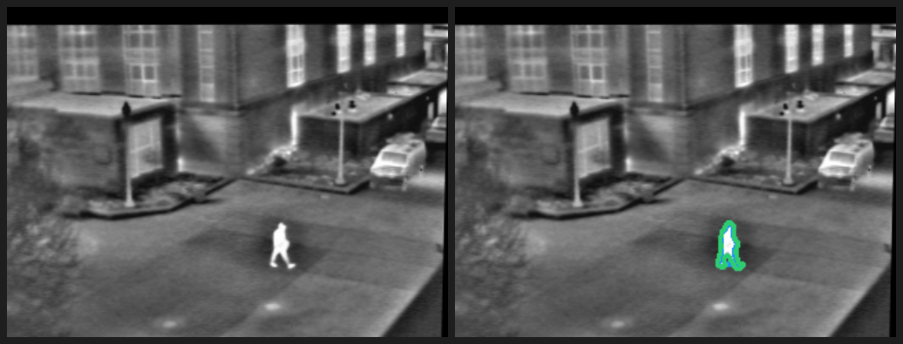
Finding a person in a video
Week 5 Challenge 1 | Inspired by Keynote 6
The problem
Finding the right moment can mean replaying and scrubbing through an entire clip.
This is especially frustrating when the person is small, partly hidden, or hard to distinguish from the background.
Question
Can a video model point to when a person is visible and give a reviewer evidence to check?
Example from my Module 4 project. This is a still image, not a Week 5 model result.
Sirichandana Bikkasani | CSc 8830 Computer Vision
1 / 3
Notes:
Keynote 6 is Fahad Khan’s “Towards Detailed Video Understanding in Generative AI Era.” The workshop description discusses detailed visual semantics and spatiotemporal grounding conditioned on text. That inspired this smaller question about finding a person in a clip. The image is from my Module 4 assignment and does not come from Gemini. Add a specific point from watching the keynote in class before presenting. Sources: https://www.crcv.ucf.edu/cvpr2025-vidllms-workshop/program.html and https://www.crcv.ucf.edu/cvpr2025-vidllms-workshop/speakers.html

Slide 2
Video question to reviewable answer
A small experiment in time grounding
01
02
03
Short video + question
Gemini 3.8 Flash
Reviewer checks
“When is the main person clearly visible?”
The app accepts a clip up to 20 MB.
Gemini analyzes the video and returns an estimated time range with a short explanation.
Replay the suggested moment and compare the answer with what is actually visible.
Keynote connection
Keynote 6 explores detailed video understanding and text-conditioned spatiotemporal grounding. This prototype tests a narrow version of that idea. It reports timestamps in text; it does not produce pixel-level grounding.
Sirichandana Bikkasani | CSc 8830 Computer Vision
2 / 3
Notes:
The selected model is Gemini 3.8 Flash because it accepts video input through the Gemini API. It is our implementation choice, not a claim about the model used in the keynote. The workshop page describes text-conditioned spatiotemporal pixel grounding; this prototype narrows the task to a text answer with approximate timestamps. Sources: https://www.crcv.ucf.edu/cvpr2025-vidllms-workshop/speakers.html and https://ai.google.dev/gemini-api/docs/video-understanding

Slide 3
Prototype and feasibility check
The app is built; one real API run is still needed
In the prototype
Current status
Upload a short clip, enter a question, and send both to Gemini. The app displays and lets you download the model’s text answer.
App flow and Gemini API call are implemented. A real response still depends on adding an API key and running a clip.
Limits to report
What to measure
20 MB upload limit. Timestamps are estimates. The app returns no person mask or exact pixel location. Video upload also requires internet and Gemini API access.
On one clip, compare Gemini’s estimated start and end times with a time range you mark by watching the video. Note whether the answer identifies the right person and misses any brief appearances.
Do not claim accuracy until you compare the answer with your own review.
Sirichandana Bikkasani | CSc 8830 Computer Vision
3 / 3
Notes:
The app code includes the Gemini API integration, but a live model response has not yet been captured because the user is creating an API key. Add the observed output and manual timestamp comparison after a real run. Do not present a fabricated result. Gemini API information: https://ai.google.dev/gemini-api/docs/video-understanding and https://ai.google.dev/gemini-api/docs/pricing. Assignment requires the student to watch Keynote 6 in class; add their own takeaway before submission.

