Slide 1

Automatic Medical Text Summarization Using NLP and Transformer Models
Under the guidance of
MR. NAGURLA MAHENDER
2203A51482 K. Pavani
2203A51039 B. Suma Sree
2203A51492 M. Siri Chandana
2203A51585 V. Nandhini
2203A51528 A.Laxmiprasagna
2203A51034 V. Bharrgawee

Slide 2

Introduction
Healthcare generates large volumes of biomedical text such as research papers and clinical records.
Manual analysis of these documents is difficult and time consuming.
Natural Language Processing (NLP) techniques help automatically summarize biomedical information.
This project applies transformer models to generate concise summaries from biomedical abstracts.

Slide 3
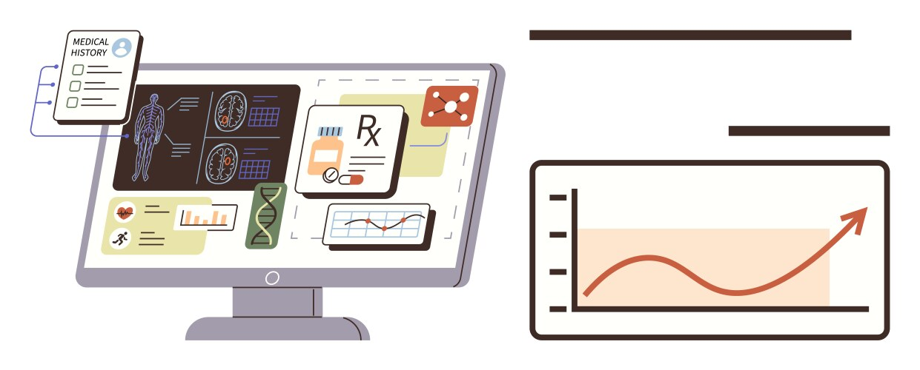
Abstract
Biomedical literature is growing rapidly making manual analysis difficult.
Transformer-based models such as T5, BioGPT and PEGASUS are used for biomedical text processing.
The system generates summaries from PubMed biomedical abstracts.
Performance is evaluated using Accuracy, Precision, Recall, F1-score and BLEU score.

Slide 4
Problem Statement
The rapid growth of biomedical publications makes extracting relevant medical information difficult and time-consuming. Doctors and researchers must analyze large volumes of clinical text to identify important findings. Therefore, automated biomedical text summarization systems are needed to generate concise and meaningful summaries.

Slide 5

Objectives
Develop an automated biomedical text summarization system.
Evaluate the T5, BioGPT and PEGASUS models using Accuracy, Precision, Recall and F1-score.
Compare the performance of different transformer models.

Slide 6
Literature Review
• Previous research shows that transformer-based models significantly improve performance in text summarization tasks.
• Models such as BERT, T5, BART, and PEGASUS have been widely used for biomedical text summarization.
• Domain-specific pretrained models help better understand complex biomedical terminology and medical context.
• Studies indicate that PEGASUS performs well in abstractive summarization due to its Gap Sentence Generation training objective.
• T5 architecture converts NLP tasks into a unified text-to-text framework, improving flexibility across multiple language tasks.
• Research also highlights that transformer models outperform traditional extractive summarization methods in biomedical applications.

Slide 7
Dataset Description
• The dataset used in this project is the PubMed Multi Label Text Classification Dataset.
• It contains biomedical research abstracts and medical text collected from PubMed publications.
• Each record includes scientific abstracts along with multiple biomedical category labels.
• The dataset contains domain-specific medical terminology and complex sentence structures.
• It is widely used in biomedical Natural Language Processing (NLP) research for text classification and summarization tasks.
• The dataset was preprocessed using normalization, tokenization, and noise removal before applying the transformer models.

Slide 8
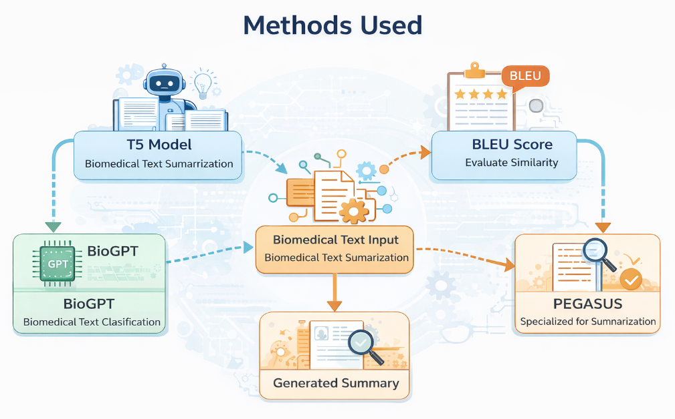
Methods Used
T5 Model – used for biomedical text summarization.
BioGPT – used for biomedical text classification.
BLEU Score – used to evaluate similarity between generated summaries and original text.
PEGASUS – transformer model specialized for summarization.

Slide 9
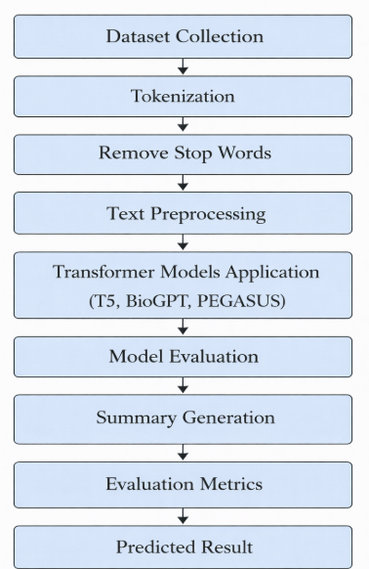
Methodology
Input biomedical abstracts from PubMed dataset.
Apply preprocessing such as text cleaning and tokenization.
Generate summaries using transformer models.
Evaluate summaries using evaluation metrics.

Slide 10
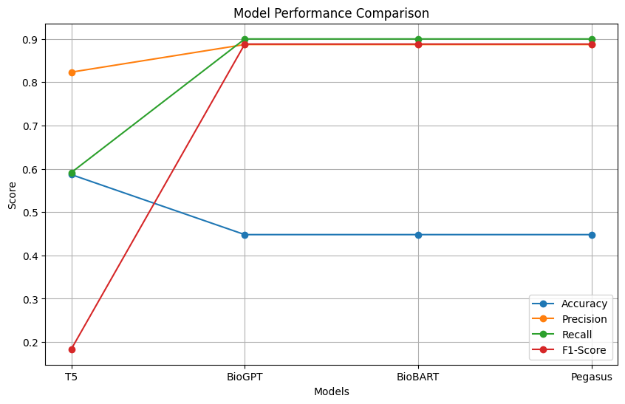
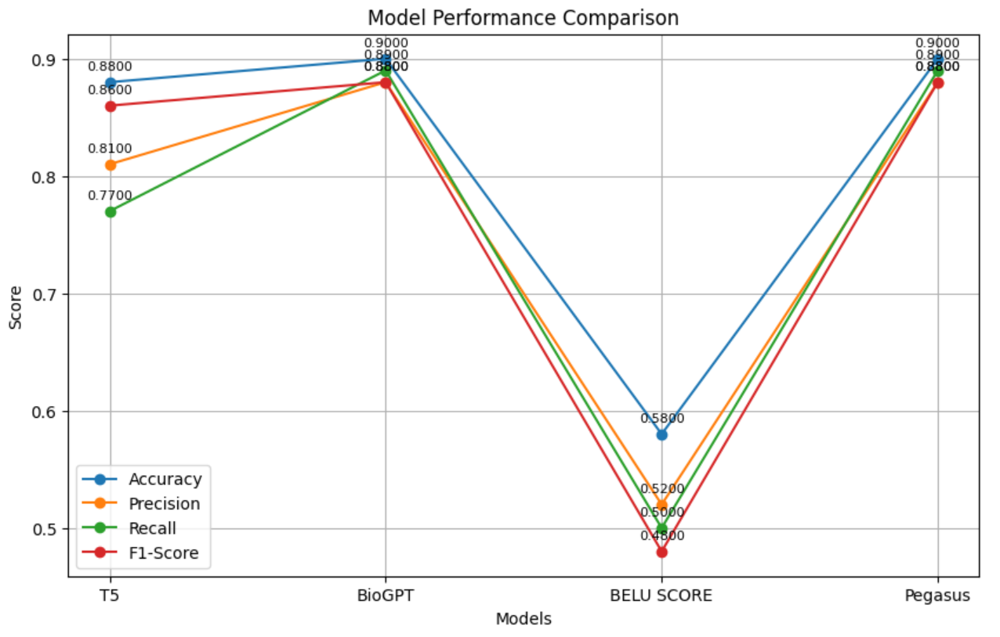
Results and Comparison
• Transformer models were evaluated for biomedical text summarization and classification.
• The T5 model generated concise summaries while preserving contextual information.
• BioGPT effectively classified biomedical texts using domain-specific knowledge.
• BLEU score was used to measure similarity between generated summaries and reference texts.
• PEGASUS produced the most accurate and informative summaries.
• Overall, PEGASUS performed better than the other models.

Slide 11
Output
• The system takes a biomedical abstract as input from the PubMed dataset.
• The transformer model processes the abstract after text preprocessing and tokenization.
• The model generates a short and meaningful summary of the biomedical text.
• The generated summary preserves important medical information and context.
• The output helps doctors and researchers quickly understand key findings from biomedical documents.

Slide 12
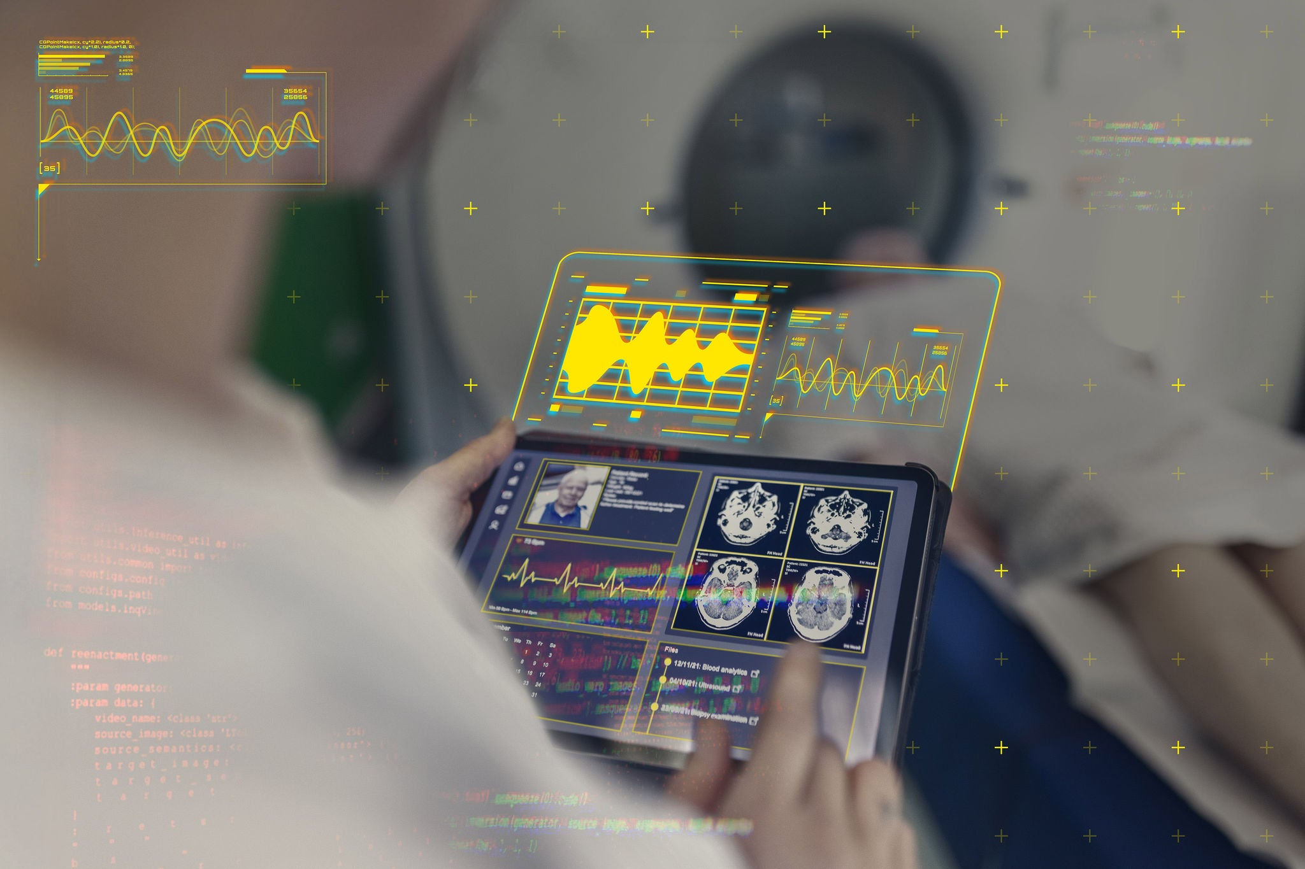
Conclusion
• This project developed a biomedical text summarization system using transformer models.
• Evaluation metrics were used to analyze the performance of the models.
• Among the models tested, PEGASUS showed the best performance in summarizing biomedical texts.
• The approach demonstrates the effectiveness of transformer-based models for biomedical NLP applications.

Slide 13
Future Scope
• The model can be improved by training on larger biomedical datasets for better accuracy.
• Advanced domain-specific medical knowledge graphs can be integrated to improve summary quality.
• The system can be applied to electronic health records (EHR) and clinical reports for real-time analysis.
• Future work can focus on developing real-time medical decision support systems using NLP.

Slide 14
THANK YOU..

