Slide 1
Examination Results dashboard(Example for CRUD operations)
K.SiriChandana

Slide 2
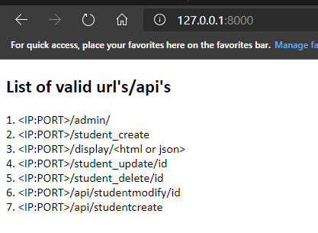
Root page(IP:PORT)
Ex url: http://127.0.0.1:8000/
This page contains the list of valid URL’s/API’s as shown below.

Slide 3
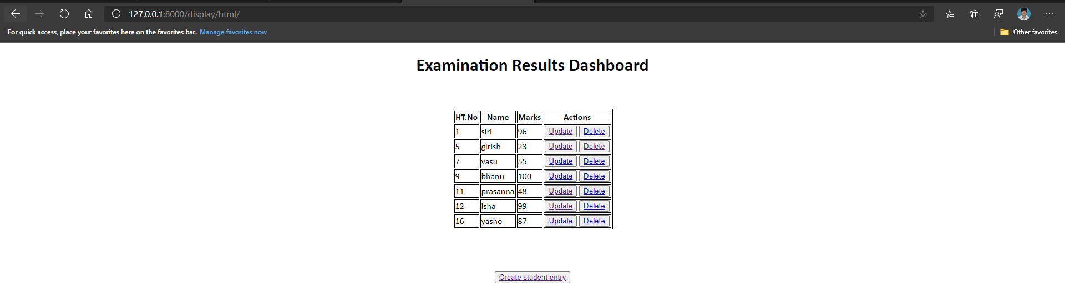
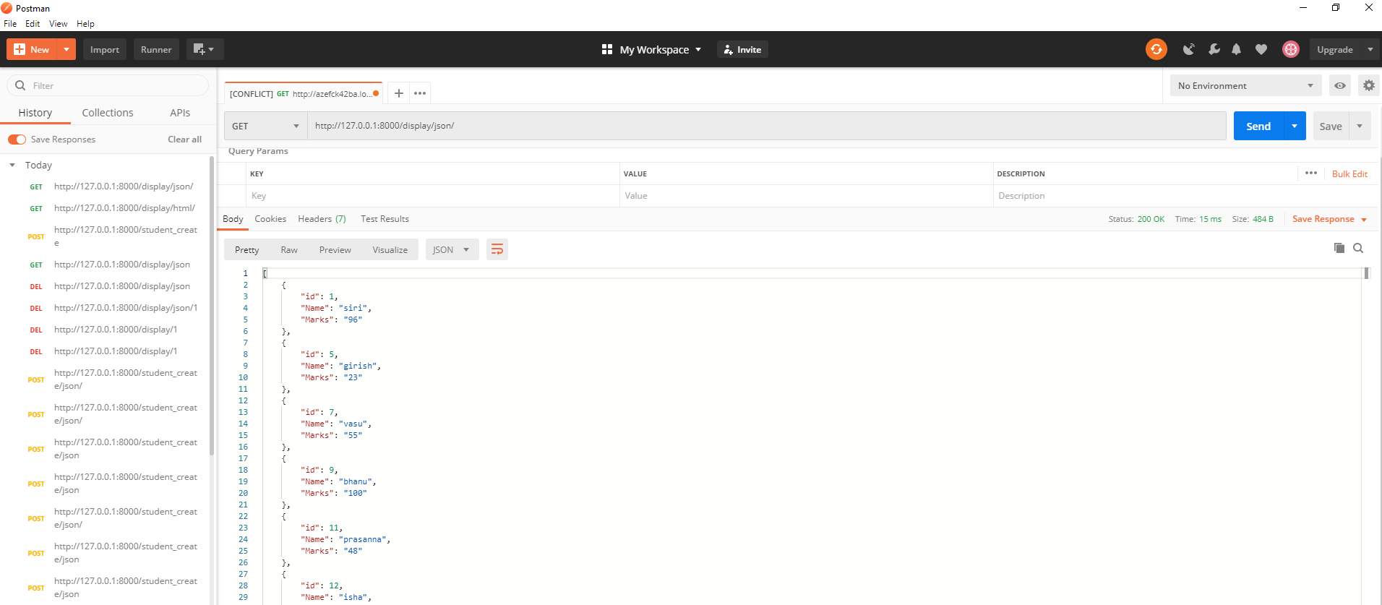
http://127.0.0.1:8000/display/<html or json>

Slide 4
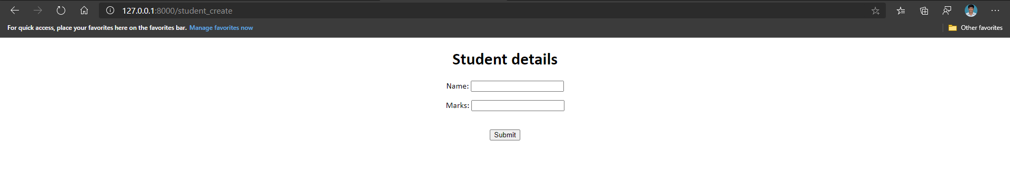
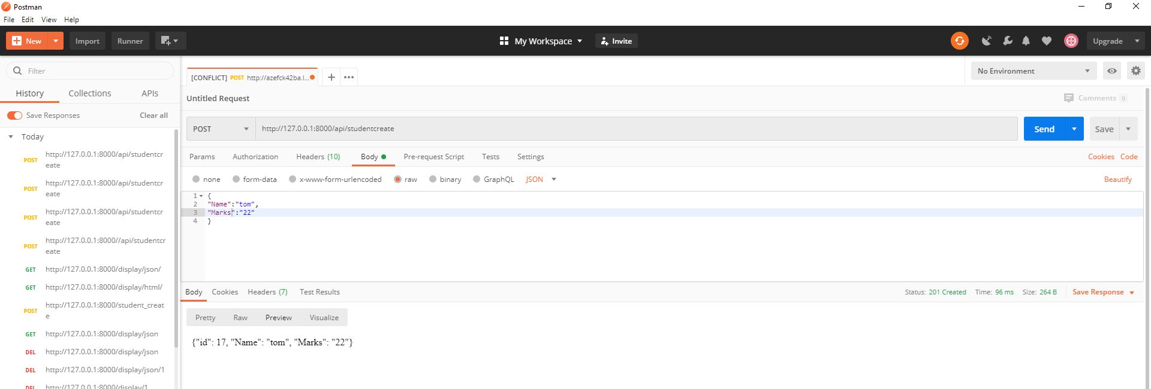
http://127.0.0.1:8000/student_create & http://127.0.0.1:8000/api/studentcreate

Slide 5
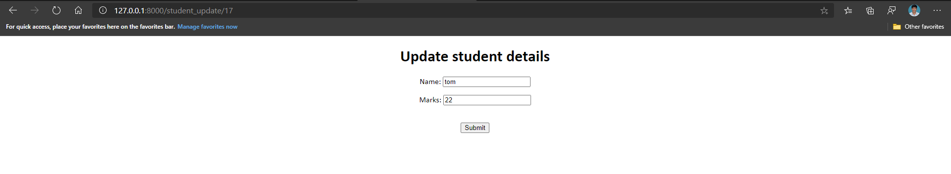
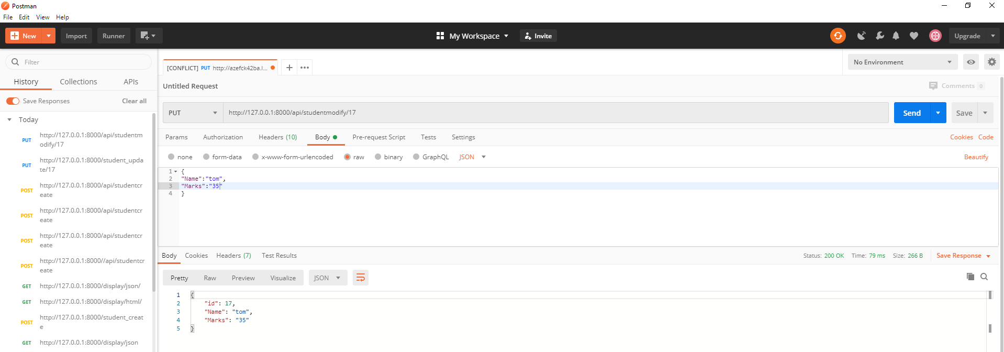
http://127.0.0.1:8000/student_update/id & http://127.0.0.1:8000/api/studentmodify/id

Slide 6
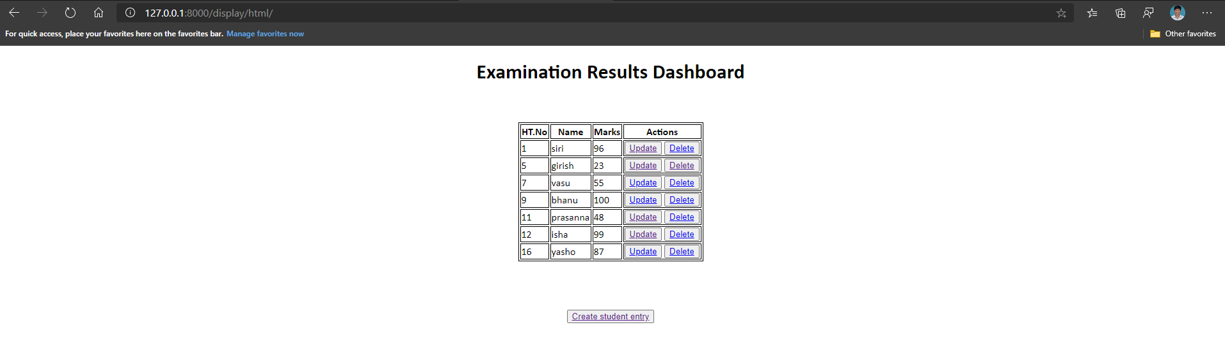
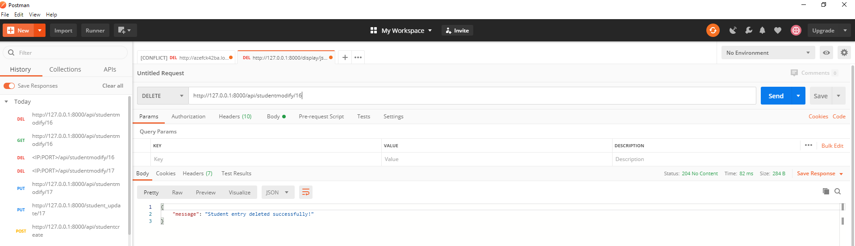
http://127.0.0.1:8000/student_delete/id & http://127.0.0.1:8000/api/studentmodify/id
Note: After
successful deletion, it
Will automatically
Redirect to display page

