Slide 1
BLUESTOCK MUTUAL FUND ANALYTICS
End-to-End Analytics Project
ETL • EDA • Performance • Power BI • Advanced Risk Analytics

Slide 2
Problem and Objectives
Build a reproducible mutual-fund analytics pipeline from raw CSV data to decision-support dashboards.
Measure return, risk, Alpha/Beta, drawdown and composite fund scores across 40 schemes.
Analyze investor behavior, SIP trends, AUM, folios, category flows and portfolio concentration.
Deliver an interactive Power BI dashboard plus a professional report and presentation.

Slide 3
Data Sources and Project Scope
10 processed datasets: fund master, NAV, AUM, SIP inflows, category inflows, folios, performance, transactions, holdings and benchmarks.
Scope: 40 schemes, 46,000 NAV observations, 32,778 investor transactions and NIFTY benchmark series.
Data period is primarily 2022–2025/May 2026 depending on dataset.
Live NAV ingestion is supported through MFAPI.

Slide 4
ETL and Data Architecture
Raw CSVs → cleaning/validation → processed CSVs → SQLite analytical layer → notebooks → Power BI dashboard.
AMFI codes provide the fund-level key; dates provide the time-series key.
Validation includes duplicate removal, date parsing, positive NAV/amount checks and scheme-code consistency.
Data-quality limitations are documented rather than hidden.

Slide 5
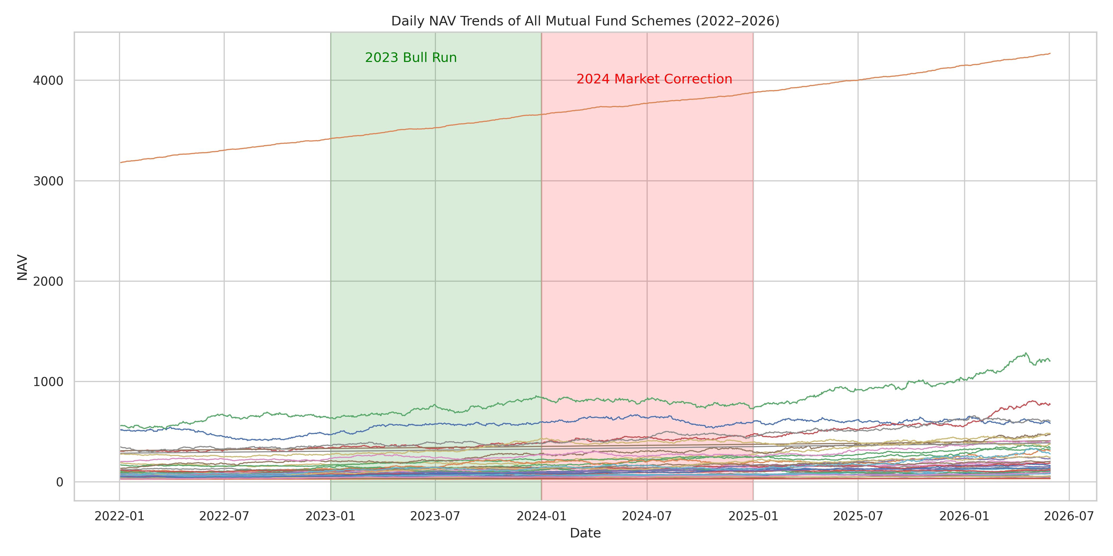
EDA Highlights — NAV and AUM
40 schemes are tracked in the supplied NAV history.
SBI is the largest fund-house AUM snapshot in the supplied data.
Daily NAV analysis provides the base for return and drawdown calculations.

Slide 6
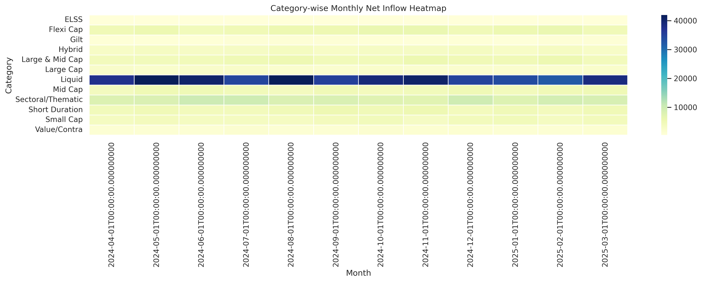
EDA Highlights — SIP, Investors and Folios
SIP inflow peaks at ₹31,002 crore in Dec 2025.
Folios rise from 13.26 Cr to 26.12 Cr.
Investor views include age, gender, state and T30/B30 segmentation.

Slide 7
Fund Performance Metrics
Daily returns: NAV_t / NAV_t-1 − 1.
Sharpe: excess return divided by daily-return volatility, annualized with √252 and a 6.5% risk-free proxy.
Sortino uses downside volatility from negative-return days.
Alpha/Beta: OLS regression against NIFTY 100 using scipy.stats.linregress.
Maximum drawdown is the minimum NAV decline from the running peak.

Slide 8
Fund Scorecard
Rank | Fund | 3Y CAGR | Sharpe | Alpha | Score
1 | ICICI Pru Midcap Fund - Regular - | 31.8% | 1.19 | 28.4% | 84.50
2 | Axis Midcap Fund - Regular - Growt | 35.1% | 1.01 | 23.1% | 81.25
3 | Mirae Asset Large Cap Fund - Regul | 34.0% | 1.46 | 25.9% | 80.50
4 | HDFC Mid-Cap Opportunities Fund - | 32.4% | 1.10 | 25.3% | 80.00
5 | Kotak Flexicap Fund - Regular - Gr | 29.6% | 1.32 | 21.9% | 75.75

Slide 9
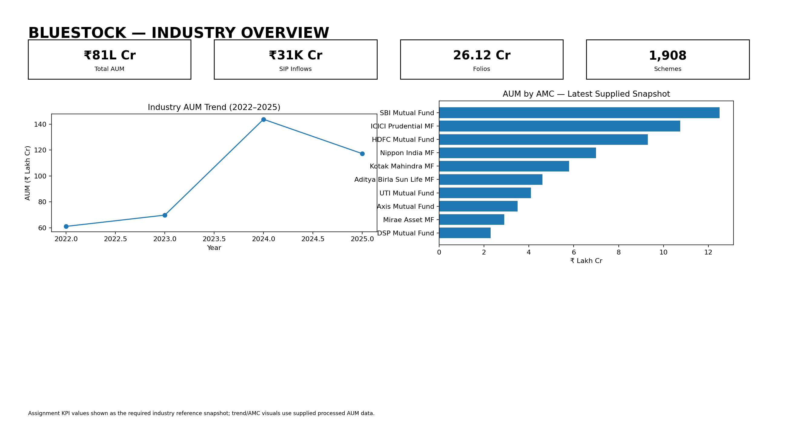
Dashboard — Industry Overview

Slide 10
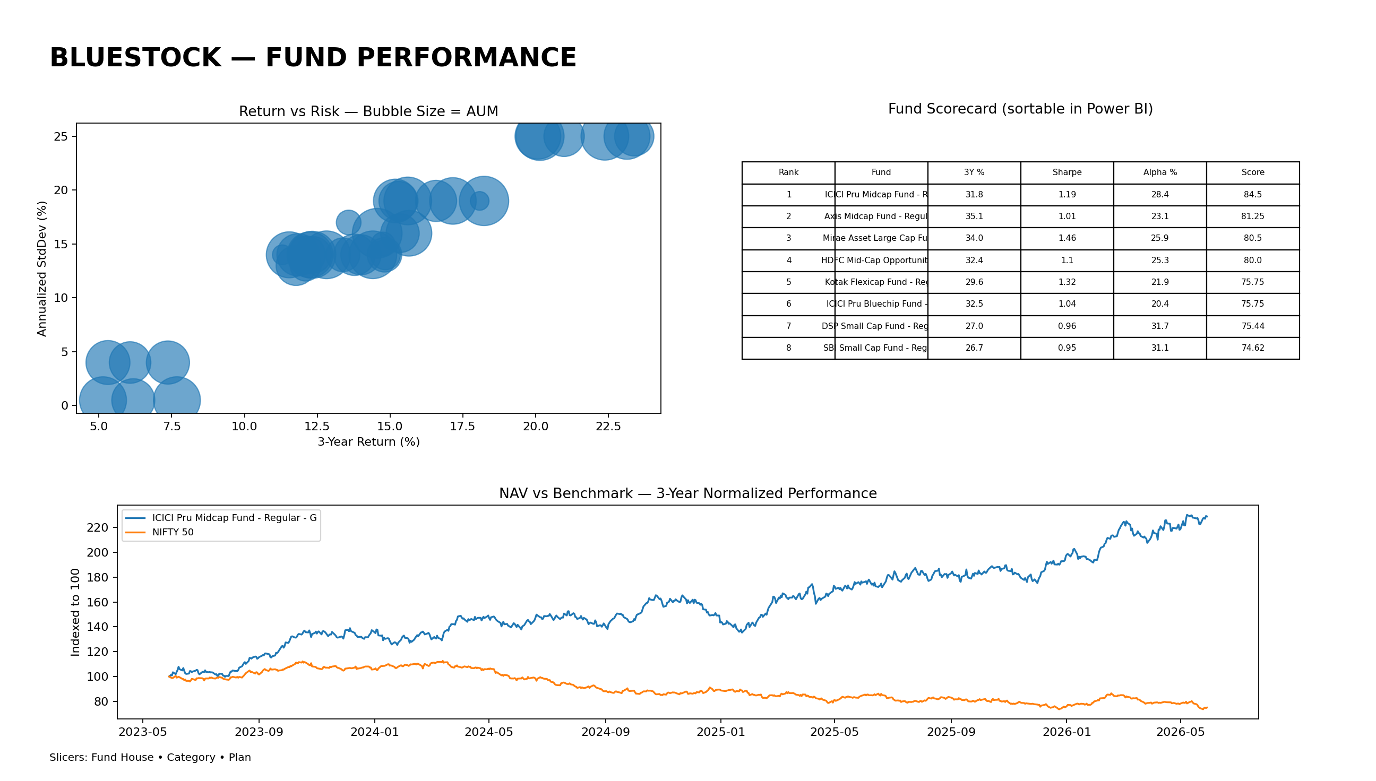
Dashboard — Fund Performance

Slide 11
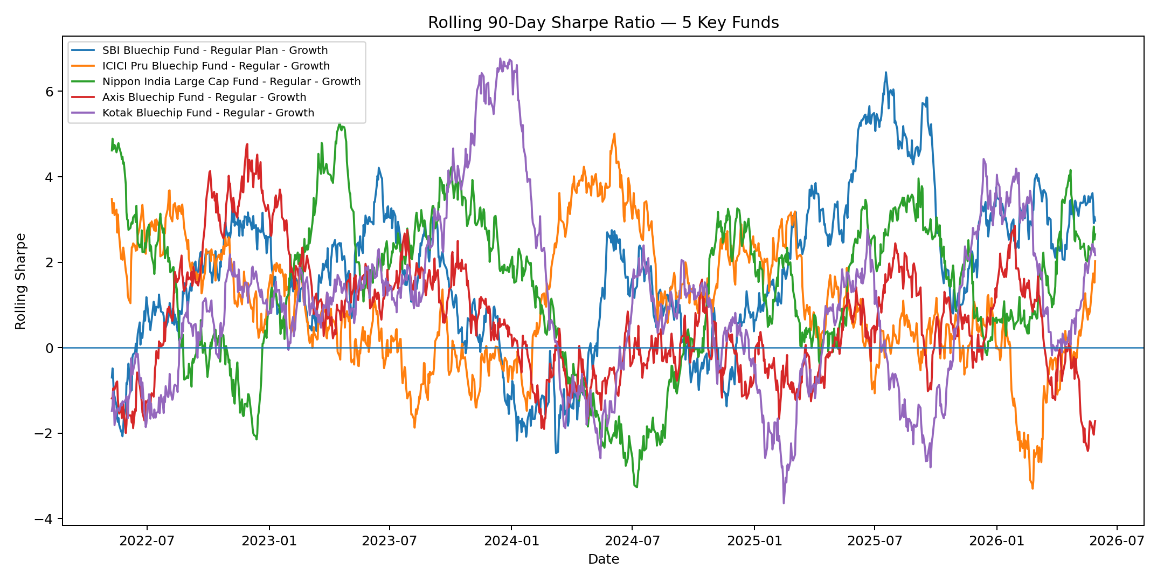
Advanced Analytics and Risk
95% VaR and CVaR quantify downside tail risk.
SIP continuity flags gaps above 35 days for investors with 6+ SIPs.
Sector HHI measures concentration across equity-fund holdings.
A simple recommender ranks funds by Sharpe within Low/Moderate/High risk grades.

Slide 12
Key Findings and Next Steps
Top composite score: ICICI Pru Midcap Fund - Regular - Growth (84.50/100).
Dec 2025 SIP inflow reaches ₹31,002 crore and folios reach 26.12 crore.
Use fund score, drawdown, benchmark tracking and risk metrics together rather than relying on one measure.
Next step: complete the native Power BI interactive edits, save the PBIX, and export the final Power BI PDF/PNG pages.

