Slide 1

Recruitment Database
Management System
DBMS Course Project
Presentation III – User Interface
Student
Roll No.
Sirigiri Sruti
25WU0102266
Section
Faculty
AIML WHALES
Dr. Kiran Mayee Adavala

Slide 2

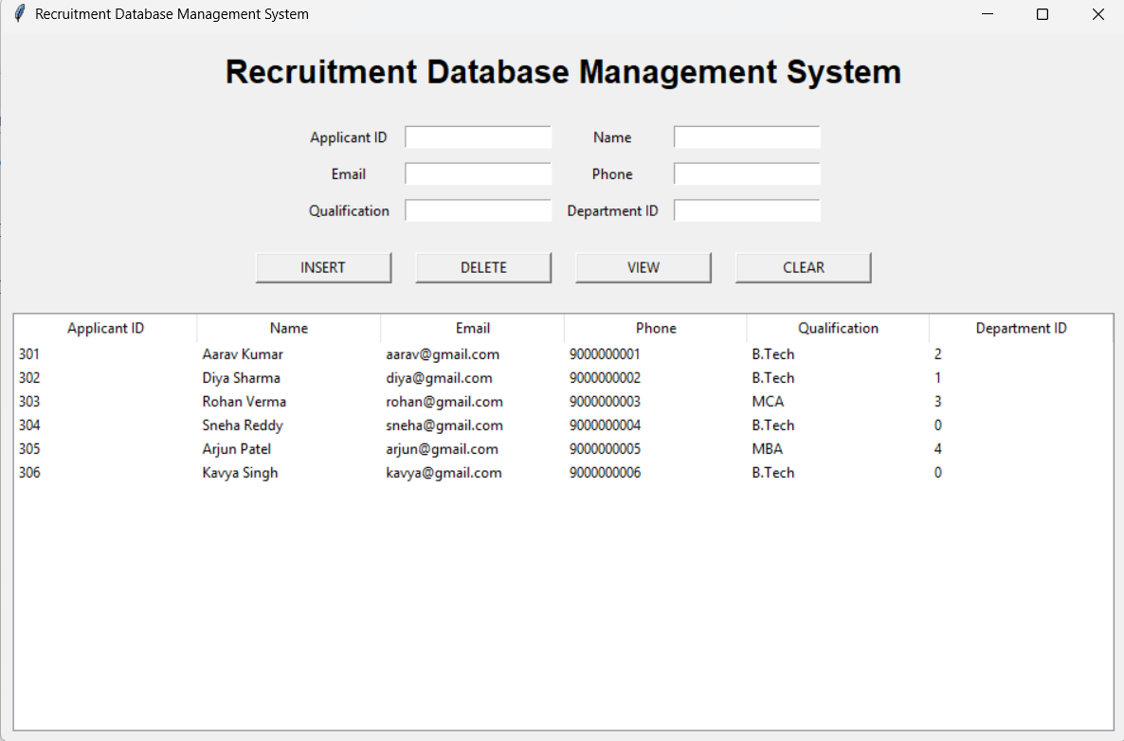
Project & UI Overview
Manages recruitment-related applicant information
Graphical interface connected to MySQL
Operations performed directly from the UI
[ Insert screenshot here ]
Main UI window with fields and buttons
INPUT FIELDS
Applicant ID
Name
Email
Phone
Qualification
Department ID
BUTTONS
INSERT
DELETE
VIEW
CLEAR
Recruitment DBMS – Main User Interface

Slide 3
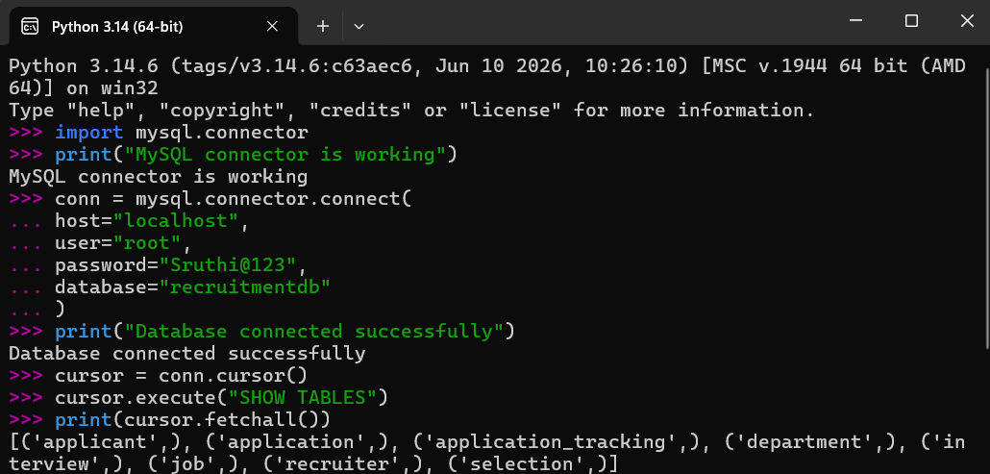
Database Connectivity
Python builds the application interface
MySQL is the backend database
mysql.connector establishes the connection
Database used: recruitmentdb
Successful connection demonstrated
[ Insert screenshot here ]
Python–MySQL connection (connection code / success output)
Python UI
→
mysql.connector
→
MySQL
Connection to recruitmentdb

Slide 4
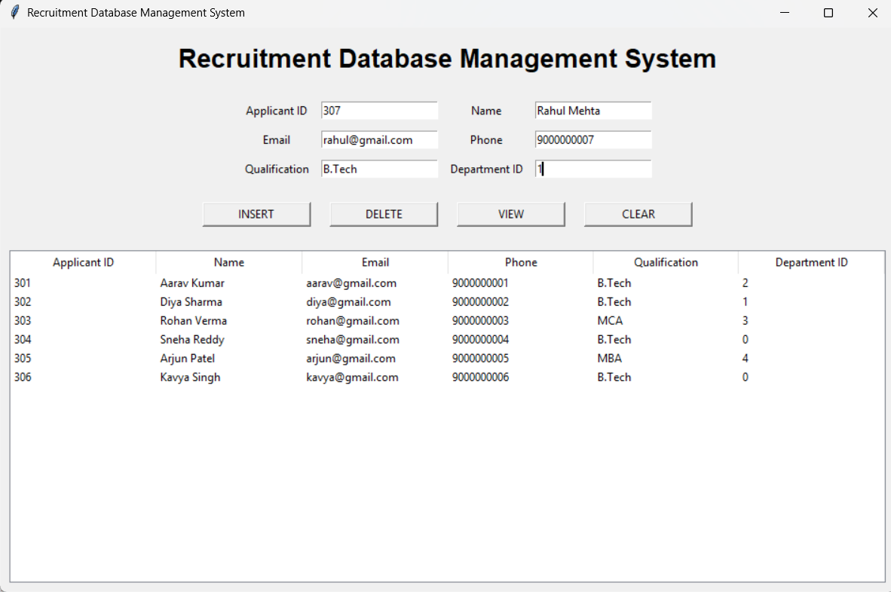
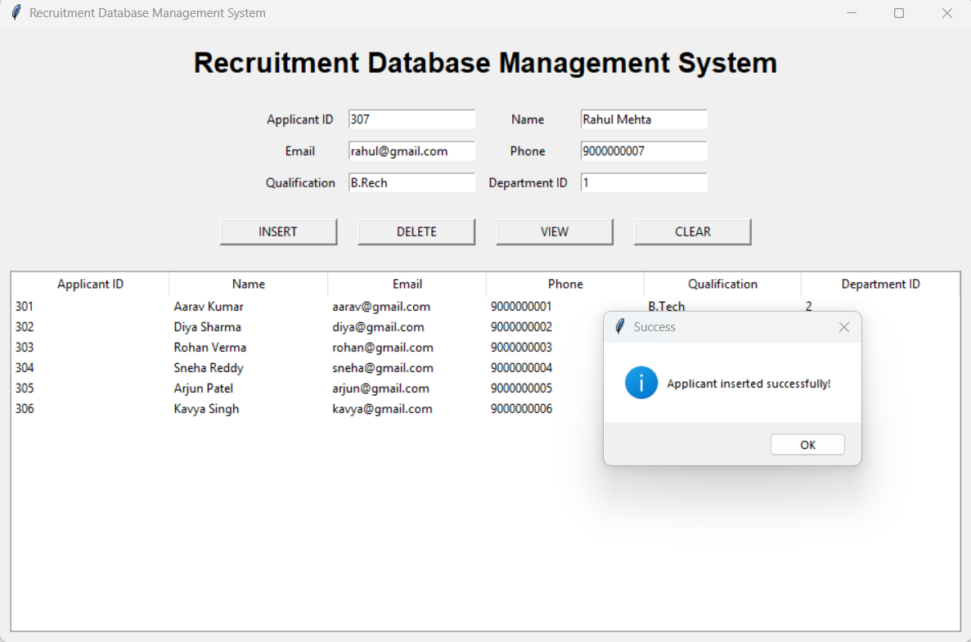
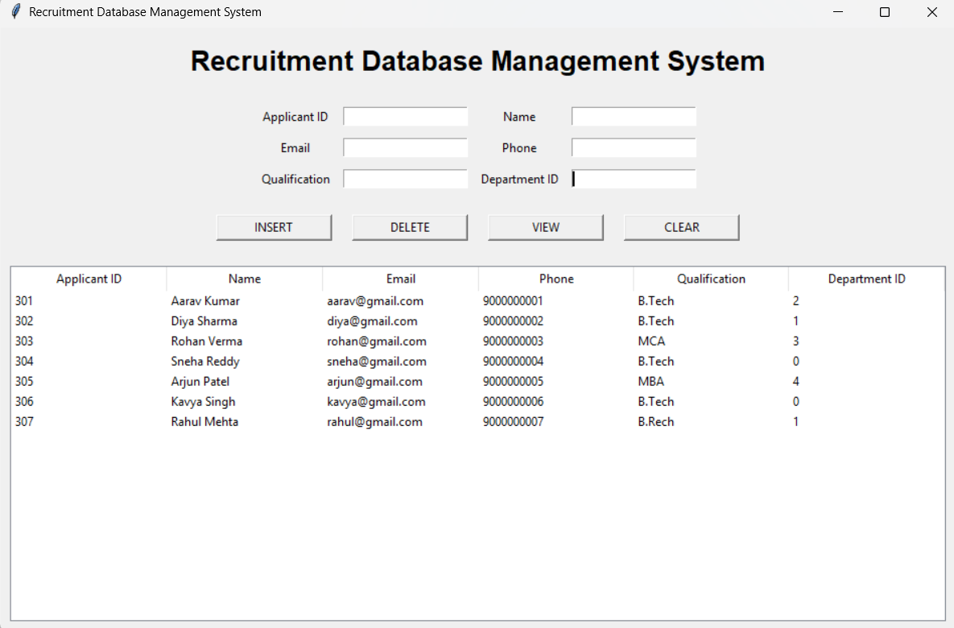
Insertion of Applicant Record
Enter details
→
Click INSERT
→
Stored in MySQL
→
VIEW shows update
[ Insert screenshot here ]
Applicant details entered in the UI
[ Insert screenshot here ]
Insertion success message
Before Insertion
Insertion Successful
After Insertion (VIEW)

Slide 5
Viewing Applicant Records
VIEW retrieves records from the MySQL applicant table
Records are displayed in the UI
Displayed data confirms the database connection works
[ Insert screenshot here ]
Applicant table showing records
VIEW – Applicant Records from MySQL

Slide 6
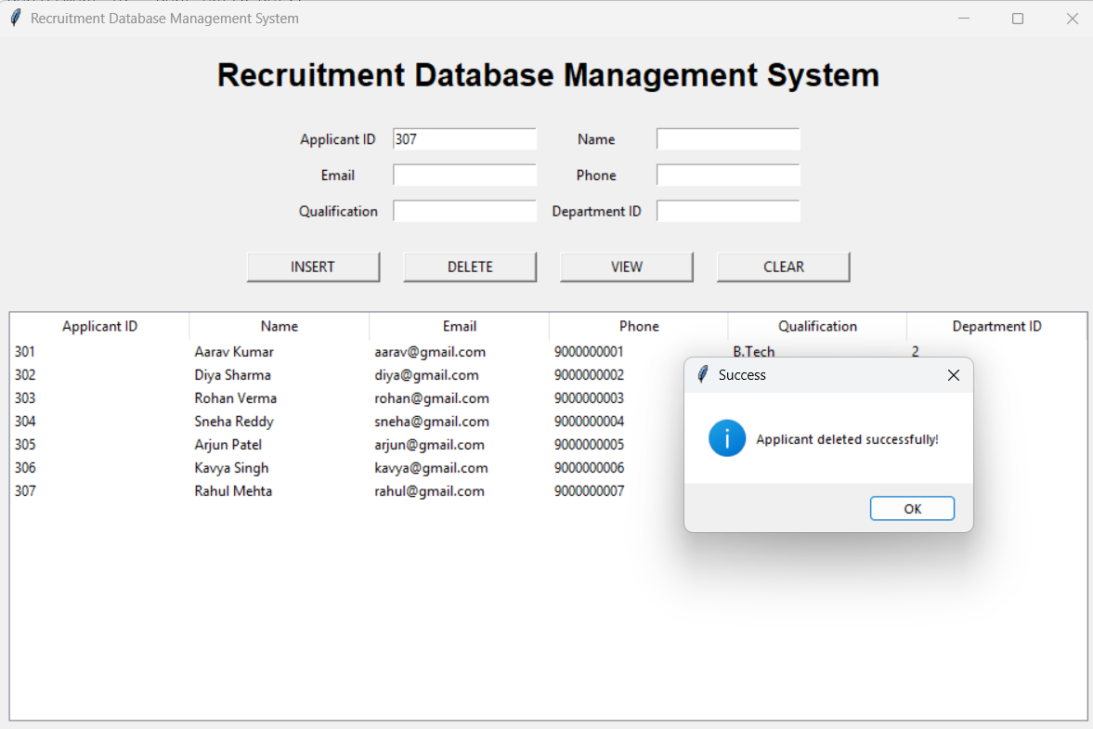
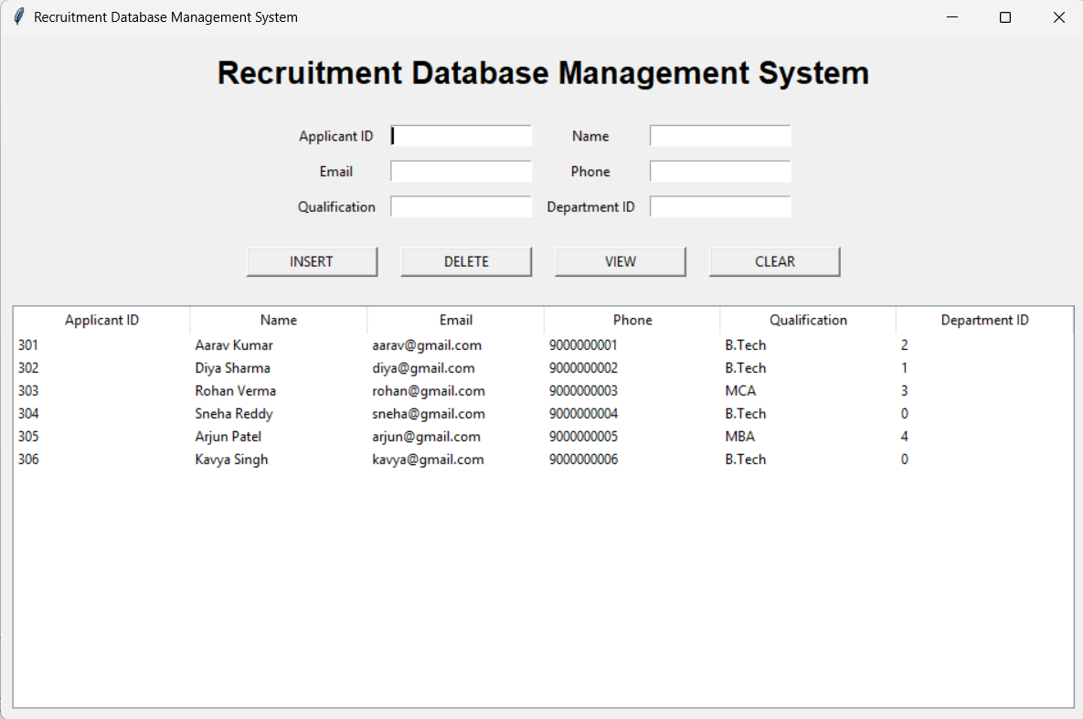
Deletion of Applicant Record
Enter Applicant ID
→
Click DELETE
→
Removed from MySQL
→
VIEW confirms
[ Insert screenshot here ]
Record visible in the applicant list
[ Insert screenshot here ]
Record no longer in the applicant list
Before Deletion
After Deletion

Slide 7
Working Demonstration / Result
Operation | UI Action | Database Result
INSERT | Enter details + INSERT | New record added
VIEW | Click VIEW | Records retrieved and displayed
DELETE | Enter ID + DELETE | Selected record removed
[ Insert screenshot here ]
Final working UI
Final Working UI

Slide 8
Conclusion
Functional graphical interface for the Recruitment DBMS
1
The UI communicates successfully with the MySQL database
2
INSERT, VIEW and DELETE operations are demonstrated
3
A simple interface for managing applicant records
4

