Slide 1
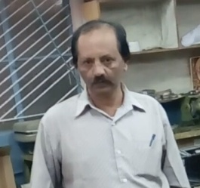

Management & Entrepreneurship
Interview of an Entrepreneur : Mr. Somshekar
Founder & CEO
Industrial Automation
Peenya,Bangalore
By,
Aishwarya R
Sindhura Gowri G S
Supraja K V

Slide 2
FORMALITIES FOR SETTING UP OF A SMALL BUSINESS ENTERPRISE
1.Selection of a project
a. product |service selection
b. Location selection
c. project feasibility study
d. business plan preparation
e. prepare project profile
2.Decide on the constitution
3.Obtain SSI registration
4.Obtain clearances from department as applicable
5.Arrange for land| shed
6. Arrange for plant and machinery
7.Arrange for infrastructure
8.Prepare project report
9.Apply and obtain finance
10.Implement and obtain final clearances.

Slide 3
1.Selection of a project project selection is the initial decision which an entrepreneur has to make. Project selection and preliminary activities involve the following –
Product or Service Selection
The entrepreneur has to decide on a suitable product or a service based on which a project can be started. He as to consider various factors before deciding on a suitable project.
The main factors are as follows--
Background and experience of the entrepreneur.
Availability of plant, machinery raw materials.
Availability of proper infrastructure facilities.
There are many organisations which are in possession of information on
business opportunities. They are--
Centres for entrepreneurship development.
Small industry service institutes.
Industrial extensions bureaus.

Slide 4

While making a product choice, the following factors related to the product need
to be considered
1. Easy availability of raw materials .
2. Process technology .
3. Incentive and support from Government.
4. Packaging.
Location selection
Major aspects to be considered before deciding on the location of the project are
Availability of raw materials .
Availability of transportation, communication and infrastructural facilities.
Nearer to city.

Slide 5


Project feasibility study
1. Market analysis
A market analyst requires information and appropriate forecasting methods. The kinds of information required are given--
Consumption trends in the past and present consumption level .
Production possibilities and constraints .
Imports and exports.
Cost structure.
2. Technical analysis
Technical Analysis seeks to determine whether the prerequisites for the successful
commissioning of the project have been
considered.

Slide 6

3. Financial analysis
Financial analysis seeks to
ascertain whether the proposed
project will be financially
viable in the sense of being able
to meet the burden of servicing
debt.
Investment outlay and cost of project.
Projected profitability.
Projected financial position.

Slide 7
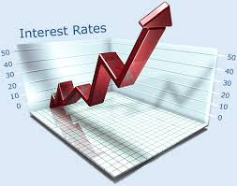
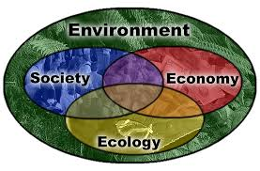
4.Economic analysis
Economic analysis, also referred to as
social cost benefit analysis, is
concerned with
Judging a project from the larger, social
point of view.
5.Ecological analysis
It should be done, particularly for major
projects which have significant ecological
implications like power plants, irrigation
schemes etc.

Slide 8

Business plan preparation
It is a document where you plan your business to have an organised and effective response to a situation which may arise in future.
A workable business plan has the following features --
Determines where the company needs to go
Formulates responses to contingencies
Keep the business on track to reach its planned goals
Table of contents of a business plan
Title page
Executive summary
Vision and mission statements
3. Company plan
Company description
Organisational plan
4. Marketing plan
Competition analysis
Methods of distribution

Slide 9
5.Financial plan
Summary of financial needs
Sources and uses of funds
Three year income projection
Balance sheet
Business financial history
6. Supporting documents
Personal resumes
Personal financial statement
Credit reports
Copies of leases
Letters of reference
Project profile
Project profile gives a bird’s-eye view of the proposed project . This may be used for obtaining the provisional registration certificate from the District industrial centre.

Slide 10
2.Registration
Entrepreneurs desiring to a small scale industry have to initially obtain a provisional registration certificate (PRC)
An SSI unit can get a Permanent Registration certificate when it goes into commercial production.
PMT unit will help the SSI unit in several ways such as--
To get working capital from banks.
To apply incentives including sales tax exemption.
Price and purchase preference for goods produced.
Availability of raw materials depending on existing policies

Slide 11

3.Project report preparation
A detailed project report helps in planning and implementing the project .
The project report must imbibe following contents—
1.Executive summary
Introduction
Financial performance
SWOT analysis
2.Company details
History
Manufacturing facilities.
Major products and customers
3.Operational details
Capacity and utilisation
Profit and loss account
Balance sheet
Marketing strategy
Export sales

Slide 12
4.Project details
Orders and enquiries
Location
Manufacturing process
Marketing
5.Project cost
6.Means of finance
Deposits
equity share capital
Debt
Other sources
7.Project status
8.Profitability and risk analysis
Financials of the project
Financial of the company

Slide 13
10.Employment generation-direct or indirect
11.Conclusion
12.Annexure
Promoters bio data
Organisation
Chart
Arrangement for land and building
Process chart
Any other details

Slide 14
4.Implementation of project and obtain final clearances
The following are the major activities that the Entrepreneurs have to undertake for implementing project–
Constructs
Order for Arrange for raw
Marketing
Erection and commissioning

Slide 15
Obtaining final clearances--Entrepreneurs are required to take several final clearances
When unit goes into production. Some of the clearances that are required are—
1.Regulatory or taxation clearances:
Registration under sales tax act
Registration under central excise act
2.Product specific clearances:
Licence for cold storage construction
Licence under explosive act for safety fireworks
3.Environmental related clearances:
Obtaining NOC(no objection certificate) from state pollution control board
Clearances of chief electrical inspector of boilers for operations with electrical and pressure vessels

Slide 16
THANK YOU

