Slide 1
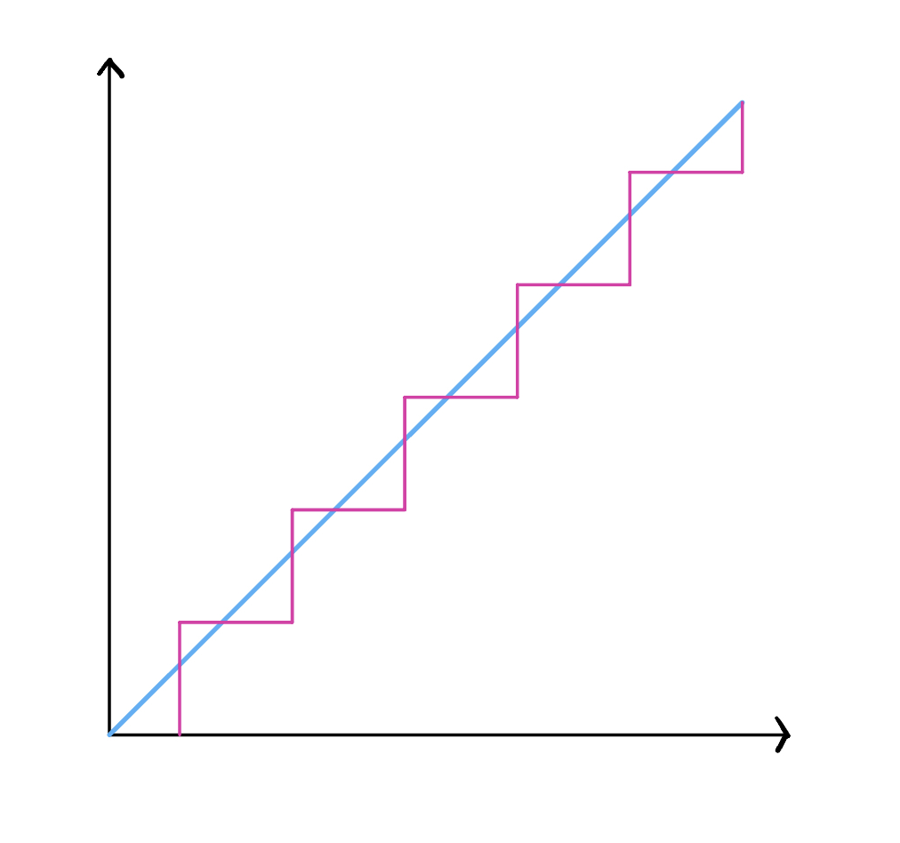



$$A/D$$
$$11−Bit$$
$$t$$

Slide 2
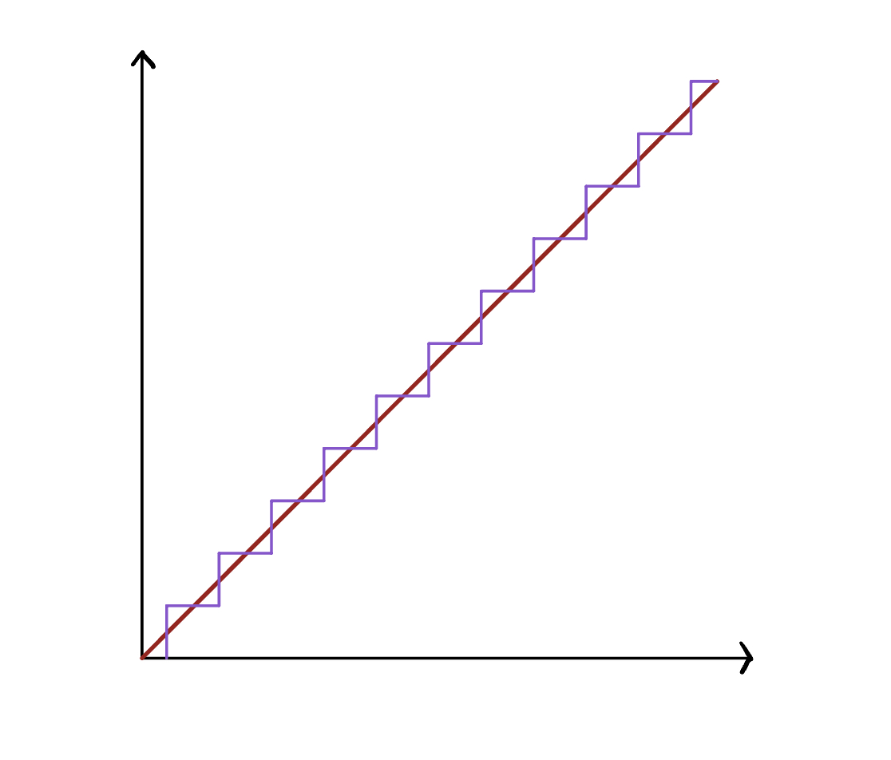



$$A/D$$
$$12−Bit$$
$$t$$

