Slide 1




People around us
Maintain Secrets
Shares everything
Do what he want
Only with family

Slide 2

Access Modifiers ~declarations in java
Access Modifiers are used to access the variables/literals.

Slide 3
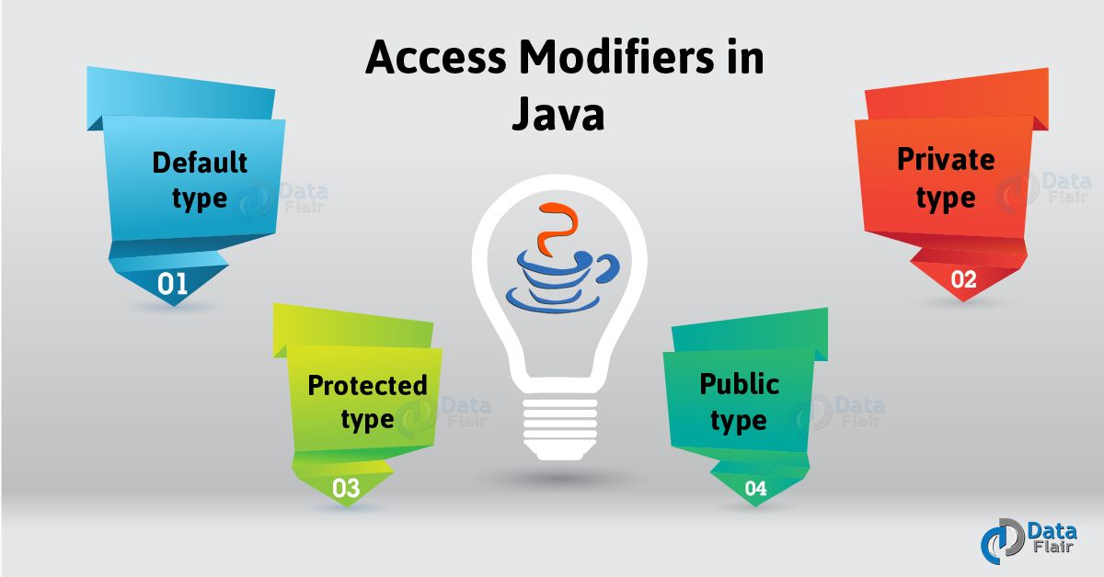

Slide 4
Types of AccessModifiers:
Default
Private
Public
Protected
Static
Final (Non access modifier)

Slide 5

Default:
If we didn’t specify any specific modifier the JavaVirtualMachine(JVM)
automatically takes as Default specifier.
Example:
****Class abc{
int a;
------
-------
}

Slide 6


Private:
These are most restrictive cannot be accessed outside an enclosing class.
To use this we use “GETTER” and “SETTER” inbuilt functions.
Example:
public class Person { private String name;
public String getName() { return name; }
public void setName(String newName) { this.name = newName;

Slide 7

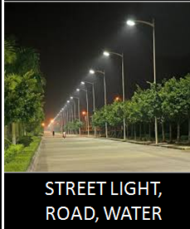
Public:
The name it self indicates that it is public. It can be accessed any where in any class.
Example:
classABC{
Public int a=10;
--------
---------}

Slide 8

Protected:
This can be accessed only inside a package.Only the methods used or when inherited can be used in the inherited package also. It is somewhat less unsecure when compared to private.
Example:
Class ABC{
Protected int a;
-------
------}

Slide 9
Static:
Static is preferred when it is necessary to use the declaration in the static block.
Example:
Class ABC{
Int a;
main();
Static int a;
-------
------
}

Slide 10
Less restrictive to more restrictive
Default
Public
Protected
Private

Slide 11

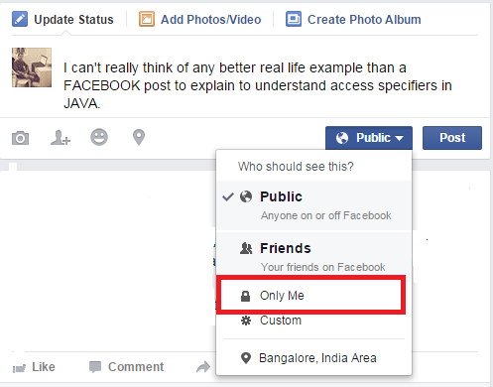
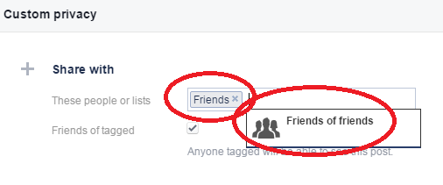
Why?
One such real time Application is “FACEBOOK”

Slide 12
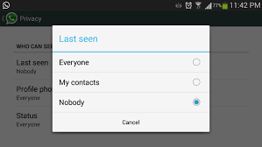

Slide 13


Slide 14


