Slide 1
EDITORIAL REPORT
Random Topic Corpus Comparison
v0.6.0 baseline vs descriptor-corpus-guided decks built from source JSON

Slide 2
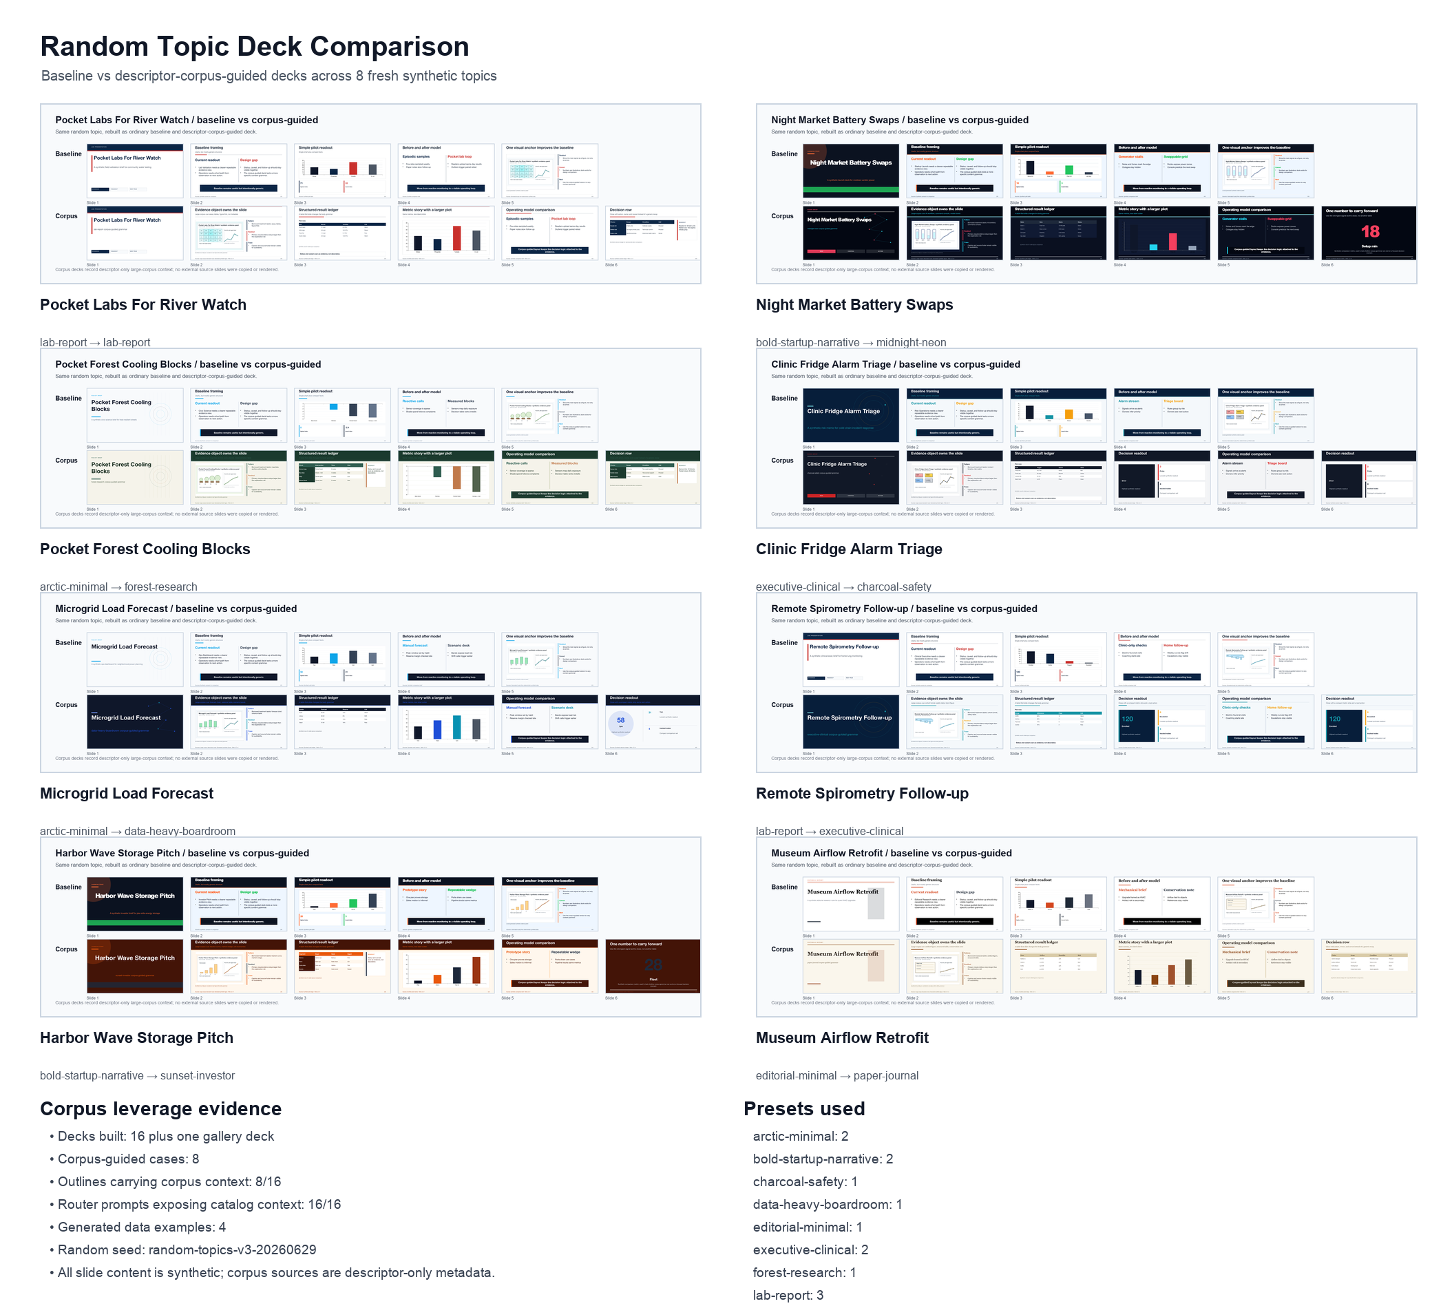
All topics at a glance
Purpose
Check whether deck structure changes when the large corpus informs design choices.
Scope
8 synthetic topics, each with baseline and corpus-guided decks.
Safety
Descriptor-only corpus references; no external slides copied.
Rendered comparison contact sheet generated locally.
Sources: Local comparison builder
2/10

Slide 3
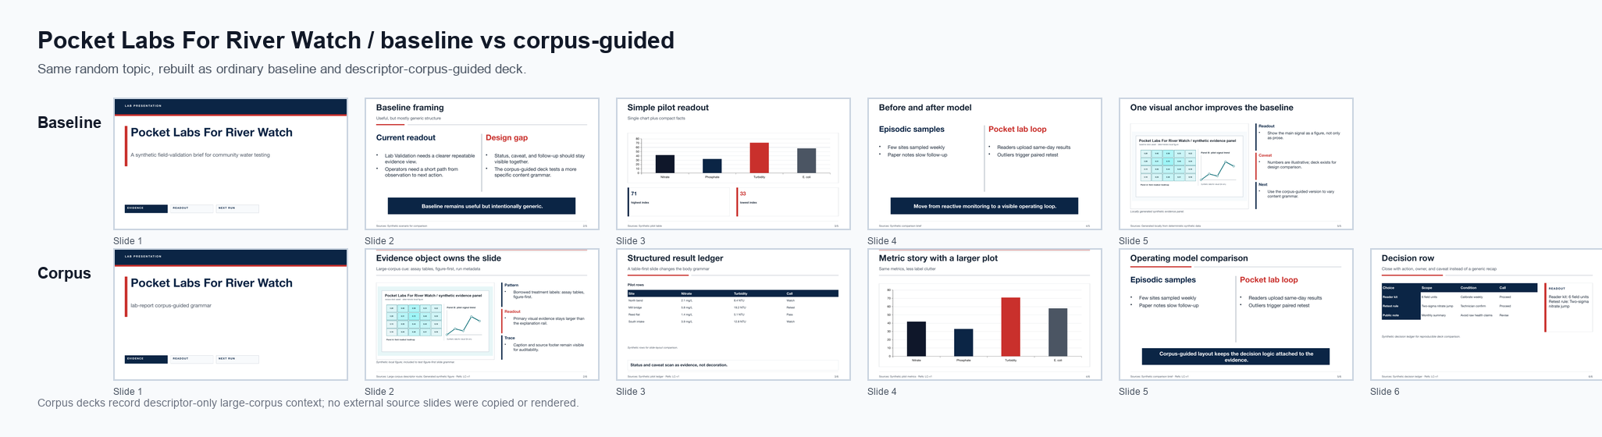
River Watch Pocket Lab
Compare
Look for evidence-object size, table/decision treatment, and source/footer handling.
Corpus signal
The corpus-guided version records selected family and treatment labels in source files.
Baseline row above, corpus-guided row below.
Sources: Local comparison builder
3/10

Slide 4
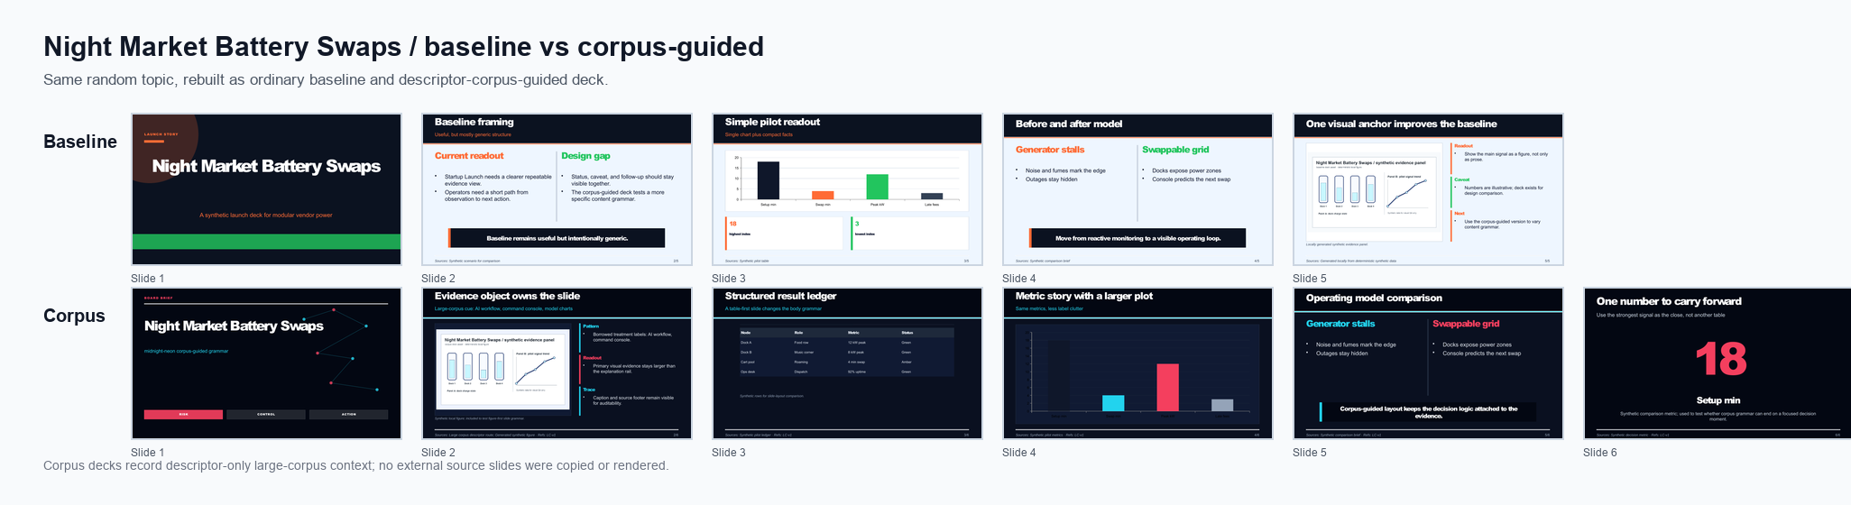
Night Market Battery Swaps
Compare
Look for evidence-object size, table/decision treatment, and source/footer handling.
Corpus signal
The corpus-guided version records selected family and treatment labels in source files.
Baseline row above, corpus-guided row below.
Sources: Local comparison builder
4/10

Slide 5
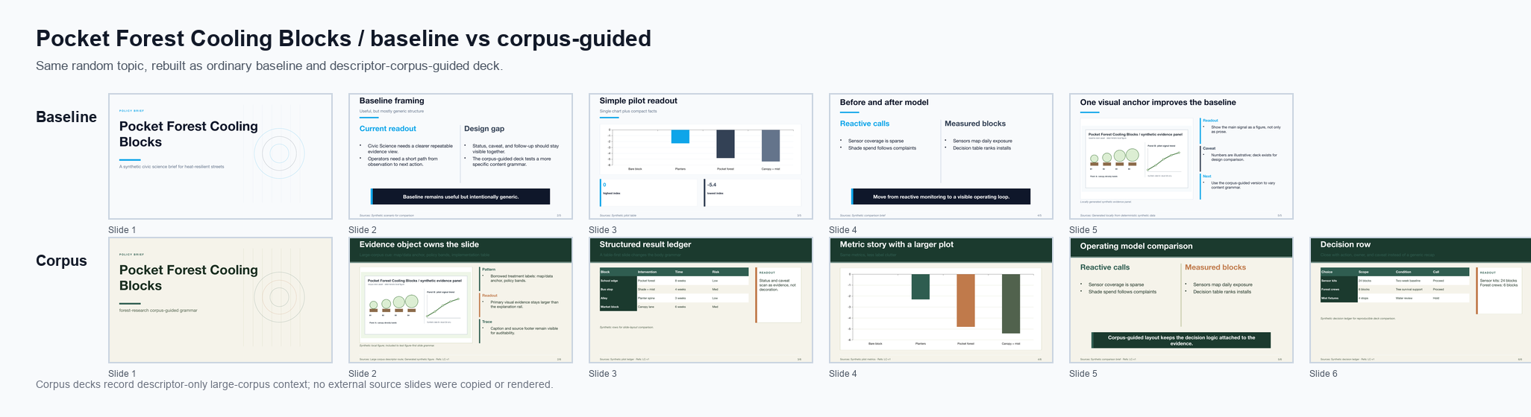
Pocket Forest Cooling Blocks
Compare
Look for evidence-object size, table/decision treatment, and source/footer handling.
Corpus signal
The corpus-guided version records selected family and treatment labels in source files.
Baseline row above, corpus-guided row below.
Sources: Local comparison builder
5/10

Slide 6
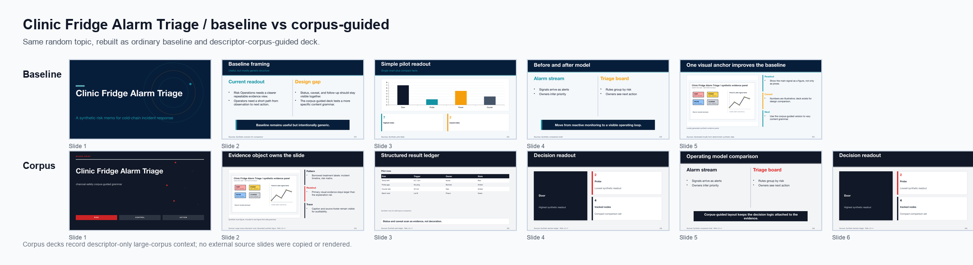
Clinic Fridge Alarm Triage
Compare
Look for evidence-object size, table/decision treatment, and source/footer handling.
Corpus signal
The corpus-guided version records selected family and treatment labels in source files.
Baseline row above, corpus-guided row below.
Sources: Local comparison builder
6/10

Slide 7
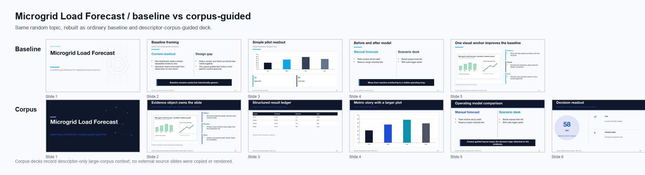
Microgrid Load Forecast
Compare
Look for evidence-object size, table/decision treatment, and source/footer handling.
Corpus signal
The corpus-guided version records selected family and treatment labels in source files.
Baseline row above, corpus-guided row below.
Sources: Local comparison builder
7/10

Slide 8
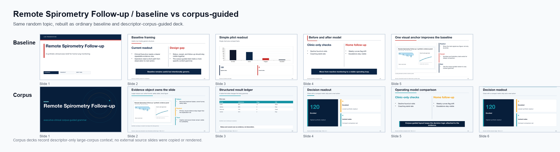
Remote Spirometry Follow Up
Compare
Look for evidence-object size, table/decision treatment, and source/footer handling.
Corpus signal
The corpus-guided version records selected family and treatment labels in source files.
Baseline row above, corpus-guided row below.
Sources: Local comparison builder
8/10

Slide 9
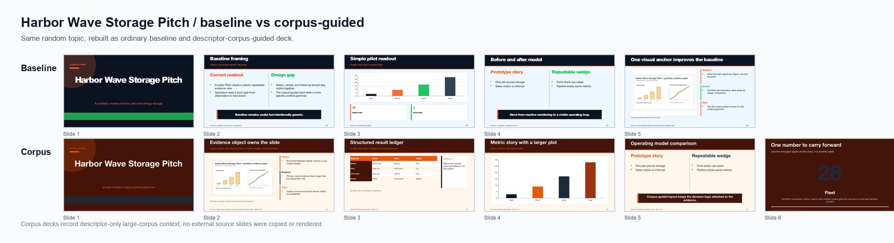
Harbor Wave Storage Pitch
Compare
Look for evidence-object size, table/decision treatment, and source/footer handling.
Corpus signal
The corpus-guided version records selected family and treatment labels in source files.
Baseline row above, corpus-guided row below.
Sources: Local comparison builder
9/10

Slide 10
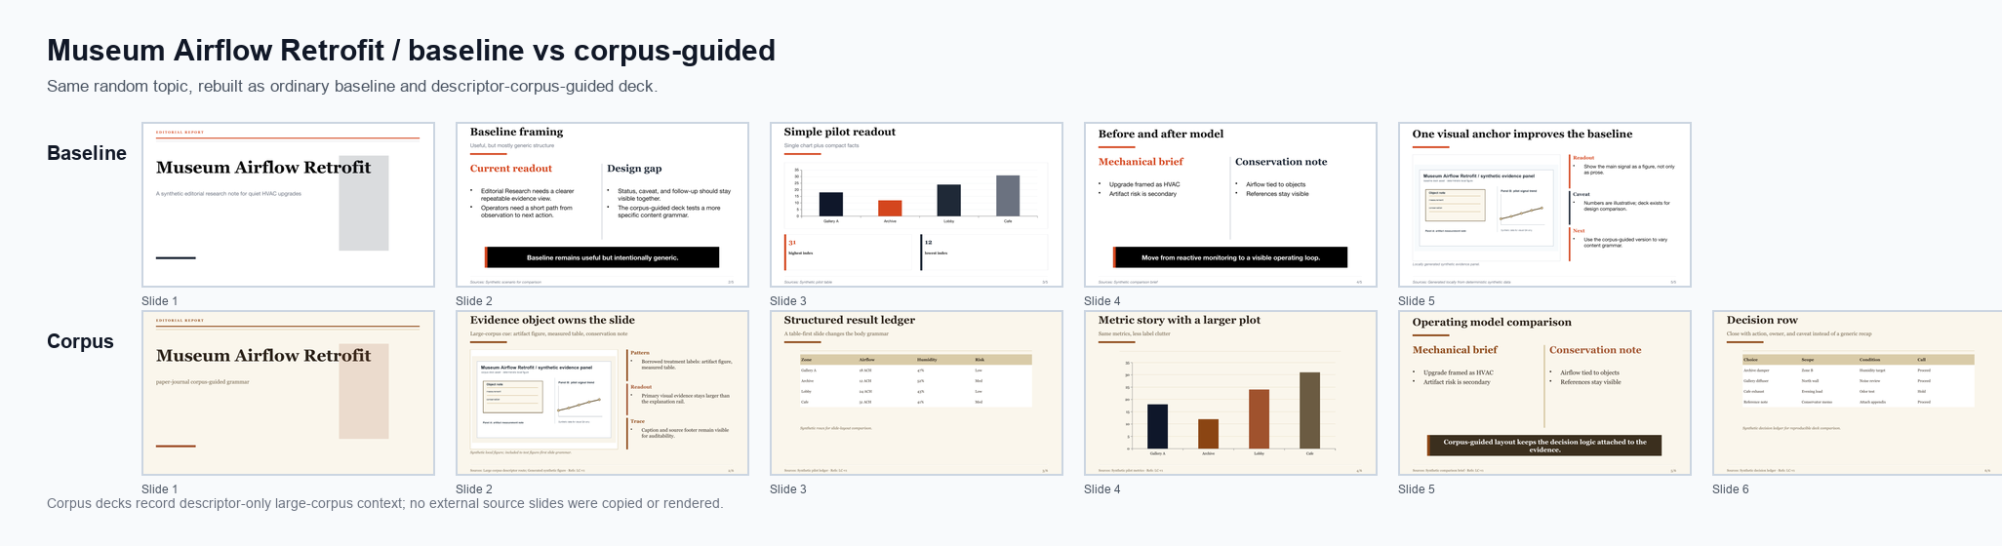
Museum Airflow Retrofit
Compare
Look for evidence-object size, table/decision treatment, and source/footer handling.
Corpus signal
The corpus-guided version records selected family and treatment labels in source files.
Baseline row above, corpus-guided row below.
Sources: Local comparison builder
10/10

