Slide 1

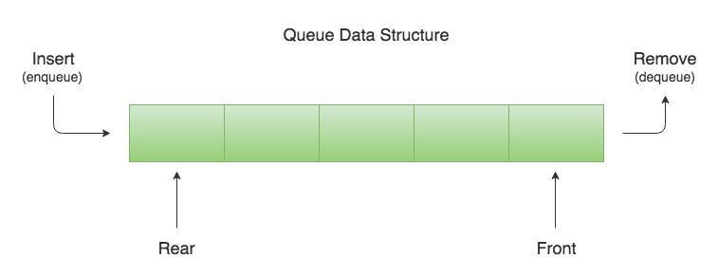
Siri Lalitha Adapa 19BQ1A05L4
Queue

Slide 2

DEFINITION

Slide 3

Components of Queues

Slide 4
DECLARATION

Slide 5
OPERATION

Slide 6

TYPES OF QUEUES

Slide 7
APPLICATIONS

Slide 8



