Slide 1
Deep Research Assistant
with web Browsing
Gold Price Edition | n8n AI Agent | Gemini + Tavily + Memory

Slide 2
What We Will Cover
1
Project goal
7
Setup steps
2
Why a research agent
8
System prompt
3
Workflow architecture
9
Test run and results
4
Node-by-node roles
10
Use cases
5
Research pipeline
11
Limitations and best practices
6
How the agent thinks
12
Next improvements

Slide 3
Project Goal
1
2
3
Decompose
Search
Compare and cite
Break a complex question into smaller research sub-questions.
Look up each sub-question on the live web with Tavily.
Compare findings and write a structured answer with sources.
Live search keeps answers current, and every answer comes with sources.

Slide 4
Why a Research Agent?
A plain chatbot
Our research agent
Answers from training data only
Prices and news can be outdated
Gives no sources to check
Handles one big question in one shot
Searches the live web every time
Splits the question into sub-questions
Compares sources and cites them
Remembers context for follow-ups

Slide 5
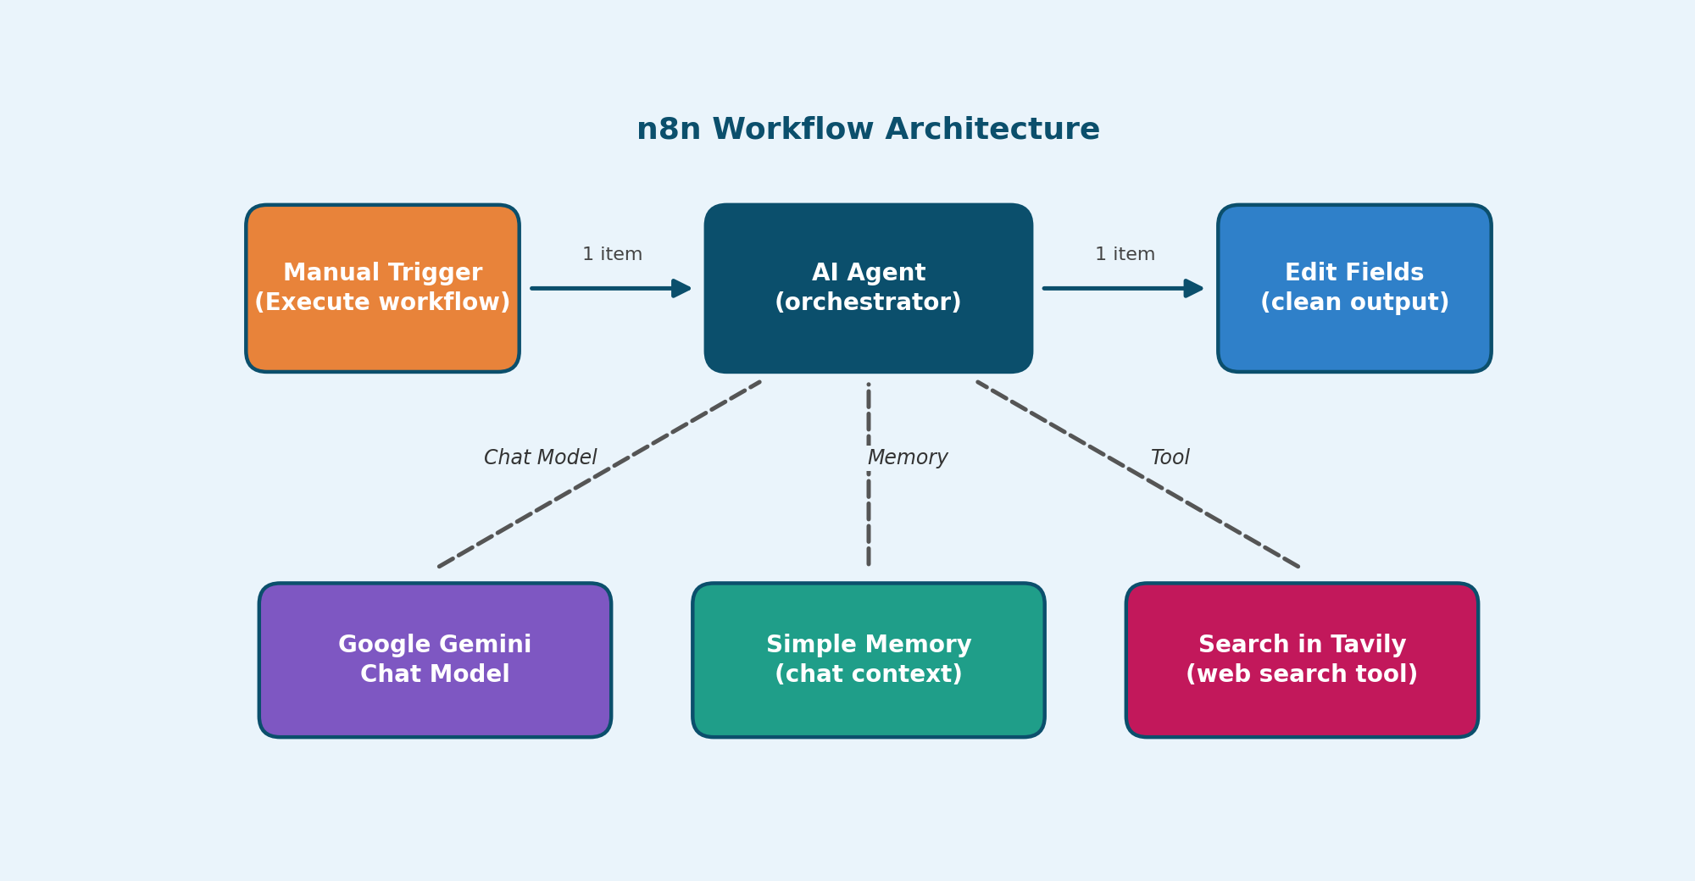
Workflow Architecture
AI Agent
plans the research and writes the answer
Gemini
the reasoning model
Memory
keeps conversation context
Tavily
web search tool

Slide 6
Node-by-Node Roles
Manual Trigger
AI Agent
Gemini Chat Model
Starts a test run and passes 1 item, the user question, to the agent.
The orchestrator. Plans, calls tools, and writes the final answer. Retry on fail is on.
The language model used for reasoning and writing the report.
Simple Memory
Search in Tavily
Edit Fields
Stores recent messages so follow-up questions keep their context.
Web search tool. The agent calls it once per sub-question.
Keeps the final answer in a clean field for the next node.

Slide 7
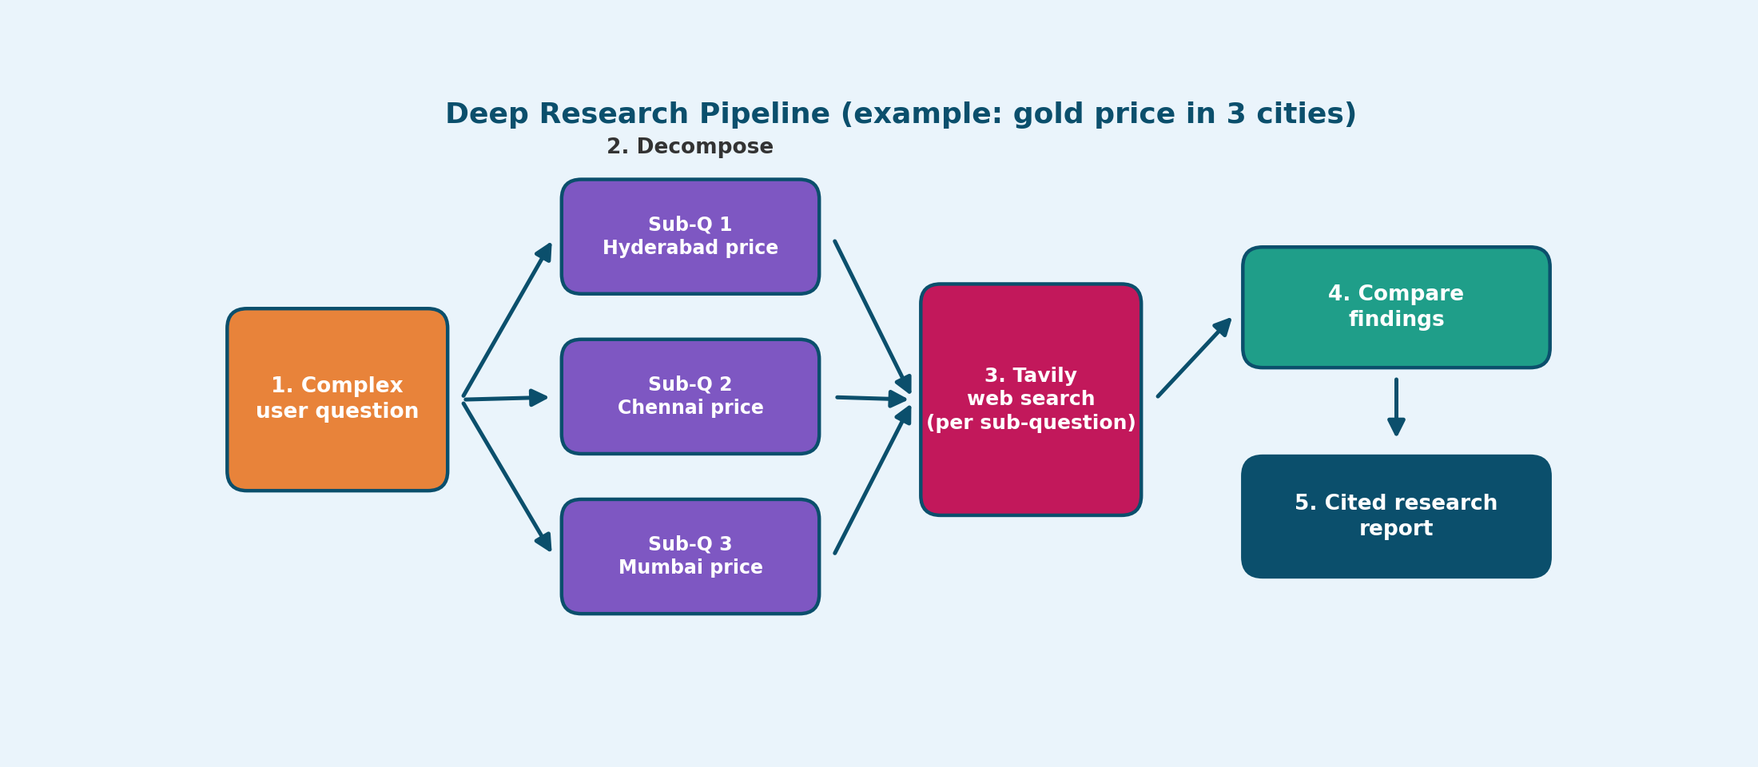
How the Research Pipeline Works

Slide 8
How the Agent Thinks
Plan
Search
Observe
Answer
Split the question into sub-questions
Call Tavily for one sub-question
Read results and note sources
Write a cited comparison
The loop
After each search the agent decides: do I have enough evidence, or should I search again?
Tavily ran 3 times in our gold test, then Gemini wrote the final answer.

Slide 9
Setup Steps in n8n
1
Add a Manual Trigger and connect it to an AI Agent node
2
Attach Google Gemini Chat Model with your API credential
3
Attach Simple Memory so the agent keeps context
4
Add Search in Tavily as a tool with your Tavily API key
5
Connect Edit Fields, then click Execute workflow to test

Slide 10
System Prompt
You are a Deep Research Assistant for gold prices in India.
1. Break the question into sub-questions (city, 22K, 24K).
2. You MUST call the Tavily search tool. Never answer from memory.
3. Use at most 4 searches, then write the final answer.
4. Use only results from the last 7 days. Ignore older dates.
5. Show date, unit and source URL for every price.
Paste into AI Agent node > Options > System Message.

Slide 11
Test Run: Gold Price, 1 Oct 2026
City | 22K (10 g) | 24K (10 g) | Source
Hyderabad | Rs 1,37,097 | Rs 1,49,560 | LiveMint
Chennai | Rs 1,37,216 | Rs 1,49,690 | LiveMint
4
Gemini calls
3
Tavily searches
Chennai is slightly higher than Hyderabad for both karats. Table shows the cities visible in the run output.
4
Memory reads
Verify with a jeweller or bank site before buying. Prices change during the day.

Slide 12
Use Cases
Product comparison
Market research
News digest
Compare prices and features of phones or laptops.
Summarise competitors, trends and market size.
Collect and summarise the latest news on a topic.
Education topics
Price tracking
Buying decisions
Explain a subject with sources, such as AI in education.
Check live gold prices in any Indian city.
Weigh options and get a cited recommendation.

Slide 13
Limitations and Best Practices
Limitations
Best practices
Search snippets can be short or outdated
Sources may disagree on prices
More searches mean more cost and time
The agent can still make mistakes
Ask the agent to cite every claim
Limit the number of tool calls
Check key numbers on official sites
Test with simple questions first

Slide 14
Next Improvements
1
Limit the number of tool calls in the agent
2
Add a web page reader tool for longer content
3
Use a chat or webhook trigger instead of manual
4
Send the final report to Google Docs or Gmail

Slide 15
Thank You
Deep Research Assistant with Web Browsing | Questions?

