Slide 1

BI Mini Project
11th Apr, 2018 Batch
Census Reporting System
Mentor: Mr. Rahul Kulkarni | Guided by: Jayavibhava. T

Slide 2


Team Details
Name | Designation
Mr. Rahul Kulkarni | Team Mentor
Mr. Jayavibhava. T | Team Guide
Akash Sai Bejgum | Team Lead
Harika Reddy Eddula | Team Member
Kalepu Sirisha Meher | Team Member
Pankaj Patil | Team Member
Swathisri Yeleswarapu | Team Member
Vignesh Vanaraj | Team Member

Slide 3
Census Reporting System
A Census is the procedure of systematically acquiring and recording information about the members of a given population.
It is a regularly occurring and official count of particular population.
The Population Census is the most detailed information source on the population at the level of small localities and small groups in population.
The data acquired forms the basis of information that is available to public and private elements at the national and local level for the purpose of decision making in variety of areas of the life of residents of the cities.

Slide 4
Scope of the Project
The purpose of this project is to gather information about general population in order to present a full and reliable picture of population in Cities- its Demographic and housing conditions, social and economic characteristics.
This project is essential for City wise comparisons of any kind of Statistics.
It collects data on many attributes of population, not just for the count of people, although population estimates remain an important function of Census

Slide 5
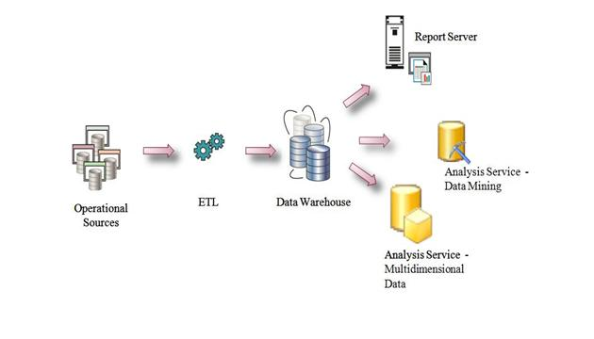
Data Warehouse Architecture (Bottom-Up Approach)

Slide 6
Technology Used
Database:-Sequential Server Management Studio(SSMS)
ETL Tool:- Sequential Server Integration Services(SSIS)
Reporting Tool:-Sequential Server Reporting Services(SSRS)

Slide 7
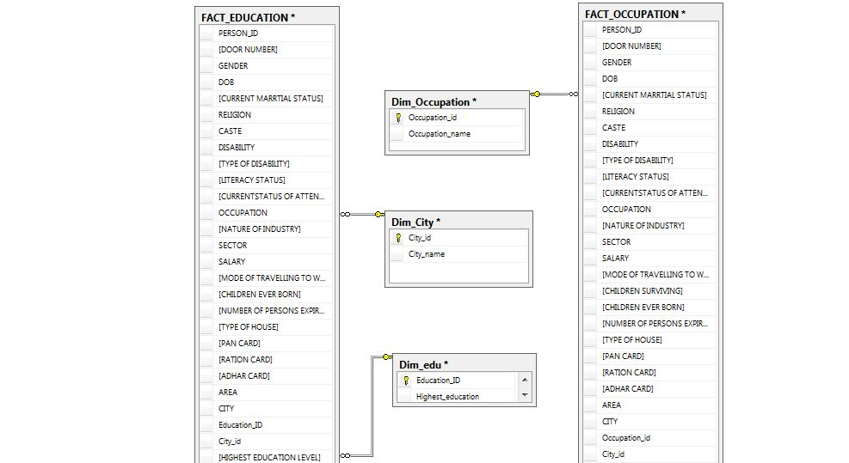
Schema

Slide 8
Implementation of ETL
Extracting data from source file
To cleanse the data
Typical transformation includes things like data formatting, resorting rows or columns of data, joining data, splitting data
To load the data into dimension and fact tables

Slide 9
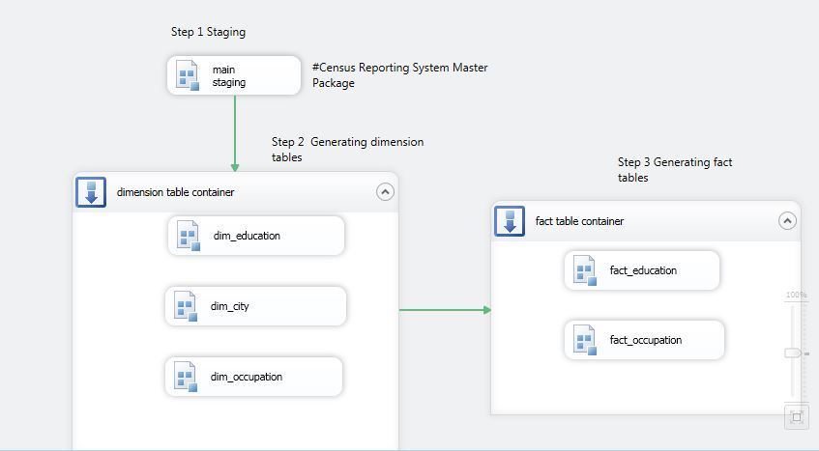
MASTER PACKAGE

Slide 10
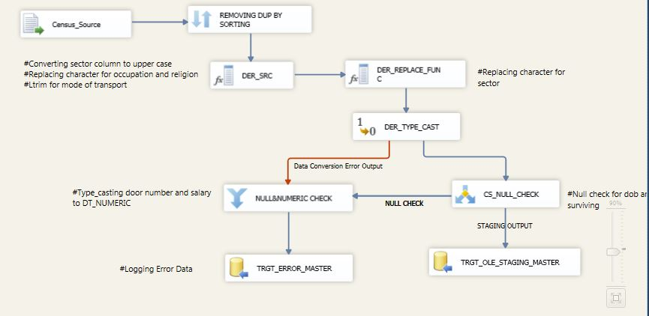
Main Staging Design

Slide 11
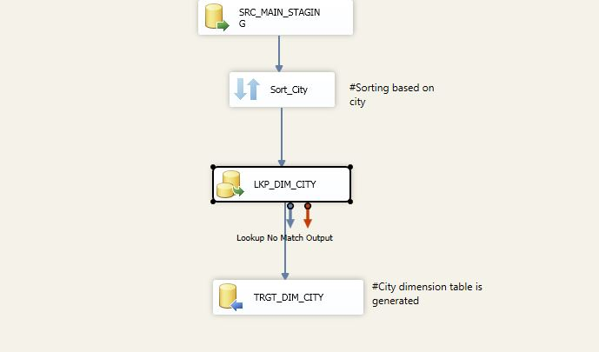
Dimension City Design

Slide 12
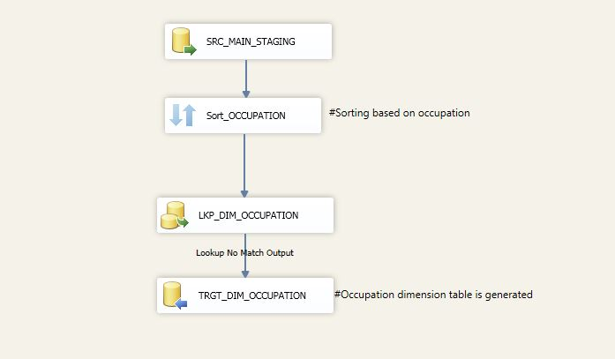
Dimension Occupation Design

Slide 13
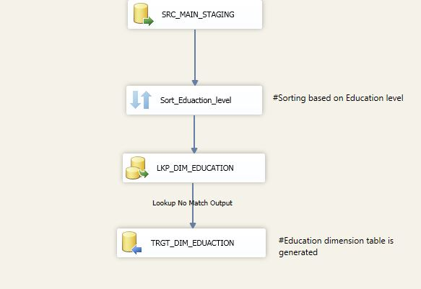
Dimension Education Design

Slide 14
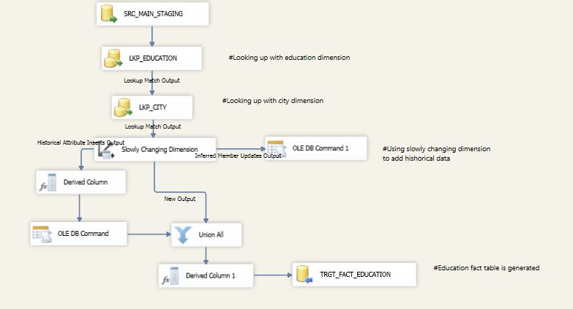
Fact Education Design

Slide 15
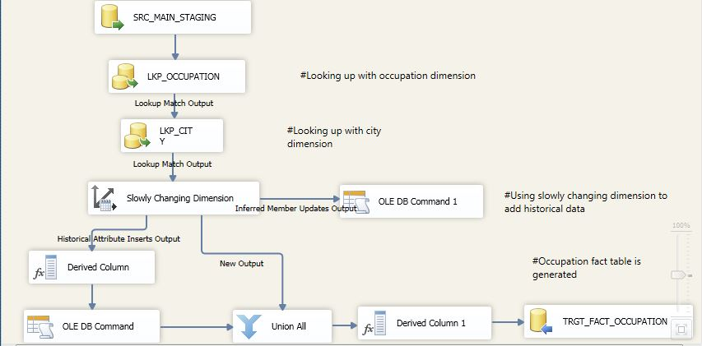
Fact Occupation Design

Slide 16
Order of Loading
Source File
(.csv)
Stage Table
Dimensional Table
Fact Table

Slide 17
REPORTS
Implemented parameters to get city wise population density.
Used tables, Matrices, Bar, Pie, line and Bubble charts to read data in effective way.
Used Stored procedures to get literacy status.

Slide 18
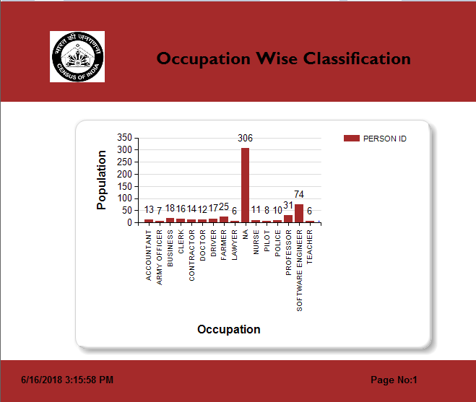

Slide 19
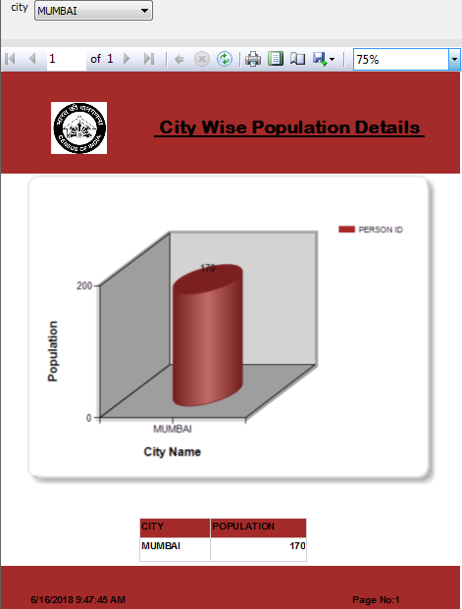

Slide 20
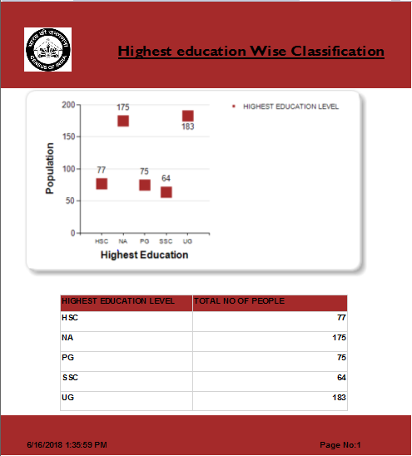

Slide 21
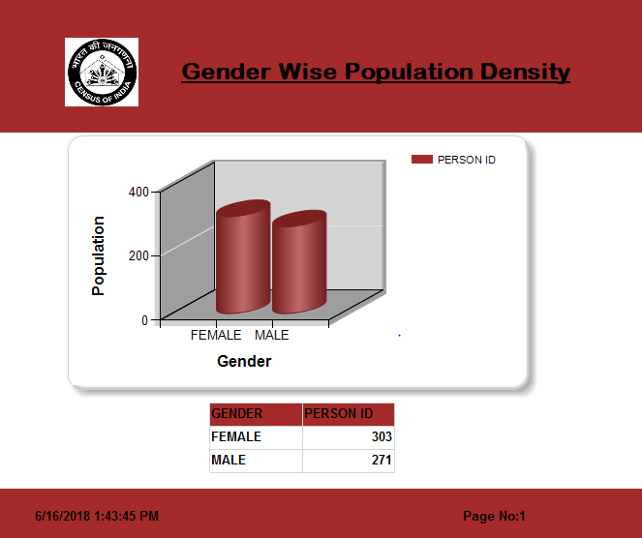

Slide 22
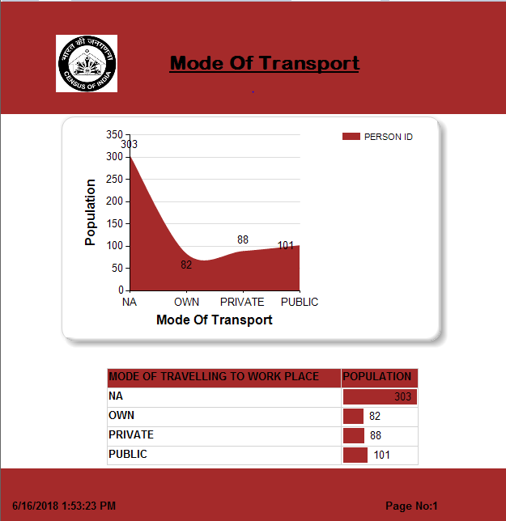

Slide 23
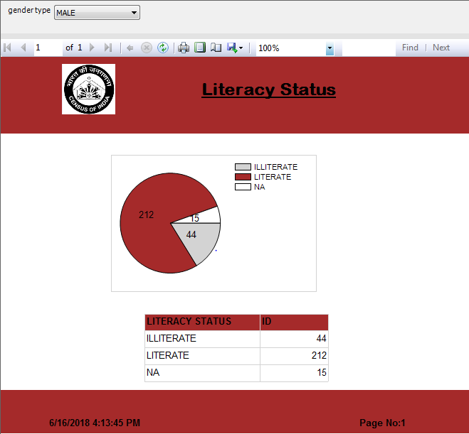

Slide 24
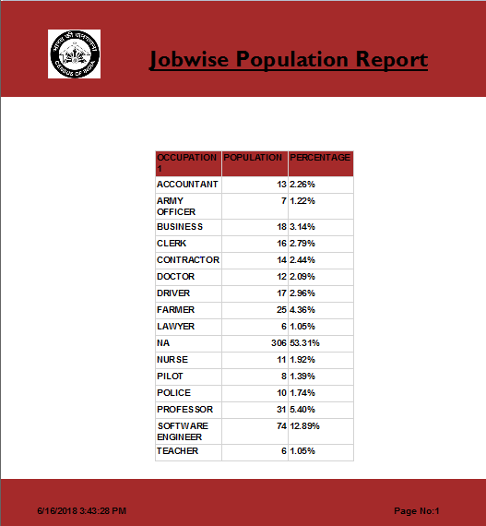

Slide 25
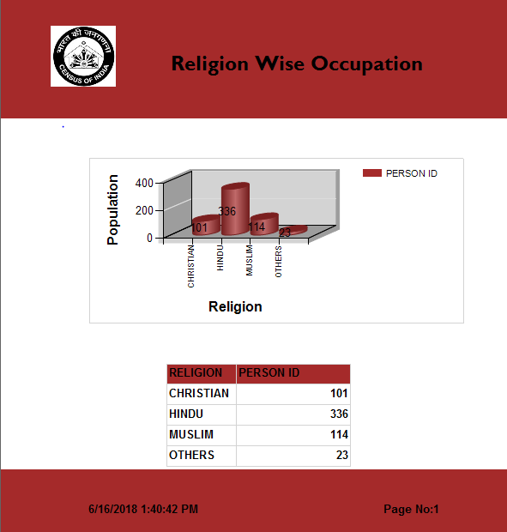

Slide 26
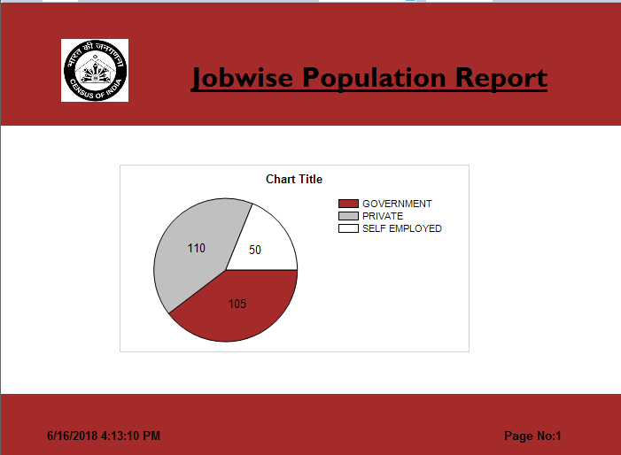

Slide 27
THANK YOU

