Slide 1
INVENTORY MANAGEMENT

Slide 2
EXAMINATION & EVALUATION SYSTEM
Prepared by/Modified by | Role | Start Date – End Date
Akhil Muni | Team Lead

Slide 3
INTRODUCTION
This document contains the work flow of the system and gives guidelines on how to build the functionality gradually in each of the course modules of the BI LOT.
The project is to develop Analysis & Reporting System of Bank Account Details of the IT Employees.

Slide 4
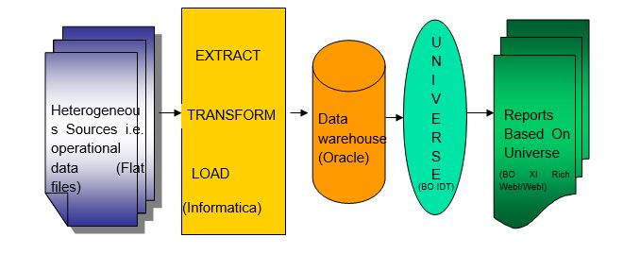
Guidelines on the functionality to be built

Slide 5
Staging Table
Staging Table is an intermediate storage area used for data processing during the extract, transform and load process.
The data staging area sits between the data source and data target, which are often data warehouses, data marts, or other data repositories.
There are staging area architectures, which are designed to hold data for extended periods of time for archival or trouble shooting purposes.

Slide 6
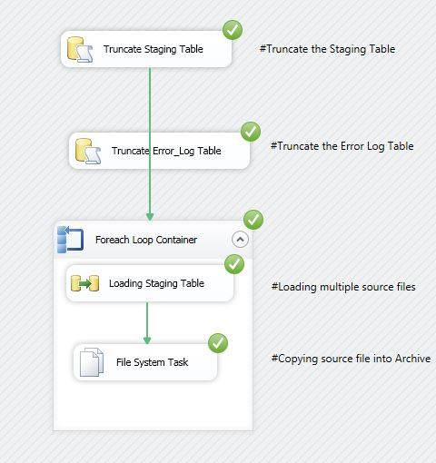
Inventory Management Staging table

Slide 7
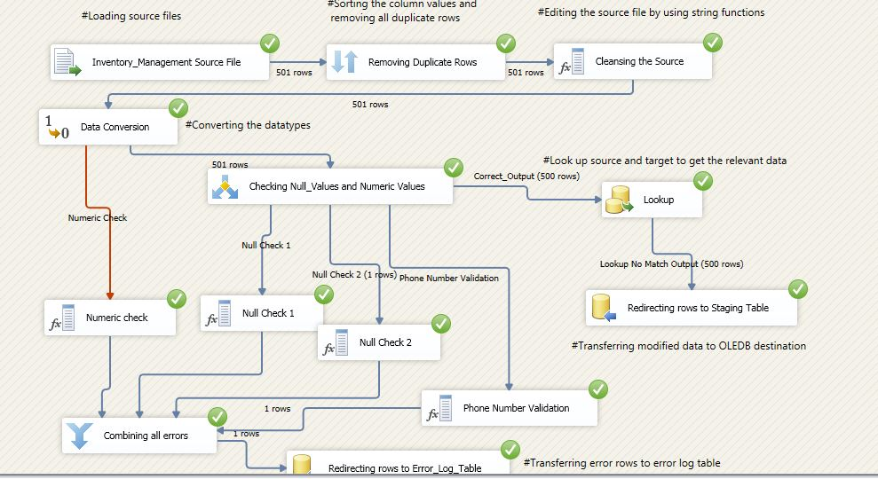
Inventory Management Staging table

Slide 8
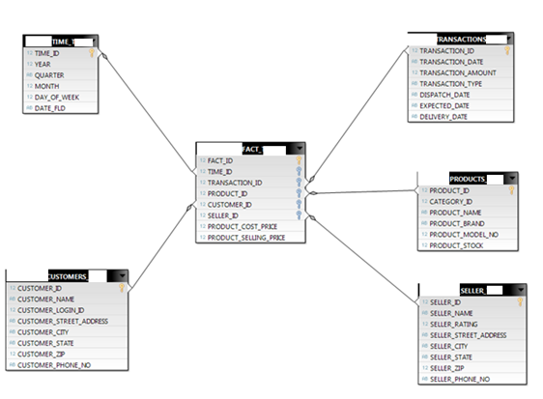
Star Schema

Slide 9
Dimension Tables
A Dimension table stores attributes or dimensions that describes the objects in a fact table.
The dimension table can be utilized across for reports and it’s about re-usability.
All dimension tables should have a single-field primary key.
For Bank Account Details of the IT Employees, we have created five dimensional tables.

Slide 10
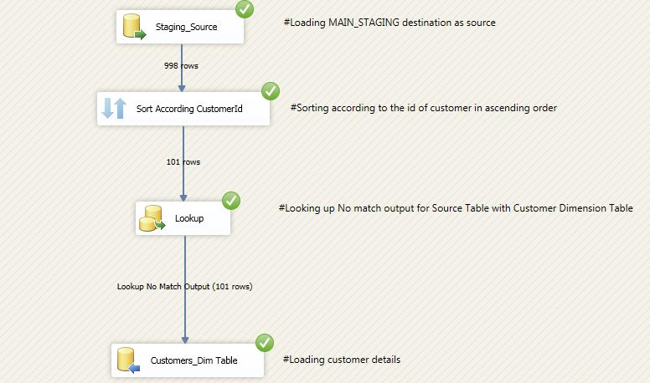
Customer

Slide 11
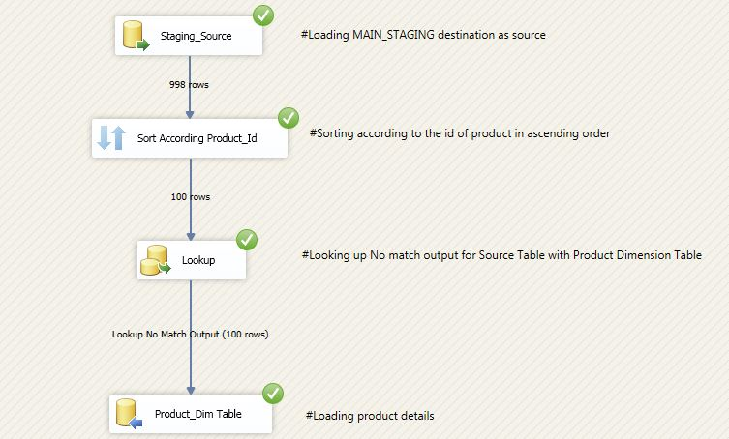
Products

Slide 12
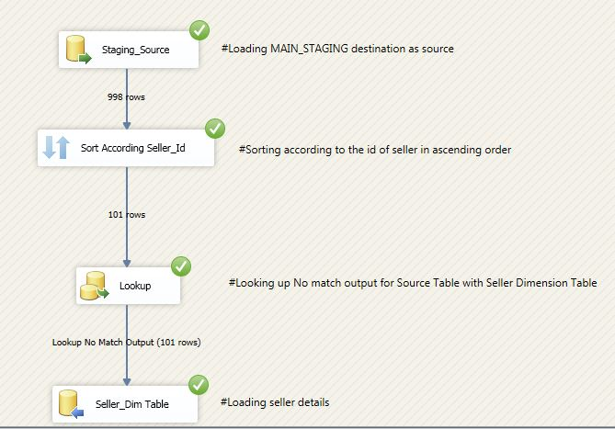
Seller

Slide 13
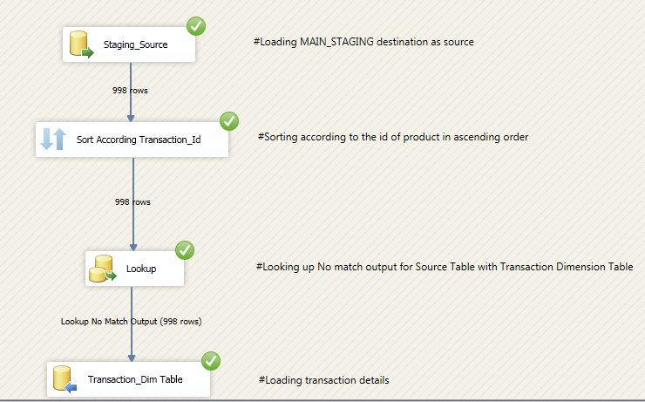
Transaction

Slide 14
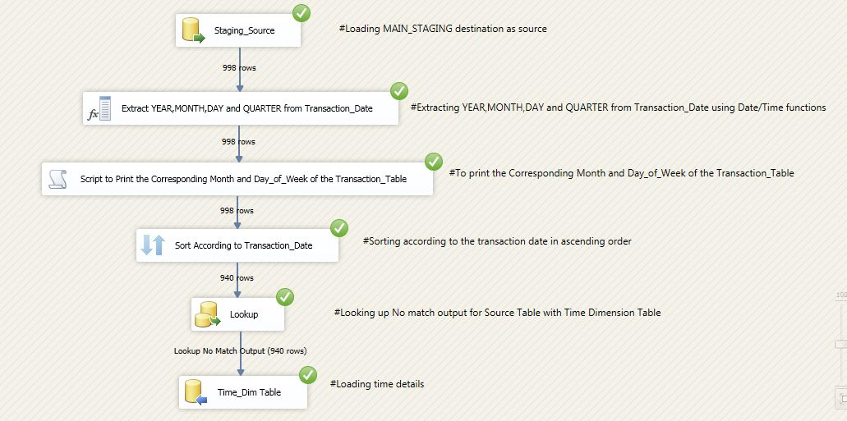
Time

Slide 15
Fact Table
Fact table consists of the measurements, metrics or facts of a business process.
It has two columns: those that contain facts and those that are foreign keys to dimension tables.
A fact table usually contains facts with the same level of aggregation

Slide 16
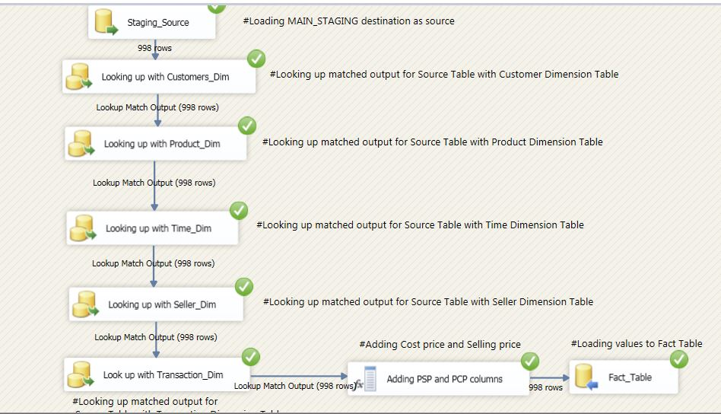
Fact Table

