Slide 1
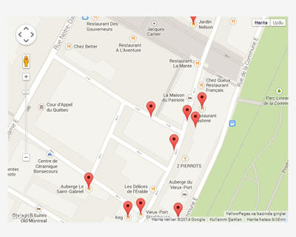

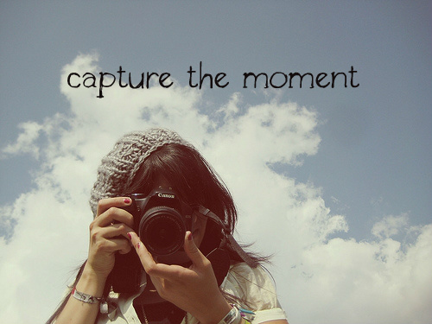
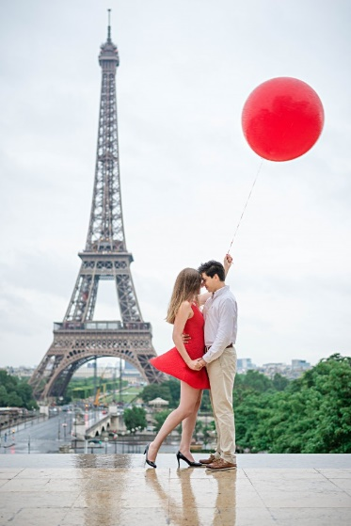
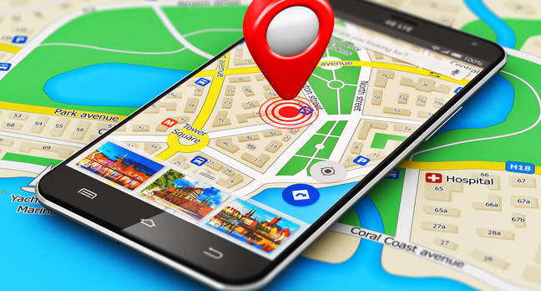
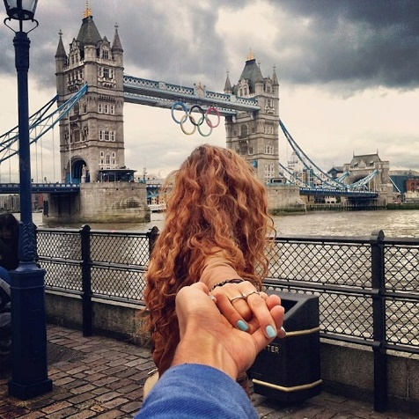
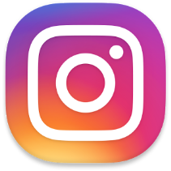
Tourist Go “Capture the moment so it will last forever”

Slide 2
Description
-Android mobile app.
-Enables users to be guided to the “best- view” locations for taking pictures in a city or area.
-Makes use of geo-data.
-Plan a trip around a city/area for taking pictures.
-Share posts on social media.

Slide 3
Technologies used
-Android studio.
-XML for front-end.
-Java.
-Firebase Cloud Service.
-Google Maps Api.
-Picasso library for images.
-Dropbox and Github to share project on.

Slide 4
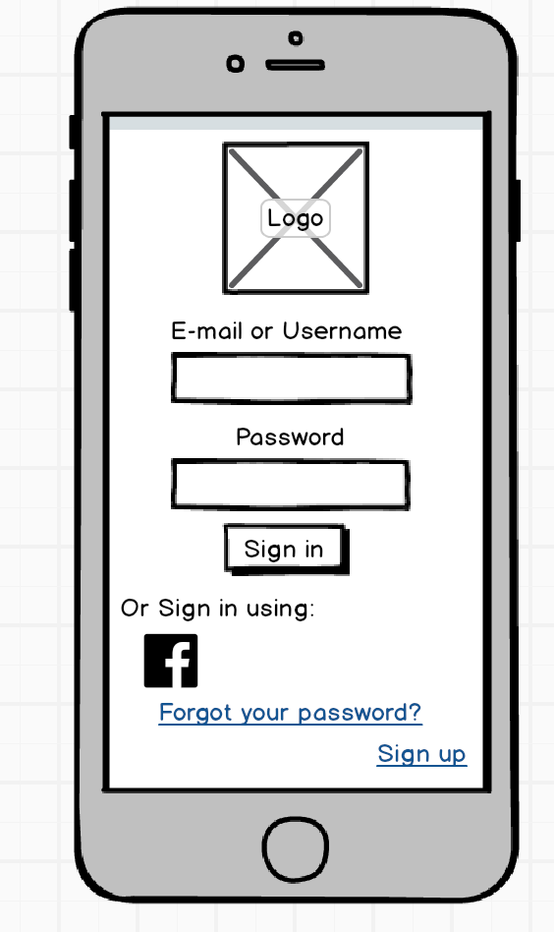
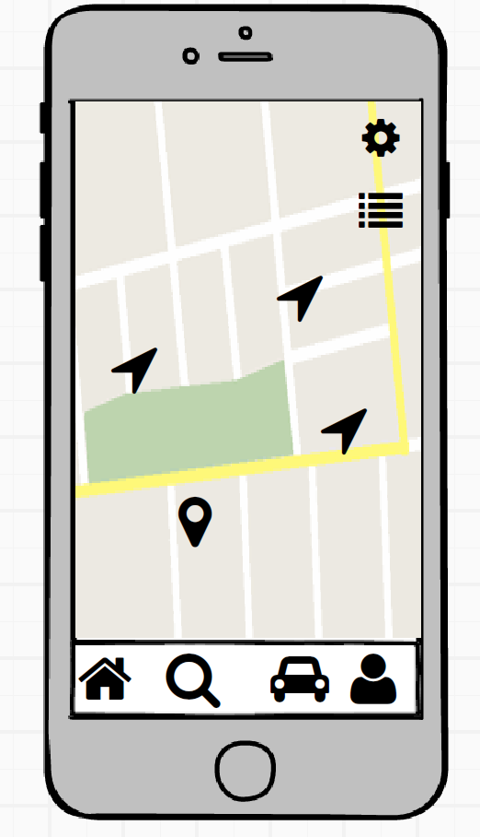
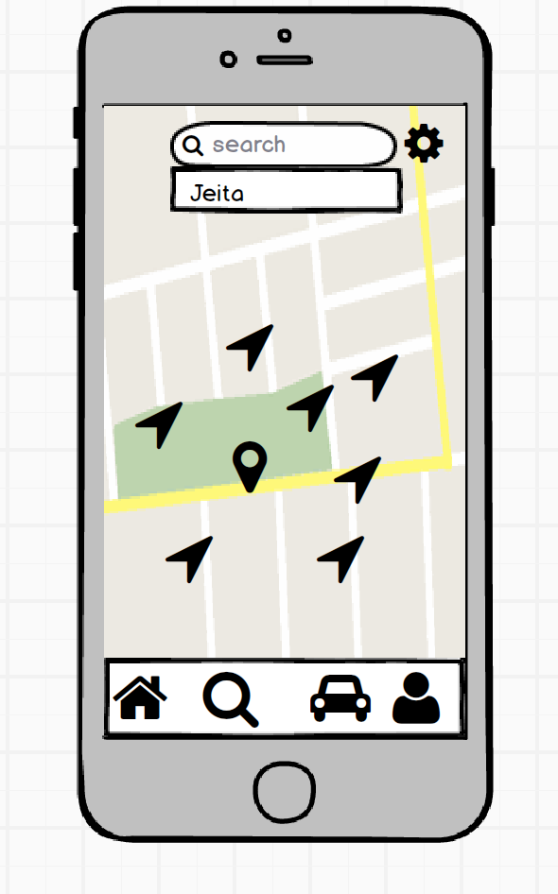
Design

Slide 5
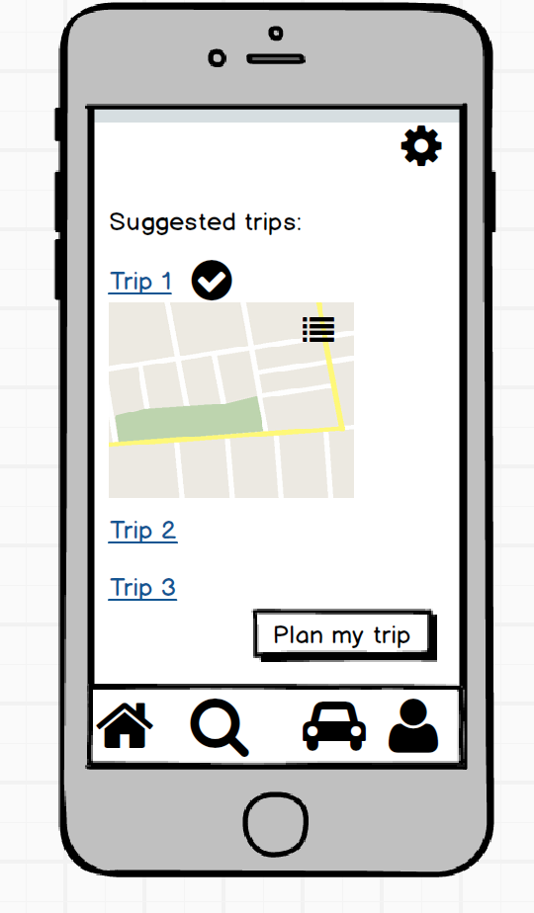
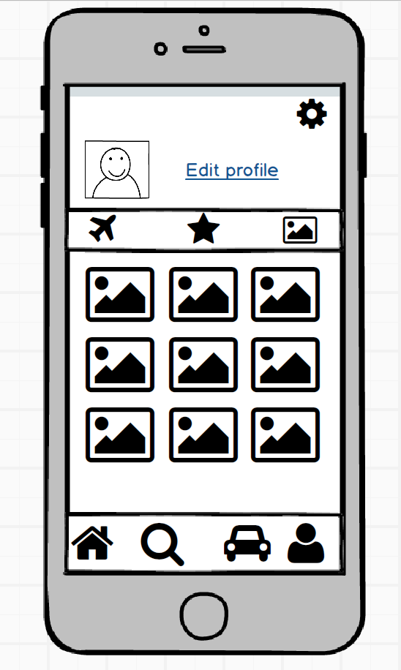
Design

Slide 6
Demo

Slide 7
Prepared by
Mohammad Alhoussein
Sirine Baba
Fawzi Chwayfaty

Slide 8
Thank you!

