Slide 1
I’m a title
I’m a subtitle

Slide 2
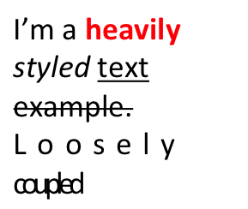


I’m text inside of a text box.
I’m centered.
No, really.
Right aligned
text
I’m a very
Long text
which has
breaks which
Should be passed
In the response.
I am
A
Bulleted list
Going down?
I am
A
Numbered list
Justified text which is absolutely amazing!

Slide 3




Z-index test
Overflown image

Slide 4
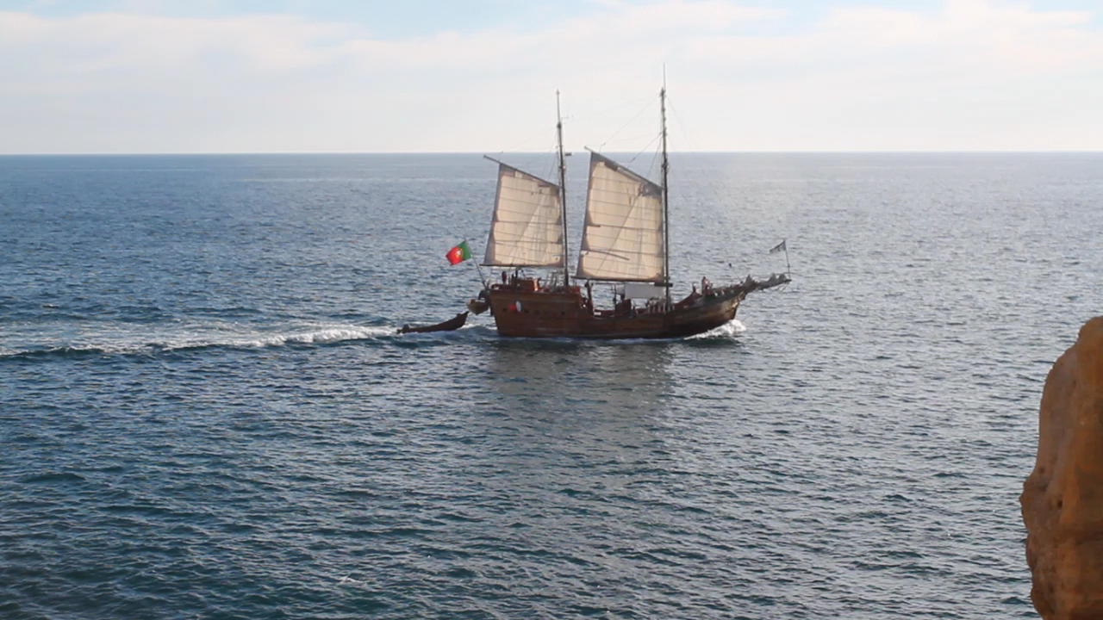
Frames from holidays

