Slide 1
Automated University Timetable Generation System
Team memebers
2520030485-M.Geethika
2520030309-Nuguri siri
GUIDE NAME:

Slide 2
ABSTRACT
The University Timetable Generator is an automated system designed to create efficient and conflict-free academic schedules for universities. It reduces the time and effort required for manual timetable preparation by automatically assigning subjects, faculty members, classrooms, and time slots based on predefined constraints. The system ensures optimal resource utilization, minimizes scheduling conflicts, and provides a user-friendly interface for timetable management. By improving accuracy and flexibility, the University Timetable Generator helps educational institutions streamline their scheduling process and enhance overall academic administration.

Slide 3
Problem Statement
Creating university timetables manually is a complex and time-consuming task that often leads to scheduling conflicts, inefficient utilization of classrooms and faculty, and frequent errors. Managing multiple courses, departments, faculty availability, and classroom constraints makes the process difficult and prone to inconsistencies. There is a need for an automated system that can generate accurate, conflict-free, and optimized timetables while reducing manual effort and improving scheduling efficiency.

Slide 4
Hardware requirements
Processor: Intel Core i3 (or equivalent)
RAM: 4 GB
Storage: 20 GB free disk space
Display: 1366 × 768 resolution monitor
Keyboard and Mouse
Internet Connection (for installing dependencies and updates)

Slide 5
Software requirements
Development Tools
Visual Studio Code (VS Code) – Code editor
Java Development Kit (JDK 17 or above) – Backend development
Node.js and npm – React application development
React.js – Frontend framework
Programming Languages
Java
JavaScript
HTML
CSS

Slide 6
METHODOLOGY
Step 1: Data Collection
Collect details of courses, subjects, faculty members, classrooms, and available time slots.
Store the information in the system database.
Step 2: Constraint Definition
Define scheduling rules such as faculty availability, classroom capacity, subject hours, and department requirements.
Ensure that no faculty member or classroom is assigned to multiple classes at the same time.
Step 3: Timetable Generation
The system processes the collected data and constraints.
It automatically assigns subjects, faculty, classrooms, and time slots to generate a conflict-free timetable.
Step 4: Validation
Check the generated timetable for scheduling conflicts and rule violations.
Verify that all subjects receive the required number of sessions.
Step 5: Timetable Display
Display the generated timetable through the React-based user interface.
Allow users to view and manage schedules easily.
Step 6: Modification and Updates
Enable administrators to make changes when required.
Regenerate the timetable after updating data or constraints.
Step 7: Final Output
Produce an optimized and accurate timetable for students, faculty, and administrators.

Slide 7
Existing system
The existing timetable scheduling process in many universities is performed manually using spreadsheets, documents, or paper-based methods. Administrators create timetables by considering faculty availability, classroom allocation, and course schedules, which requires significant time and effort.
Limitations of the Existing System
Time-consuming timetable preparation.
High chances of scheduling conflicts.
Difficult to manage faculty and classroom availability.
Frequent manual errors and inconsistencies.
Limited flexibility for modifications and updates.
Inefficient utilization of resources.
Increased administrative workload.

Slide 8

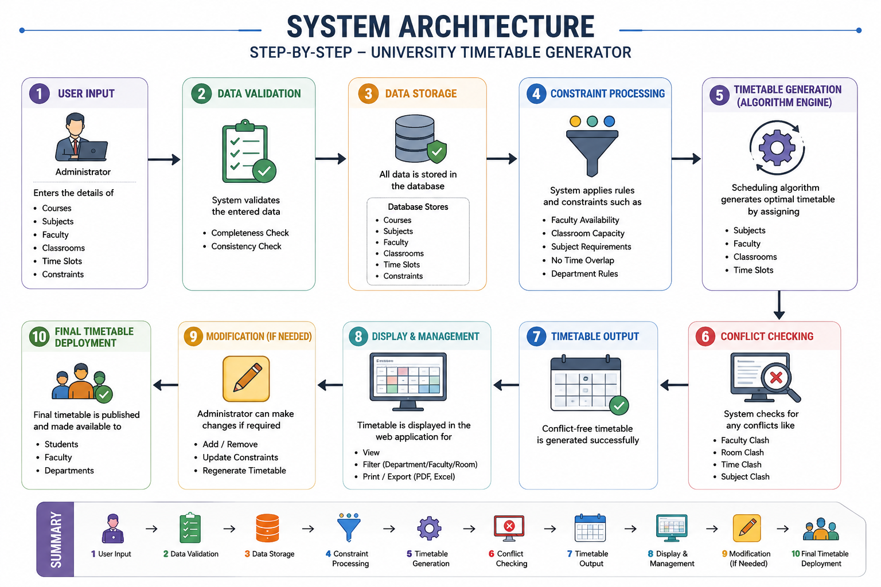

Slide 9
Proposed system
The proposed University Timetable Generator is an automated web-based application developed using React.js for the frontend and Java for the backend., classroom allocation, subject requirements, and time-slot constraints. It minimizes manual effort, reduces scheduling errors, and allows easy modification and regeneration of timetables whenever required.
Advantages of Proposed System
Automated timetable generation.
Eliminates scheduling conflicts.
Reduces manual workload.
Saves time and effort.
Efficient utilization of faculty and classrooms.
Easy timetable updates and modifications.
User-friendly web interface.
Improved accuracy and reliability.

Slide 10
