Slide 1
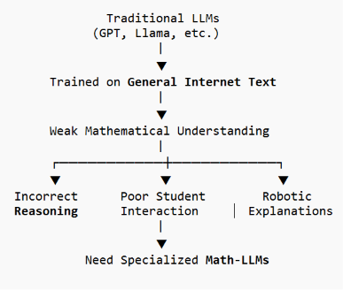
Development of Specialized Math-LLMs for Mathematics Education
115 . Math-LLMs: AI Cyberinfrastructure with Pre-trained
Transformers for Math Education
Problem Statement:
Traditional Large Language Models such as GPT and Llama are trained on general text and often struggle with mathematical reasoning, educational conversations, and personalized student guidance.
Existing math datasets mainly contain:
Mathematical problems and solutions
Scientific papers
AI-generated datasets
They do not contain authentic student–teacher mathematical conversations.
Real-World Need:
The education sector requires AI tutors that can
Understand mathematics deeply
Explain concepts naturally
Provide personalized assistance
Improve K-12 learning
Key Takeaway: General-purpose LLMs are not sufficient for mathematics
education, motivating the development of specialized Math-LLMs.
ROLL NO-CH.SC.U4CSE24038

Slide 2
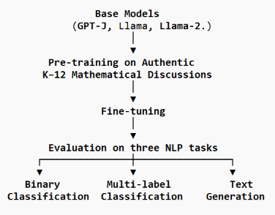
Development of Specialized Math-LLMs for Mathematics Education
Understanding of the Problem
Objective:
Develop specialized Math-LLMs by pre-training Large Language Models on authentic K–12 mathematical discussions to improve mathematical reasoning and educational assistance.
Proposed Workflow
Why Existing LLMs Fall Short:
Trained on general internet text
Limited understanding of mathematical reasoning
Cannot effectively understand student learning patterns
Generate generic explanations instead of teacher-like guidance
Expected Improvements
Better at solving mathematics
Better at understanding student language
Better at generating human-like explanations
Research Questions
RQ1-
Does increasing fine-tuning data improve performance?
RQ2
Does mathematical pre-training improve downstream NLP tasks?
RQ3
Does mathematical pre-training improve text generation?
ROLL NO-CH.SC.U4CSE24038

Slide 3
Development of Specialized Math-LLMs for Mathematics Education
DATASETS & ML TECNIQUES
Datasets Used
DATASET | Purpose | Evaluation
Algebra Nation (Math Nation) | Pre-train LLMs using authentic K–12 mathematical discussions (3.09M discussion–reply pairs, 71,918 users) | Improves mathematical understanding
ASSISTments | Binary Classification (Correct/Incorrect student answers) | Accuracy
NCTE Classroom Transcript Dataset | Multi-label Classification (Teacher–Student dialogues) | Precision, Recall, F1-score
Reserved Algebra Nation Dataset (1000 discussions) | Text Generation | BLEURT, BERTScore, Readability, Coherence
ML Techniques Proposed
1)Transformer-based Large Language Models (LLMs)
Models used: GPT-J, Llama, Llama-2
Understand mathematical context and natural language
Serve as the base models for training
2) Pre-training
Learns mathematical reasoning
Understands student–teacher interactions
Improves domain knowledge before fine-tuning
3) Fine-tuning
The pre-trained models are adapted to perform specific NLP tasks.
Binary Classification
Multi-label Classification
Text Generation
4) LoRA (Low-Rank Adaptation)
Efficient fine-tuning technique
Reduces GPU memory usage
5) Q-LoRA (Quantized LoRA)
Uses quantized weights to updated parameters
Lower memory requirements
6) Adam Optimizer
Updates model parameters
Faster convergence
ROLL NO-CH.SC.U4CSE24038

Slide 4
Development of Specialized Math-LLMs for Mathematics Education
Interpretation of the Solution
The proposed solution improves existing LLMs by training them on authentic K–12 mathematical discussions.
Pre-trained GPT-J, Llama, and Llama-2 on authentic K–12 mathematical discussions.
Fine-tuned the models for binary classification, multi-label classification, and text generation.
Compared the pre-trained models with the original models.
Pre-trained models achieved better mathematical reasoning and more natural educational responses.
ROLL NO-CH.SC.U4CSE24038

