Slide 1
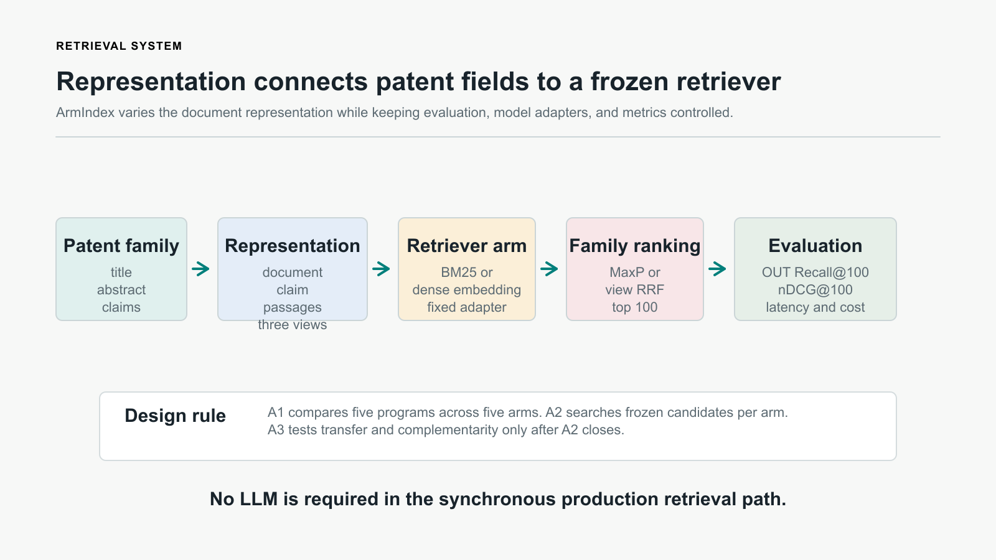
ADVISOR UPDATE | 18 AUGUST 2026
ArmIndex
Retriever-conditioned representation search for cross-domain patent retrieval.
A controlled sequence: foundation -> common screen -> per-arm search -> transfer and harness design.
A0
A1
A2
Complete
25 / 25
Closed
Reproducibility foundation
Measured REP-DEV screen
44 measured; 8 dormant
A2 has receipt-bound aggregate development evidence; A3 awaits a hash-bound Train-250 package.
Notes:
Open with the research question and evidence boundary. A2 is closed with exact aggregate accounting, but its results remain development evidence rather than Selection or Final confirmation.
[Sources]
[P1] ArmIndex Research Plan V02
[P2] Current campaign plan
[P11] A2 Goal 004
[P17] A2 closeout projection

Slide 2
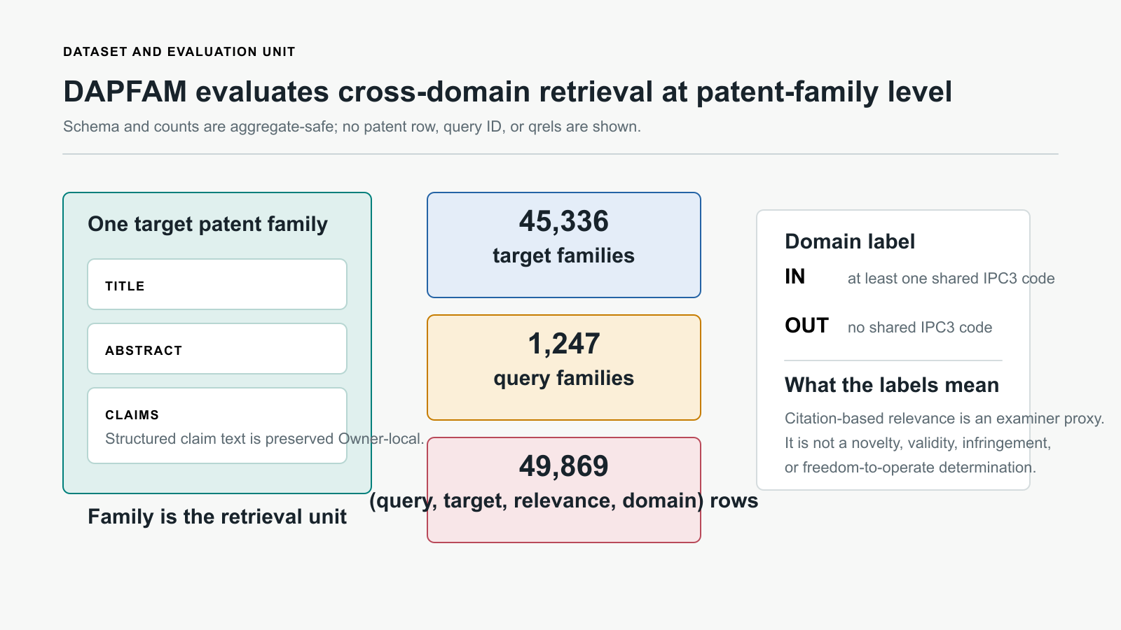
CONTEXT | DAPFAM
A patent family is the retrieval unit
A family carries heterogeneous technical and legal text across its ordered fields.
45,336 target families; 1,247 query families; 49,869 evaluation rows.
IN shares at least one IPC3; OUT shares none.
Citation relevance is an examiner proxy, not a legal conclusion.
Raw patent text, IDs, qrels, rankings, and per-query outcomes remain Owner-local.
02 / 18
Notes:
Explain why one isolated chunk is inadequate: patent-family retrieval aggregates several fields and publications. The figure deliberately shows the schema, not a raw protected record.
[Sources]
[P3] DAPFAM source contract
[R1] DAPFAM dataset paper

Slide 3
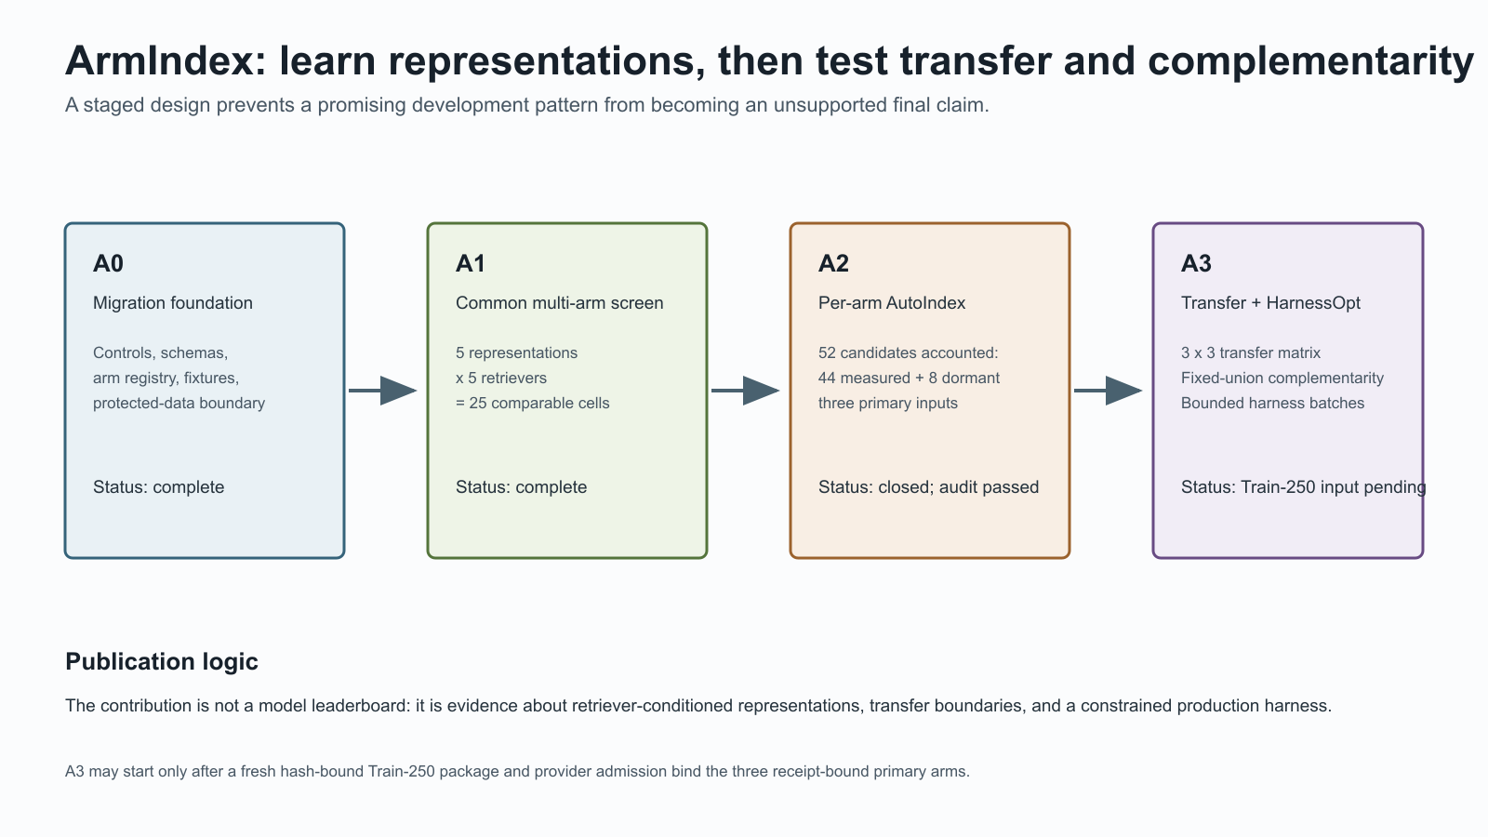
METHODOLOGICAL LINEAGE | GEPA
GEPA motivates bounded program search
The target changes: executable document representations, not free-form answer prompts.
GEPA lineage
Reflective, evidence-driven optimization within a constrained text space.
ArmIndex adaptation
A schema-valid representation program is frozen before deterministic retrieval.
Scientific boundary
The proposer and reviewer do not receive protected evaluation signal or results.
03 / 18
Notes:
GEPA is methodological lineage, not a reproduced result. A2 uses Official Codex only before measurement to propose/review bounded, falsifiable programs; production retrieval stays deterministic and hash-bound.
[Sources]
[R2] GEPA paper
[P14] A2 Official Codex bridge
[P1] ArmIndex Research Plan V02

Slide 4
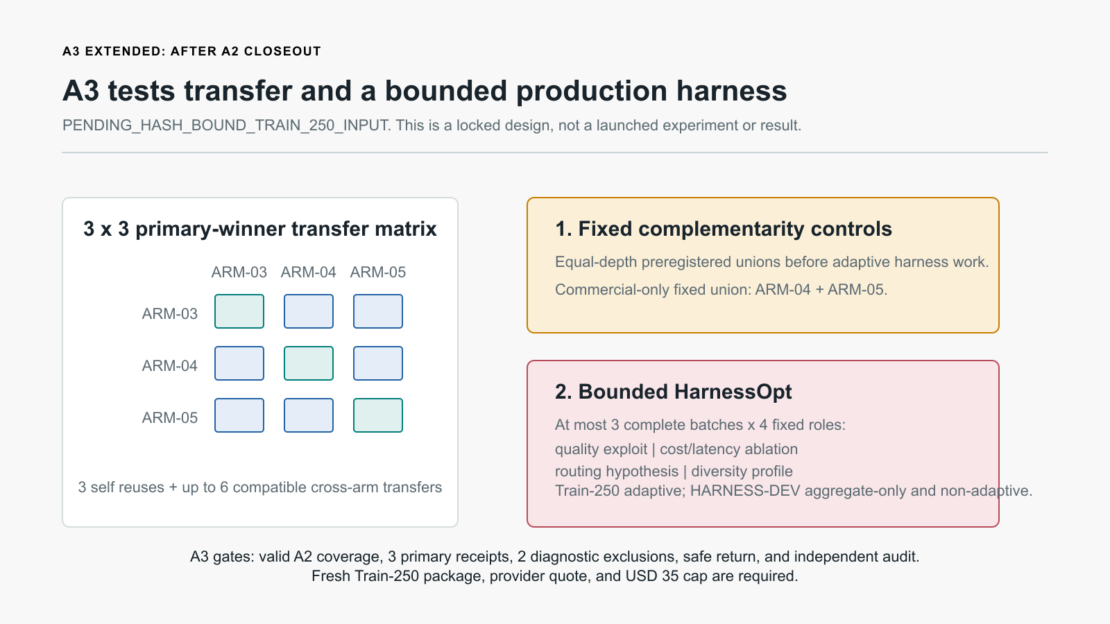
RESEARCH PROGRAM
ArmIndex separates four scientific questions
The phases intentionally turn one broad idea into testable claims.
1
Search
Which program fits each frozen arm?
2
Transfer
Can one arm's winner help another?
3
Coverage
Do equal-depth unions recover more families?
4
Harness
Does quality justify cost and latency?
04 / 18
Notes:
Use this as the talk's roadmap. Each phase supports a distinct inference and controls what later phases may adapt on.
[Sources]
[P1] ArmIndex Research Plan V02
[P13] A3 Extended Goal 003

Slide 5
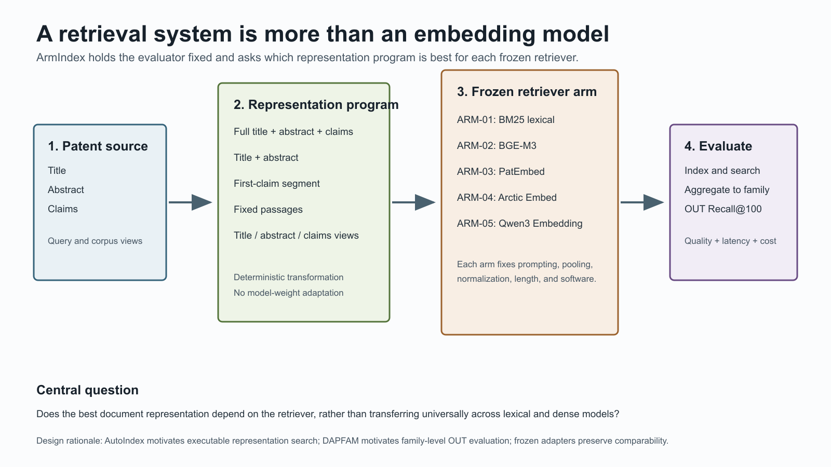
RETRIEVAL FOUNDATIONS
Retrieval quality is a full-system property
Representation affects what is indexed, aggregated, ranked, and ultimately evaluated.
Chunking / unitization
Family, claim, fixed passage, or field view.
Embedding / indexing
Frozen templates, pooling, and similarity.
Aggregation
MaxP or multiview RRF to one family ranking.
Evaluation
OUT Recall@100; retain quality, latency, and cost.
05 / 18
Notes:
This slide establishes why chunking is part of the scientific treatment rather than preprocessing. Keep the causal claim modest: ArmIndex measures associations under frozen execution, not a universal mechanism.
[Sources]
[P4] Deterministic common-program compiler
[R1] DAPFAM dataset paper

Slide 6
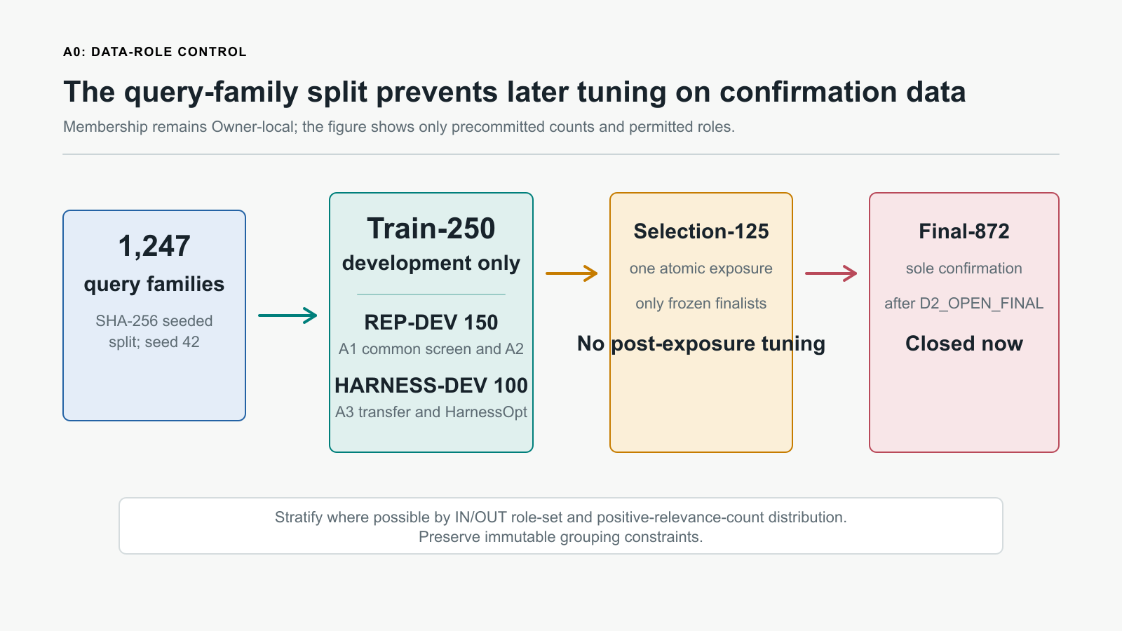
A0 | SCIENTIFIC CONTROL
A0 separates evidence roles
Development can adapt; later evidence remains reserved for later decisions.
150
100
REP-DEV
HARNESS-DEV
Selection-125 is an atomic finalist exposure. Final-872 is the sole confirmation set and remains closed.
The protocol releases only aggregate-safe counts and hashes; protected membership and qrels never leave Owner-local storage.
06 / 18
Notes:
The Train-250 split uses seed 42 and protected deterministic membership. Explain the role separation before showing any A1 quality result.
[Sources]
[P5] REP/HARNESS split decision
[P6] A1 publication-impact preregistration

Slide 7
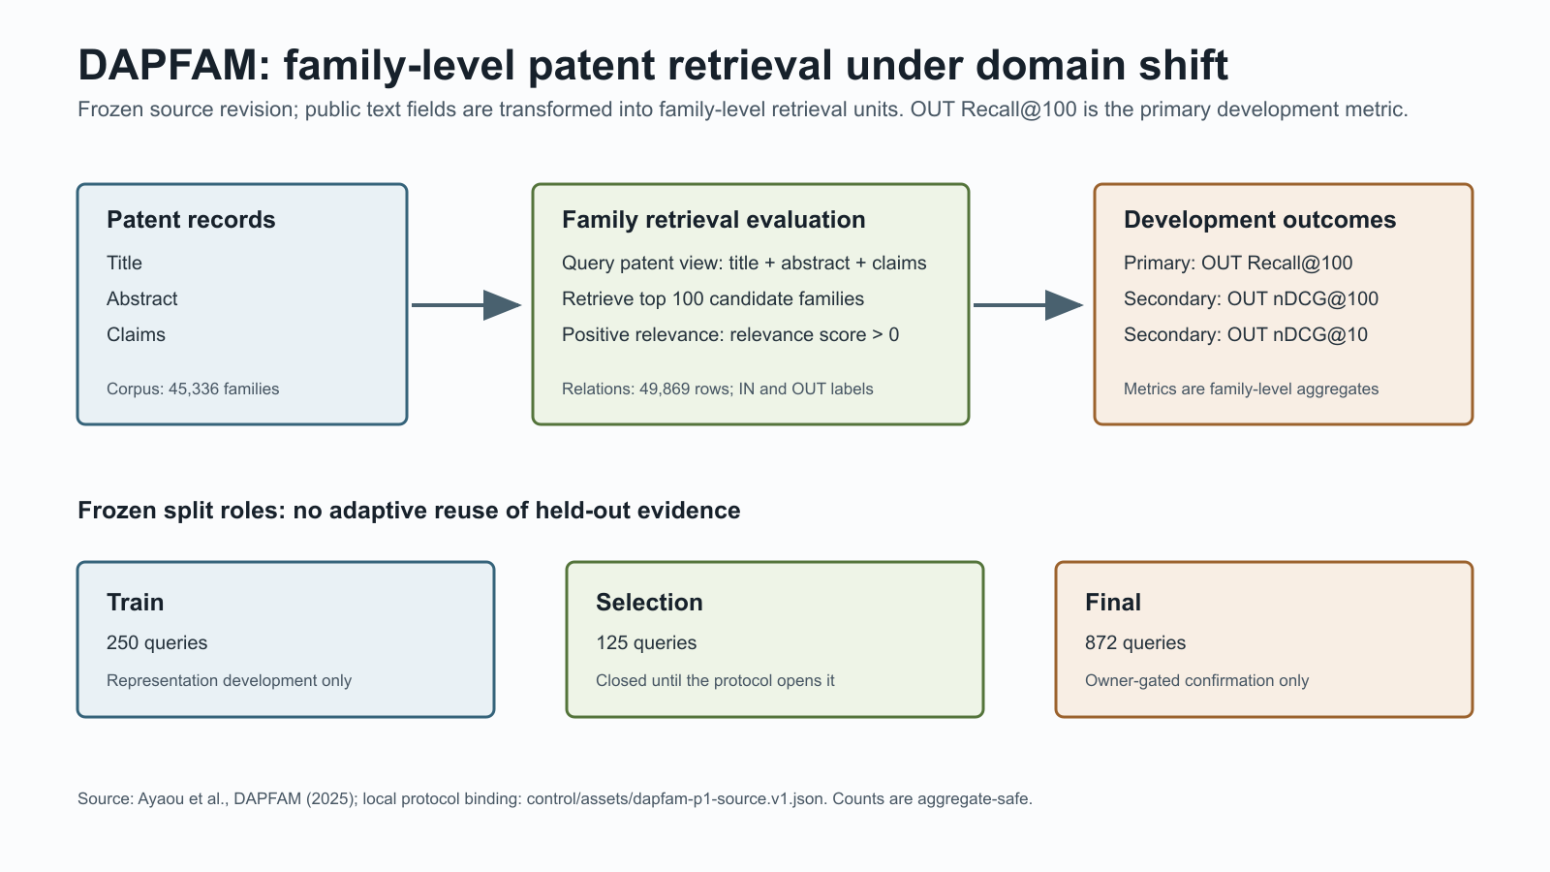
A0 | FOUNDATION
A0 delivered infrastructure, not a score
The first phase makes later evidence reproducible, auditable, and protected.
Canonical controls, schemas, five-arm registry, source locks, and safe evidence paths.
CPU adapter and contract fixtures validated before measured retrieval.
No measured retrieval run, GPU scientific run, protected payload, Selection access, or Final access in A0.
A0 establishes a trustworthy substrate; it makes no retrieval-quality claim.
07 / 18
Notes:
Make the absence of an A0 quality score explicit. The foundation is evidence infrastructure, not a performance claim.
[Sources]
[P7] A0-A2 advisor progress report

Slide 8
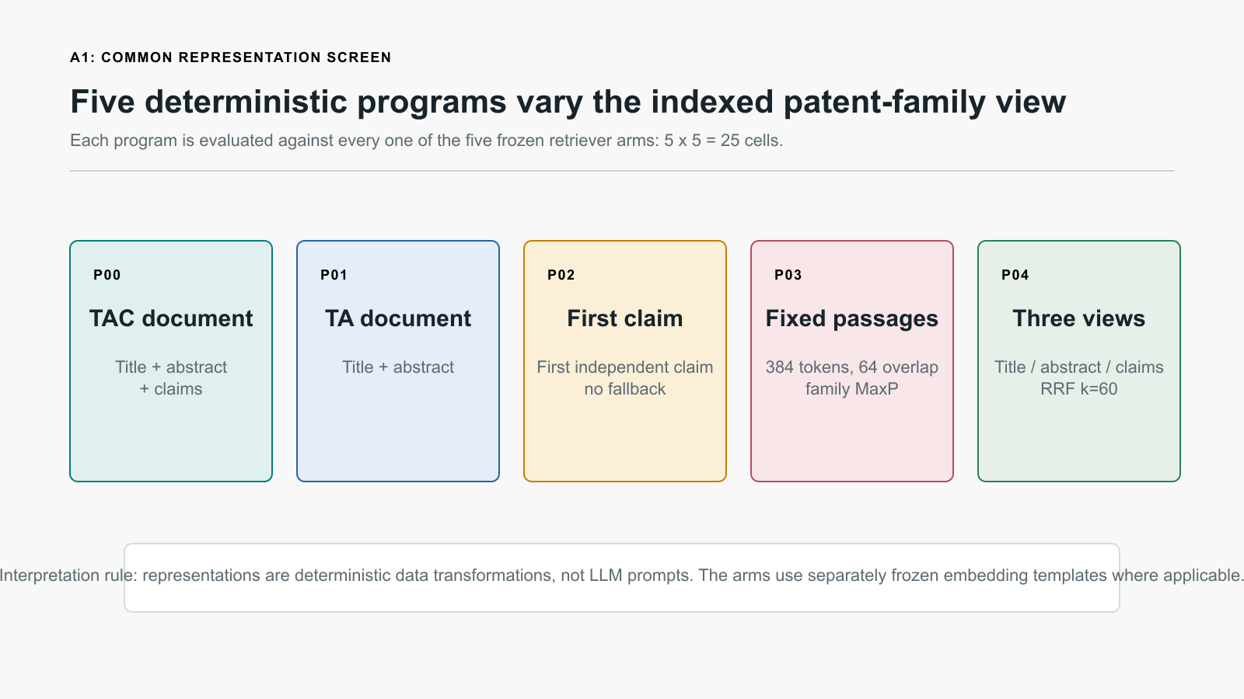
A1 | COMMON SCREENING
A1 is a controlled 5 x 5 screen
Five common representations are measured against five frozen retrieval arms.
The comparison changes one factor
P00 full TAC document
P01 title + abstract
P02 first independent claim
P03 fixed passages
P04 field-specific multiview
25 / 25 valid logical cells on REP-DEV | USD 11.161632
08 / 18
Notes:
A1 is a common screen, not a final model-selection result. The only changing treatment is the deterministic representation program; evaluator and role remain fixed.
[Sources]
[P4] Deterministic common-program compiler
[P8] A1 validated aggregate evidence

Slide 9
A1 | FROZEN RETRIEVERS
Five diverse arms expose the interaction
The arms differ in lexical/dense behavior, domain training, context envelope, and template semantics.
Arm
Frozen source
Retrieval role
Envelope
License
ARM-01
bm25s==0.3.10
Lexical CPU anchor
k1=1.2; b=0.75
MIT
ARM-02
BAAI/bge-m3
Generic dense
1,024d; 8,192 tokens
MIT
ARM-03
datalyes/patembed-large
Patent-domain dense
1,024d; 512 tokens
CC-BY-NC-SA
ARM-04
Snowflake Arctic Embed M v2.0
Long-context dense
768d; 8,192 tokens
Apache-2.0
ARM-05
Qwen3-Embedding-0.6B
Instruction-aware dense
1,024d; 32,768 tokens
Apache-2.0
Exact public revisions, pooling, query/document templates, and non-commercial qualification for ARM-03 are frozen in the speaker notes and backup material.
09 / 18
Notes:
Each arm is bound to a specific model revision and adapter template. ARM-01 has no embedding prompt. ARM-03 remains research/non-commercial. The full exact templates are documented in Appendix B of the material.
[Sources]
[P9] A1 model source locks
[P10] Frozen dense adapter contract
[R4]-[R7] Official model cards

Slide 10
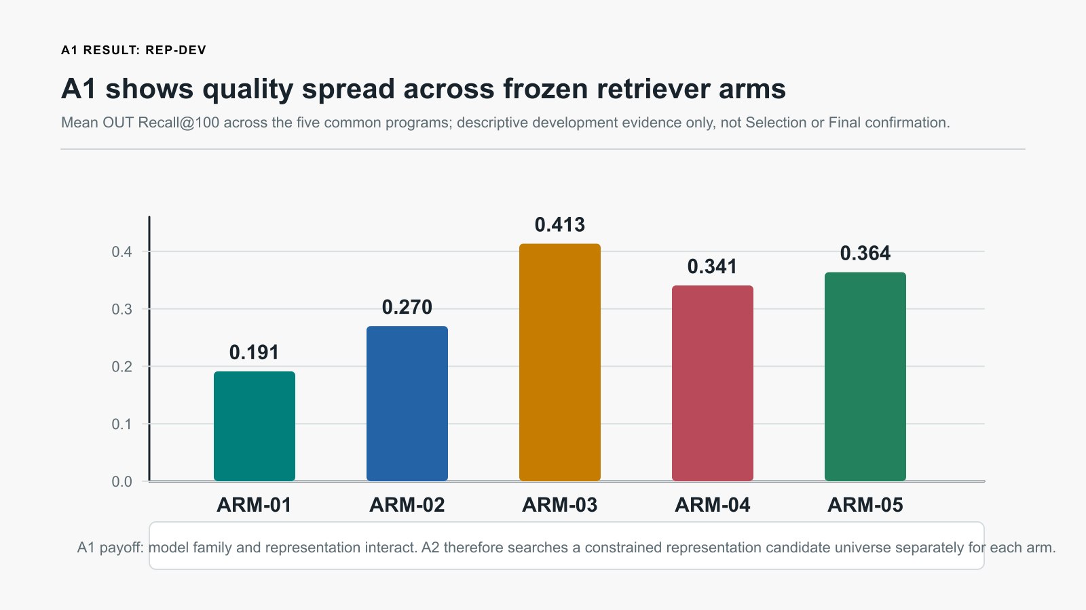
A1 | REP-DEV RESULT
A1 reveals a broad quality range
The representation surface differs across frozen retriever arms.
P03
Highest common cell
Fixed passages obtain the highest individual Recall@100 cell in all five arms.
ARM-03, ARM-04, and ARM-05 pass the frozen promotion rule; ARM-01 and ARM-02 remain diagnostic/non-advancing in A2.
REP-DEV descriptive evidence only; not Selection or Final confirmation.
10 / 18
Notes:
Read the arm means as a quality spread, not a final model selection. The arm-level numbers are 0.191, 0.270, 0.413, 0.341, and 0.364 mean OUT Recall@100 for BM25, BGE-M3, PatEmbed, Arctic, and Qwen3 respectively.
[Sources]
[P8] A1 cell EDA CSV and validated figures

Slide 11
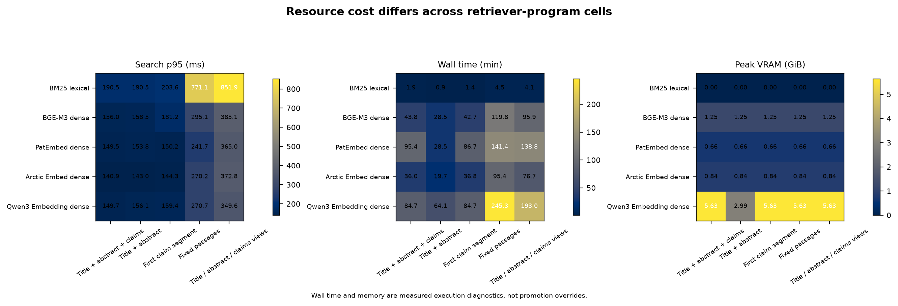
A1 | OPERATIONAL EVIDENCE
Quality gains bring physical work
The quality-latency-cost frontier is a result, not an afterthought.
The full receipt-bound frontier retains quality, p95 latency, wall time, VRAM, RAM, index size, and cost together.
11 / 18
Notes:
Use the EDA to distinguish the common-screen pattern from deployment policy. No conclusion is drawn from Recall alone; later phases preserve p95 latency, throughput, cost, RAM, VRAM, and index-size receipts.
[Sources]
[P8] A1 efficiency EDA
[P13] A3 Extended Goal 003

Slide 12
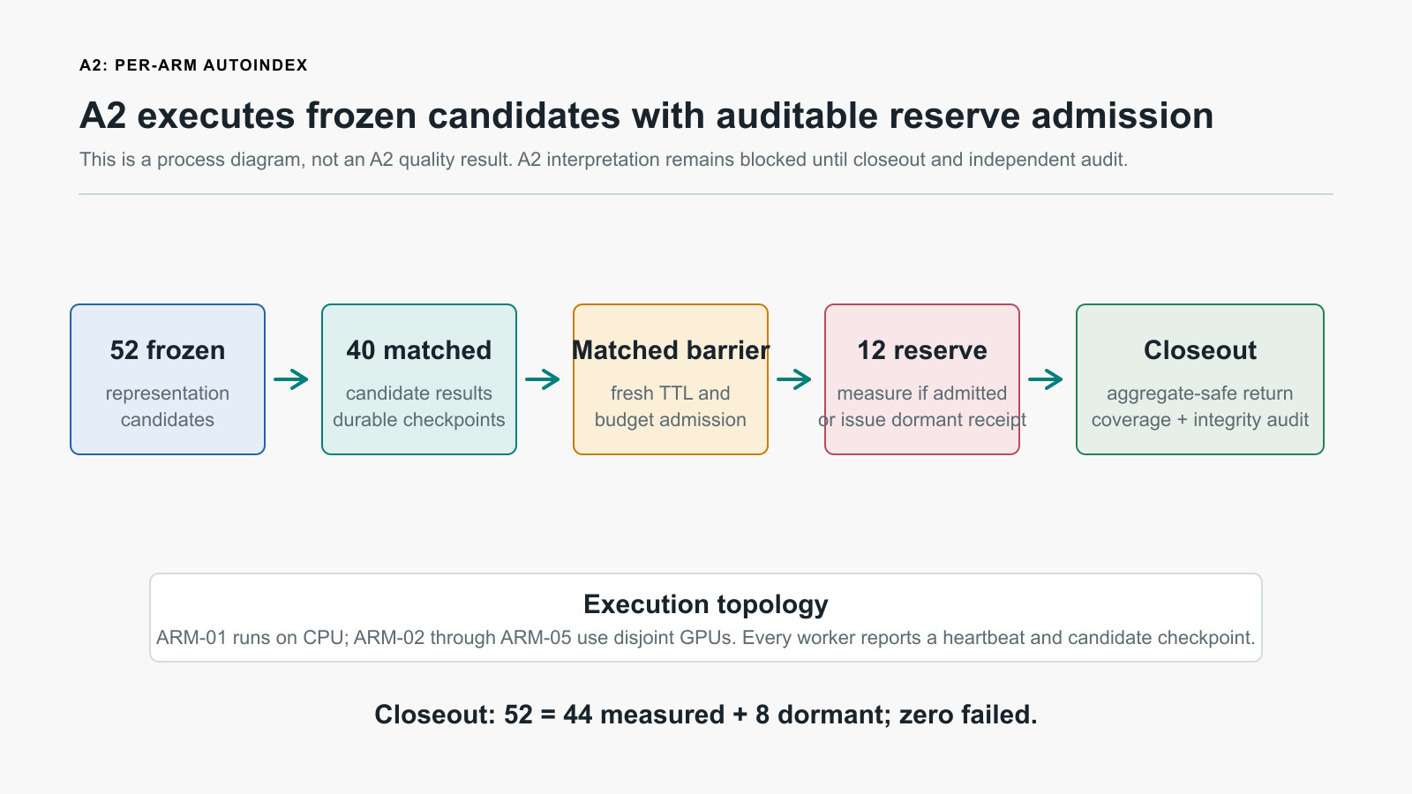
A2 | PER-ARM AUTOINDEX
A2 evaluates a frozen candidate universe
Candidate generation is pre-measurement; evaluation remains deterministic and checkpointed.
52
Frozen candidates
40 matched + 12 conditional reserve candidates
ARM-01 is CPU; ARM-02-05 use separate GPUs.
Each candidate has a durable checkpoint and heartbeat.
Reserves need fresh barrier, budget, and TTL admission.
12 / 18
Notes:
Define dormant carefully. A dormant reserve candidate is not zero, null, failure, or equal to the baseline. It was not evaluated because its pre-registered admission predicate did not trigger.
[Sources]
[P11] A2 Goal 004
[P12] A2 execution runbook
[P14] A2 Official Codex bridge

Slide 13
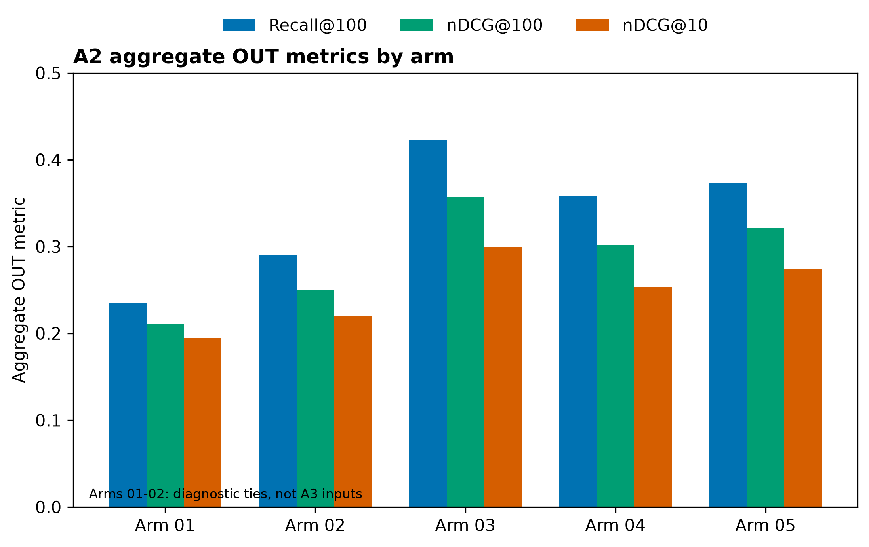
A2 | MEASURED CLOSEOUT
A2 closes with bounded primary inputs
Exact accounting, safe return, and an independent audit support aggregate-only interpretation.
ARM-03
Recall@100 0.4230; numerical tie to A1 at presentation precision.
ARM-04
Recall@100 0.3587; strict +0.0060 improvement over A1.
ARM-05
Recall@100 0.3737; no strict A1 improvement, retained for transfer.
13 / 18
Notes:
A2 passed execution closeout and result-integrity audit: 52 equals 44 measured plus 8 dormant, with zero failures, safe return, and worker reaping. ARM-01 and ARM-02 are three-way diagnostic ties with no winner and are excluded. ARM-03, ARM-04, and ARM-05 are the three approved A3 transfer inputs. No Selection or Final claim is supported.
[Sources]
[P11] A2 Goal 004
[P17] A2 closeout projection
[P18] A2 execution closeout and integrity audit

Slide 14
A3 EXTENDED | PENDING INPUT PACKAGE
A3 needs a fresh hash-bound Train-250 package
ARM-03, ARM-04, and ARM-05 are prepared; admission and spend remain closed.
Transfer
3 self-reuses + up to 6 compatible cross-arm transfers.
Complementarity
Equal-depth unions first; commercial-only union is ARM-04 + ARM-05.
HarnessOpt
At most three complete batches; quality, cost/latency, routing, and diversity roles.
Admission
Hash-bound Train-250, fresh provider receipt, USD 35 A3 cap, USD 180 campaign ceiling.
14 / 18
Notes:
A3 is prepared but cannot launch. It requires a fresh Owner-authorized hash-bound Train-250 query/corpus/evaluator package, then a fresh provider admission. The three-primary route excludes ARM-01 and ARM-02 permanently from A3 optimization.
[Sources]
[P13] A3 Extended Goal 003
[P5] REP/HARNESS split decision
[P17] A2 closeout projection

Slide 15
TAKEAWAY
ArmIndex is an auditable interaction test
The contribution is a defensible research sequence, not a one-off model win.
A0
A1
A2
A3
made the scientific sequence controlled and reproducible.
showed a representation-by-retriever quality and cost surface.
closed with three transfer inputs and bounded negative evidence.
will test the three-primary transfer and operational frontier.
The next meaningful update is a hash-bound Train-250 package and fresh A3 admission, not reuse of an idle instance.
15 / 18
Notes:
Close on the evidence sequence. The advisor discussion is whether the A2 evidence justifies the bounded three-primary A3 design and whether its required Train-250 package can be bound without weakening the protocol.
[Sources]
[P1] ArmIndex Research Plan V02
[P11] A2 Goal 004
[P13] A3 Extended Goal 003

Slide 16
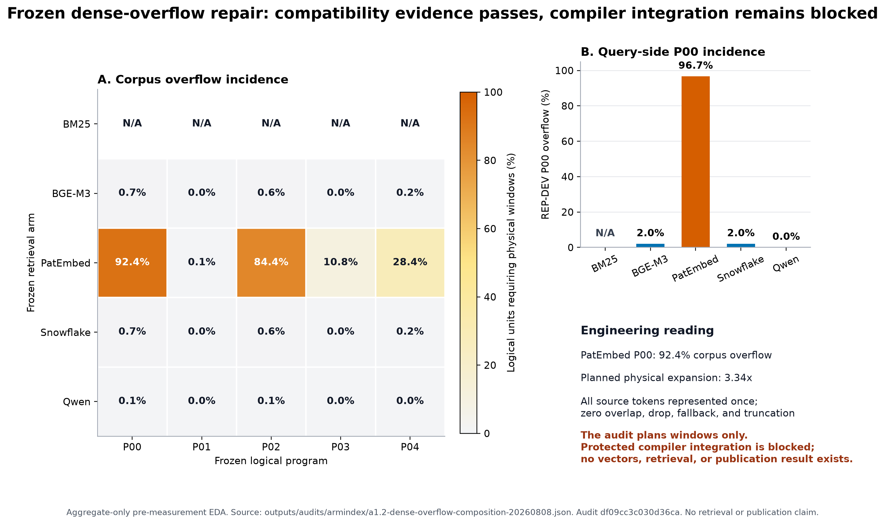
APPENDIX A | EVIDENCE ROLES
Appendix: the split protects the sequence
The allocation is a protocol decision that limits what can adapt at each stage.
REP-DEV is used for A1 screening and A2 representation search.
HARNESS-DEV supports A3 transfer, complementarity, and bounded harness optimization after representation freeze.
Selection and Final remain protected from adaptive development use.
16 / 18
Notes:
This backup slide documents the rationale for the staged split and shows a safe aggregate windowing diagnostic. It does not open protected membership or qrels.
[Sources]
[P5] REP/HARNESS split decision
[P6] A1 preregistration
[P8] Dense-overflow EDA

Slide 17
APPENDIX B | MODEL CONTRACTS
Appendix: frozen model contracts
Templates, pooling, and revisions are part of each measured retrieval identity.
Arm
Query template
Document / pooling
Revision
ARM-01
No embedding prompt
BM25 lexical scoring
bm25s==0.3.10
ARM-02
{query}
{document}; official dense parity
5617a9f...
ARM-03
encode query for different document retrieval: {query}
document prefix; mean non-padding
2d5c0f9...
ARM-04
query: {query}
{document}; CLS / first token
95c2741...
ARM-05
Instruct: Retrieve patent families ... Query:{query}
{document}; last token / left padding
97b0c61...
Full immutable template text, public hashes, dimensions, token envelopes, licenses, and pooling rules are retained in the source locks and the talk material.
17 / 18
Notes:
Read exact binding from the material Appendix A. ARM-02 revision 5617a9f61b028005a4858fdac845db406aefb181; ARM-03 2d5c0f92a3e5dc3d5415c08e612c57543c0e03ad; ARM-04 95c2741480856aa9666782eb4afe11959938017f; ARM-05 97b0c614be4d77ee51c0cef4e5f07c00f9eb65b3.
[Sources]
[P9] A1 model source locks
[P10] Frozen dense adapter contract
[R4]-[R7] Official model cards

Slide 18
APPENDIX C | PROMPT GOVERNANCE
Appendix: audited prompt governance
Official Codex proposes and reviews only pre-measurement, aggregate-safe candidate programs.
Proposer template
Independent reviewer template
Returns schema-constrained JSON for exactly four requested slots.
Checks determinism, role fit, duplication, safety, and interpretability.
Uses only frozen aggregate-safe operation payload.
Cannot change evaluator, metrics, promotion rule, model weights, or protected split.
States a falsifiable intervention, comparator, expected direction, and failure condition.
No qrels, query IDs, memberships, rankings, protected text, or measured results.
Preserves accepted candidates byte-for-byte on revision rounds.
Accepts only candidates satisfying every frozen check.
Model binding: gpt-5.6-sol, high reasoning effort, before A2 measurement. Full exact prompt templates are retained in the speaker notes and material Appendix D.
18 / 18
Notes:
Full exact proposer template:
You are the Official Codex representation proposer for a pre-measurement, five-arm patent-retrieval study. Return only JSON matching the supplied output schema.
Use only the frozen aggregate-safe payload below. Propose exactly the four requested candidate slots. Preserve every candidate ID and role exactly. Make each hypothesis falsifiable, retriever-conditioned, compatible with the listed source fields, and distinct from the other candidates in the batch. Do not use or request qrels, query IDs, membership, rankings, per-query outcomes, protected text, credentials, provider payloads, or measured results. Do not claim that an unmeasured candidate improves retrieval. Do not expose hidden reasoning.
For program fields, use only the allowed source fields and ensure field_order contains exactly the same fields once. Keep logical passage sizes conservative for the declared arm limit. ARM-01 and ARM-02 candidates are diagnostic only when the payload says advancement_eligible=false.
Every hypothesis must identify one deterministic representation intervention, the frozen within-arm comparator, the expected direction that can later be falsified, and a concrete failure condition without claiming improvement. Avoid learned, adaptive, data-dependent, ranking-dependent, or unspecified processing. Keep each candidate attributable to its declared axis and explain it in language suitable for a journal ablation. For conditional reserve slots, state that the candidate remains dormant unless the frozen activation predicate is satisfied. Apply every reviewer_required_changes item to its named candidate while keeping the other slots independently valid. On revision rounds, accepted_candidate_ids are immutable: copy those candidates from previous_candidates byte-for-byte, including their hypothesis, program, expected_effect, and failure_risk. Revise only candidate IDs that are not in accepted_candidate_ids. Return all four slots in the canonical order.
Operation payload:
{{OPERATION_PAYLOAD_JSON}}
Full exact reviewer template:
You are the independent Official Codex reviewer for a frozen pre-measurement representation-candidate batch. Return only JSON matching the supplied output schema.
Review only the frozen aggregate-safe context and candidate payload below. You have no proposer transcript and no measured outcomes. Preserve every candidate ID. Check falsifiability, role fit, duplication, protected-boundary safety, arm compatibility, deterministic interpretability, and publication interpretability. Accept only candidates that satisfy every check. Required changes must be specific and must not alter the frozen evaluator, metrics, A1 promotion, model weights, protected split, or diagnostic non-advancement. Do not expose hidden reasoning.
previously_accepted_candidate_ids were accepted in an earlier independent review and are required to be byte-identical in this round. Recheck them, but do not request stylistic changes or reinterpret their scientific semantics. Reject a previously accepted candidate only for a concrete newly observed safety, determinism, duplication, or contract defect.
Operation payload:
{{OPERATION_PAYLOAD_JSON}}
[Sources]
[P14] A2 Official Codex bridge
[P15] A2 representation proposer prompt
[P16] A2 representation reviewer prompt

