Slide 1

SOFT SENSING PREDICTION- SEAGATE
Big data challenge
Name USN Roll
Leelaprasad P 01FE19BCS278 256
Shreesh Bhat 01FE20BCS411 267
Dhananjay K 01FE19BCS131 254
Siri Revant 01FE19BCS126 251

Slide 2
Team Member contributions
Name | Model | Contribution
Leelaprasad P | LSTM | Complete Model
Dhananjay K | Logistic Regression | Complete Model
Shreesh Bhat | Decision Tree Classifier | Complete Model
Siri Revant | KNN classifier | Complete Model

Slide 3
INTRODUCTION
Soft sensing problem:
Wafer manufacturing is highly complex and takes a long time
To improve predictability and product yield, Seagate has added a lot of sensors and measurements in the manufacturing line
The sensors and measurements are noisy, expensive and take a long time to manage
We want to save the time for measurement and get better insights into the predictive value of these sensors for product quality by using learning models to predict the measurement results based on the sensing data

Slide 4
Motivation
The motivation for doing this project was primarily an interest in undertaking a challenging project.
The opportunity to learn about data mining and analysis practically, and learn from the theory taught in lectures was appealing.
The thought of competing with learners from around the world was a added boost.

Slide 5
PROBLEM STATEMENT
The scope of this challenge is to tackle the task of classifying soft sensing data with machine learning models that works best.
To improve predictability and product yield, a lot of sensors were added in manufacturing of wafer
To save the time for measurement and get better insights into the predictive value of these sensors for product quality by using learning models to predict the measurement results based on the sensing data.

Slide 6
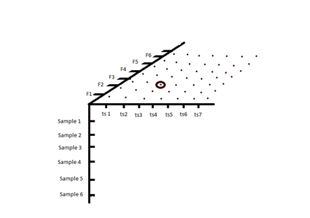
DATA DESCRIPTION
X_train.npy
The number of samples are 194042
Each sample contains 2 timestep
Each timestep will have 817 features
x_val.npy
The number of samples are 34122
Each sample contains 2 timestep
Each timestep will have 817 features
x_test.npy
The number of samples are 27326
Each sample contains 2 timestep
Each timestep will have 817 features 3D graphical representation of data

Slide 7
DATA DESCRIPTION
Output Data
1. label_train.npy
The number of samples are 194042
The number of labels are 11
2. label_val.npy
The number of samples are 34122
The number of labels are 11

Slide 8
DATA DESCRIPTION
Features of Input data
• The feature axis has 817 columns, which are again of 3 types
•One hot encoded integer values of categorical features – 0 to 726 column
•Float features are scaled numerical features – 727 to 815 column
•Padding indicator – 816 column

Slide 9
DATA PRE PROCESSING 1
Data Provided Was Already Preprocessed.

Slide 10
LEARNING MODELS
1.Logistic Regression
2.KNN classifier algorithm
3.Decision tree
4.LSTM

Slide 11
Used for models to predict values having dependent variable with 2 classes.
The independent variables can be binary or continuous.
Logistic function:
The logistic function is a sigmoid function, which takes any binary or real input t, and outputs a value between zero and one.
The standard logistic function
σ: R→(0,1) is defined as follows:
σ(t) = (e^t)/(e^t + 1).
for 1 predictors: t = β0 + β1*x
for 2 predictors: t = β0 + β1*x1 + β2*x2
Accuracy
Train set : 0.99
LOGISTIC REGRESSION

Slide 12
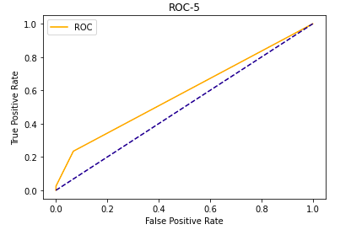
Th
Fig 1: The graph shown is the Receiver operator Curve for all the Labels of Logistic Regression Model
AUC Score: 0.59

Slide 13
KNN CLASSIFIER ALGORITHM :
KNN algorithm is one of the simplest Machine Learning model
It is simple to implement and robust to the noisy training data.
It can be more effective if the training data is large.
As KNN is a lazy learner model, it doesn’t learning from the training data instantly but stores the dataset and at the time of classification, it performs an action on the dataset.
Accuracy
Train set : 0.91

Slide 14

Fig 1: The graph shown is the Receiver operator Curve for all the Labels of KNN Classifier Model
AUC Score: 0.55

Slide 15
DECISION TREE ALGORITHM :
Decision Tree algorithm belongs to the family of supervised learning algorithms.
A decision tree does not require scaling of data as well.
Training period is less as compared to other used models because it generates only one tree.
Accuracy
Train set : 0.92

Slide 16
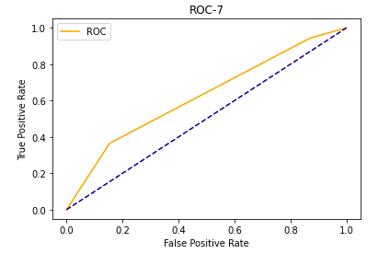
Fig 1: The graph shown is the Receiver operator Curve for all the Labels of Decision tree Classifier Model
AUC Score: 0.63

Slide 17
LSTM
LSTM is a novel recurrent network architecture training with an appropriate gradient-based learning algorithm.
The original LSTM model is comprised of a single hidden LSTM layer followed by a standard feedforward output layer.
The Stacked LSTM is an extension to this model that has multiple hidden LSTM layers where each layer contains multiple memory cells
Stacking LSTM hidden layers makes the model deeper and more accurately earning the description.
Accuracy
Test set: 0.84

Slide 18
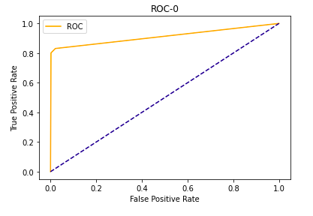
Fig 1: The graph shown is the Receiver operator Curve for all the Labels of LSTM Model
AUC Score: 0.91

Slide 19
RESULTS FROM LEARNING MODELS
Model | AUC | Accuracy
Logistic Regression | 0.59 | 0.99
KNN Classifier | 0.55 | 0.91
Decision Tree Classifier | 0.63 | 0.92
LSTM | 0.91 | 0.84

Slide 20
DATA PREPROCESSING 2
The given Dataset is imbalanced.
The prediction output skews towards class label with value “Zero”.
Hence, we found two techniques to be most feasible, namely Oversampling and Undersampling.
As the given Dataset is large, choosing Oversampling requires hardware with higher specifications. Hence we chose to go with undersampling.

Slide 21
LEARNING MODELS & RESULTS –
We decided to apply undersampling to the top two models with the highest accuracy
Model | AUC | Accuracy | Previous AUC | Previous Accuracy
Decision Tree classifier (After Undersampling) | 0.63 | 0.92 | 0.57 | 0.897

Slide 22
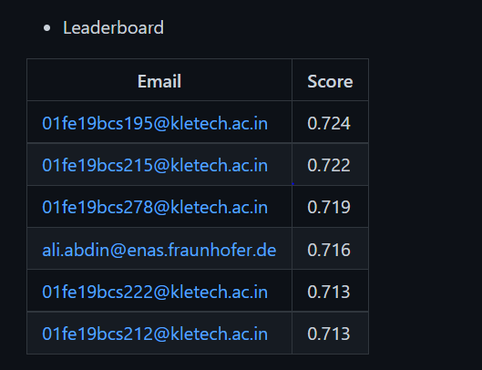
RANKING
Fig: The following is the leader board of the competition, the score for test set using LSTM model is 0.719 and currently we stand at 3rd place

Slide 23
CONCLUSION
In this work, we concentrated on the problem of soft sensing data classification.
Four models were implemented, namely Logistic regression model, KNN classification, Decision tree classification and LSTM.
Undersampled Data was used to predict score using Decision tree classifier.
Finally, LSTM model had the highest AUC score among the four models for train set.

Slide 24
REFERENCES
Sergei Petrov, Chao Zhang, Jaswanth Yella, Yu Huang, Xiaoye Qian, Sthitie Bom(2021).
IEEE BigData 2021 Cup: Soft Sensing at Scale

