Slide 1

SOFT SENSING AT SCALE - SEAGATE
Big Data Challenge
Name | USN | Roll Number
Leelaprasad P | 01FE19BCS278 | 256
Shreesh Bhat | 01FE20BCS411 | 267
Dhananjay K | 01FE19BCS131 | 254
Siri Revant | 01FE19BCS126 | 251

Slide 2
Introduction To Challenge
Soft sensing problem:
Wafer manufacturing is highly complex and takes a long time
To improve predictability and product yield, seagate have added a lot of sensors and measurements in the manufacturing line
The sensors and measurements are noisy, expensive and take a long time to manage
Organizers want to save the time for measurement and get better insights into the predictive value of these sensors for product quality by using deep learning models to predict the measurement results based on the sensing data

Slide 3
Introduction To Challenge
Challenge Specific Details
Important dates
Registration: Jul. 12 - Aug. 31, 2021
Submission: Jul. 12 - Nov. 4, 2021
Judgement: Nov. 5 - Nov. 12, 2021

Slide 4
Understanding of data
The proposed Data Challenge belongs to the business problem/research problem sector.
The data released contain the sensor data coming out of vacuum tools.
There are 5 Data files, 3 of them are input files for train/val/test, and rest 2 are output labels for train/val.
The output labels are hidden, and the final score is calculated based on the average ROC-AUC calculated
based on the hidden labels and predictions
Input Data
X_train.npy
The number of rows are 194042
The number of columns are 2
The number of 3d-columns are 817

Slide 5
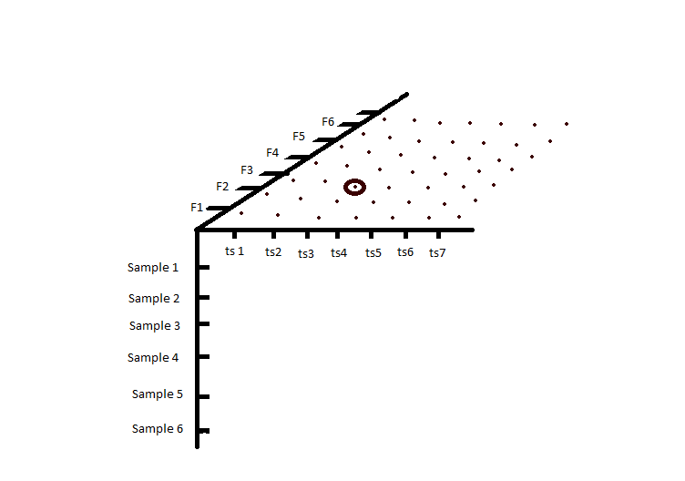
Understanding of data
x_val.npy
The number of rows are 34122
The number of columns are 2
The number of 3d-columns are 817
x_test.npy
The number of rows are 27326
The number of columns are 2
The number of 3d-columns are 817
3D graphical representation of Data

Slide 6
Understanding of data
Output Data
label_train.npy
The number of rows are 194042
The number of columns are 22
label_val.npy
The number of rows are 34122
The number of columns are 22

Slide 7
Reference
Challenge and Dataset Source
https://github.com/Seagate/BigDataChallenge
Description Of Data
https://github.com/Seagate/BigDataChallenge/blob/main/data/Data_description

