Slide 1
SOFT SENSING PREDICTION- SEAGATE
Big Data Challenge
Name | USN | Roll Number
Leelaprasad P | 01FE19BCS278 | 256
Shreesh Bhat | 01FE20BCS411 | 267
Dhananjay K | 01FE19BCS131 | 254
Siri Revant | 01FE19BCS126 | 251

Slide 2
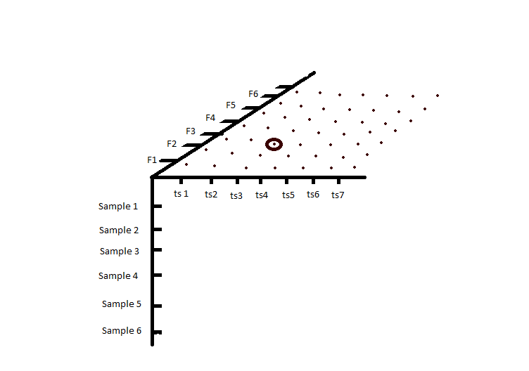
Understanding of data
X_train.npy
The number of samples are 194042
Each sample contains 2 timestep
Each timestep will have 817 features
x_val.npy
The number of samples are 34122
Each sample contains 2 timestep
Each timestep will have 817 features
x_test.npy
The number of samples are 27326
Each sample contains 2 timestep
Each timestep will have 817 features
3D graphical representation of Data

Slide 3
Understanding of Data
Output Data
label_train.npy
The number of samples are 194042
The number of labels are 11
label_val.npy
The number of samples are 34122
The number of labels are 11

Slide 4
Understanding of Data
Features of Input data
The feature axis has 817 columns, which are again of 3 types
One hot encoded integer values of categorical features – 0 to 726 column
Float features are scaled numerical features – 727 to 815 column
Padding indicator – 816 column

Slide 5
Learning models
Logistic Regression
KNN classification algorithm
Decision Tree classifier

Slide 6
Proposed approach to derive solution
Logistic Regression
Used for models to predict values having dependent variable with 2 classes.
The independent variables can be binary or continuous.
Logistic function:
The logistic function is a sigmoid function, which takes any binary or real input t, and outputs a value between zero and one.
The standard logistic function
σ: R→(0,1) is defined as follows:
σ(t) = (e^t)/(e^t + 1).
for 1 predictors: t = β0 + β1*x
for 2 predictors: t = β0 + β1*x1 + β2*x2

Slide 7
Proposed approach to derive solution
K-nearest neighbors algorithm :
KNN algorithm is one of the simplest Machine Learning model
It is simple to implement and robust to the noisy training data.
It can be more effective if the training data is large.
As the given dataset is an Unsupervised data, clustering is one technique to predict the values by grouping similar data for dataset which do not have labels.
In KNN algorithm the new data is added to existing clusters or data based on similarity.
As KNN is a lazy learner model, it doesn’t learning from the training data instantly but stores the dataset and at the time of classification, it performs an action on the dataset.

Slide 8
Proposed APPROACH TO DERIVE SOLUTION
Decision tree algorithm :
Decision Tree algorithm belongs to the family of supervised learning algorithms.
A decision tree does not require scaling of data as well.
Training period is less as compared to other used models because it generates only one tree.

Slide 9
References
Sergei Petrov, Chao Zhang, Jaswanth Yella, Yu Huang, Xiaoye Qian, Sthitie Bom(2021).
IEEE BigData 2021 Cup: Soft Sensing at Scale

