Slide 1
SOFT SENSING PREDICTION- SEAGATE
Big data challenge
Name USN Roll
Leelaprasad P 01FE19BCS278 256
Shreesh Bhat 01FE20BCS411 267
Dhananjay K 01FE19BCS131 254
Siri Revant 01FE19BCS126 251

Slide 2
Team Member contributions
Name | Model | Contribution
Leelaprasad P | Decision Tree classifier | Complete Model
Dhananjay K | Logistic Regression | Training Model
Shreesh B | Logistic Regression | Calculating AUC for train and val set
Siri R | KNN classifier | Complete Model

Slide 3
Problem Statement
The scope of this challenge is to tackle the task of classifying soft sensing data with machine learning models that works best.
To improve predictability and product yield, a lot of sensors were added in manufacturing of wafer
To save the time for measurement and get better insights into the predictive value of these sensors for product quality by using learning models to predict the measurement results based on the sensing data.

Slide 4
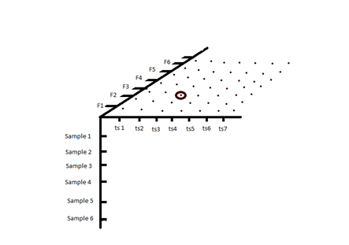
Understanding of data
X_train.npy
The number of samples are 194042
Each sample contains 2 timestep
Each timestep will have 817 features
x_val.npy
The number of samples are 34122
Each sample contains 2 timestep
Each timestep will have 817 features
x_test.npy
The number of samples are 27326
Each sample contains 2 timestep
Each timestep will have 817 features 3D graphical representation of data

Slide 5
Understanding of data
Output Data
1. label_train.npy
The number of samples are 194042
The number of labels are 11
2. label_val.npy
The number of samples are 34122
The number of labels are 11

Slide 6
Understanding of data
Features of Input data
• The feature axis has 817 columns, which are again of 3 types
•One hot encoded integer values of categorical features – 0 to 726 column
•Float features are scaled numerical features – 727 to 815 column
•Padding indicator – 816 column

Slide 7
Data pre processing
Our data is pre-processed

Slide 8
Learning models
1.Logistic Regression
2.KNN classifier algorithm
3.Decision tree

Slide 9
Proposed approach to derive solution
Logistic Regression
•Used for models to predict values having dependent variable with 2 classes.
• The independent variables can be binary or continuous.
Logistic function:
•The logistic function is a sigmoid function, which takes any binary or real input t, and outputs a value between zero and one.
•The standard logistic function
σ: R→(0,1) is defined as follows:
σ(t) = (e^t)/(e^t + 1).
for 1 predictors: t = β0 + β1*x
for 2 predictors: t = β0 + β1*x1 + β2*x2
Accuracy
Train set : 0.62

Slide 10
Proposed approach to derive solution
KNN classifier algorithm :
KNN algorithm is one of the simplest Machine Learning model
It is simple to implement and robust to the noisy training data.
It can be more effective if the training data is large.
As KNN is a lazy learner model, it doesn’t learning from the training data instantly but stores the dataset and at the time of classification, it performs an action on the dataset.
Accuracy
Train set : 0.6

Slide 11
Proposed approach to derive solution
Decision tree algorithm :
Decision Tree algorithm belongs to the family of supervised learning algorithms.
A decision tree does not require scaling of data as well.
Training period is less as compared to other used models because it generates only one tree.
Accuracy
Train set : 0.8262

Slide 12
Results from Learning models
Model | AUC | Accuracy
Logistic Regression | 0.54 | 0.97
KNN Classifier | 0.51 | 0.91
Decision Tree Classifier | 0.7 | 0.99

Slide 13
Data preprocessing 2
The given Dataset is imbalanced.
The prediction output skews towards class label with value “Zero”.
Hence, we found two techniques to be most feasible, namely Oversampling and Undersampling.
As the given Dataset is large, choosing Oversampling requires hardware with higher specifications. Hence we chose to go with undersampling.

Slide 14
Learning models & Results -
Model | AUC | Accuracy
Decision Tree Classifier (Before Undersampling) | 0.7 | 0.99
Decision Tree Classifier (After Undersampling) | 0.74 | 0.81

Slide 15
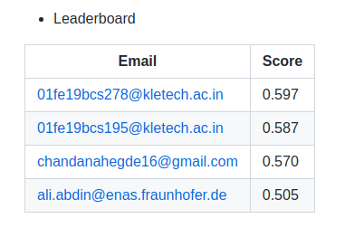
Ranking

Slide 16
Conclusion
In this work, we concentrated on the problem of soft sensing data classification.
Three models were implemented, namely Logistic regression model, KNN classification, Decision tree classification.
Decision tree classification was found out to be having highest AUC score for validation and te

Slide 17
References
[1] Sergei Petrov, Chao Zhang, Jaswanth Yella, Yu Huang, Xiaoye Qian, Sthitie Bom(2021).
IEEE BigData 2021 Cup: Soft Sensing at Scale

