Slide 1
REAL TIME KALMAN 6D ACCELERATOR
BY: SIRI SATYAMURTHY

Slide 2
Aim & Objectives
To derive the Kalman filter mathematical model and translate it into a hardware-oriented RTL architecture.
To design modular RTL blocks for state prediction, error covariance update, Kalman gain computation, and measurement update.
To implement fixed-point arithmetic units optimized for hardware efficiency while maintaining acceptable estimation accuracy.
To develop a parameterized architecture that supports scalability in state dimension and data precision without major redesign.
To integrate and optimize the complete Kalman filter Datapath and control logic for efficient hardware execution.

Slide 3
Project Abstract
Estimation filters are widely used for optimal state estimation in the presence of noise in applications such as sensor signal processing, navigation systems, and tracking. This project focuses on the RTL design of a parameterizable Kalman filter architecture suitable for hardware implementation. The design is derived from the mathematical Kalman filter equations and mapped into a modular, register-transfer level architecture using System Verilog. Key computational blocks such as state prediction, error covariance update, Kalman gain computation, and measurement update are architected with scalability in mind, enabling extension from single state to multi-state estimation without major structural changes.

Slide 4
Signal processing filter vs estimation filter
Parameter | Signal-Processing Filter | Estimation Filter
Purpose | Removes unwanted frequency components | Estimates true system state from noisy measurements
Domain | Frequency domain | State-space domain
Needs System Model | No | Yes
Adaptivity | Fixed coefficients | Adaptive (updates every iteration)
Noise Handling | Filters frequency-based noise | Minimizes statistical noise
Applications | Audio, ECG, communication systems | Radar, LiDAR, robotics, navigation

Slide 5
Types of Kalman filters
1. Kalman Filter (KF)
The standard Kalman Filter is designed for linear dynamic systems where both system and measurement models are linear. It provides optimal state estimation by combining predictions and measurements under Gaussian noise assumptions. It is widely used in navigation, tracking, and control systems where system behavior is linear.
2. Extended Kalman Filter (EKF)
The Extended Kalman Filter is used for nonlinear systems. It approximates nonlinear equations by linearizing them around the current estimate using Jacobian matrices, allowing Kalman filtering principles to be applied. EKF is commonly used in robotics, GPS positioning, and autonomous vehicle navigation.
3. Cubature Kalman Filter (CKF)
The Cubature Kalman Filter improves estimation for highly nonlinear systems by using cubature points to accurately propagate mean and covariance through nonlinear transformations without requiring Jacobians. CKF offers better accuracy and numerical stability, making it suitable for aerospace and advanced autonomous applications.
1D Kalman Filter: Estimates a single state variable (e.g., position or temperature) using scalar equations.
2D Kalman Filter: Estimates two related state variables (e.g., position and velocity) using matrix-based state equations.
6D Kalman Filter: Estimates six or more state variables using higher-dimensional state-space modeling.

Slide 6
Working of Kalman filter
The Kalman filter operates in repeated stages at each time step to estimate the system state accurately:
1. State Prediction
Predicts the next state of the system using the previous estimate and system model.
2. Covariance Prediction
Updates the uncertainty (error covariance) associated with the predicted state.
3. Kalman Gain Computation
Calculates Kalman Gain to decide how much the measurement should influence the prediction.
4. Measurement Update (Correction)
Corrects the predicted state using the new measurement data.
5. Covariance Update
Updates estimation uncertainty after correction, preparing for the next cycle.
These stages repeat continuously to provide real-time state estimation.

Slide 7
KALMAN FILTER VERIFICATION parameters
Specification | Definition
Functional Correctness | RTL output matches golden model
Prediction Accuracy | State prediction equation correctly implemented
Covariance Update | Error covariance updates correctly
Kalman Gain Accuracy | Gain computed correctly within tolerance
Reset Behaviour | Registers initialize correctly

Slide 8
Design Methodology
Requirement analysis & system modeling
Algorithm simulation (floating-point)
Fixed-point conversion
Hardware architecture design
RTL implementation in SystemVerilog
Testbench & functional verification

Slide 9
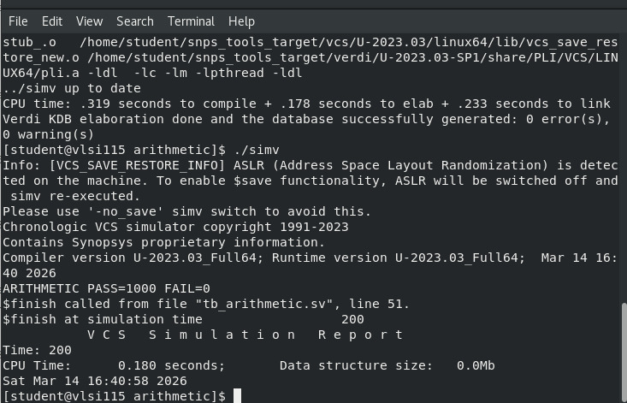
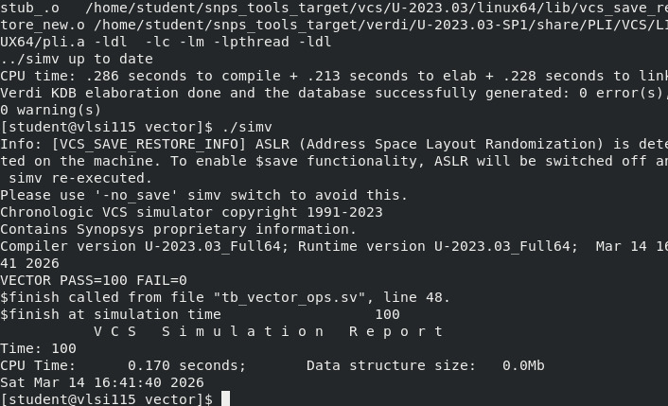
RESULTS
Arithmetic
Vector

Slide 10
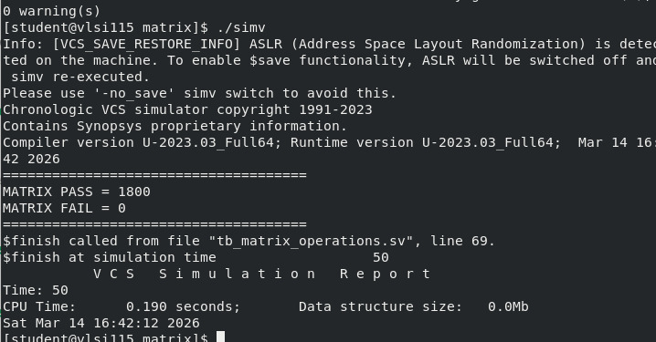
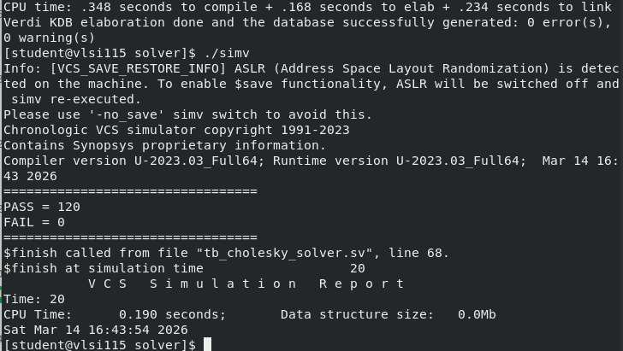
Matrix
Solver

Slide 11
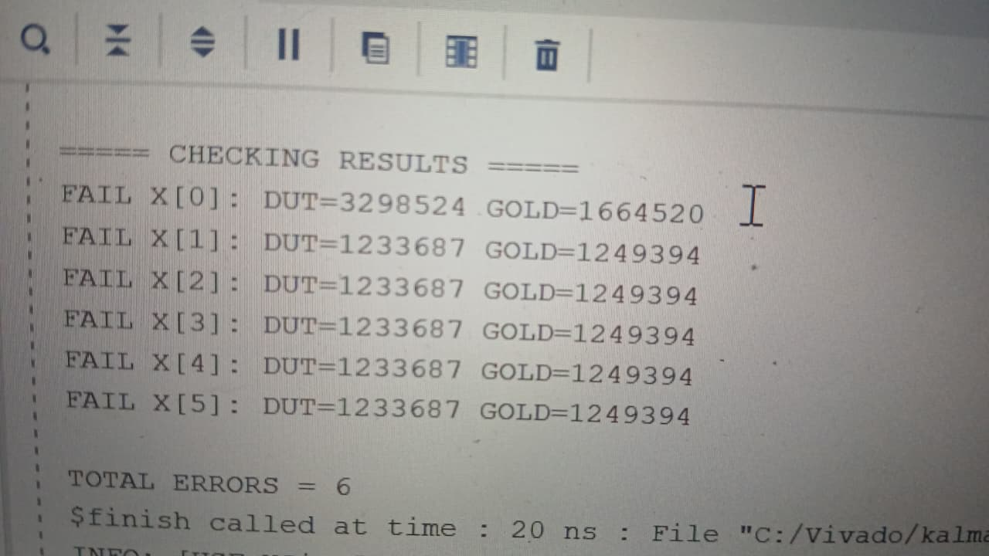
Errors

Slide 12
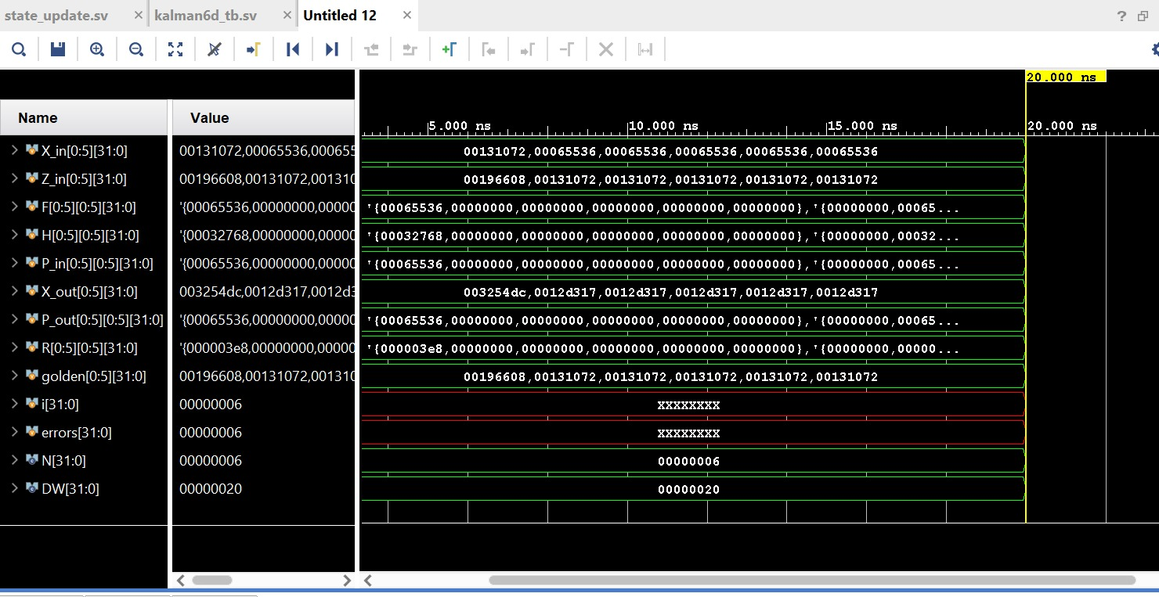
Outputs

Slide 13
Tools & Technologies Used
System Verilog – For RTL coding of the parameterizable Kalman filter architecture
Synopsys VCS – For RTL functional simulation and basic sanity checks of the design
MATLAB – For Kalman filter algorithm modelling and fixed-point behaviour analysis

Slide 14
General applications of Kalman filter
Autonomous vehicle navigation
Radar and object tracking systems
Sensor fusion systems
Robotics and drone control
Biomedical signal processing
IoT and smart sensing platforms

Slide 15
Future scope
Hardware acceleration using FPGA or ASIC deployment.
Integration with machine learning estimation models.
Adaptive filtering techniques.
Multi-sensor fusion systems.
Low-power embedded implementations.

Slide 16
THANK YOU

