Slide 1
White Blood Cell Classification using Convolutional Neural Networks
Gurraj Atwal
Sirish Prabakar

Slide 2
Problem Description
White blood cells are an important part of the body’s immune system
Five major types:
Neutrophils
Eosinophils
Lymphocytes
Monocytes
Basophils
Accurate classification is critical in diagnosing blood-based disorders
Explored three different approaches for accurate classification
Multilayer perceptron (MLP) neural network
Convolutional neural network (CNN)
Transfer learning

Slide 3
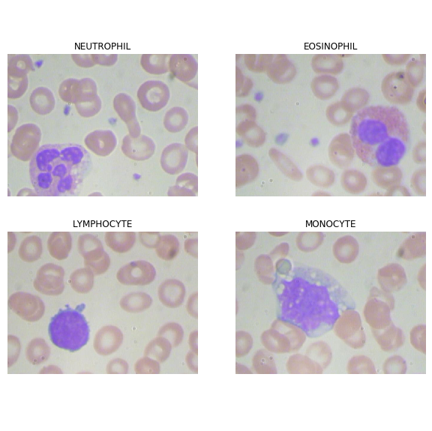
Dataset
Hosted on Kaggle
365 images of patient blood samples
Labels for each image
15 images with two white blood cells
Only 3 images for the Basophil class
Contains a directory with pre-augmented images

Slide 4
Related Work
Jung et al. proposed a CNN-based architecture: W-Net
6,572 real white blood image dataset
Average 97% accuracy for all five classes
Kaggle kernels
Most kernels used the pre-augmented dataset
Top kernel achieved an 84% accuracy on testing set
Possibly due to validation and training data coming from the same seed images

Slide 5
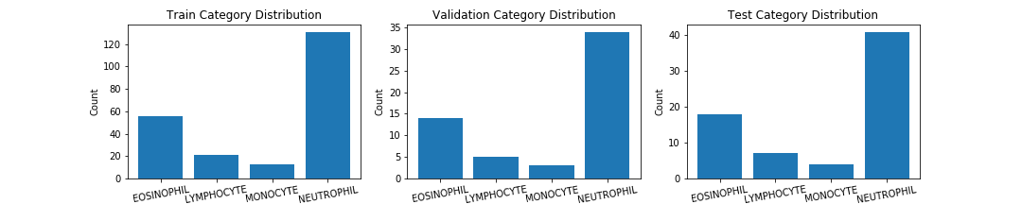
Dataset Distribution
Train-validation-test stratified split

Slide 6
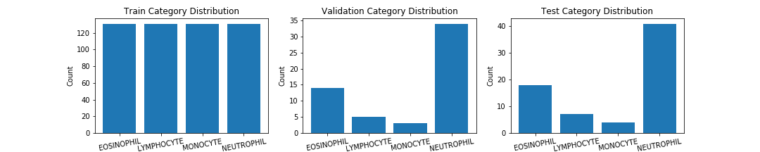
Class Imbalance
We oversampled the minority classes until their representation in the training dataset matched that of the majority class

Slide 7
Image Augmentation
Image normalization
Pixels scaled from 0-255 to 0-1
Used Keras ImageDataGenerator for augmentation
Parameter | Value
rotation_range | 30
horizontal_flip | True
vertical_flip | True
width_shift_range | 0.2
height_shift_range | 0.2
shear_range | 0.1
zoom_range | 0.1
fill_mode | Constant

Slide 8
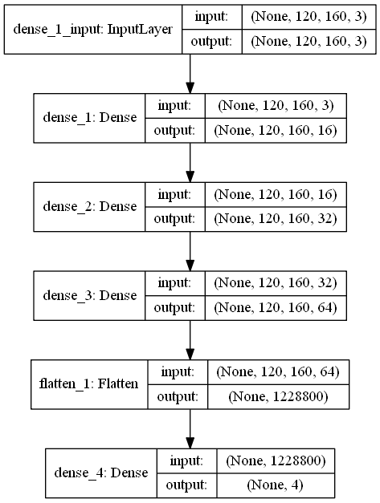
Multilayer Perceptron NN (MLP)
Simple architecture
No convolutional layers
3 Dense layers
Flatten layer
Soft-max layer for output
Accuracy: 85.7%
F1: 85.5%

Slide 9
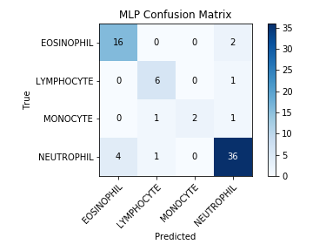
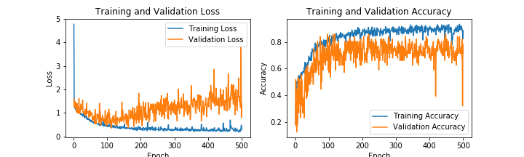
MLP Results

Slide 10
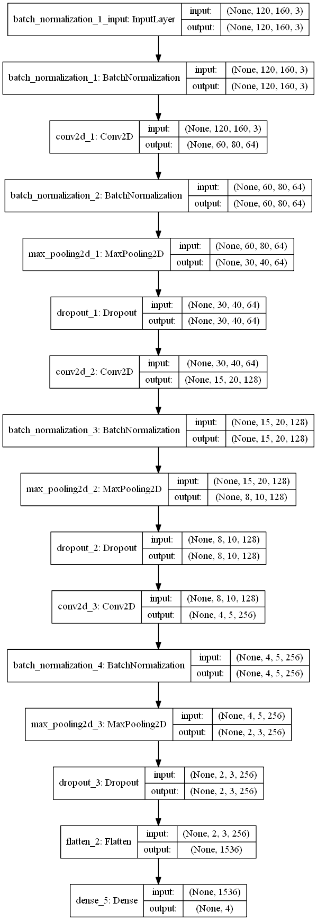
Convolutional NN (CNN)
Better suited for image classification
Able to recognize relationships between pixels
Kernels scan images and perform convolutional operations
Convolutional operations extract high-level features
Overfitting
More aggressive data augmentation
Batch normalization
Dropout
Accuracy: 94.4%
F1: 94.2%

Slide 11
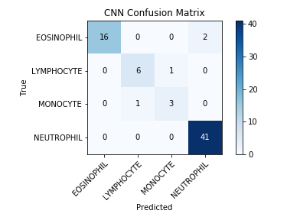
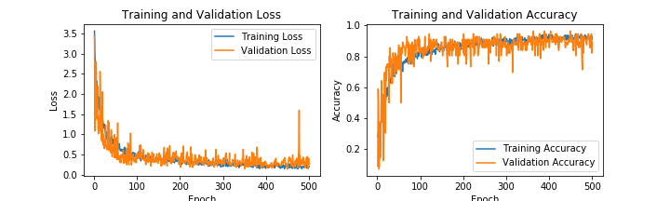
CNN Results

Slide 12
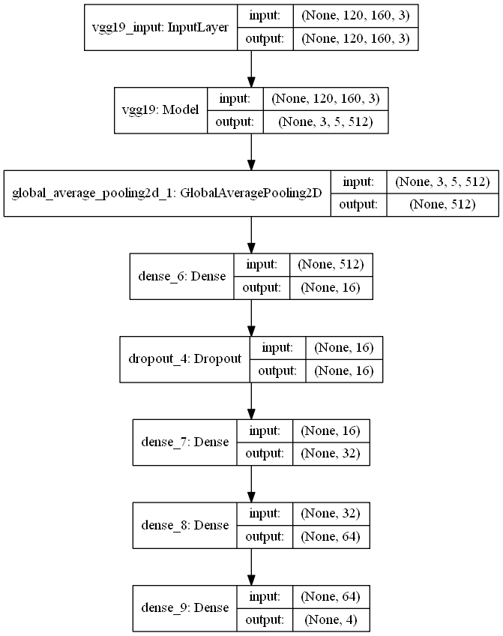
Transfer Learning
Pre-trained model as a feature extractor for our task
VGG-19
Introduced by Simoyan and Zisserman in 2015
Trained on ImageNet Challenge 2014 dataset
Final layer removed
All remaining layers frozen
Accuracy: 64.3%
F1: 66.3%

Slide 13
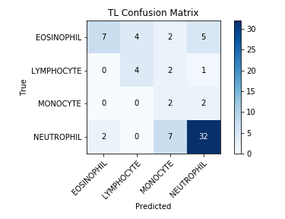
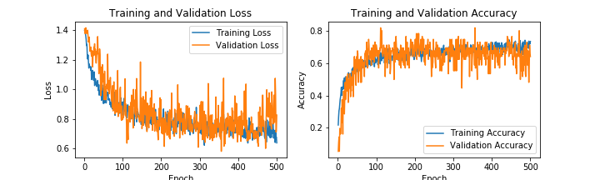
TL Results

Slide 14
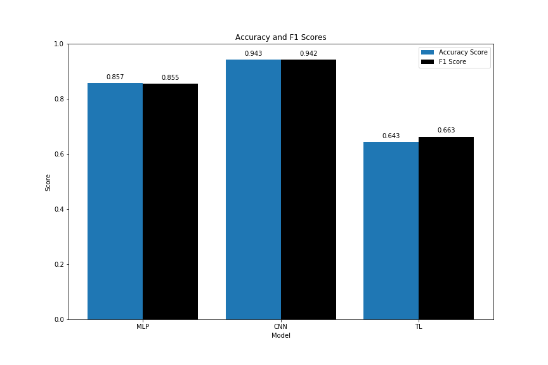
Overall Results

Slide 15
Thank you!

