Slide 1
Metro Operations Optimization
Name: Sirisha P G Department: MCA (VTU) Semester:Third
USN: 1BO23MC040

Slide 2
Outline
Title Name
Outline
Abstract
Problem Statement
Proposed Solution
Short Video
Implementation
Output Screenshots
References

Slide 3
Abstract:
Metro rail systems play a crucial role in urban transportation, but operational inefficiencies, high costs, service disruptions, and increasing passenger demand present significant challenges. Metro Operations Optimization aims to enhance efficiency, reliability, and sustainability by leveraging advanced technologies such as AI, IoT, and data analytics. Key strategies include AI-driven scheduling for demand-based train frequency, predictive maintenance to prevent failures, energy-efficient operations through regenerative braking and smart driving techniques, and automated train control for precision and safety. Additionally, real-time passenger information systems, smart ticketing, and crowd management improve user experience, while centralized control centers enable swift incident management

Slide 4
Problem Statement
The increasing demand for efficient, reliable, and sustainable urban transportation presents significant challenges for metro rail systems. Inefficiencies in train scheduling, high operational costs, energy wastage, frequent service disruptions, and overcrowding negatively impact both operators and passengers. Traditional methods of metro operations struggle to adapt to fluctuating passenger demand, leading to delays, increased maintenance costs, and suboptimal resource utilization. Additionally, safety concerns, environmental impact, and the need for seamless passenger experiences further complicate operations. The lack of real-time data integration and advanced predictive analytics results in inefficient decision-making, affecting service quality and financial sustainability. Therefore, there is a critical need for an optimized metro operations framework that leverages data-driven strategies, automation, and advanced technologies such as AI and IoT to enhance efficiency, reduce costs, improve passenger satisfaction, and support sustainable urban mobility.

Slide 5
Proposed Solution
To address the challenges in metro operations, an optimized metro operations framework should leverage advanced technologies and data-driven strategies to enhance efficiency, reduce costs, and improve passenger satisfaction. Key solutions include:
Smart Scheduling and Real-Time Optimization
Predictive Maintenance and Asset Management
Energy Efficiency and Sustainability
Automated and AI-Driven Operations
Data-Driven Decision Making

Slide 6
Short Video
https://drive.google.com/file/d/1BIV7AoA1VfCcNAzE632XUe6Uhd4_VYlu/view?usp=sharing

Slide 7
Implementation
https://github.com/sirisha771/siri45-Metro-Operations-Optimization

Slide 8
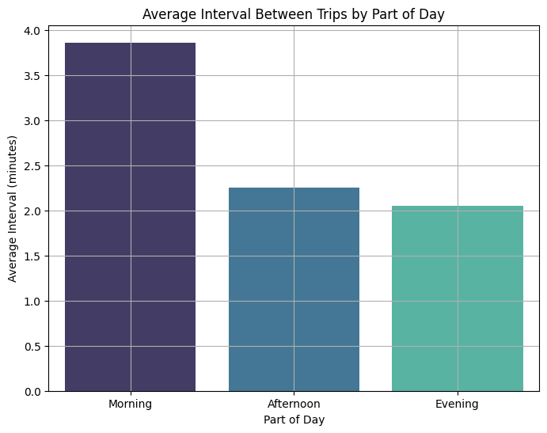
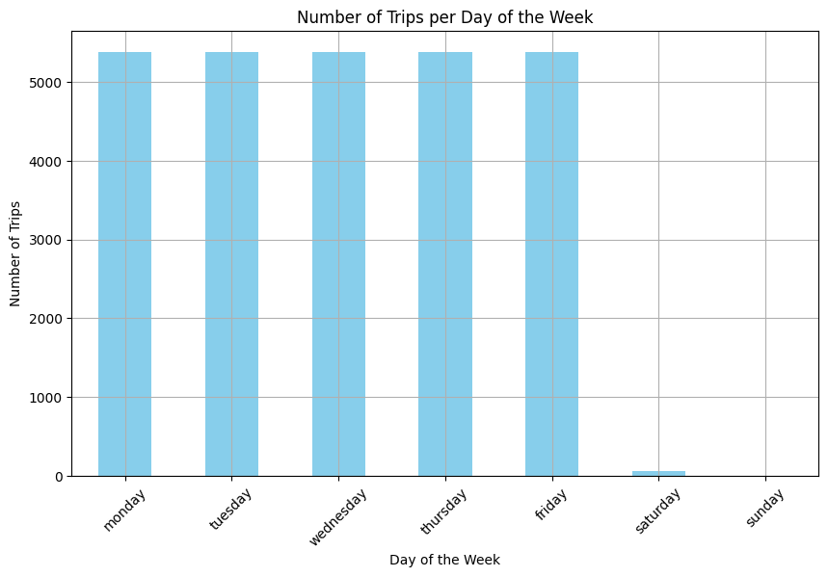
Output

Slide 9
