Slide 1
ANALYSIS OF THE COVID-19 DATA
COVID-19
ANALYSIS
HYPOTHESIS TESTING
GRAPH REPRESENTATION
INTERPRETATION
SOURCES

Slide 2

COVID-19
Coronavirus disease 2019 (COVID-19) is a contagious disease caused by severe acute respiratory syndrome coronavirus 2 (SARS-CoV-2). The first case was identified in Wuhan, China in December 2019.
Other names | The coronavirus 2019-nCoV acute respiratory disease Novel coronavirus pneumonia Severe pneumonia with novel pathogens

Slide 3
The overall number of global coronavirus cases has crossed the 66 million mark, while the deaths have surged to more than 1.52 million, according to the Johns Hopkins University.
In its latest update on Sunday, the University's Center for Systems Science and Engineering (CSSE) revealed that the current global caseload and death toll stood at 66,460,498 and 1,527,972, respectively.
The US is the worst-hit country with the world's highest number of cases and deaths at 14,575,623 and 281,134, respectively, according to the CSSE.
India comes in second place in terms of cases at 9,608,211, while the country's death toll soared to 139,700.
The other countries with more than a million confirmed cases are Brazil (6,577,177), Russia (2,410,462), France (2,334,626), the UK (1,710,379), Italy (1,709,991), Spain (1,684,647), Argentina (1,459,832), Colombia (1,362,249), Germany (1,170,095), Mexico (1,168,395), Poland (1,054,273) and Iran (1,028,986), the CSSE figures showed.

Slide 4
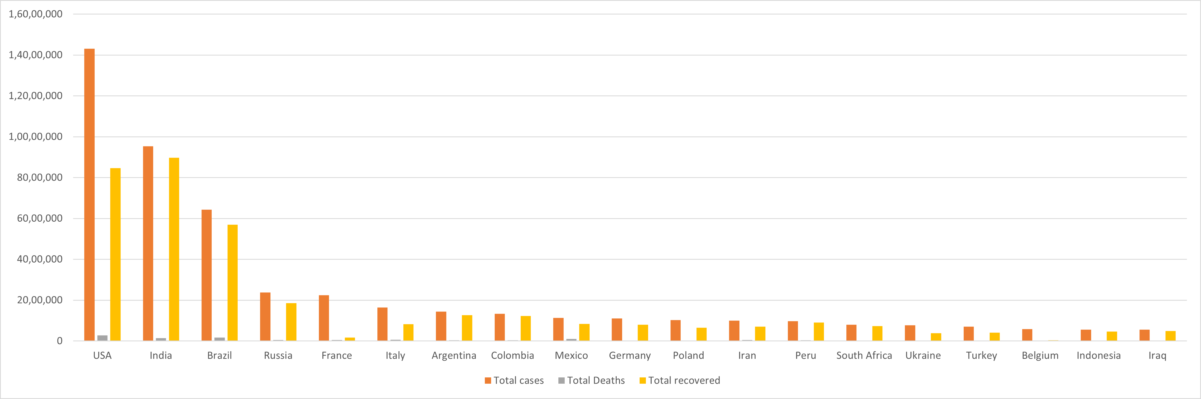

Slide 5
ANALYSIS
From our python code we got the following results based on the data:-
FOR WORLD
Total cases and deaths are probably dependent.
Total cases and deaths are not gaussian.
FOR INDIA
Deaths, cured and cases are different distributions.
Deaths, cured and cases are not gaussian.
Deaths, cured are probably dependent Similarly (Cured ,confirmed) and (confirmed ,deaths) this two pairs are also probably dependent.

Slide 6
HYPOTHESIS
FOR STATES IN INDIA
H0: mu0=mu1=mu2
H1: At least one state do not have same death rate.
1. Deaths in Kerala, Maharashtra and Delhi
P-value = 1.7208e^-77
Reject Null Hypothesis
2. Cured Cases in Kerala, Maharashtra and Delhi
P-value =9.72799e^-42
Reject Null hypothesis
3. Confirmed Cases in Kerala , Maharashtra and Delhi
P-value = 1.8860e^-50
Reject Null Hypothesis

Slide 7
H0: mu1-mu2 = 0
H1 : mu1 not equal to mu2
a) Confirmed Cases in Delhi , Maharashtra
P-value = 7.466727e^-27
Reject Null Hypothesis
b) Confirmed Cases in Delhi and Kerala
P-Value = 0.1103e^-05
Reject Null Hypothesis
c) Confirmed Cases in Maharashtra and Kerala
P-Value = 5.14144e^-37
Reject Null Hypothesis
d) Deaths in Kerala and Delhi
P-Value = 4.694084033e^-37
Reject Null Hypothesis
e) Deaths in Maharashtra and Kerala
P-Value =7.610510e^-62
Reject Null Hypothesis

Slide 8
f) Deaths in Maharashtra and Delhi
P-Value = 1.74662272247e^-38
Reject Null Hypothesis
FOR WORLD
Total Death cases & Total Recovered cases in each country
P-value = 0.0367322885467
Reject the null hypothesis
Total confirm cases &total recovery rate
P-value = 0.059221746469
accept the null hypothesis
Total confirm cases and total death cases
P-value = 0.79300673488341
accept the null hypothesis

Slide 9
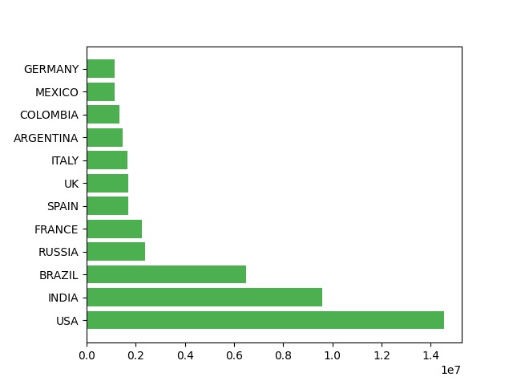
GRAPHS REPRESENTATION
FOR THE WORST-HIT COUNTRIES BY COVID-19:-
We did our analysis for worst-hit countries and plotted these graphs using code to show the total number of covid-19 cases in each country.
BAR GRAPH:-
SCATTER GRAPH:-
HISTOGRAM:-
BOX PLOT:-

Slide 10
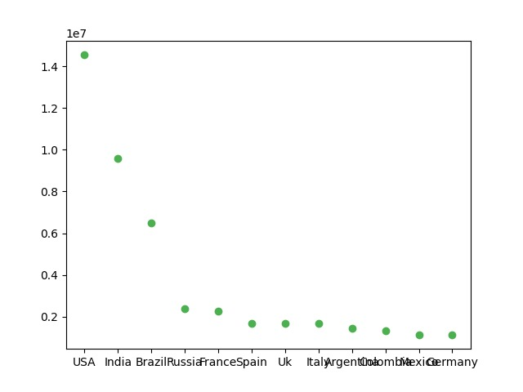
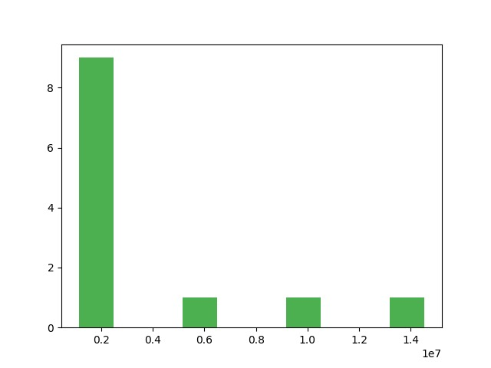
SCATTER PLOT AND HISTOGRAM

Slide 11
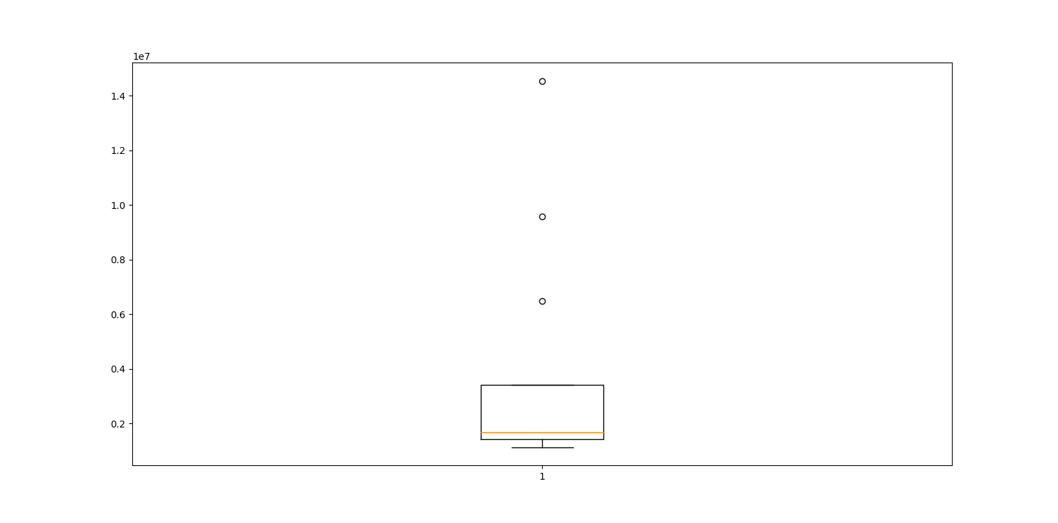
BOX PLOT & BAR PLOT

Slide 12
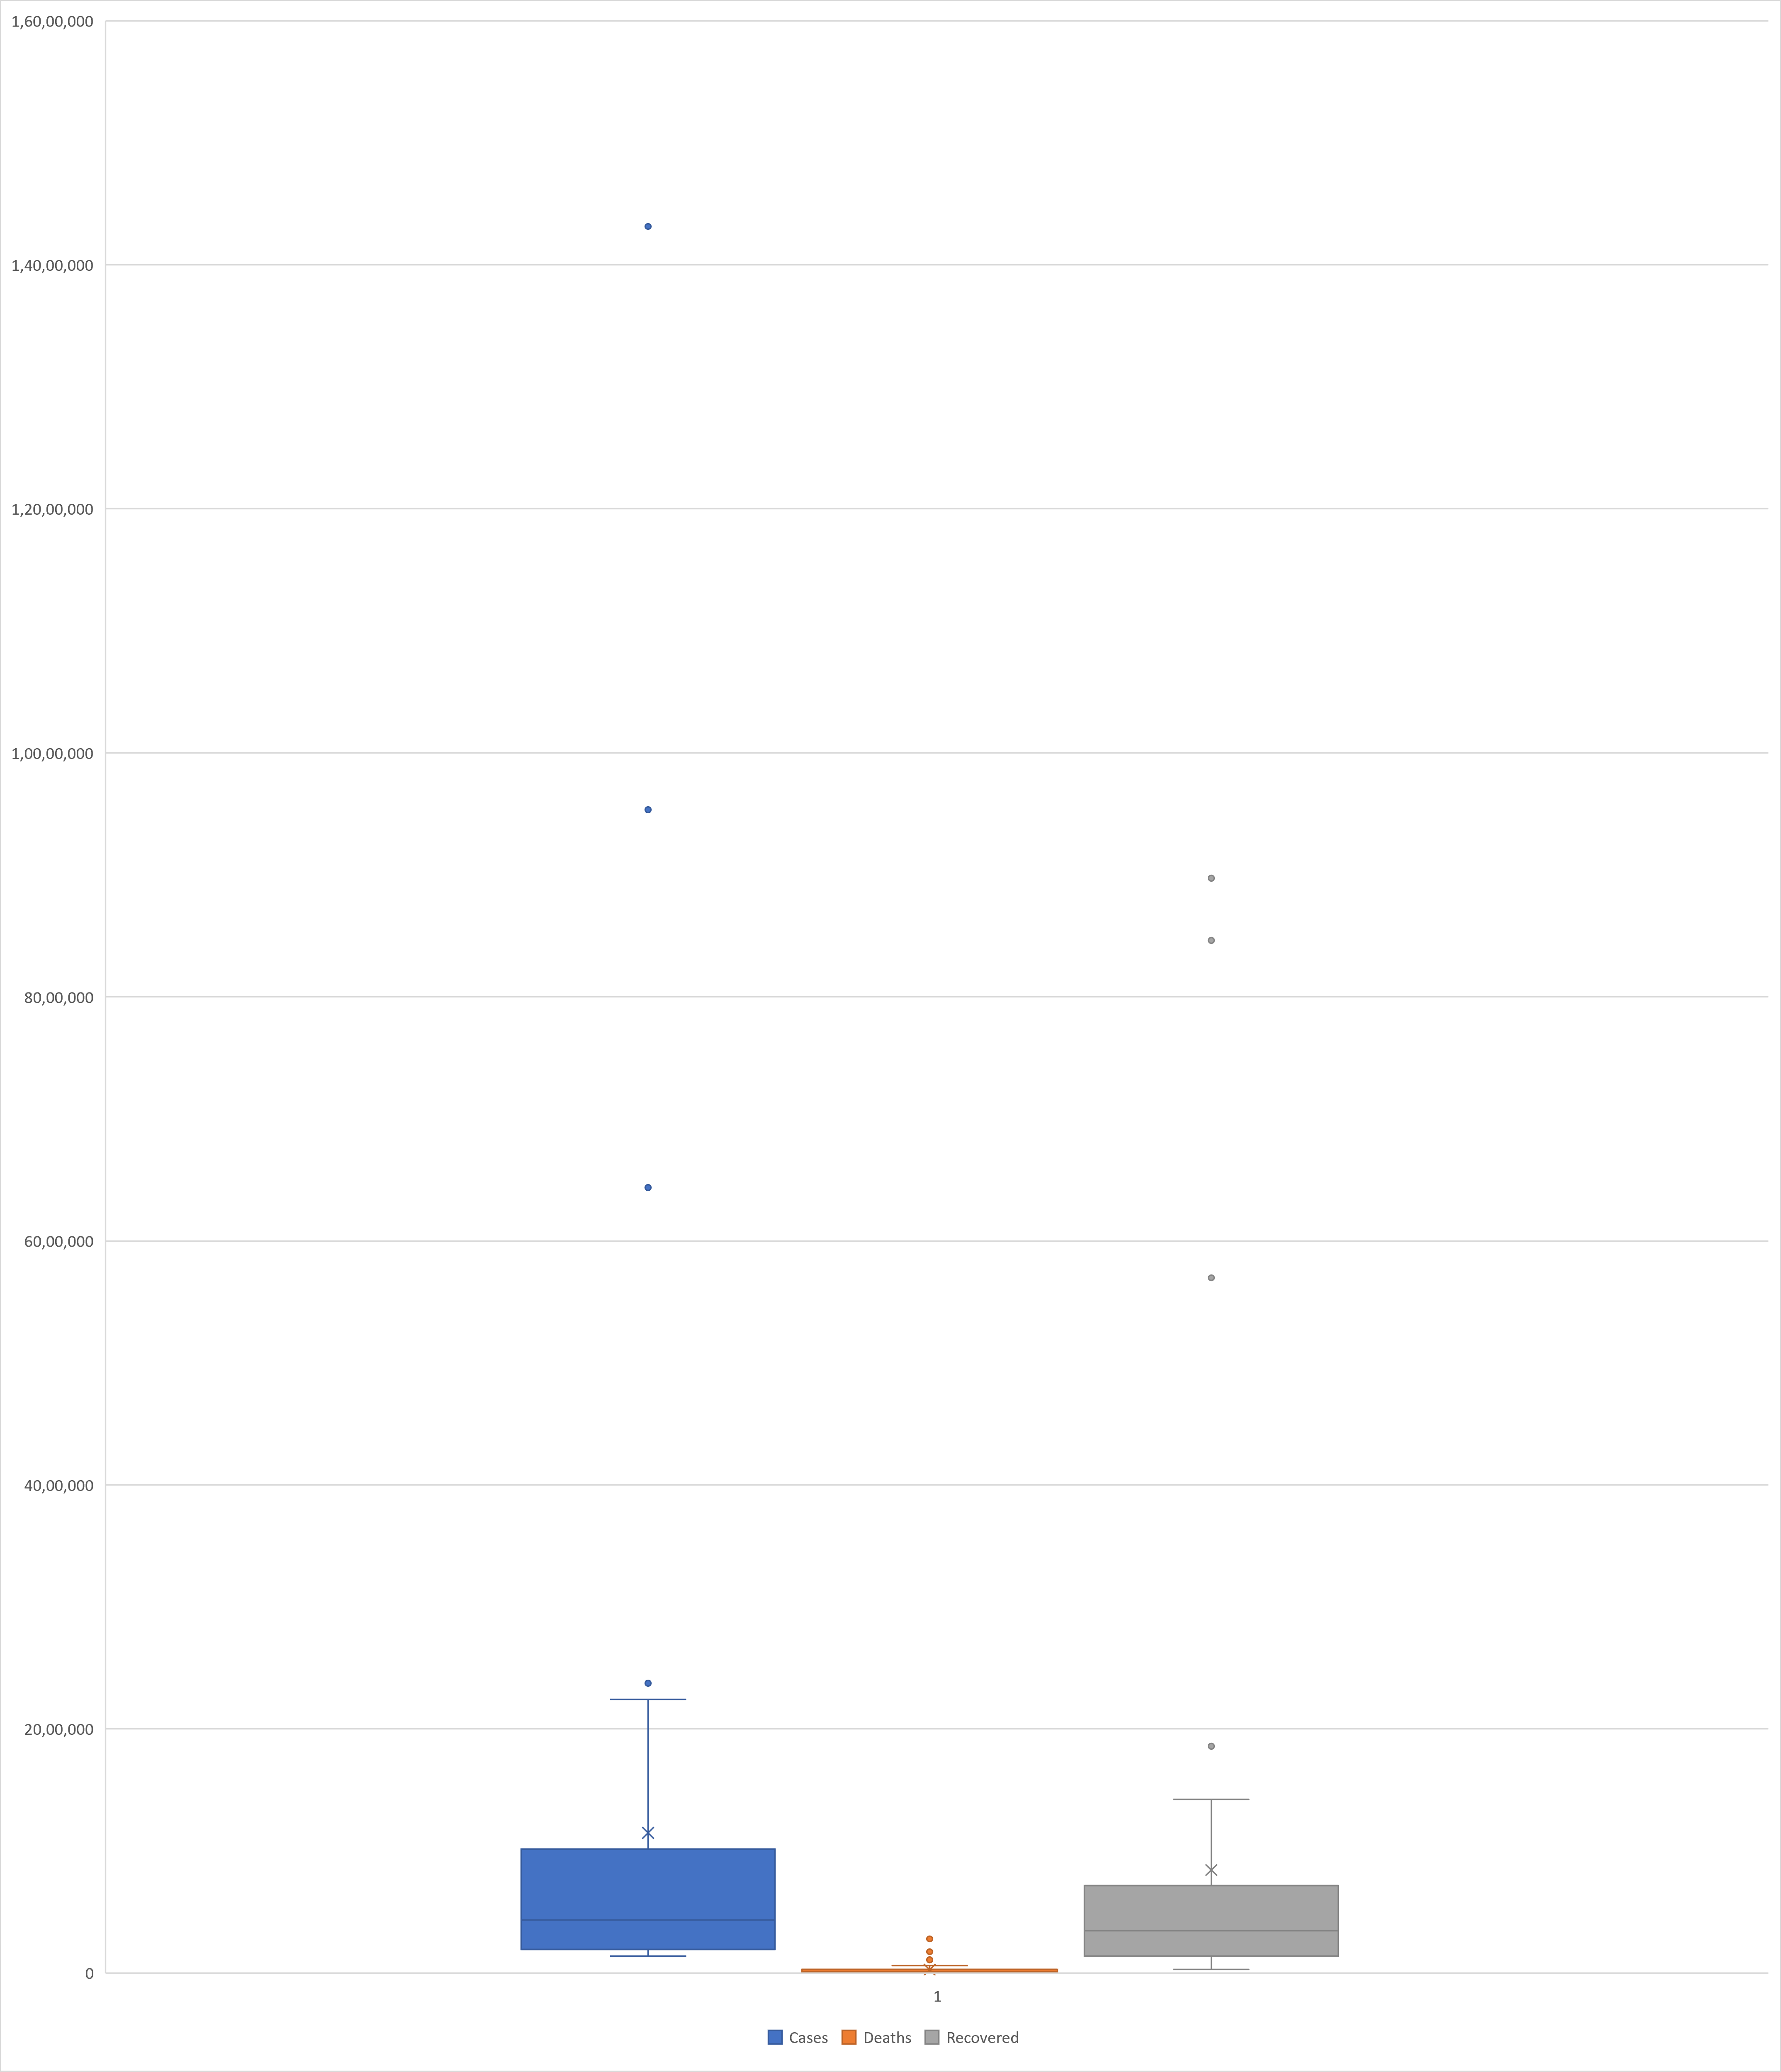
TOTAL CASES,TOTAL RECOVERED ,TOTAL DEATH IN EACH COUNTRY IN WORLD

Slide 13
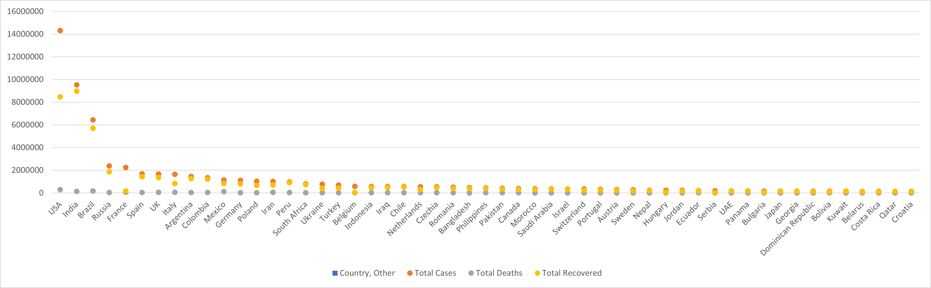
Scatter plot

Slide 14
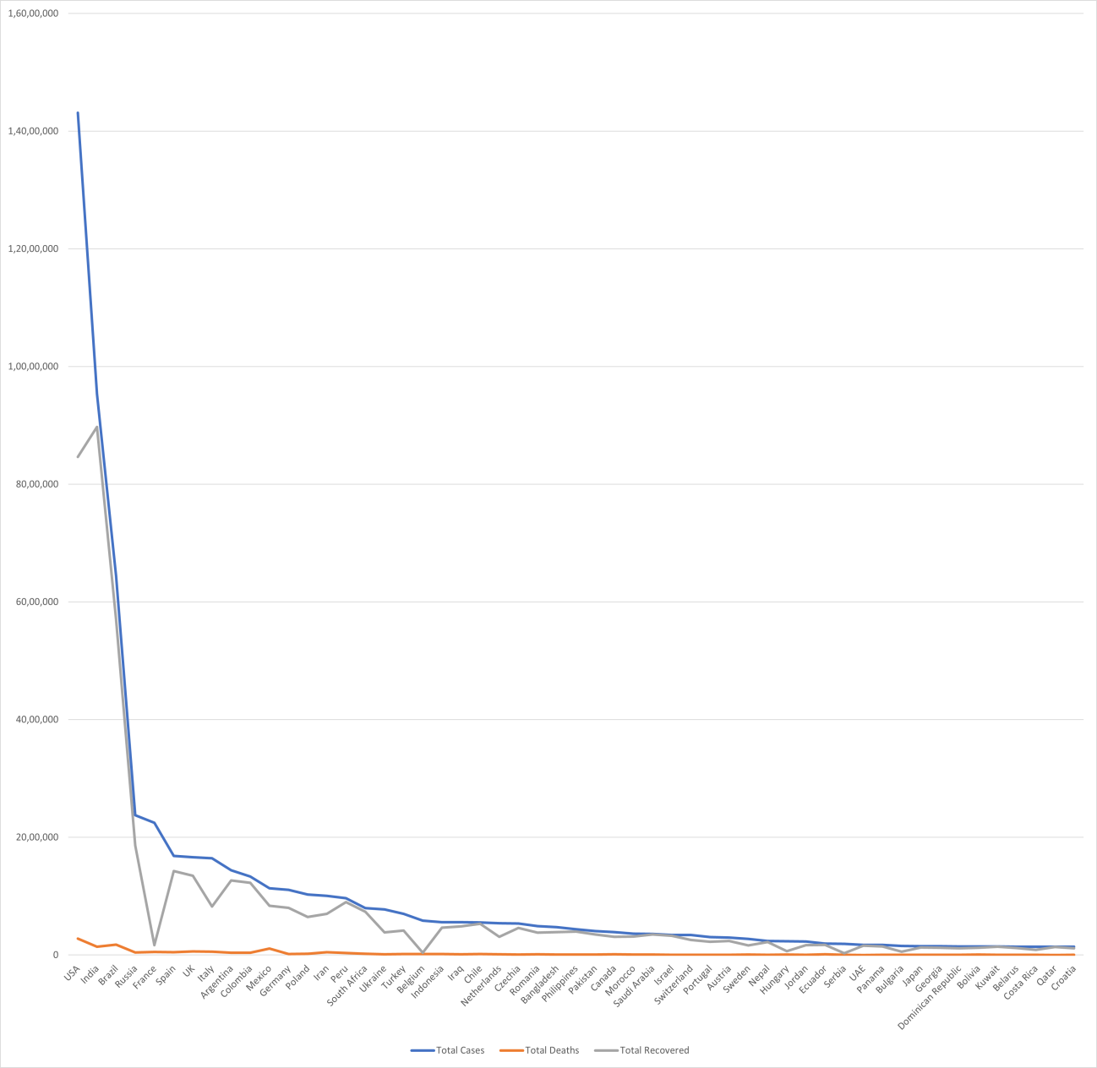
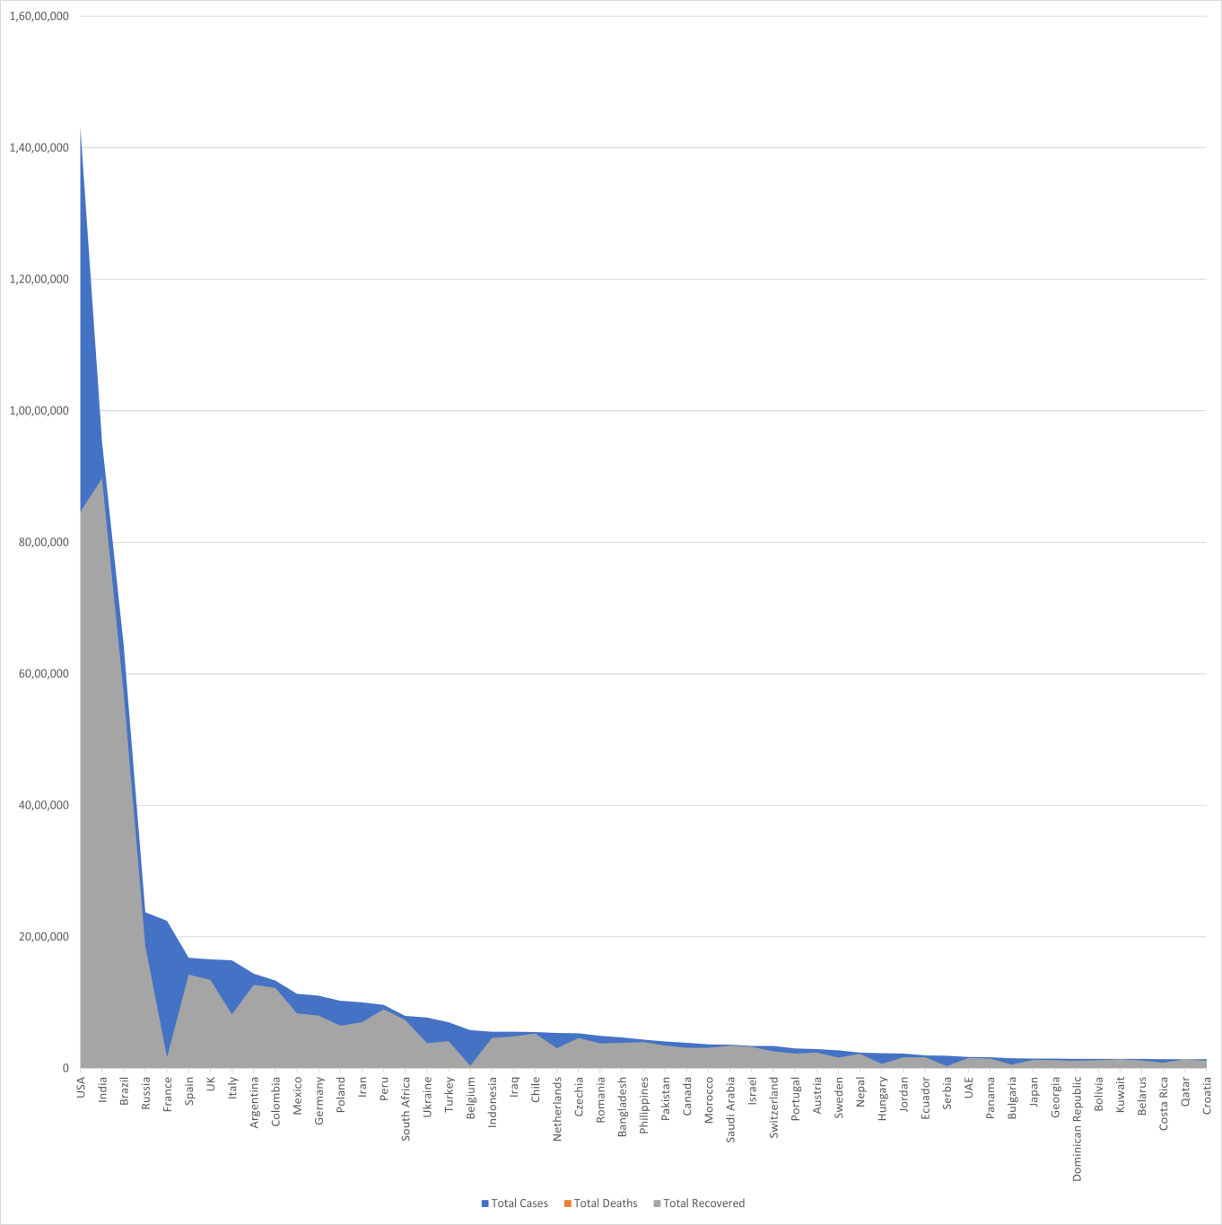
Line and Area plots

Slide 15
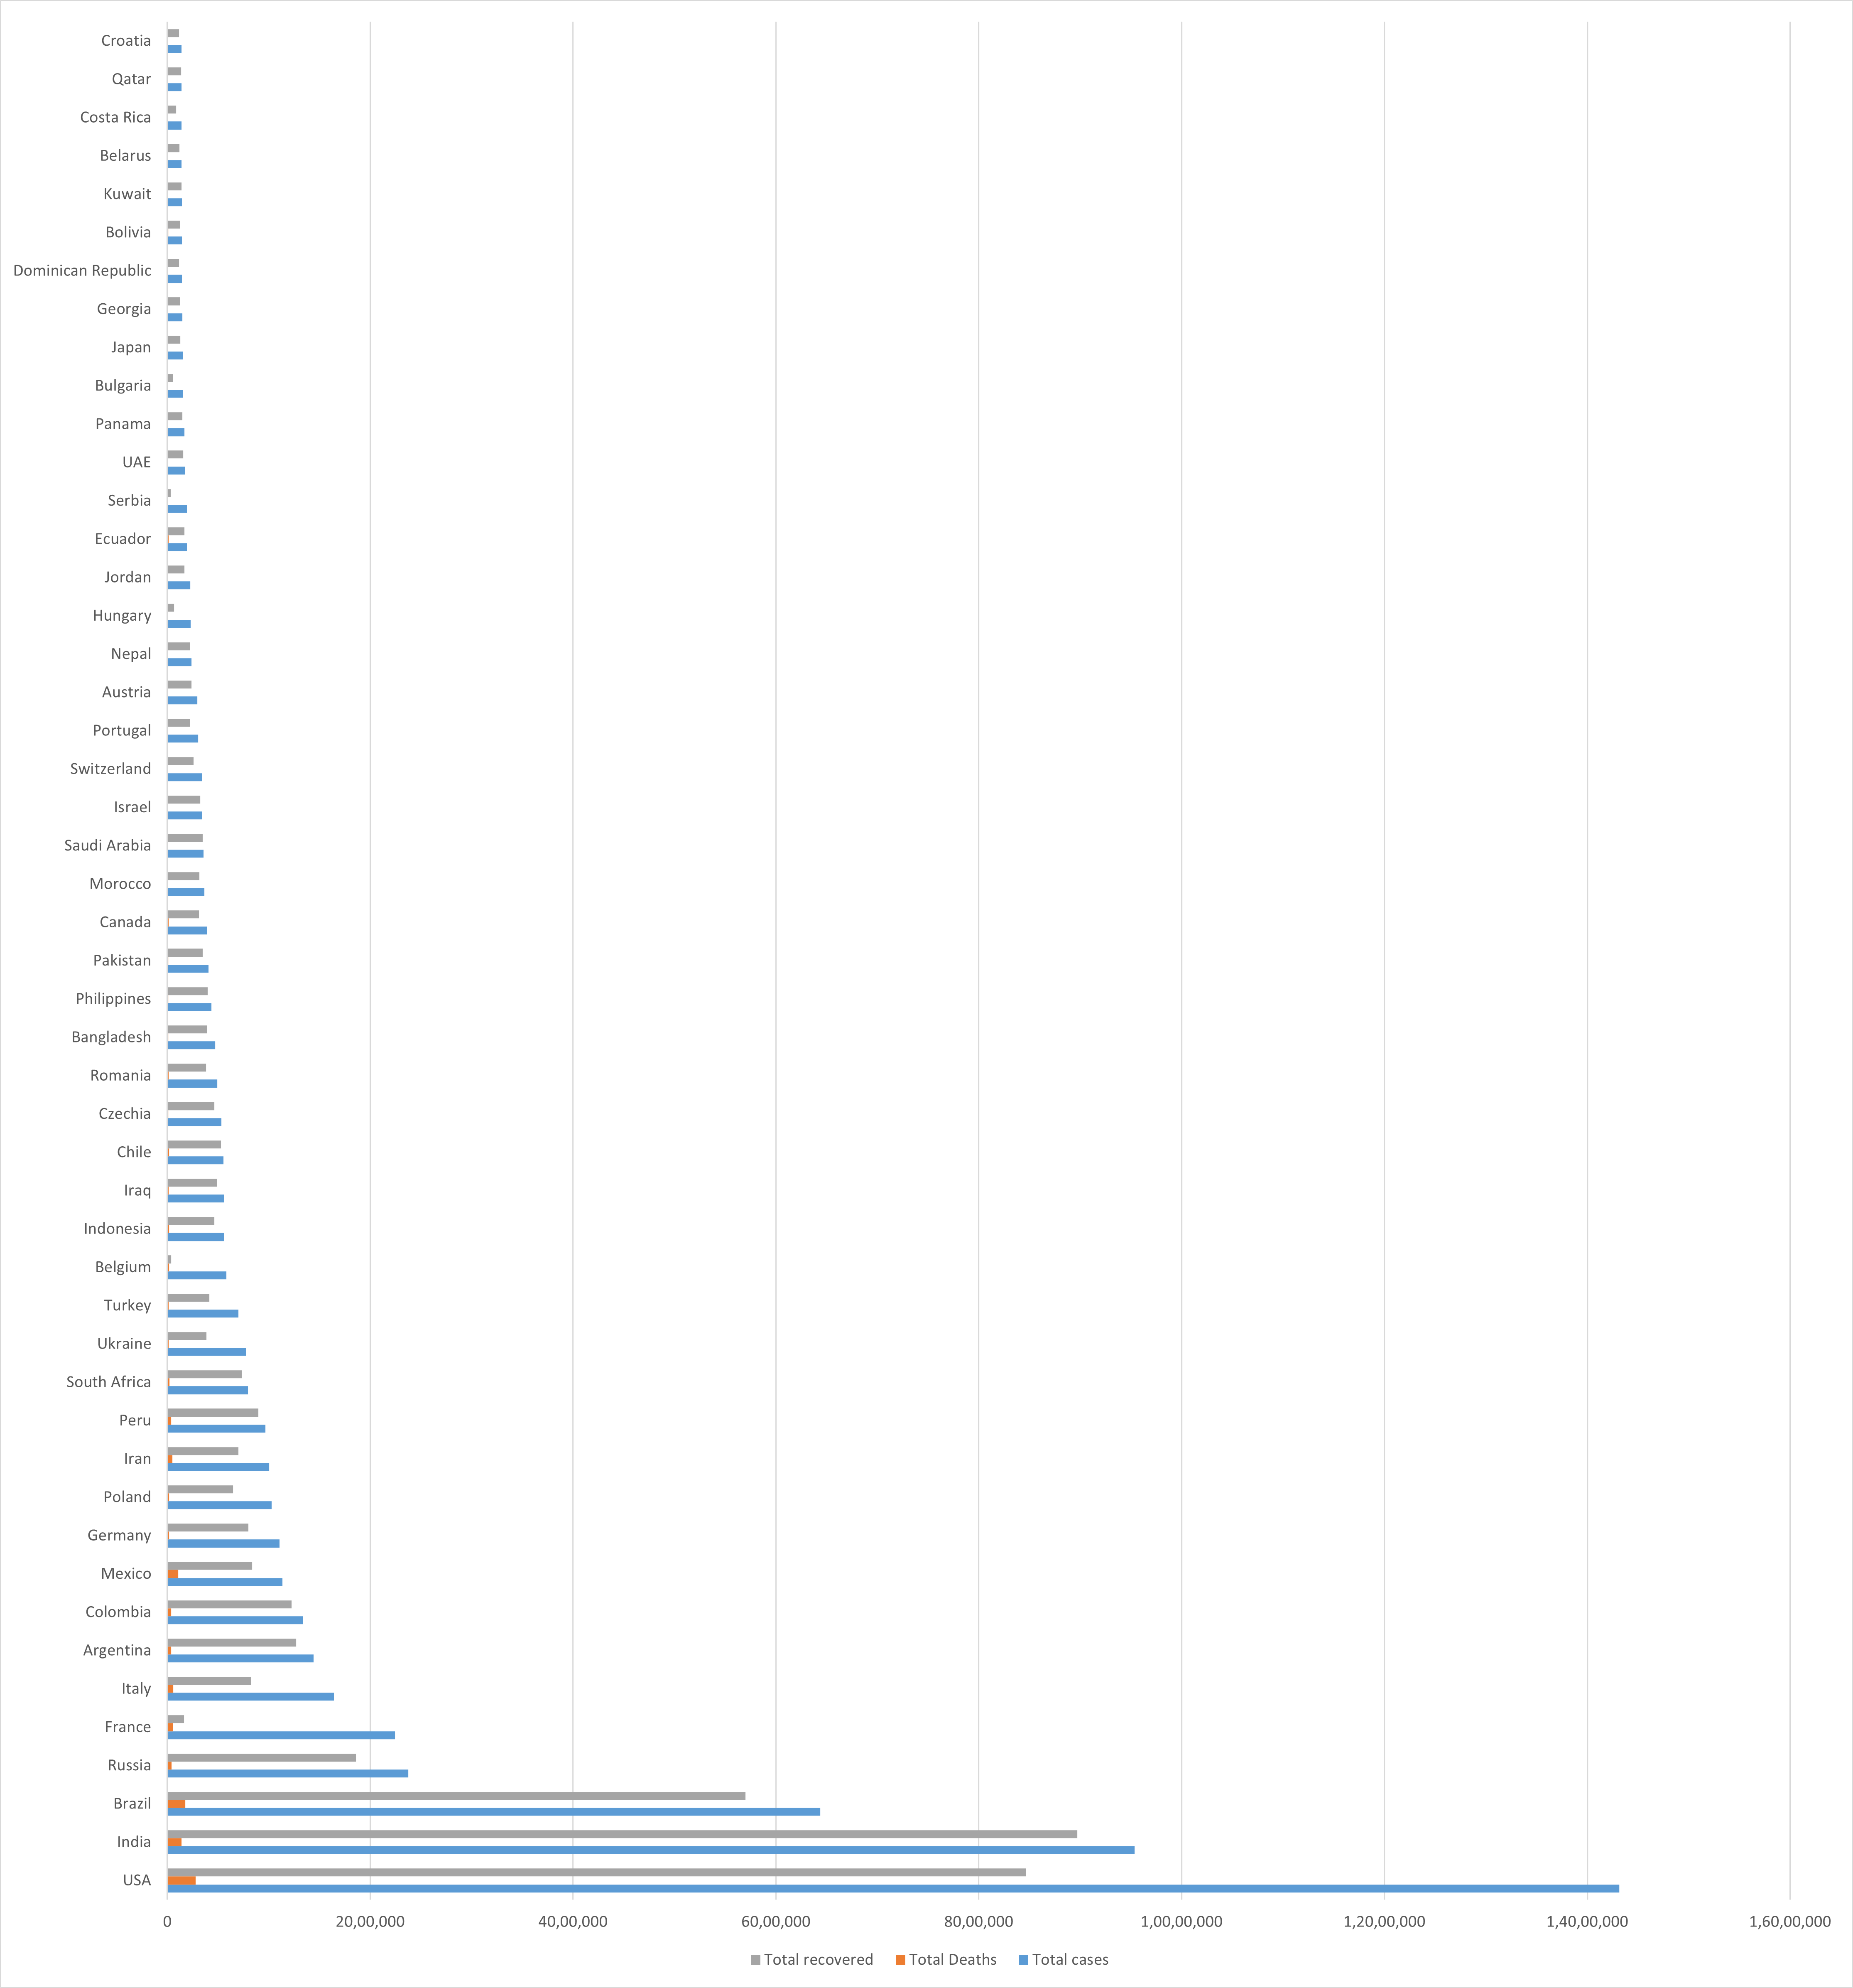
Bar graph

Slide 16
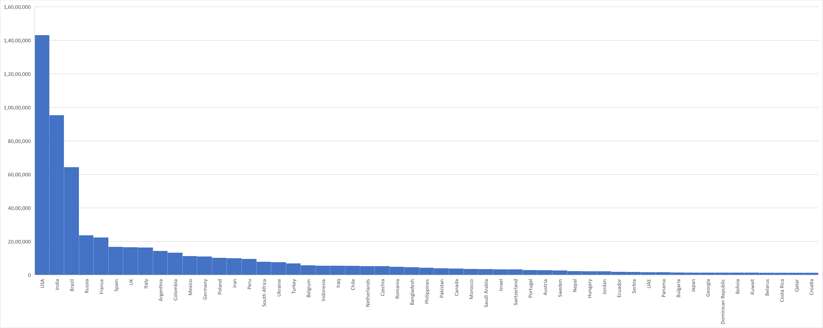
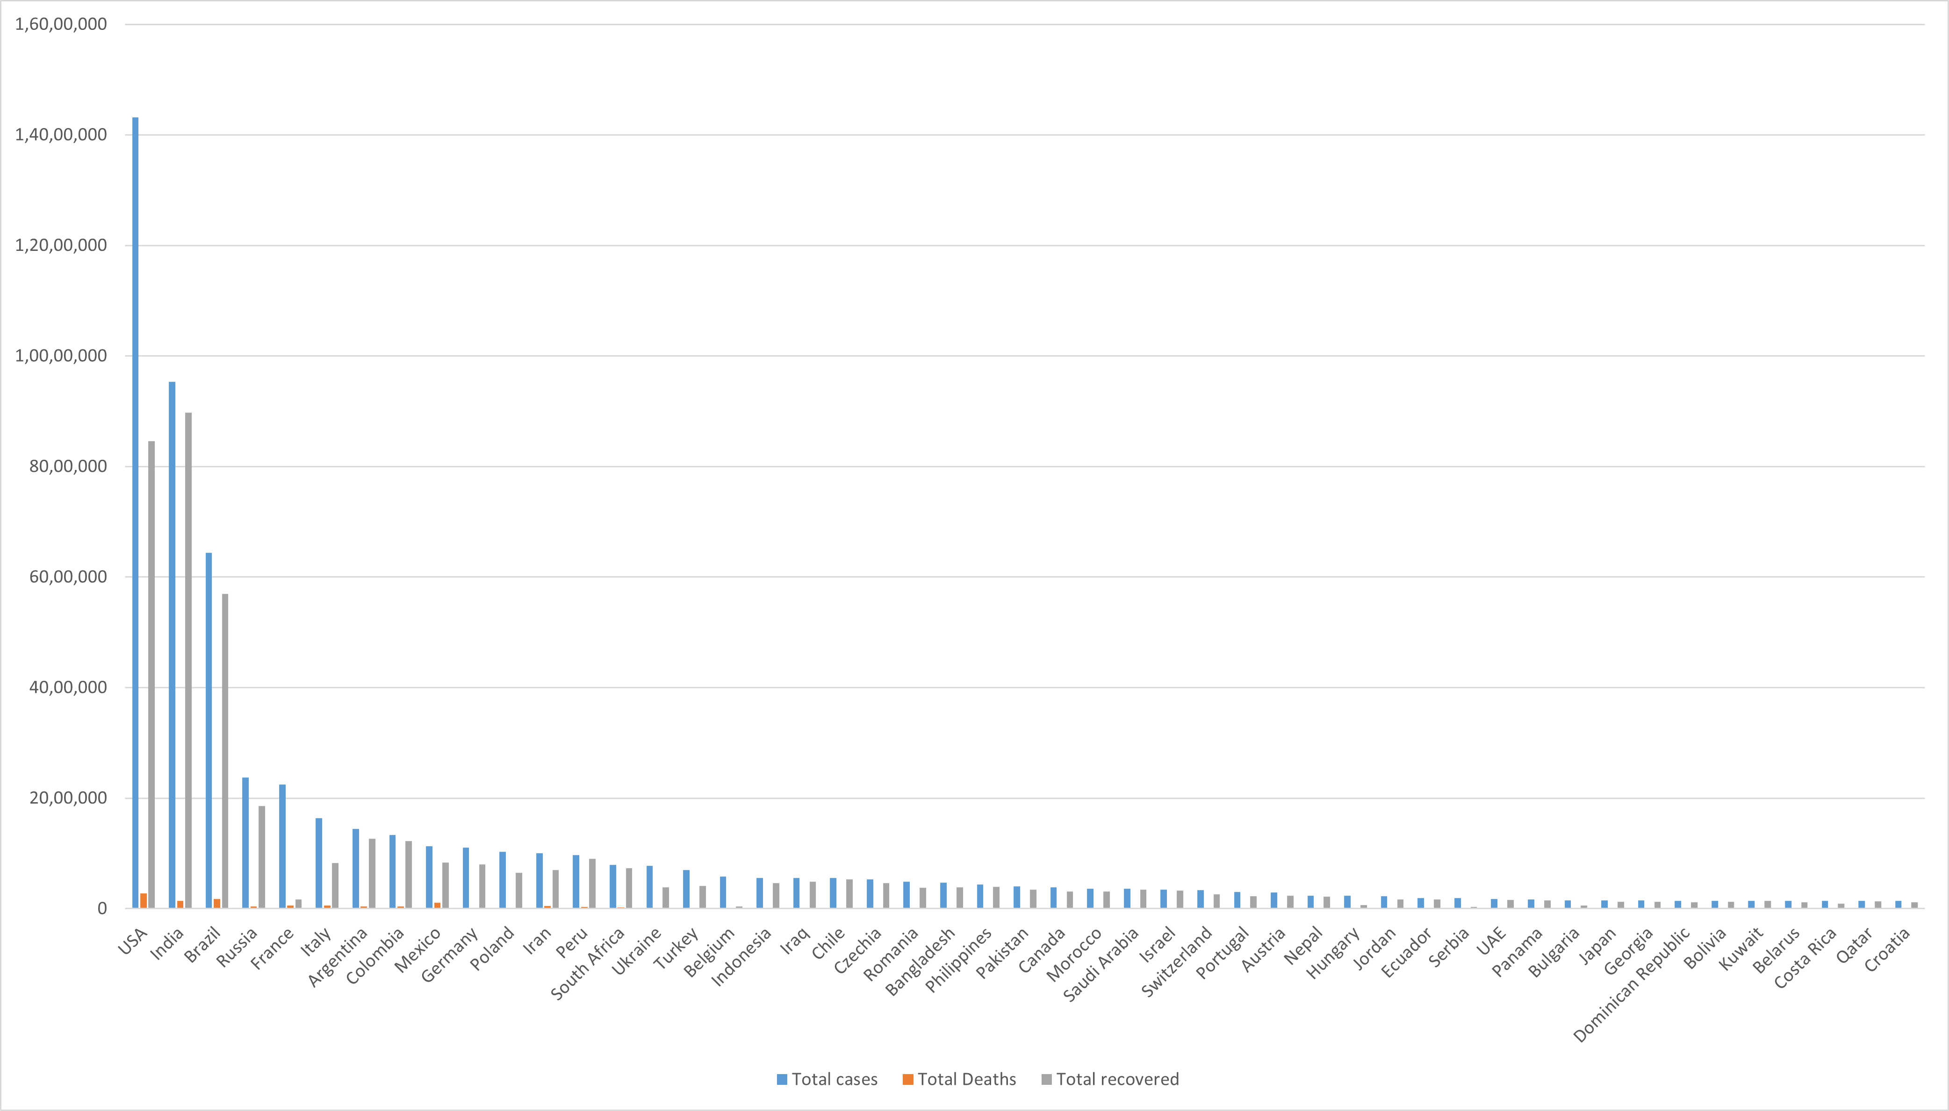
Histogram & Column plot

Slide 17
INTERPRETATION OF THE GRAPH
We used 4 kinds of different graphs to interpret our Covid-19 data . We used Bar , Scatter , Box , Line plot , Histogram , Area and Column plots to make it more understandable to the viewer. If we see the Bar graph which shows clearly that in each country the recovery rate is more than the death rate . Its visible that since December 2019 covid-19 has affected USA and India the most. As comparison USA’s recovery rate is less than in India which is visible from histogram and column plot. Looking at these graphs these are the few questions that arises in our mind which are as follows:-
Are the number of deaths increasing or decreasing ?
- From the line graph , we can see that the slope is decreasing due to which we can say that the deaths and total cases are decreasing whereas it doesn’t have much impact on recovery rate .
Which countries are testing the most ?
- Among the countries with highest cases are some of the most populous countries in the world such as US,BRAZIL,INDIA &RUSSIA but in these countries, the death tolls are relatively less compared to no. Of cases found and recovered ones.
Which country had the most new cases?
- As per the plots , we can say that USA is the most affected country with more than one crore cumulative cases.

Slide 18
Why estimating undetected Covid-19 cases is crucial ?
-This estimation through graphs and charts is important for authorities to plan economical policies , make decisions around different stages of lockdown and work towards the production of intensive care units of different nations.
Are the countries making any progress against the pandemic ?
- From the column plot ,we can notice that countries like India , Russia , Italy , Spain , Germany have a high recovery rate compared to that of underdeveloped countries.
Are countries with fewer reported cases doing well?
- It depends. If these countries are not sufficiently testing or sharing their data , they may have many more undiagnosed cases.
During covid19 ,digitalization of India offers people job by sitting at home.
Health and support from their caregivers can provide support ,in addition to regular taking of medication.
A good mental status in the difficult times may win you the battle
more easily :)

Slide 19
SOURCES :
www.worldometers.info
https://mohfw.gov.in/
www.kaggle.com
www.wikipedia.org (for matter )
CONNTRIBUTION OF EACH MEMBER IN GROUP-14
Data collection – Ponnagananti Sirisha Devi
Graphs – Ammisetti Sivani (Using Excel) ,Rajarapu Lakshmi Mounika (using code for worst-hit countries)
Hypothesis - Shivani Koukuntla , Princey Chaudhary
Interpretation- Kanwaldeep Edewar
Presentation- Princey Chaudhary

