Slide 1
CS644- Introduction to Bigdata HW2
Sirisha Bojjireddy(31485745)
Masters in Datascience(Spring 2019)

Slide 2
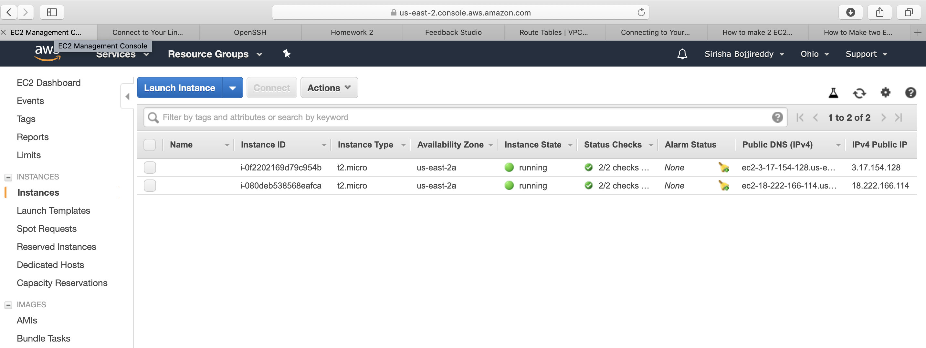
Snapshot of two amazon EC2 instances:

Slide 3
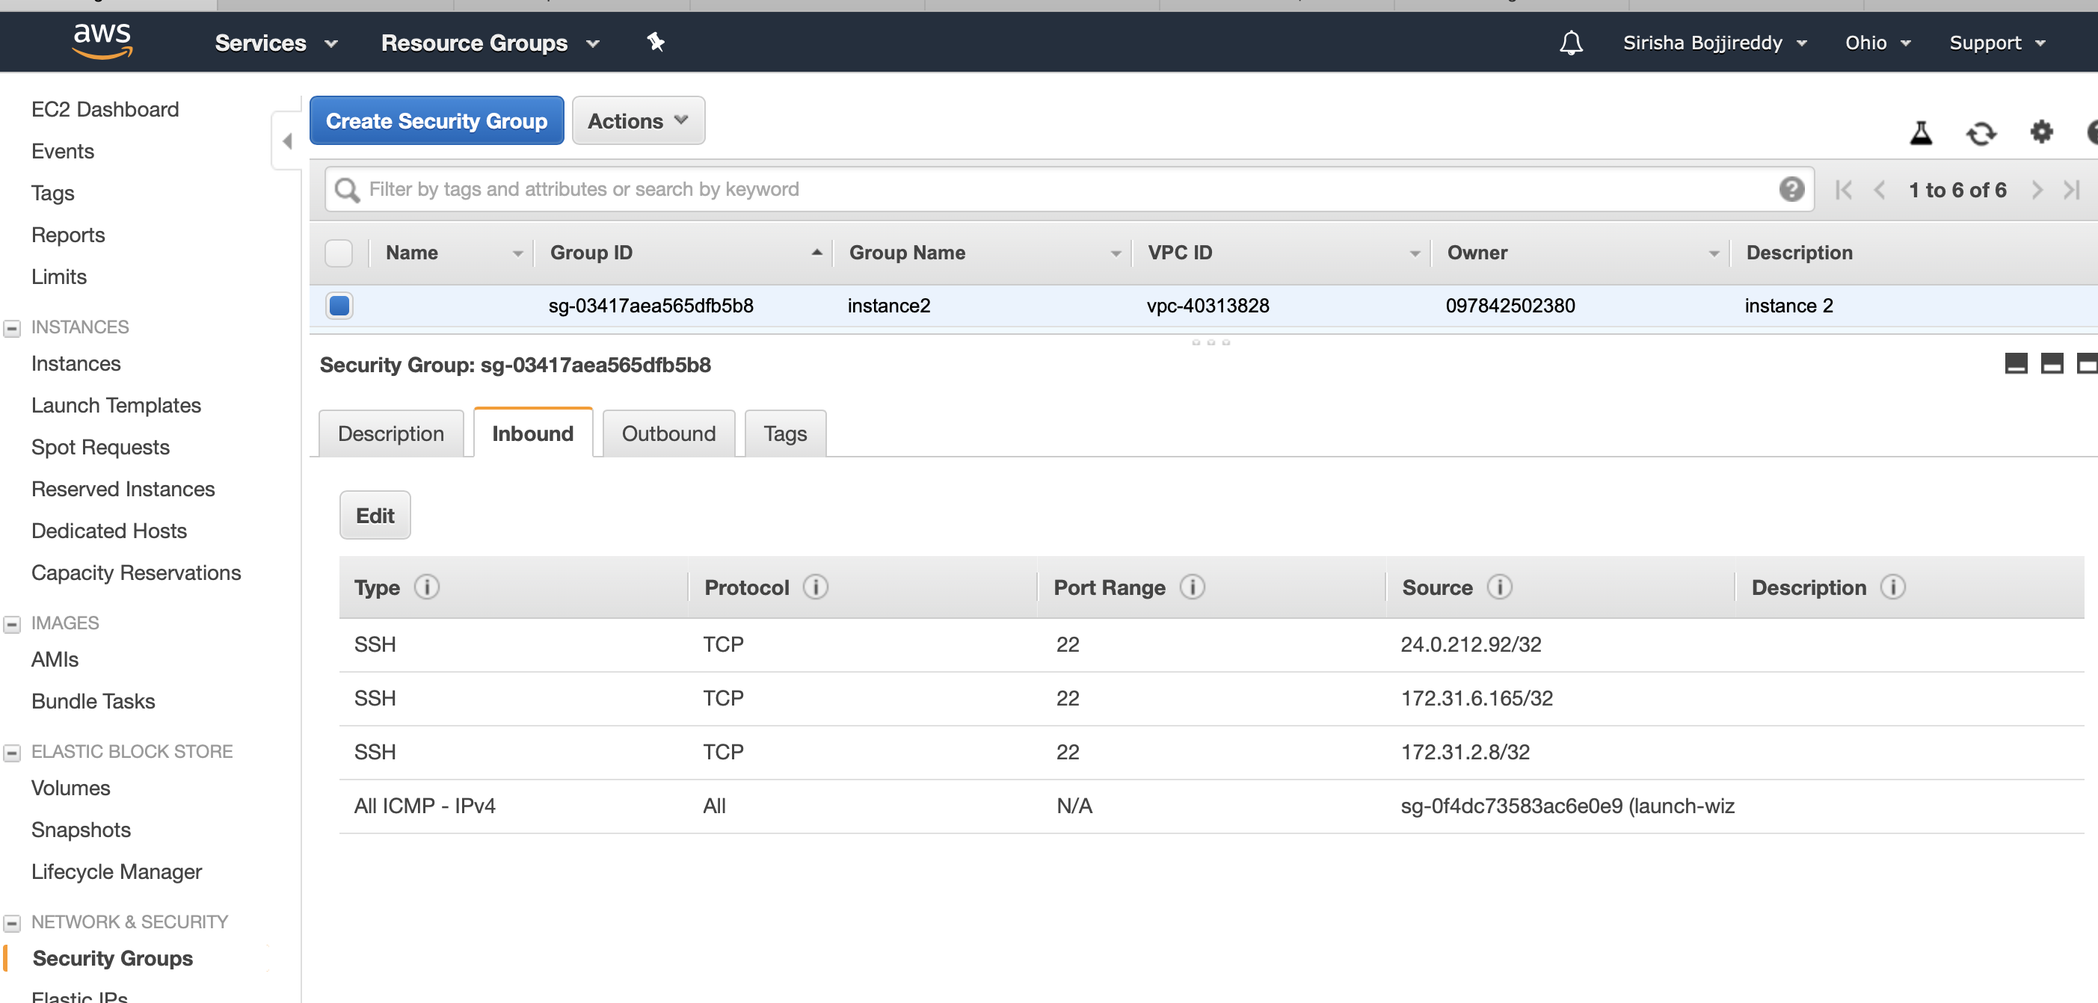
Snapshot of security group for VM1:

Slide 4
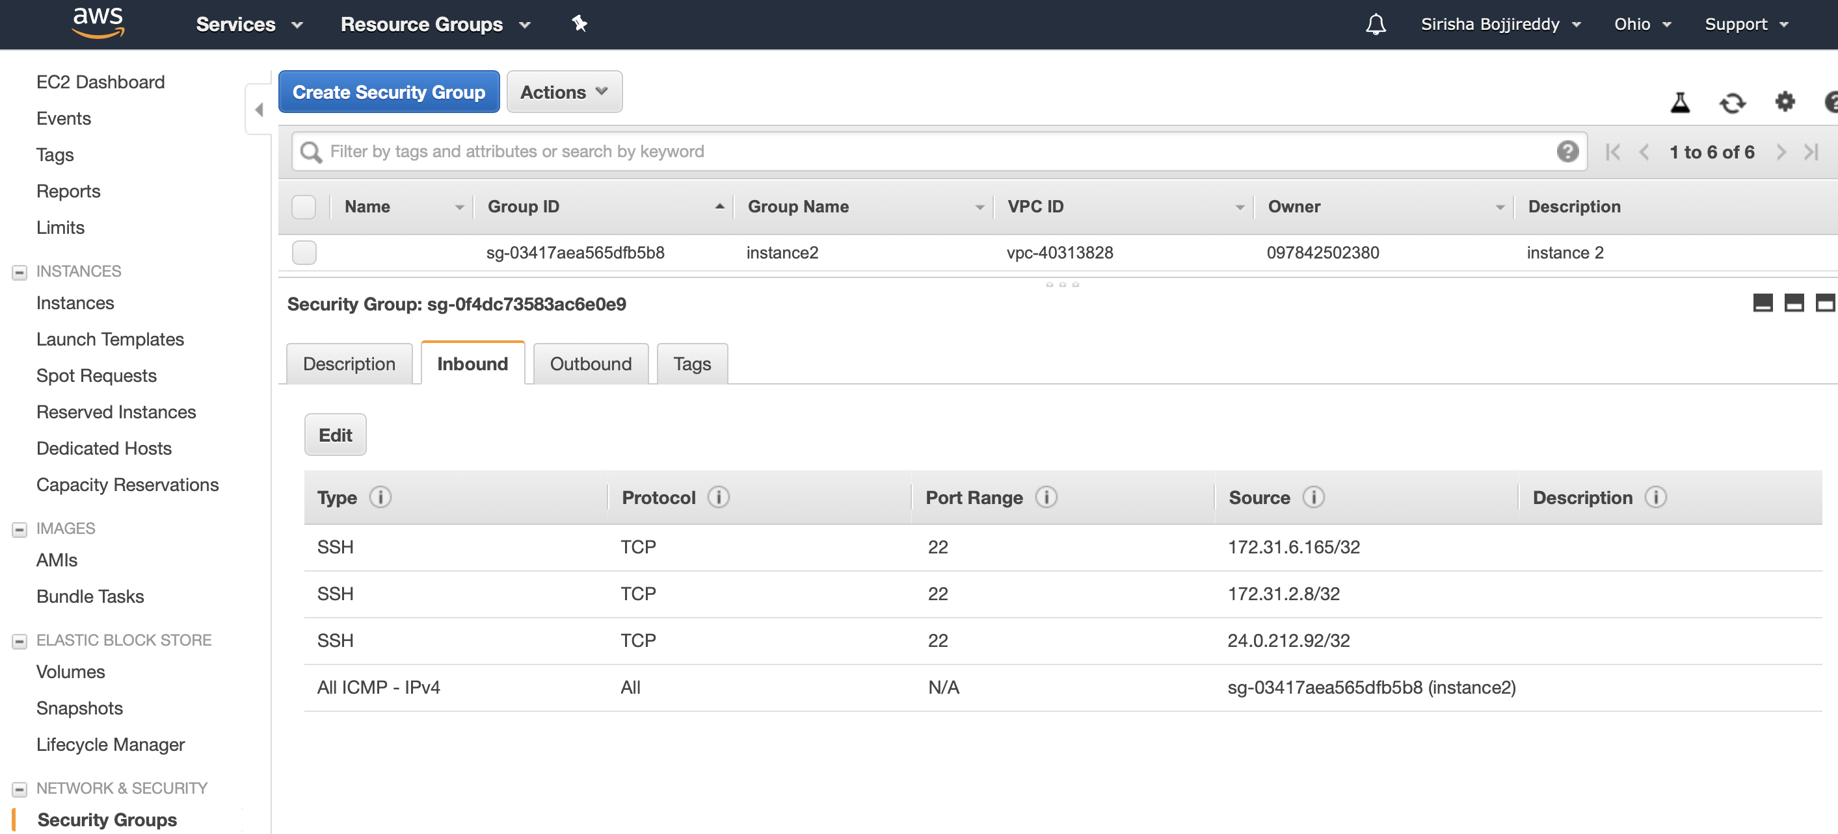
Snapshot of security group for VM2:

Slide 5
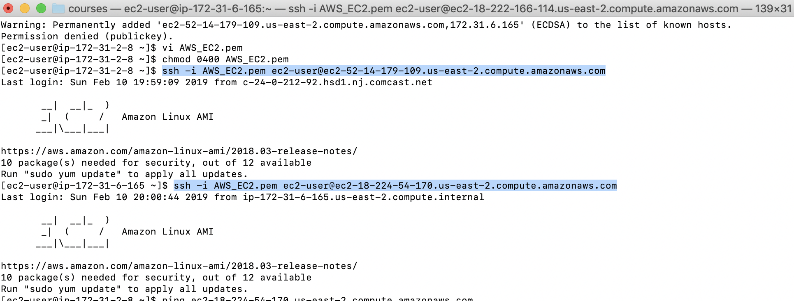
Snapshot of SSH based communication between VM1 and VM2:

Slide 6
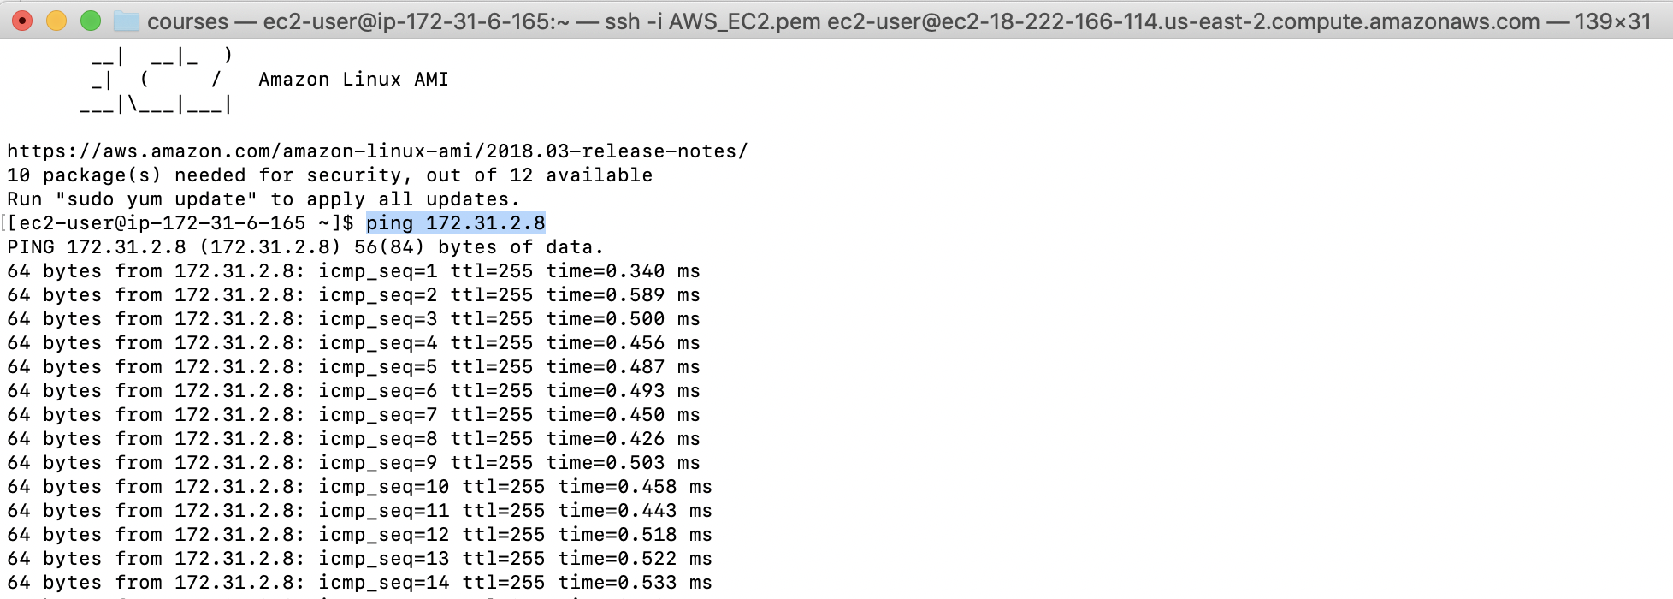
Snapshot of network traffic between VM1 and VM2:

Slide 7
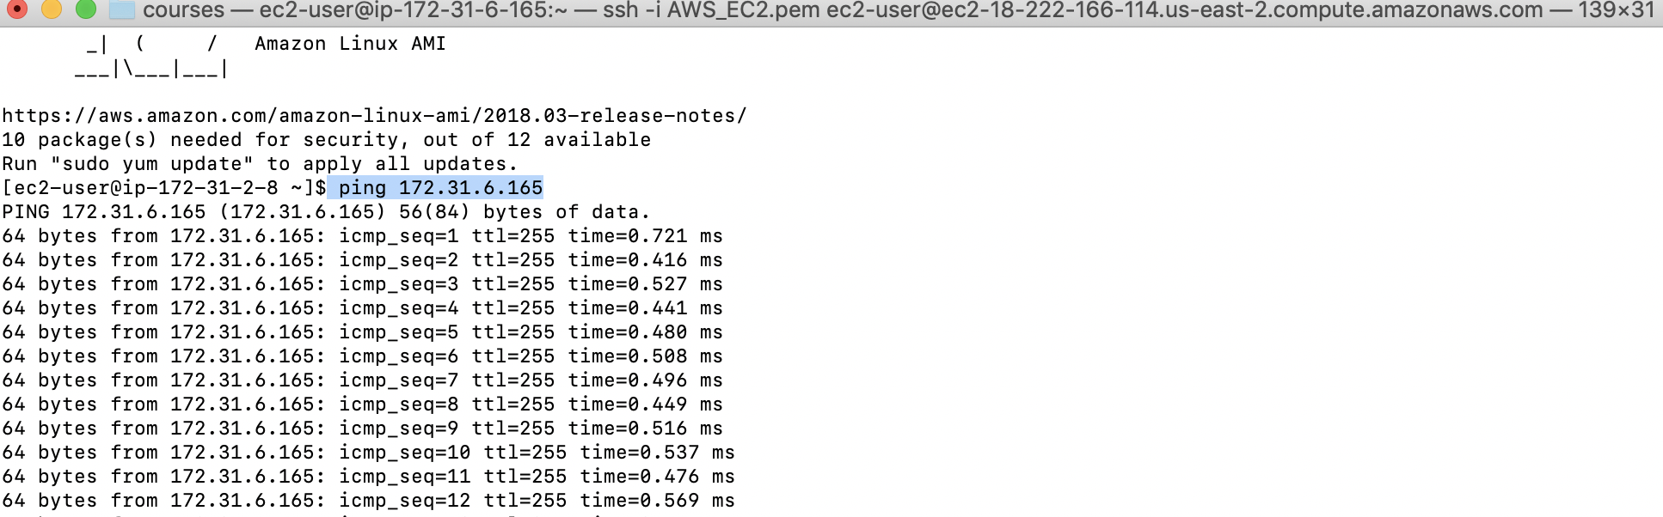
Snapshot of network traffic between VM1 and VM2:

Slide 8
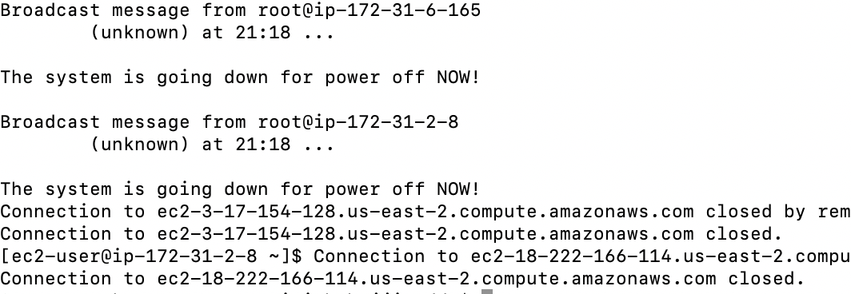
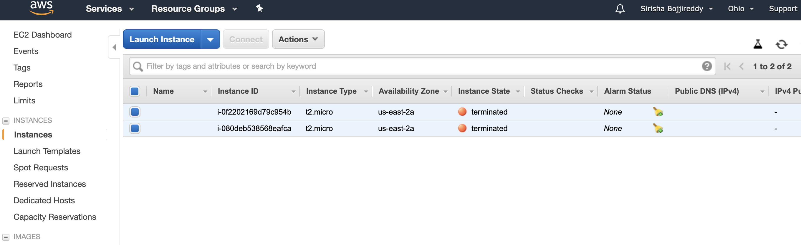
Snapshot of 2 amazon EC2 instance terminated:

