Slide 1
Introduction to Bigdata
Computing Trends - HW2
Sirisha Bojjireddy(31485745)
Masters in Datascience(Spring 2019)

Slide 2
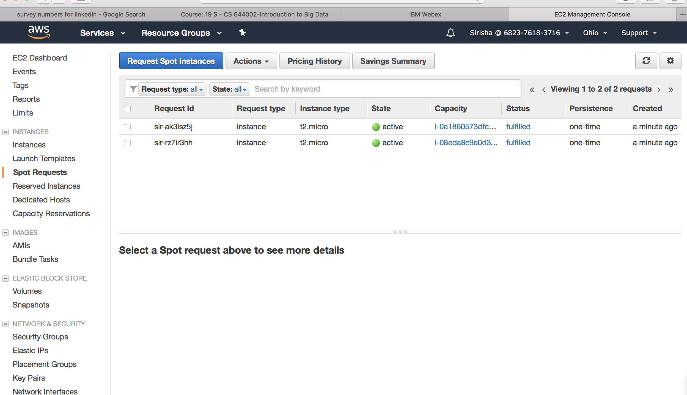
Snapshot of 2 AWS EC2 instance launched

Slide 3
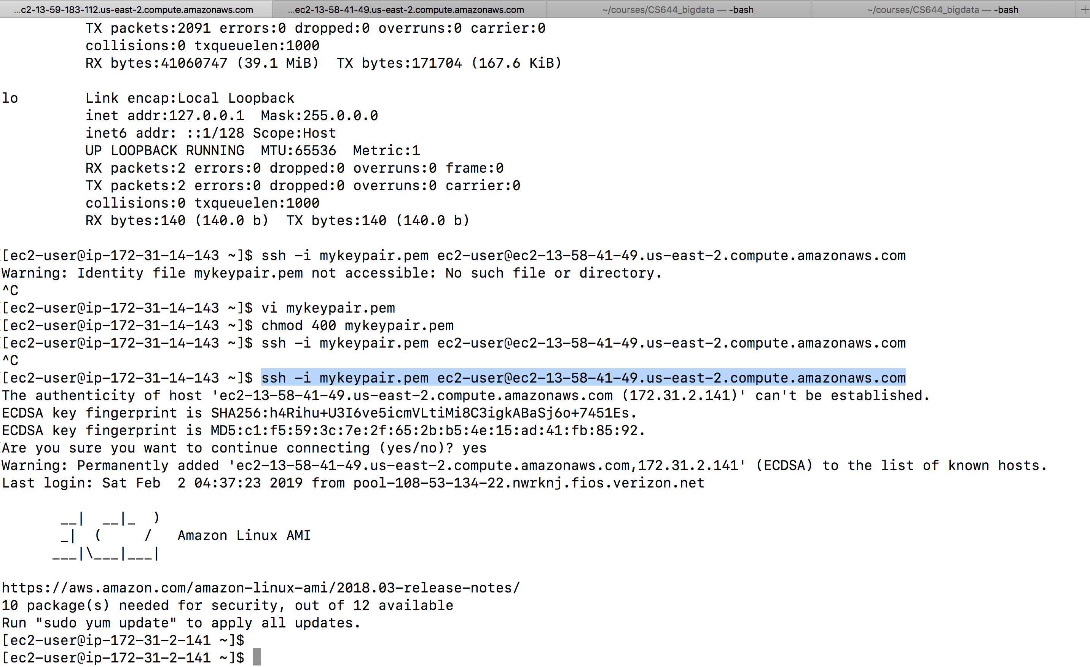
Snapshot of SSH based communication between two instances

Slide 4
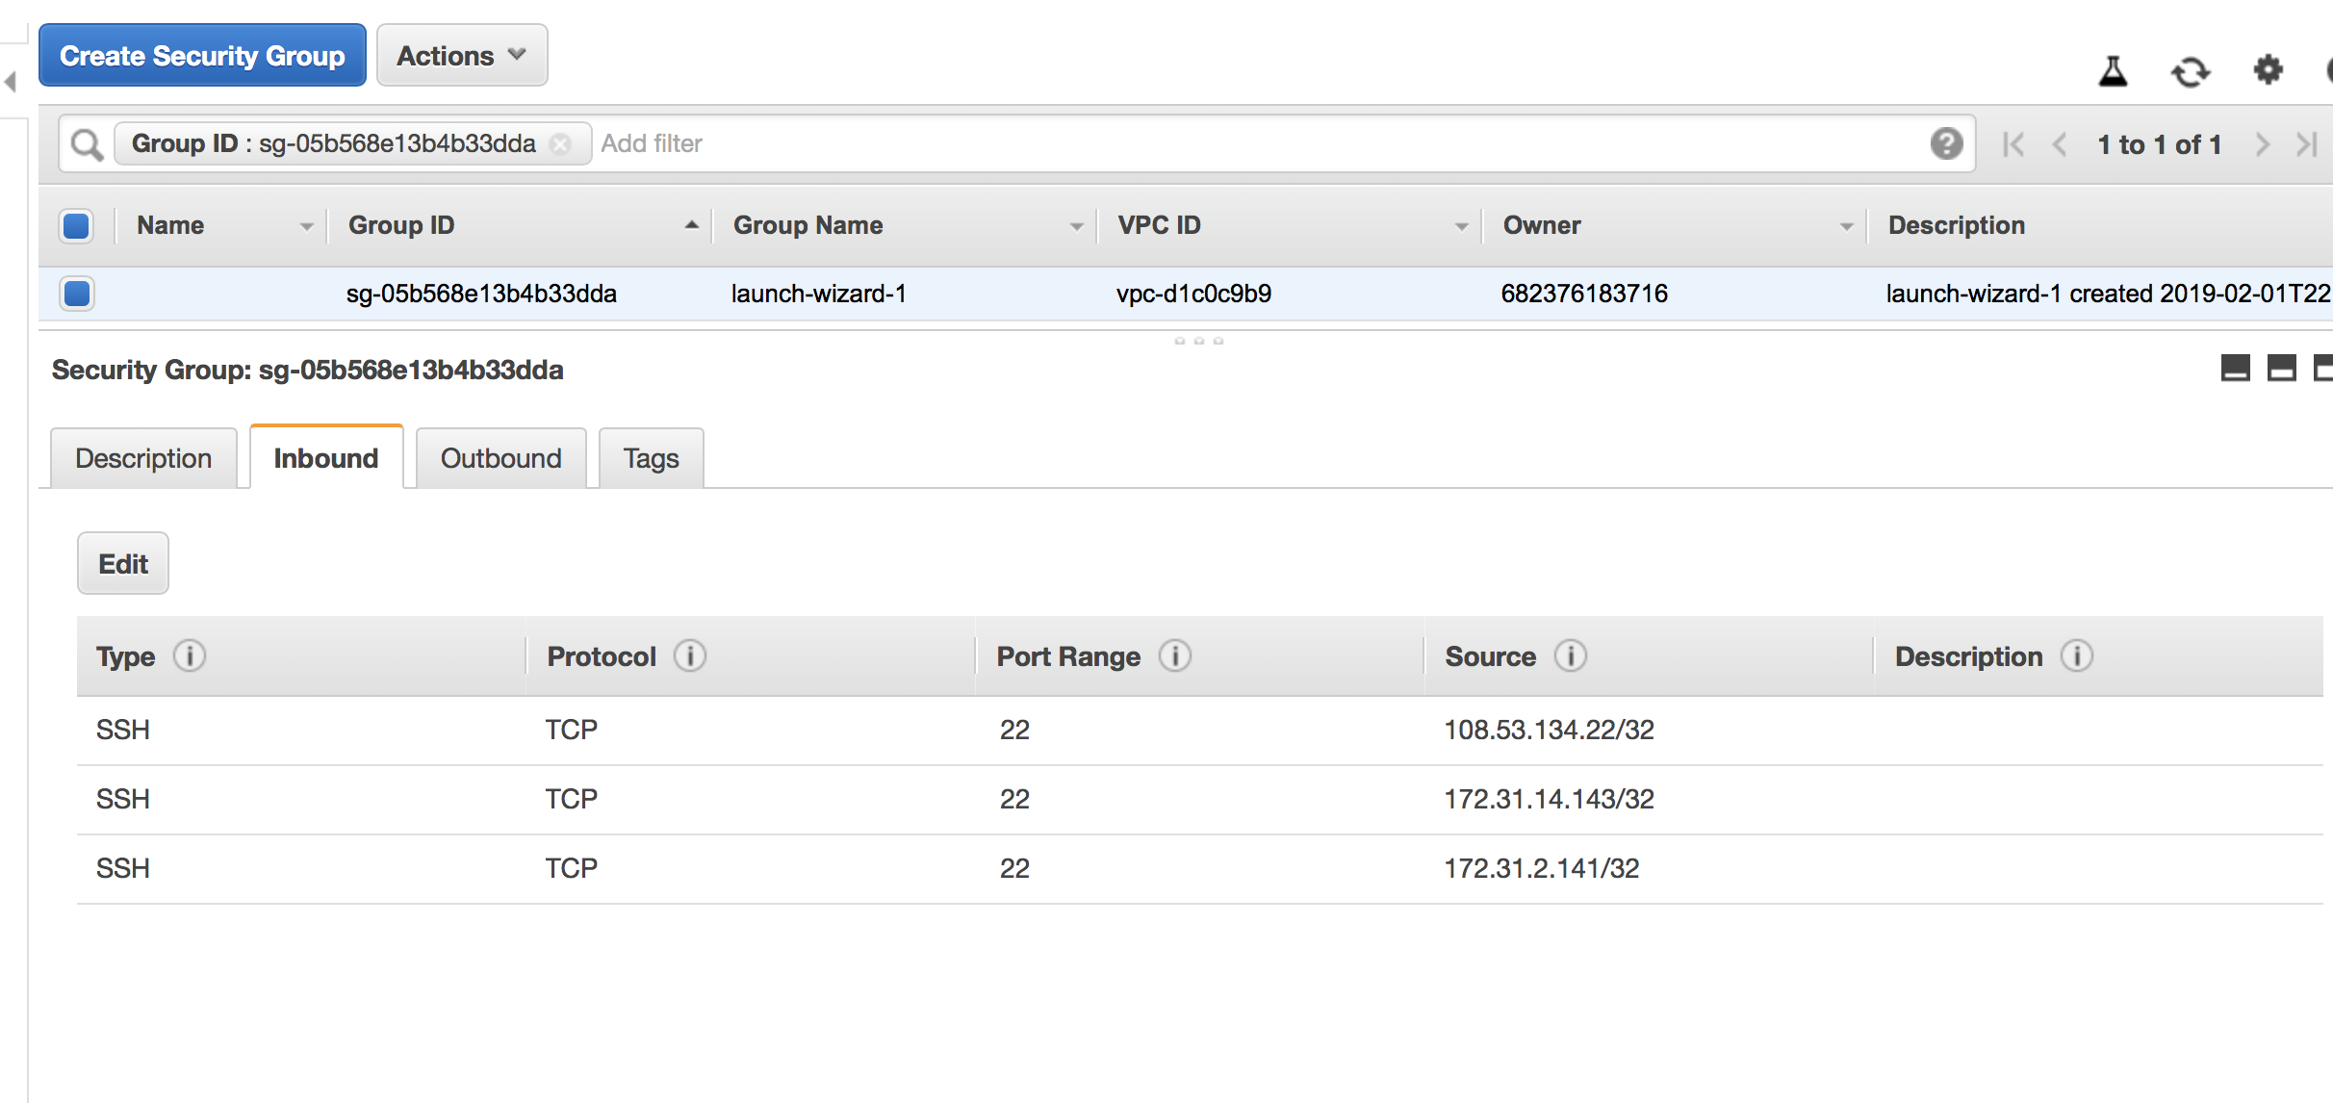
Assigning security group with firewall

Slide 5
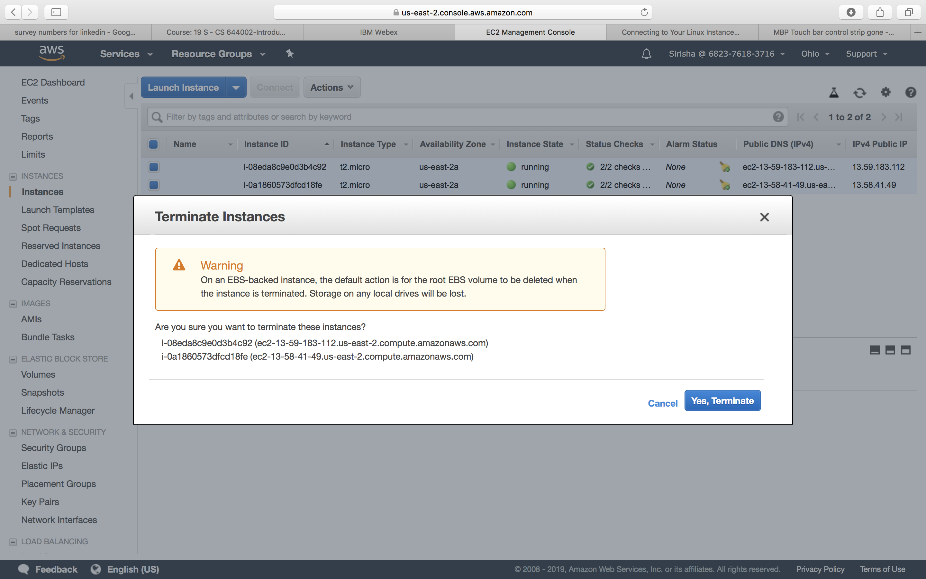
Snapshot of termination of instances

