Slide 1
COVID-19 Data Analysis Presented By Sirisha Gathpa (KG86292)

Slide 2
Overview of COVID-19 and its global impact
Origin and Nature: Emerged in Wuhan, China in 2019; a respiratory illness caused by the SARS-CoV-2 virus.
Transmission and Symptoms: Highly contagious, spread through respiratory droplets; symptoms vary from mild to severe.
Global Impact: Caused widespread health crises, economic disruptions, and altered daily life across the globe.
Response Efforts: Prompted global lockdowns, accelerated vaccine development, and adoption of new public health measures.
Ongoing Challenges: Continues to pose challenges with new variants, vaccine distribution, and healthcare system strains.

Slide 3
Data Overview
The dataset consists of 71,129 entries and 135 columns, including 77 float64, 56 int64, and 2 object data types.
Dataset Info:
<class 'pandas.core.frame.DataFrame'>
RangeIndex: 71129 entries, 0 to 71128
Columns: 135 entries, state to total_staffed_pediatric_icu_beds_coverage
dtypes: float64(77), int64(56), object(2)
memory usage: 73.3+ MB
None

Slide 4

Critical Staffing Shortages Classification Model
The classification model achieved an accuracy of approximately 58.5%.
The macro-averaged F1-score for the classification model is 0.100, indicating poor performance.
The Mean Absolute Error (MAE) for the regression model is approximately 1.721.
The Mean Squared Error (MSE) for the regression model is approximately 28.945.

Slide 5
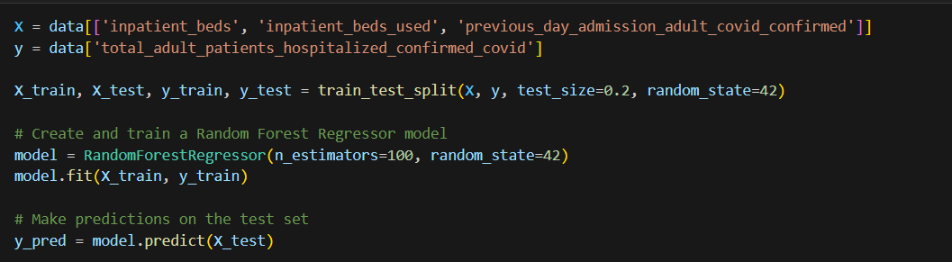
COVID-19 Hospitalization Regression Model
The precision of the regression model is approximately 92.5%, indicating a high proportion of true positives among the predicted positive cases.
The recall of the regression model is approximately 93.3%, indicating a high proportion of true positives captured.
The F1-score of the regression model is approximately 92.9%, reflecting a balance between precision and recall.

Slide 6
Correlation Matrix Heatmap:
The heatmap shows the correlation between various features.
Some features exhibit strong positive correlations, while others have negative correlations.
It helps identify relationships between different variables in the dataset.
Top States with Highest Average ICU Patients with COVID-19:
The bar chart displays the top 20 states with the highest average ICU patients confirmed and suspected of having COVID-19.
It highlights the states facing a significant burden of ICU patients due to COVID-19.

Slide 7
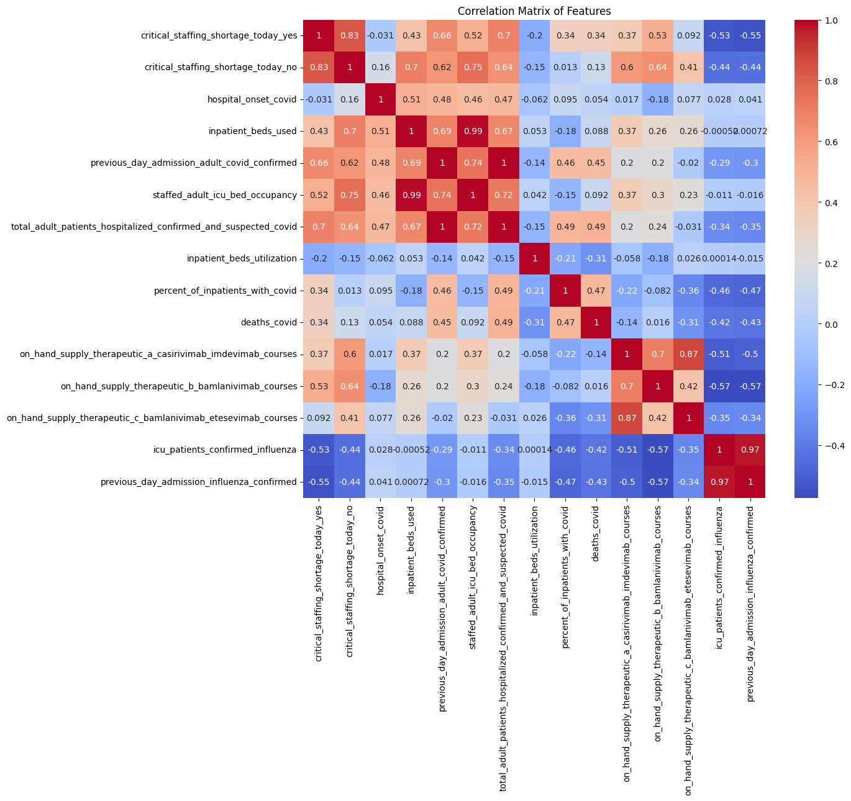
Feature Correlation Analysis

Slide 8
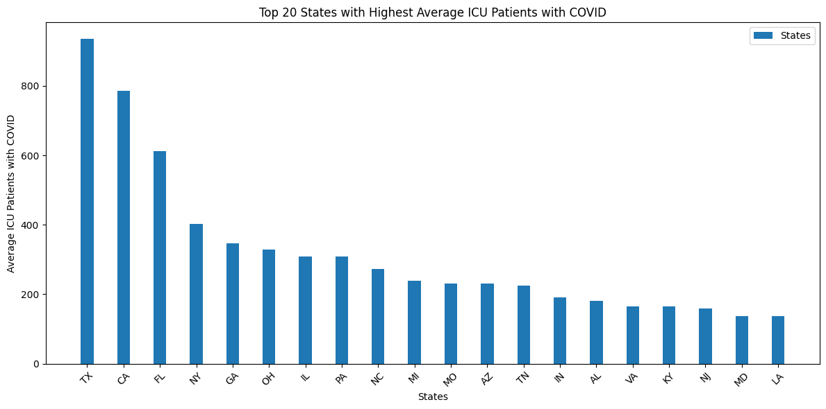
Top States for ICU Patients

Slide 9
Monthly ICU Patients by Month:
The bar chart illustrates the monthly variation in the number of staffed ICU patients with confirmed and suspected COVID-19.
It shows how ICU patient numbers fluctuated over time.
Inpatient Bed Utilization by State:
The bar chart presents the inpatient bed utilization for each state.
It allows for a comparison of bed utilization rates among different states.

Slide 10
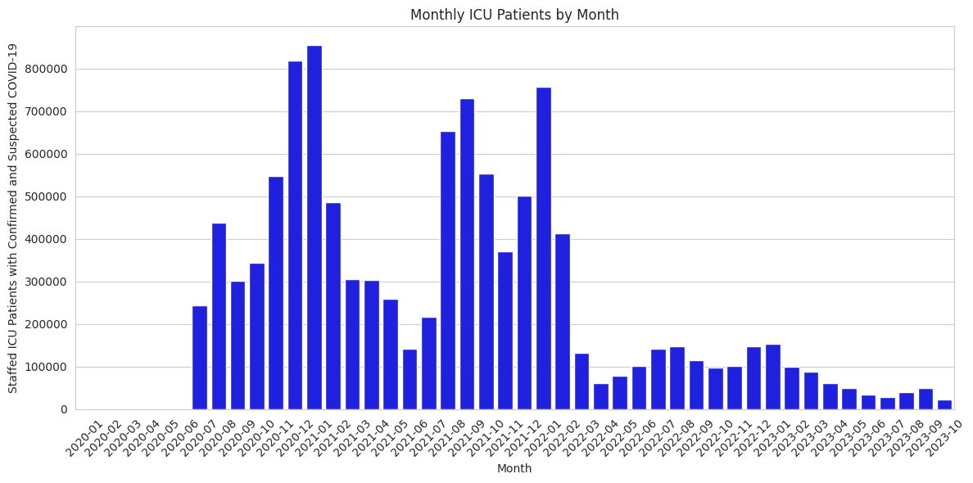
Monthly Trends in ICU Patients

Slide 11
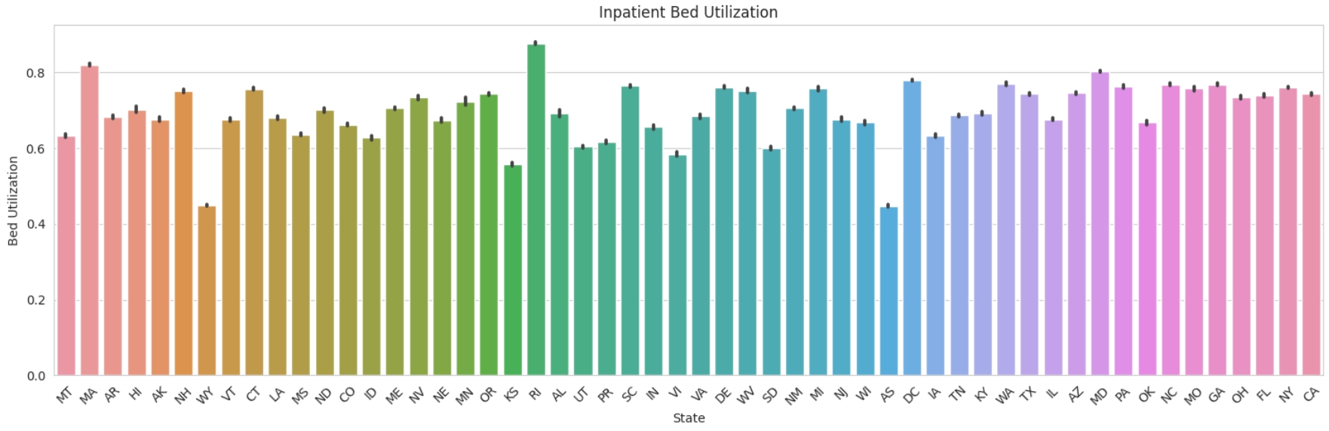
Inpatient Bed Utilization by State

Slide 12
Aggregated COVID-19 Deaths and Average ICU Bed Utilization:
The bar chart displays aggregated COVID-19 deaths over six-month periods.
The line graph overlays the average ICU bed utilization percentage on the same chart.
It helps visualize the relationship between COVID-19 deaths and ICU bed utilization over time.
Critical Staffing Shortage (Yes/No/Not Reported):
The pie chart shows the distribution of hospitals with critical staffing shortages.
It provides an overview of the staffing situation in hospitals

Slide 13
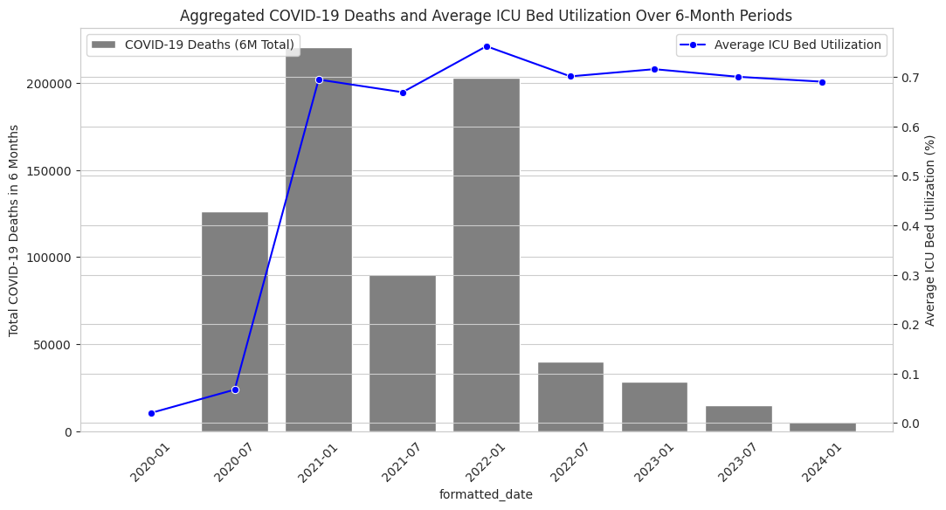
COVID-19 Deaths and ICU Utilization

Slide 14
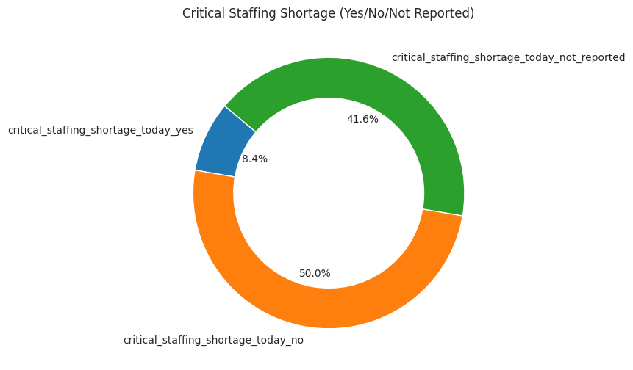
Critical Staffing Shortages Overview

Slide 15
Percent of Inpatients with COVID vs. Deaths due to COVID:
The scatter plot examines the relationship between the percentage of inpatients with COVID and COVID-related deaths.
It helps identify any trends or patterns between these two variables.
Comparison of Hospitals with and without Critical Staffing Shortages:
The bar chart compares the number of hospitals with and without critical staffing shortages.
It illustrates the distribution of hospitals facing staffing issues.
ICU Patients vs. Total Inpatients by State:
The stacked bar chart visualizes the total number of ICU patients (confirmed and suspected) and total inpatients for each state.
It provides insights into the healthcare burden in different states.

Slide 16
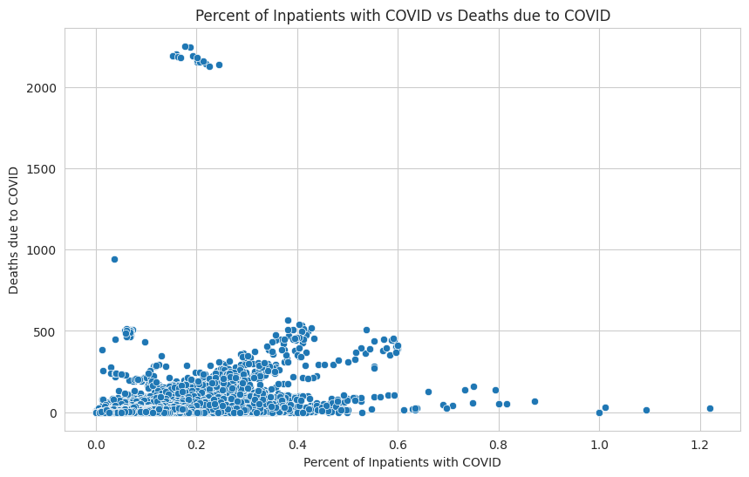
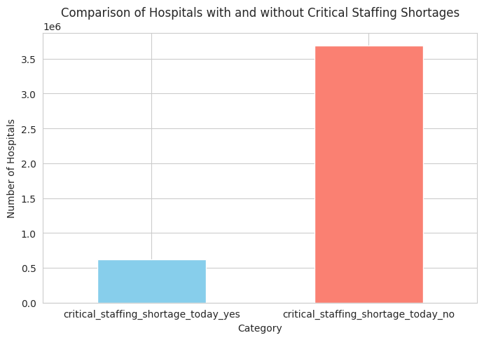
COVID-19 Impact Analysis
Inpatient Percentage vs. Deaths Staffing Shortages Comparison

Slide 17
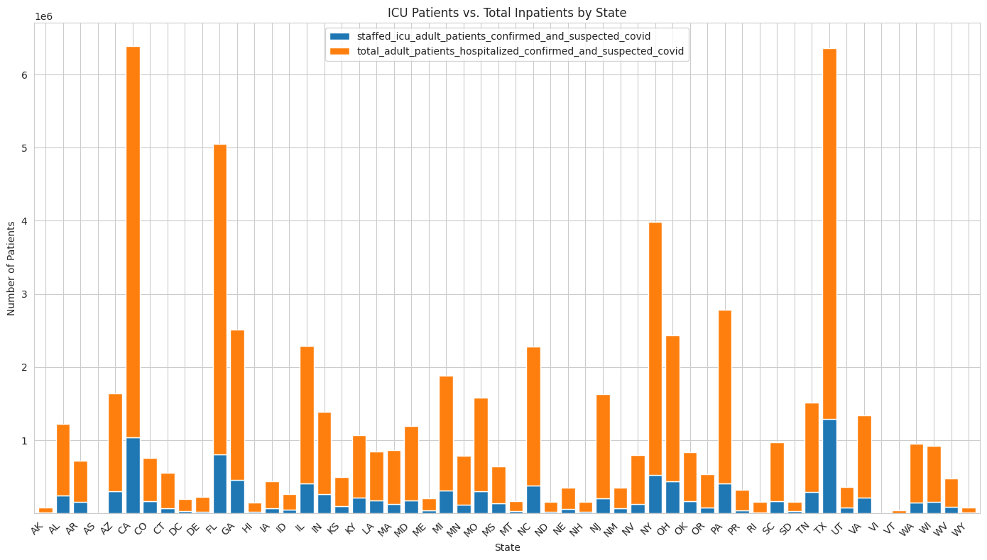
State wise Healthcare Insights

Slide 18
Thank You

