Slide 1



Revolutionizing Customer Usage with Data-Driven Insights
Presenters:
Sirisha Gathpa
Sumasri Chitturi
Sreyasree Siloju
1

Slide 2
Problem Statement
Identifying Early Warning Signs: In the realm of application ownership, detecting early warning signs of customer churn is pivotal for proactive intervention and retention efforts. The ability to foresee potential churn enables application owners to implement targeted strategies before users disengage.
Usage Patterns and Trends: Usage patterns and trends play a pivotal role in assessing the health of customer relationships and predicting potential churn. Analyzing how users interact with an application over time provides valuable insights into their evolving needs and satisfaction levels.
Dynamic Market and Dynamics: Application owners must embrace a forward-thinking approach, anticipating changes, and actively adapting to market dynamics. The ability to stay ahead in the race for user retention lies in a combination of strategic foresight, technological agility, and a relentless commitment to meeting user expectations in an ever-evolving digital landscape.

Slide 3
Business Goal
Revenue Protection: Identify and address customer churn early to safeguard existing revenue streams and preserve the financial health of the business.
Customer Satisfaction and Loyalty: Proactively understand and resolve factors contributing to churn, aiming to improve overall customer satisfaction and build long-term loyalty.
Strategic Decision-Making: Utilize churn predictions to inform targeted marketing, resource allocation, and product/service enhancements, enabling data-driven decision-making for sustained business growth.

Slide 4
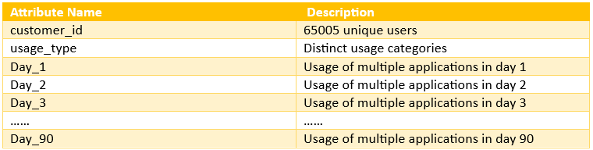
Dataset

Slide 5
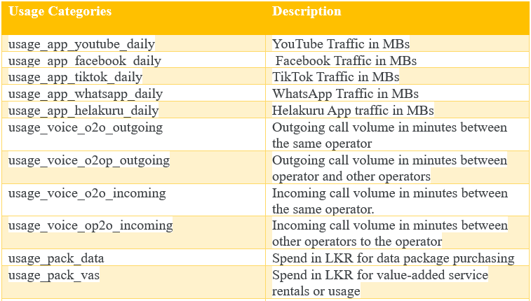
Dataset The dataset contains data on over 60,000 customers across more than 10+ distinct usage categories. Some of the key usage categories include:

Slide 6
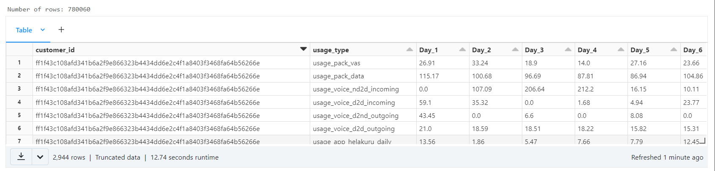
Sample Dataset

Slide 7
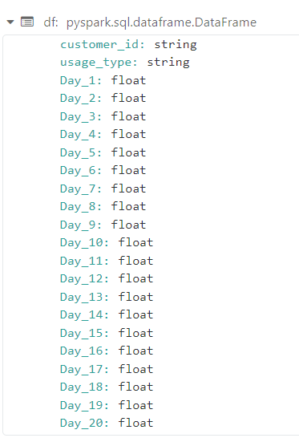
Data Pre-Processing Convert categorical day columns to float type

Slide 8
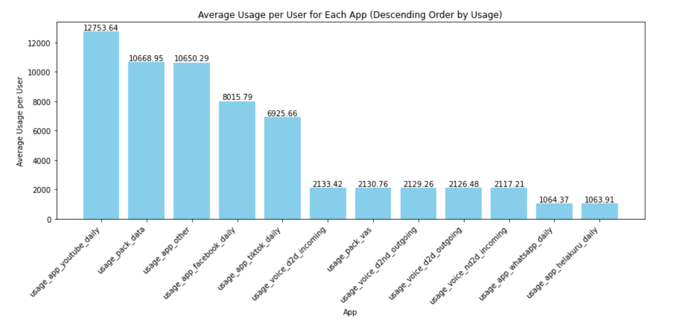
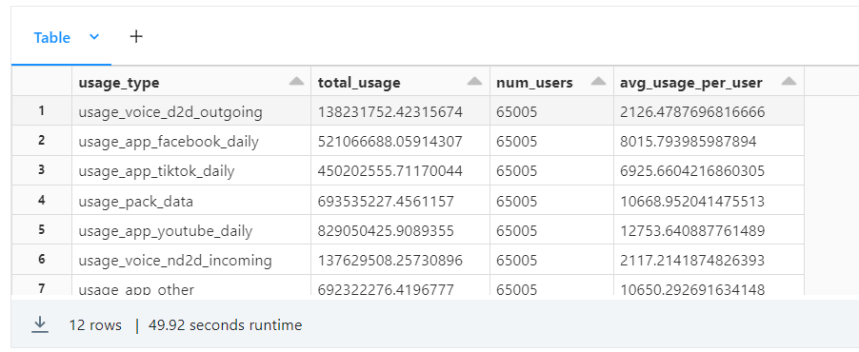
Average Usage Per Application and Data Visualization The bar graph to visualize the average usage for each app in descending order

Slide 9
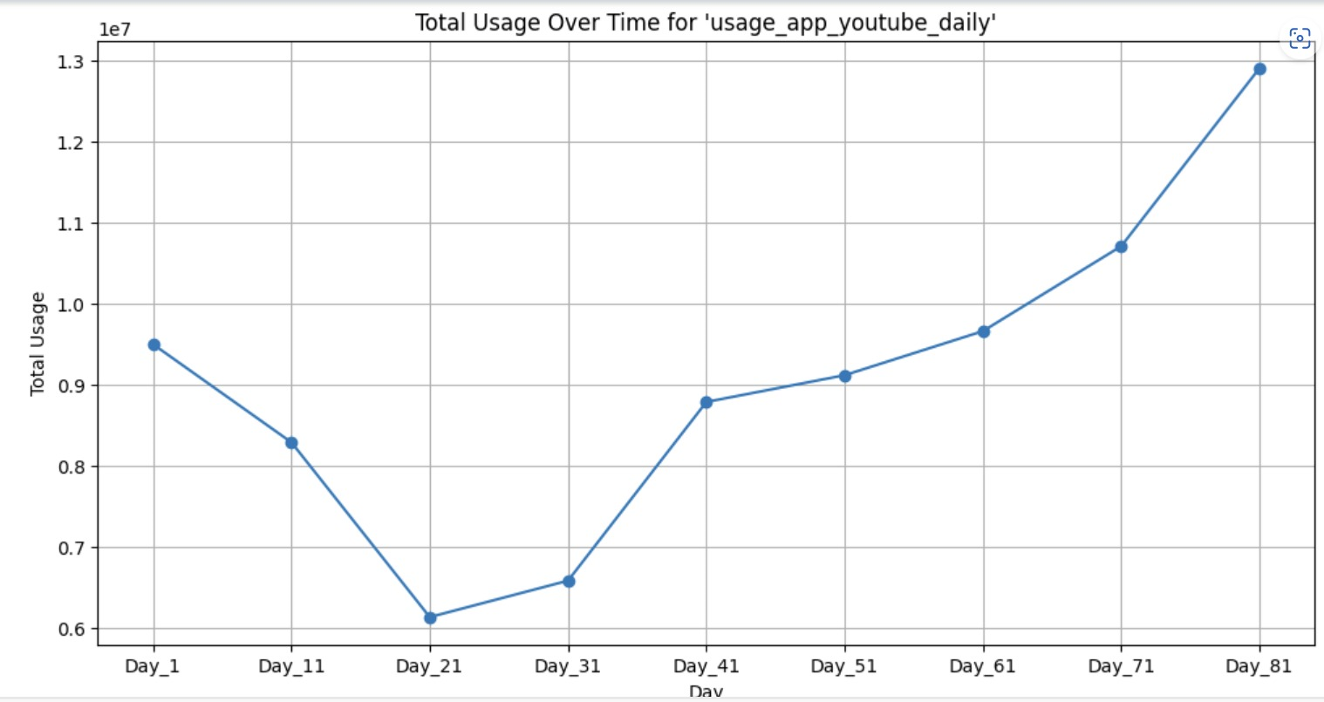
The day-wise trend in using YouTube The bar graph to visualize the day-wise usage for YouTube.

Slide 10
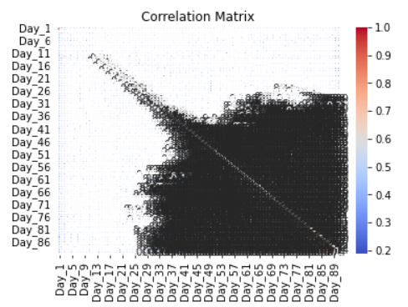
Correlation Correlation matrix to understand relationships between features

Slide 11
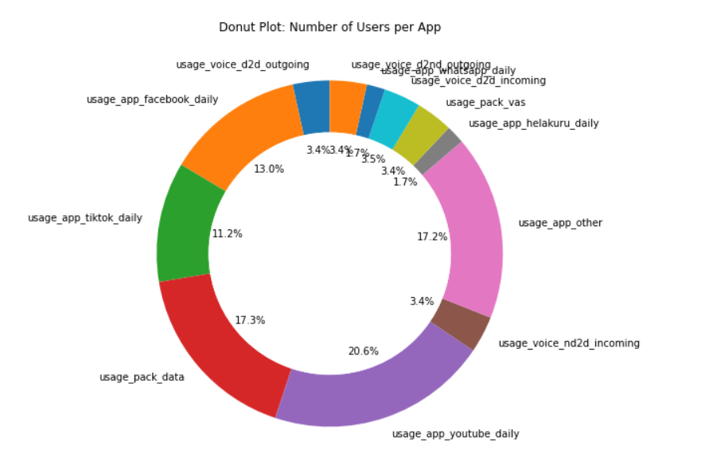
Number of Users per App

Slide 12
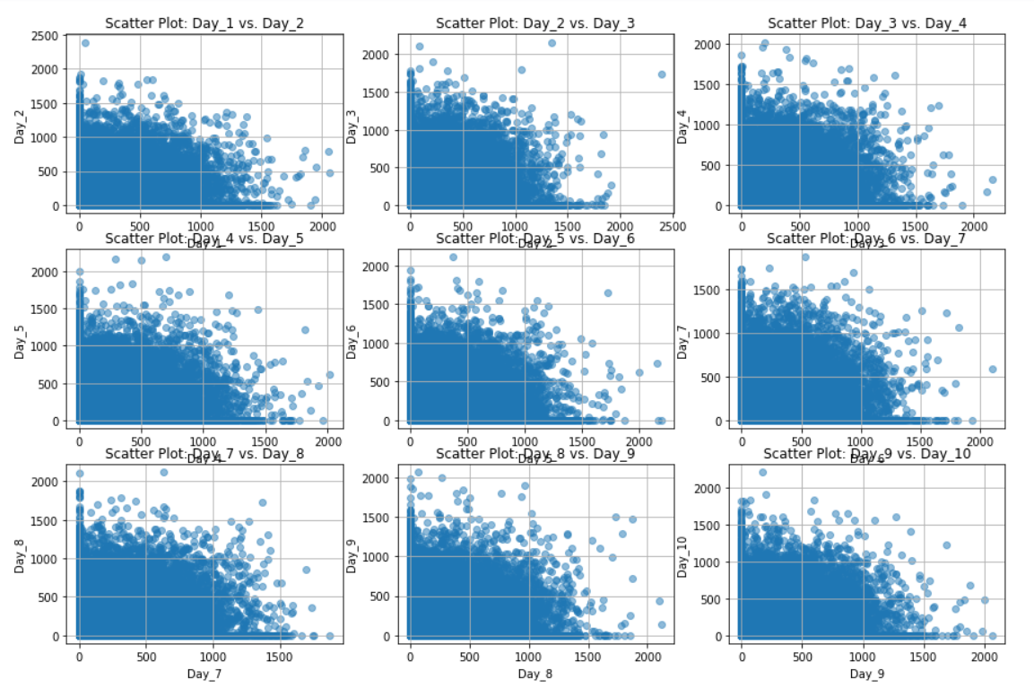
Scatter plots for the increase in daily app usage

Slide 13
Model Results
RMSE with value of 4.6*e-06 signifies near-perfect precision in predicting customer churn.
Reliable Model Fit: Indicates a highly reliable model, effectively capturing patterns associated with customer churn.
Low RMSE serves as validation, instilling confidence in stakeholders regarding the model's accuracy.

Slide 14
Benefits
Improved Customer Experience: By addressing issues leading to churn, businesses can enhance the overall customer experience, resulting in higher satisfaction and loyalty among the existing customer base.
Cost Savings: Identifying and retaining at-risk customers is often more cost-effective than acquiring new customers. Churn prediction helps allocate resources efficiently, focusing on retention efforts where they are most needed.
Proactive Problem Resolution: Churn prediction allows businesses to identify and address issues that may lead to dissatisfaction or churn, promoting proactive problem resolution and improving overall customer satisfaction.
Data-Driven Insights: Churn prediction provides valuable insights into customer behavior and preferences, enabling businesses to make informed decisions about product development, marketing strategies, and overall business planning.

Slide 15
Findings
Exploring the dataset has given that YouTube is the most viewed application and Helakuru is the least viewed application with average usage of 12,753.64 MB and 1063.91 MB respectively.
The average number of users for YouTube is 20.6% whereas, for Helakuru is 1.7%.
The Root Mean Square Error metric evaluation considering the target label as Day_90 has resulted in a value of 4.6e-06. This justifies the model has exceptional precision, the logistic regression used for analysis is well fitted for the dataset, and is reliable.

Slide 16
Conclusion
This analysis gives the importance of real-time churn prediction in maintaining a competitive edge in the market.
Encourage proactive customer retention strategies to foster long-term business success.

Slide 17
Thank You
15

