Slide 1
Amazon Product Analytics Dashboard
ApexPlanet Internship Task 2
EDA, SQL Analysis & Dashboard Mockup

Slide 2

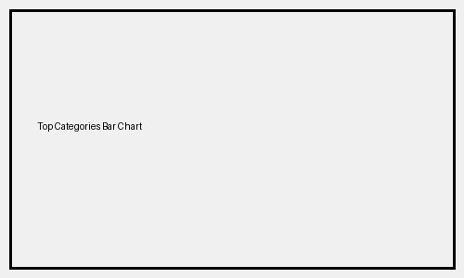


Amazon Product Analytics Dashboard
Total Products
1465
Average Rating
4.09
Highest Discount
94%
Average Price
₹5444

Slide 3
Key Insights
• Most products belong to Electronics and Computer Accessories categories.
• Many products provide discounts above 90%.
• Highly rated products usually receive more customer reviews.
• Some highly discounted products still have low ratings.
• Most product ratings fall between 4.0 and 4.5.

