Slide 1
REAL TIME RESEARCH PROJECT

Slide 2
Early Detection of Human Diseases Using Artificial Intelligence
TITLE:
Advances in Artificial Intelligence and Blockchain Technologies for Early Detection of Human Diseases

Slide 3
Abstract:
Healthcare systems require early detection of diseases to improve treatment outcomes.
Manual analysis of medical data is time-consuming and error-prone.
This project uses Artificial Intelligence and Machine Learning algorithms to detect diseases at an early stage.
The system analyzes datasets and predicts diseases using models like ANN, SVM, Random Forest, Gradient Boosting, and KNN.
It provides accurate predictions and comparison of model performance.

Slide 4
Existing System:
Traditional healthcare systems depend mostly on manual diagnosis.
Doctors analyze symptoms and reports manually.
Limited use of automated prediction systems.
Difficult to analyze large medical datasets.
Decision making becomes slow.

Slide 5
Disadvantages of Existing System:
Time-consuming process.
Higher chances of human error.
Difficult to manage large datasets.
Lack of automated disease prediction.
Limited decision support for doctors.

Slide 6
Proposed System:
Development of a web-based disease prediction system.
Uses machine learning algorithms to analyze datasets.
Allows dataset upload, training, and testing of models.
Compares performance of different algorithms.
Displays prediction results through a user-friendly interface.

Slide 7
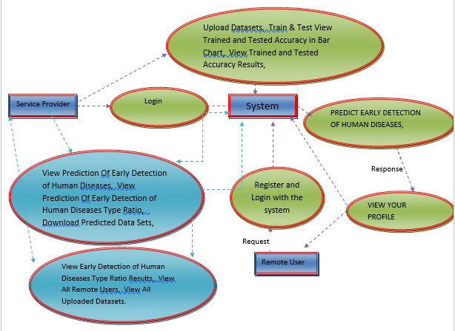
Data Flow Diagram

Slide 8
Advantages:
Helps in early detection of diseases.
Faster analysis of medical data.
Improved prediction accuracy.
Easy dataset management.
User-friendly system interface.

Slide 9
Hardware & Software Requirements
Hardware:
Processor: Intel i3 or above
RAM: 4GB or higher
Hard Disk: 500GB
Software:
Operating System: Windows
Programming Language: Python
Web Technologies: HTML, CSS, JavaScript
Server: XAMPP
Database: MySQL
ML Libraries: Pandas, NumPy, Scikit-learn

Slide 10
Novelty of the Project:
Uses Artificial Intelligence for disease prediction.
Combines multiple machine learning algorithms.
Provides accuracy comparison between models.
Allows dataset upload and prediction analysis.
Helps in improving early disease detection.

Slide 11
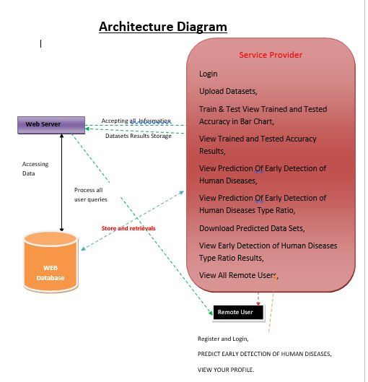
Architecture:

Slide 12
CONCLUSION:
This project presents a system for early detection of human diseases using machine learning and a web-based platform. By analyzing patient symptoms and medical datasets, the system predicts whether a disease may be detected at an early stage. It helps service providers make quicker decisions and reduces manual effort. Overall, the project demonstrates how AI and web technologies can support healthcare by enabling faster and smarter disease detection.

Slide 13
THANK YOU

